Slide 1
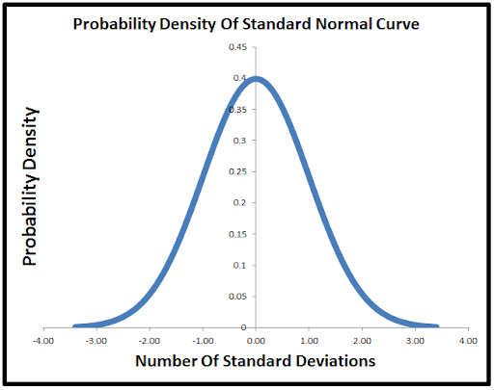
Your New BFF

Slide 2
Normal Distribution
In Normal Distribution:
Mean == Mode == Median
Symmetry
50-50% split of data on either side
(Remember total probability = 1)

Slide 3

Normal Distribution
Standard deviation:
a measurement of how far the data is spread out
square root of the variance.
For each data point:
subtract the mean of the whole dataset
then square the result.
Then...
These are added together and then divided by the number of datapoints → variance
Take the square root of the variance

Slide 4
“Empirical Rule”
In a Normal Distribution...
There’s a specific proportion of datapoints within different standard deviations from the mean:
+/- Standard Deviations | Percentage of Points
1 | 68%
2 | 95%
3 | 99.7%

Slide 5
Why does this matter?
If data follow a normal distribution, we can apply this probability of data distribution to determine if certain data points are more likely/less likely to be observed and to compare groups and see if they are different.

Slide 6
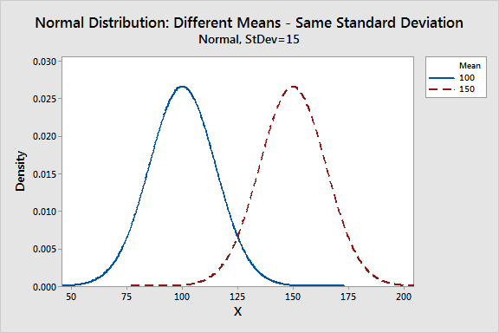

Slide 7
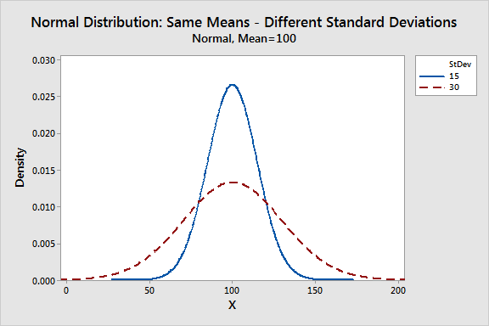

Slide 8
Inferential Statistics
Examining hypotheses:
Musicians and non-Musicians groups talk about knobs and faders in different amounts in an average day.
Null hypothesis (this is not the case): They talk about these things the
same amount (I hope not).

Slide 9
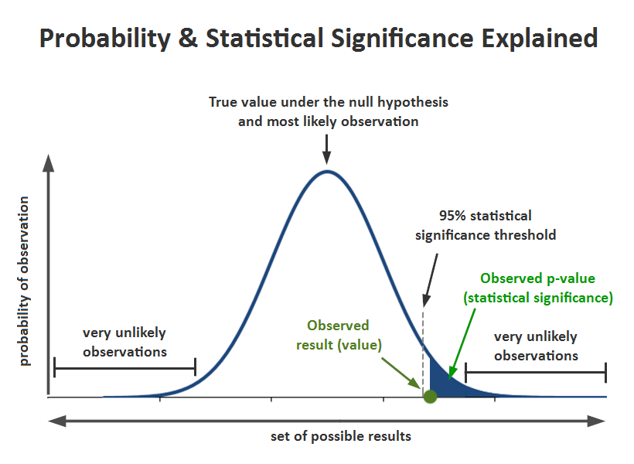

Slide 10
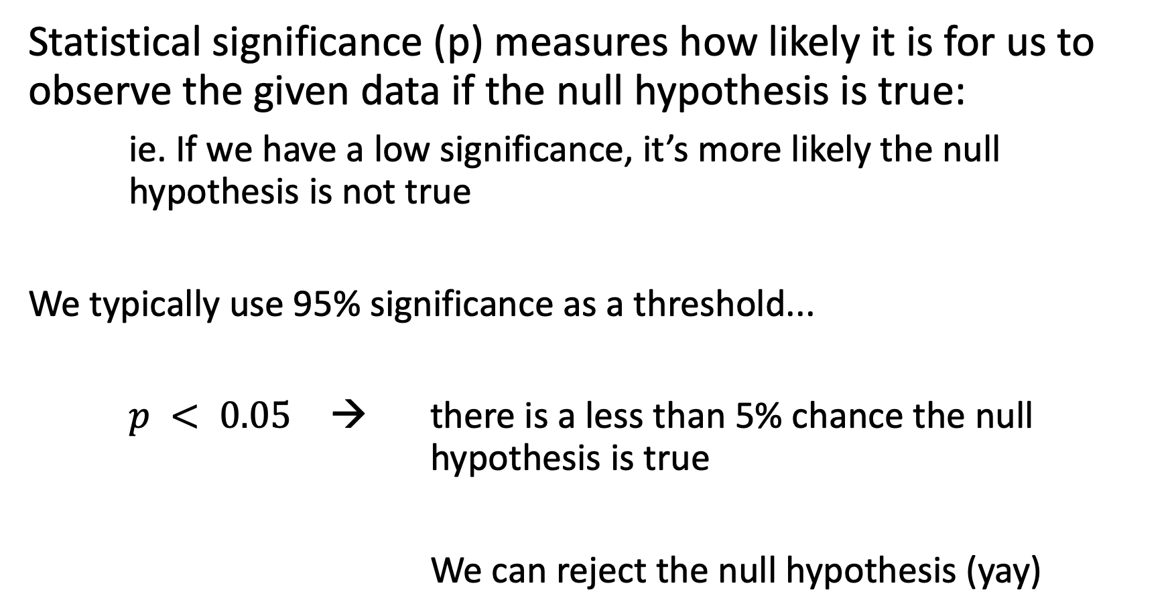
Statistical significance (p) measures how likely it is for us to observe the given data if the null hypothesis is true:
ie. If we have a low significance, it’s more likely the null hypothesis is not true
We typically use 95% significance as a threshold...
$p < 0.05$ → there is a less than 5% chance the null hypothesis is true
We can reject the null hypothesis (yay)

