Slide 2
Baldr module in github
Allows creation of field, DM, detector, phasemask objects and a
Still working progress…

Slide 3
first stage AO (Naomi)
Assume temporal errors dominate residuals (reasonable assumption)
Rolling Von-Karman phase screens (L0=24m) measure first N modes with latency and subtract from phase screen with PI controller
We consider 4 grid points:
Bright (14 modes, latency = 4.6ms)/faint (7 modes, latency = 24.0ms)
Median / poor atmospheric conditions
median: seeing=0.8” ~ r0=0.13m , tau0 = 3ms =>v_turb=40m/s
Poor: seeing = 1.3” => r0=0.08m, tau0 = 1ms=>v_turb=70m/s)
High temporal resolution to allow Baldr simulations to go to 2kHz. Wavelength binned phase screens saved in fits files. These are the input to Baldr simulation

Slide 4
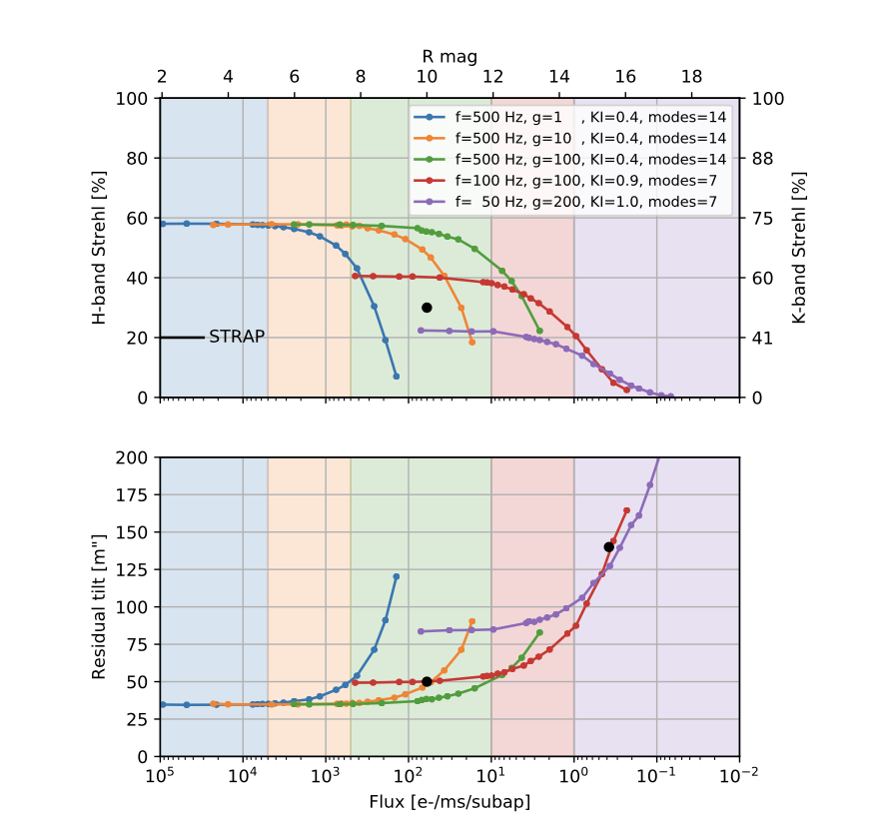
first stage AO (Naomi)
Woillez (2019) Simulation (Baldr input)

Slide 5
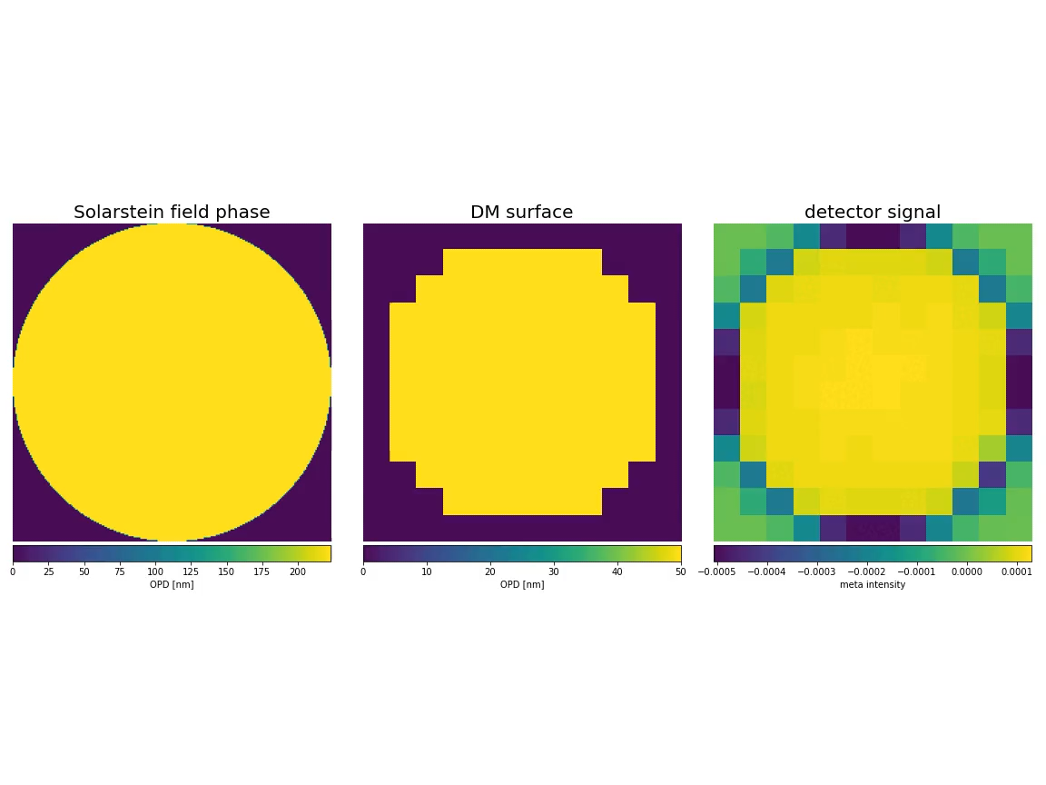
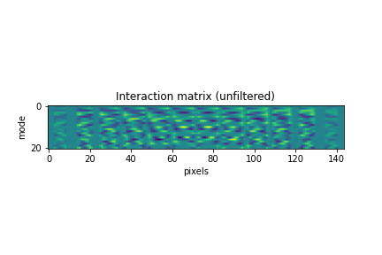
Baldr Controller
Simulate a thermal calibration source with T=1900K and near perfect phase front
Apply modes (KL) on DM to and measure control signals from the detector to construct IM. Psuedo inverse for CM
Basic SVD modal filtering of CM and then put in use with basic PI controller for closed loop simulations.

Slide 6
Tonight – show calib spectrum vs real spectrum
How phase mask design effects closed loop? Use different radii!.
LEFT = 1.06 lambda/D diameter, Hmag=0
Right = ~2\lambda/D diameter, Hmag=0
Top right 1.06 lambda/D diameter, Hmag=3

Slide 8
Aotools to generate Von Karman phase screens
Sense and correct first N modes with Lags
E.g. of plots
Dictionary / json input files
Calibration source T.. Show spectrum
Use to create interaction matrix
Show video of closed loop.

Slide 9
﻿Npix120_1.8m_AT_V50_r00.1_lag25.0_Nmodes7
Faint naomi Strehl in H-band

