Slide 2
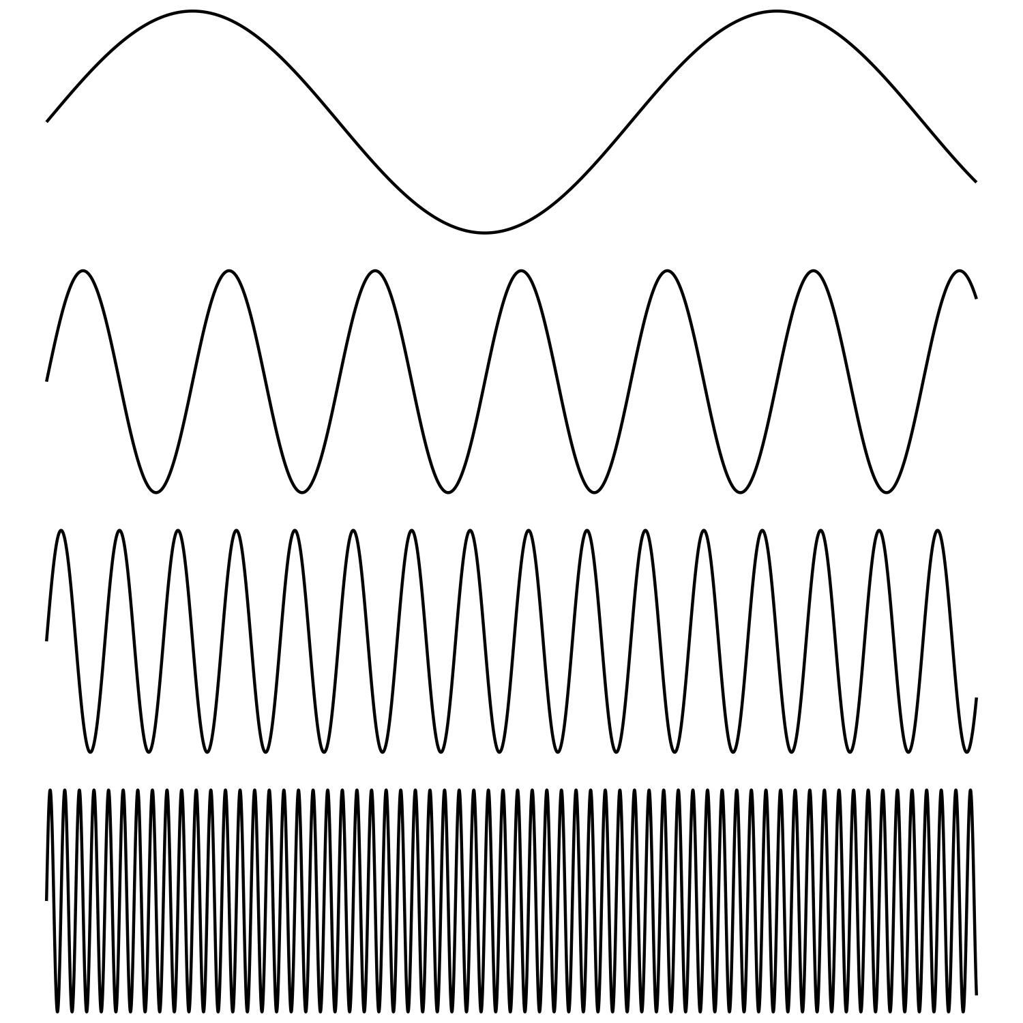
20KHz
fundamental frequency
20Hz

