Slide 1
妈
马
麻
骂
(mā)
(mǎ)
(má)
(mà)
(Mum)
(horse)
(numb)
(scold)

Slide 2


Slide 5
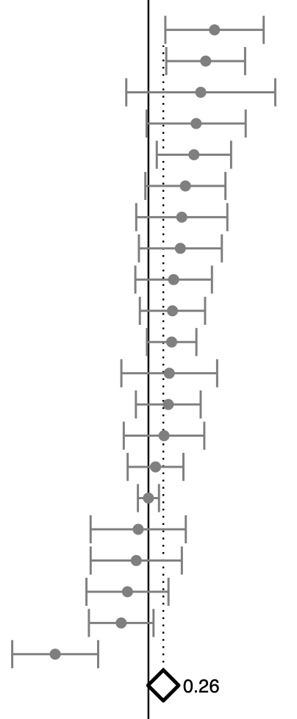
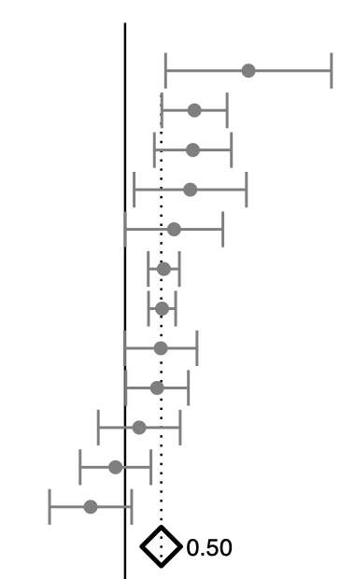
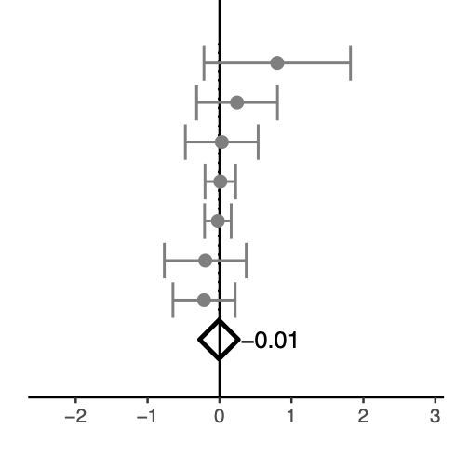
Fine-grained pitch processing
Melodic processing
Rhythmic processing

Slide 6
Fine-grained pitch processing
Melodic processing
Rhythmic processing

Slide 7
Fine-grained pitch processing
Melodic processing
Rhythmic processing

Slide 8
