Slide 1
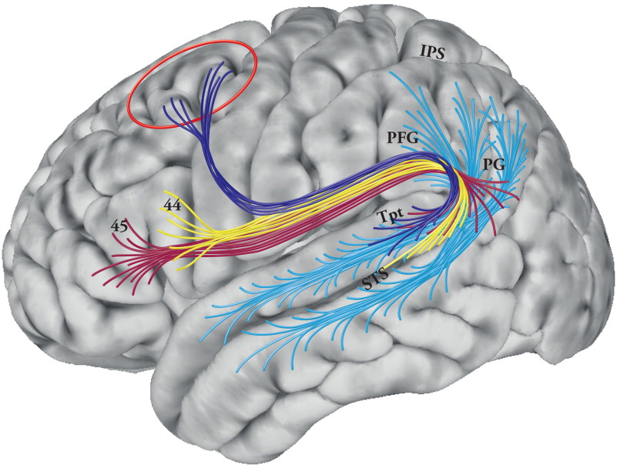
white matter integrity
conscious
accesibility
pitch sensitivity

Slide 2
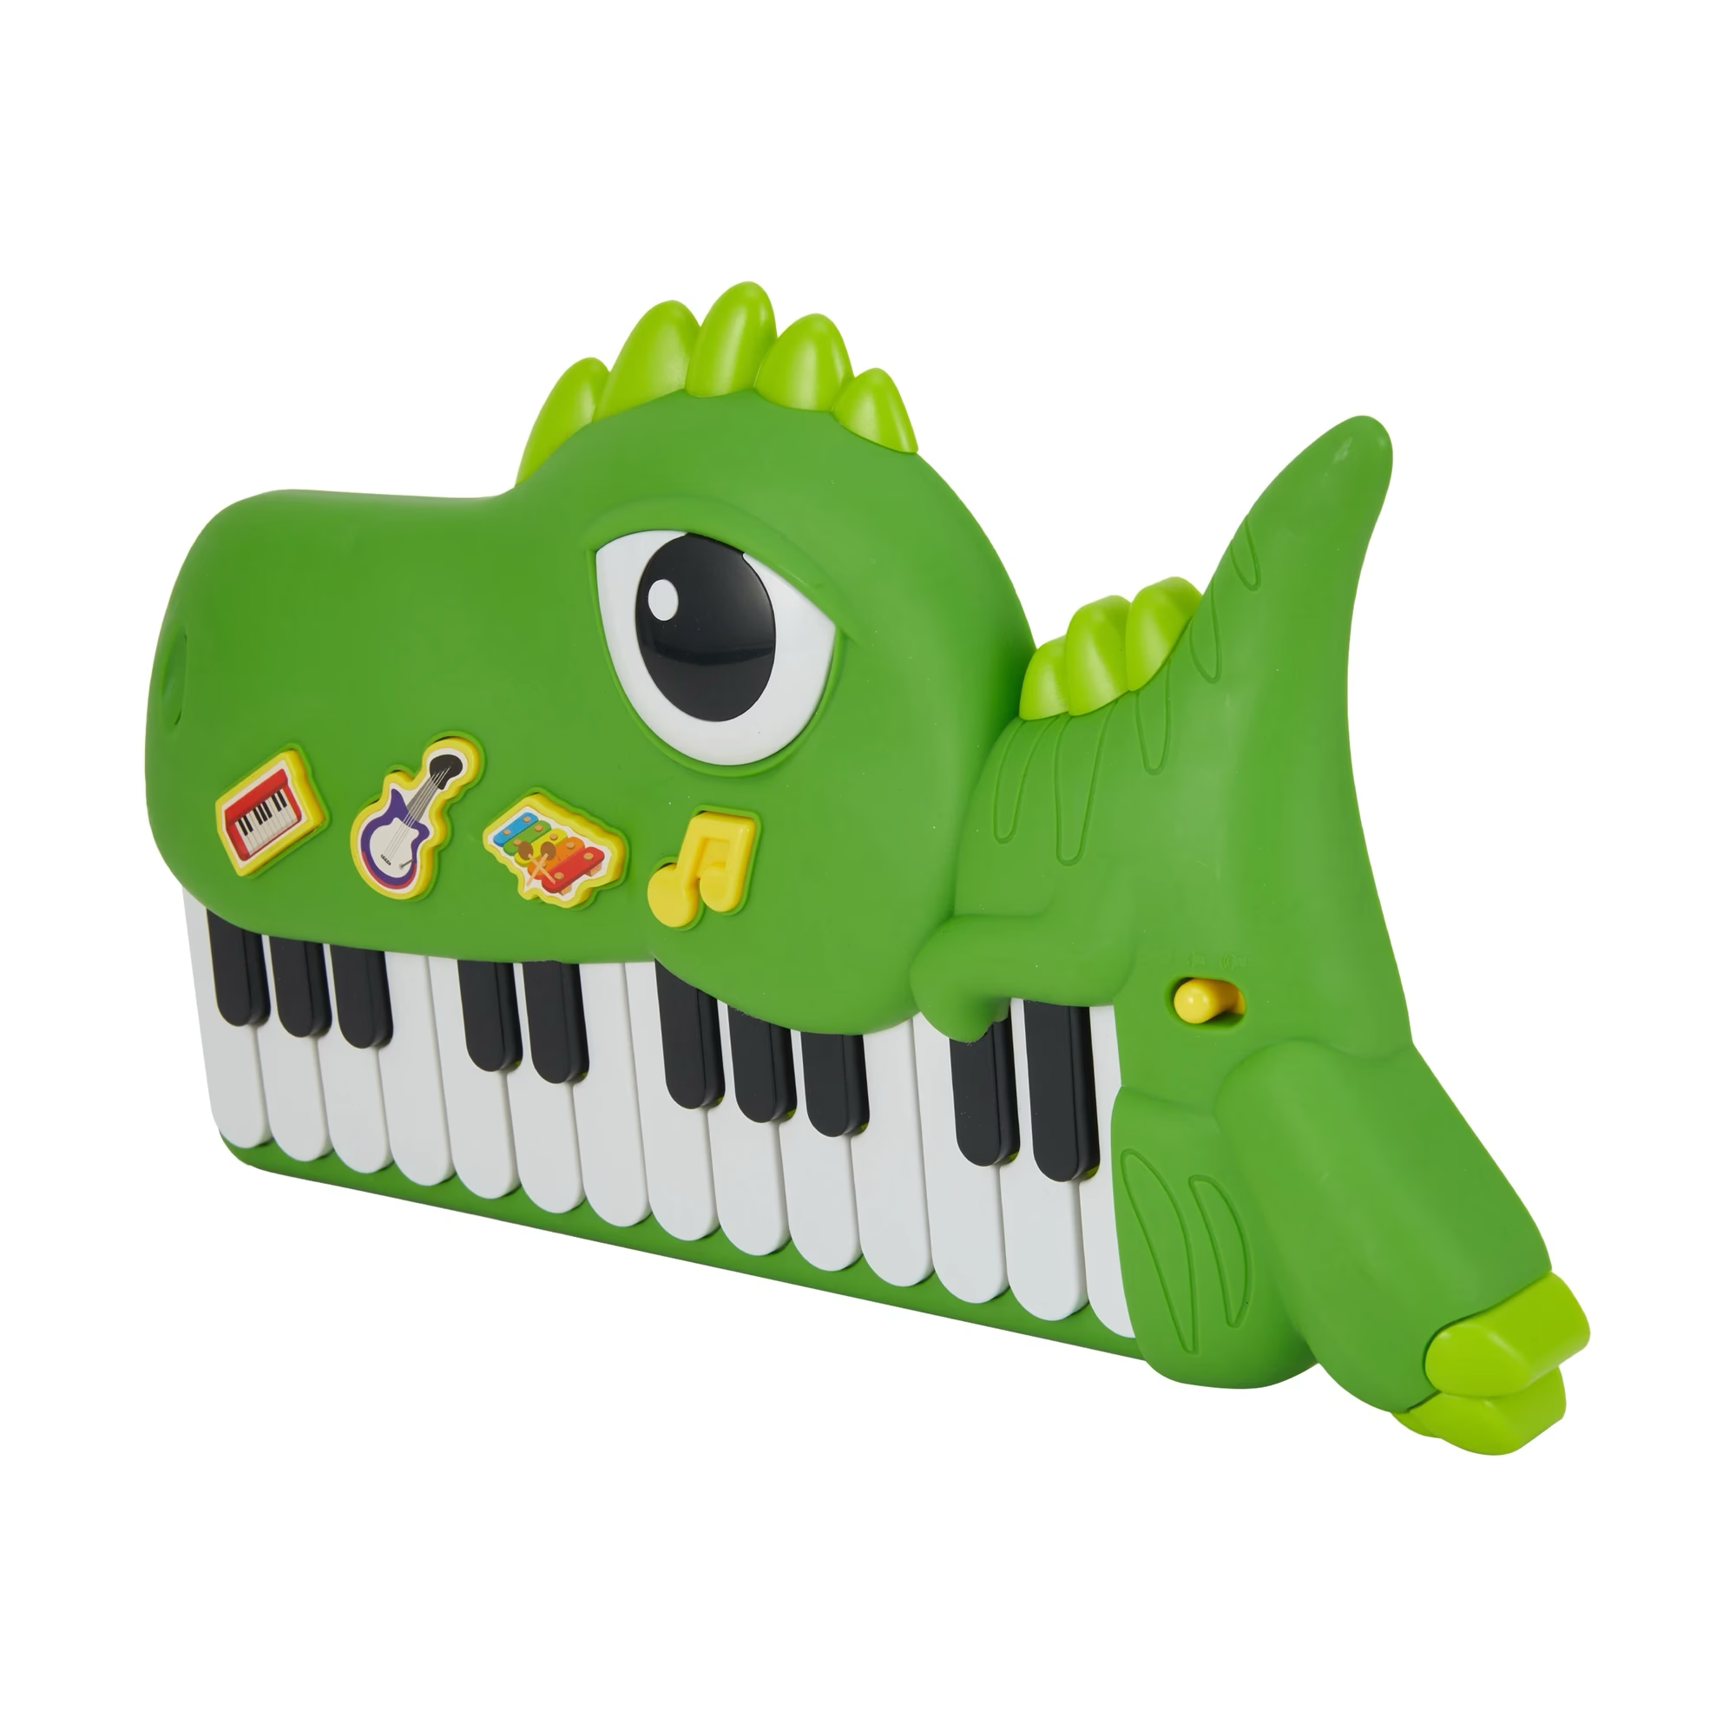

Slide 3
CHEAP!

Slide 4
CHEAP!
NON-
INVASIVE!

Slide 5
CHEAP!
NON-
INVASIVE!
PORTABLE!

Slide 6
maturation /
development
encoding /
peripheral
brain-wide white-matter integrity
pitch sensitivity
conscious
access
pitch white-matter
integrity
error
music
lessons
pathology

