Slide 1


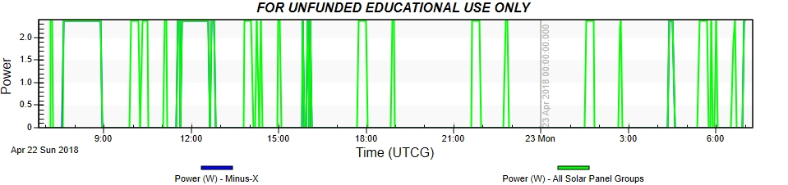
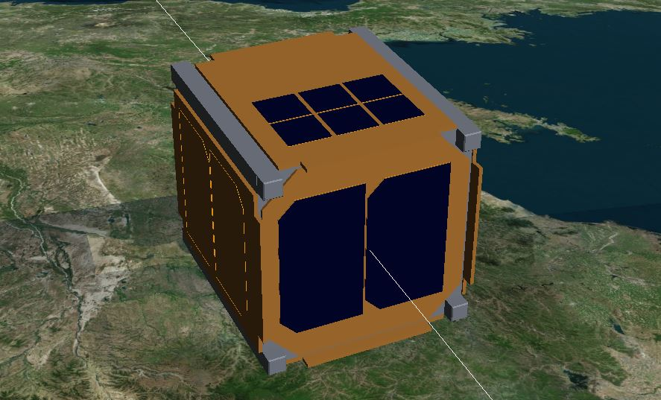
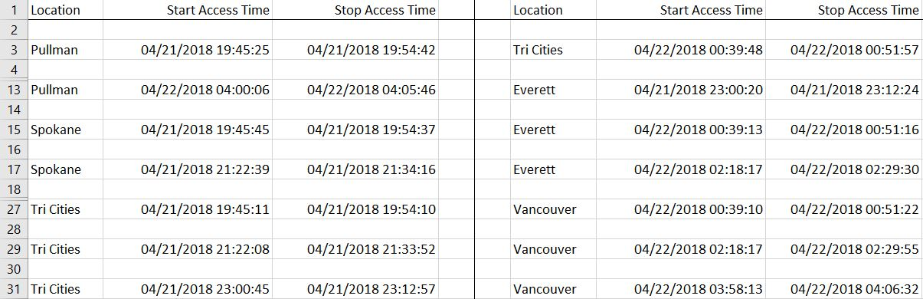
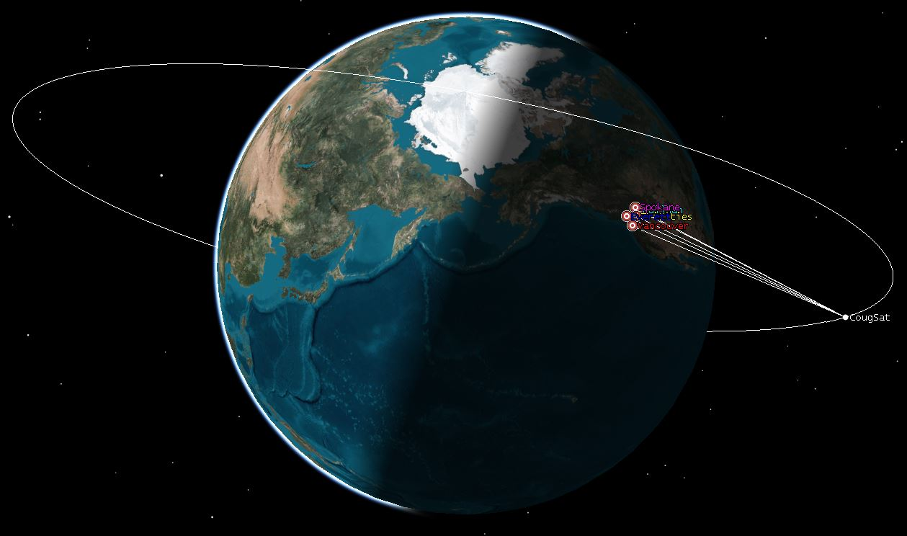
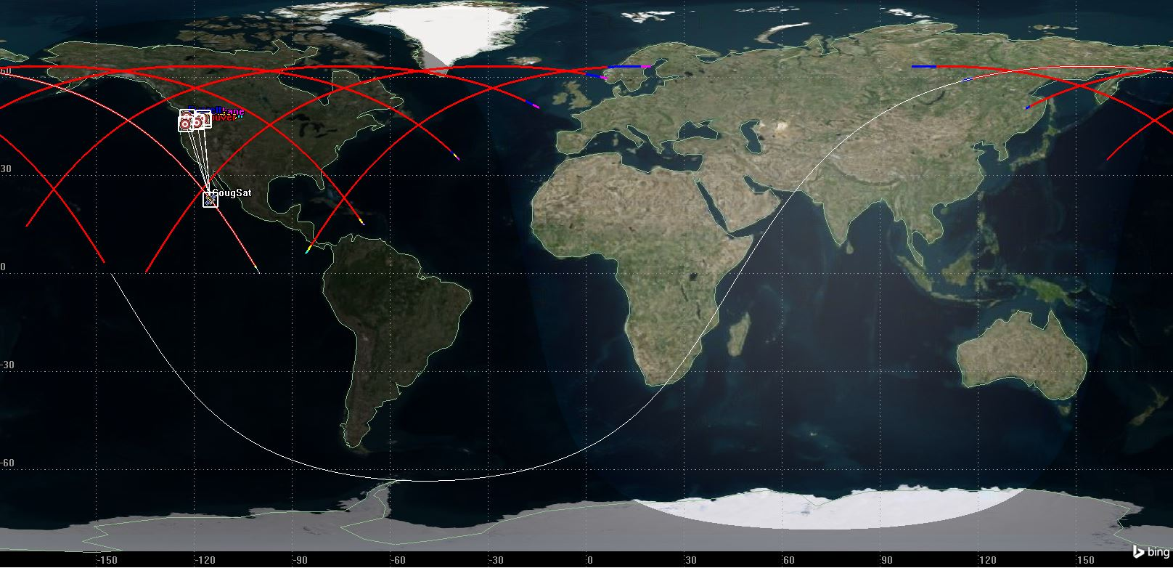
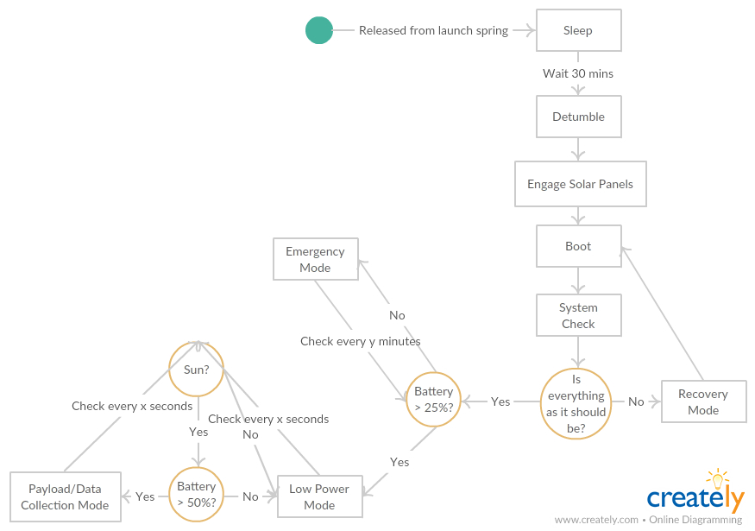
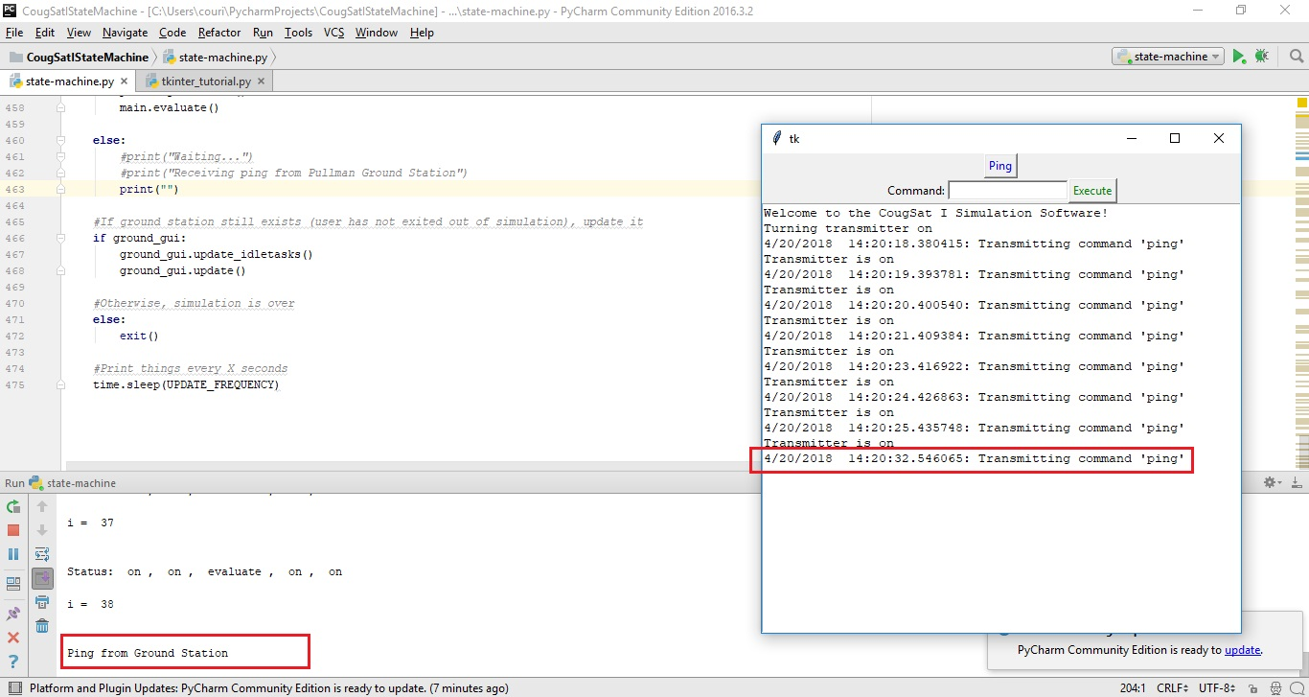



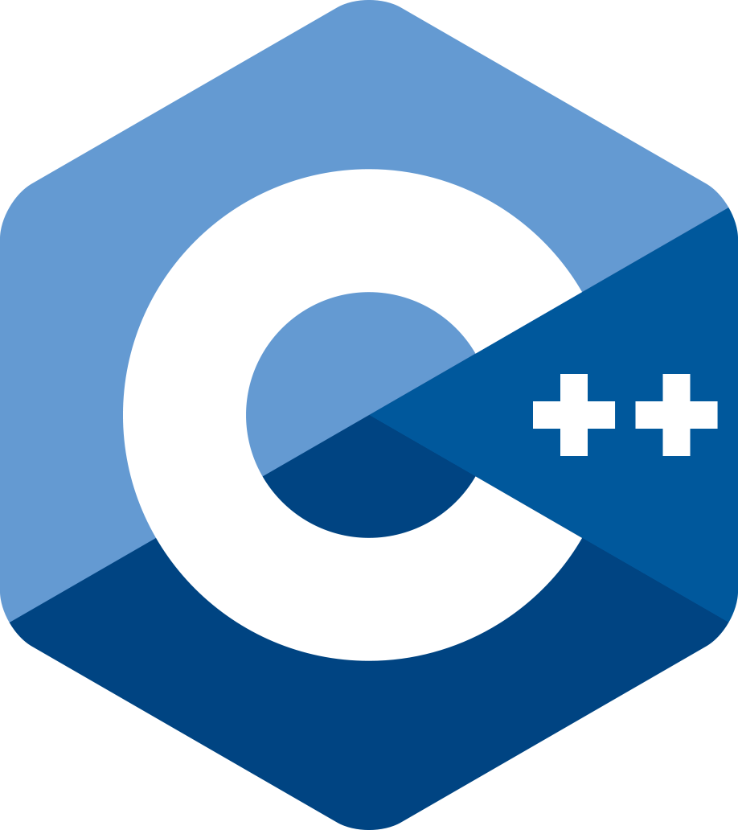

CougSat I Simulation Suite
Sponsors: Cougs In Space, Washington State University
Mentor: Dr. Aaron Crandall
Courtney Snyder, Angie Park, Edward Kuo, Solomon Egwuonwu
Cougs in Space needs modelling software to help them get a better understanding of engineering requirements for their cubesat, adhere to NASA’s launch requirements, and to visualize satellite behavior from launch to orbit. This software should also promote and develop the skills necessary for designing, manufacturing, and testing of the physical cubesat.
Time periods when satellite is in range of ground stations
Helps optimize transmission and receiving time windows
Background
Implementation
Results
We began by creating a Python script with a config file to launch STK, create a custom scenario, and generate access reports from the satellite to the ground station.
Solar panel input
How much power can be generated per orbit
We then created a 3D model of the satellite using a COLLADA (.dae) file. There are custom-made solar panels on four sides of the model. We then integrated the .dae file into the Python script.
Deliver the most accurate representation of the cubesat, ground station, and LEO environment
  Implement state machine of the cubesat’s behaviors
  Create accurate model of the cubesat
  Exhibit behaviors similar to the orbiting satellite
  Build an interactive ground station interface
  Integrate everything into a physics engine that will act as our LEO environment
Make this software easy for our clients to use
  Wrap all those components into one package
Goal
The simulation runs for the duration specified by the user in the config file. The user can also select an orbit type and a launch location.
When the satellite passes the coverage area of a ground station, the access interval (left), is recorded in the access report.
Future Work
Incorporate more features of CougSat I into the state machine
  The payload specifications remained unknown during our development
  The temperature thresholds of individual boards and components were also unknown
Logic
Glossary
COLLADA file: COLLAborative Design Activity. An interchange file
format for interactive 3D applications and models
Config file: Configuration file containing variables for the simulation
Cubesat: A type of miniaturized satellite commonly used for
space research that is made up of 10×10×10 cm cubic units
ROS: Robot Operating System. Used to emulate hardware and software behavior
STK: Systems Tool Kit. A physics engine and aeronautical analysis tool created by AGI
Technologies
The Ground Station UI (right) interacts with the satellite’s state machine (left) in the same manner the real ground station and CougSat I will behave.
Whenever the satellite is in range and the ground station sends a ping or other command, the satellite will receive the command, decrypt it, and respond to it appropriately.
Acknowledgements
Thanks to Dr. Aaron Crandall, Larry Reeves from Urthecast, and Cougs in Space for the opportunity and support.
TEAM VIKING
Notes:
Implementation will be added below each screenshot (SS)
Sat in Orbit SS: Explain what STK is doing and that the model was custom built to reflect CougSat I
Ground Station UI SS: Explain what the state machine is doing, how it is related to the above image
Results will include the following graphs
Solar panel input from the sun
Communication windows w/Pullman Ground Station
Design
State machine UML diagram
Show a UML component diagram (?) of how STK, script, state machine, ground station communicate
Courtney: Technologies, Goal, Ground Station implementation
Angie: Model of CougSat I implementation
Edward: Design, Future Work
Solomon: Background, Motivation
Everyone: Glossary, Acknowledgements

