Slide 1
Background: CCA Overview
“The method was first introduced by Harold Hotelling in 1936, although in the context of angles between flats the mathematical concept was published by Jordan in 1875.”
Example:
50 students (n=50)
Dataset 1: 5 measures of academic performance (gpa, test scores, etc.)
Dataset 2: 5 measures of income (personal, household, etc.)
Goal: Show the correlation between two datasets, X_{a} and X_{b}, by finding weights, W_{a} and W_{b}, that produce projections/canonical variables, Z_{a}=X_{a}W_{a} and Z_{b}=X_{b}W_{b}, such that Z_{a} and Z_{b} are most correlated.
https://en.wikipedia.org/wiki/Canonical_correlation
https://gregorygundersen.com/blog/2018/07/17/cca/
https://youtu.be/2tUuyWTtPqM?si=sXB59uhkxU1VLS5y
Notes:
In order to analyze the correlation between the two datasets, we first have to summarize each dataset by projecting them to a lower dimensional space (creating a canonical variable). For example, I want to project the academic performance dataset into 2d space, to get a 50 x 2 matrix. Do the same thing for the second dataset. For each student, there will be two points on the plane, one corresponding to academic performance, and one corresponding to income. Goal: Find the best projection, one that transforms the data so that the points match up as best as possible. The more they match up, the stronger relationship/higher correlation between the datasets.

Slide 2
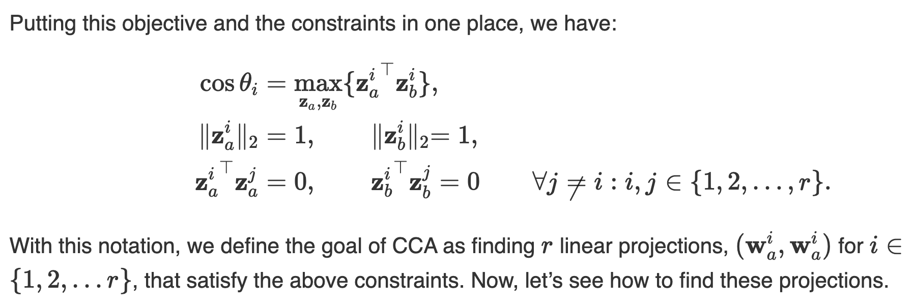
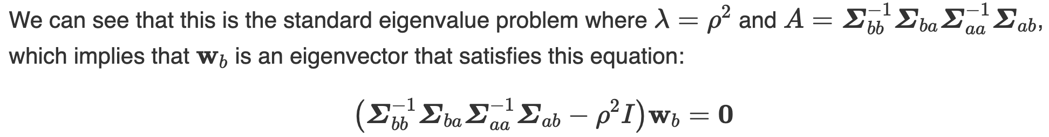
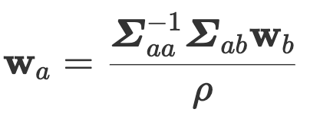
Background: CCA Procedure
Standardize the datasets
Calculate covariance and cross-covariance matrices
Solve for W_{a} and W_{b}
Take the top few pairs of vectors
https://gregorygundersen.com/blog/2018/07/17/cca/
https://github.com/gwgundersen/ml
Notes:
*Rho is square root of eigenvalue of M
*r is the minimum of the rank (number of linearly independent columns) of Xa and Xb
Constraints:
Minimize the angle between the projected vectors
Projected vectors are unit length
Projected vectors have to be orthogonal
The vectors that comprise the Wa and Wb matrices are given by the following equations.
To assemble the Wb matrix, calculate M, then calculate M’s eigenvectors and eigenvalues, then sort in decreasing order by eigenvalue
To assemble the Wa matrix, apply the second equation to each column in Wb.
Number of vectors chosen depends on how many dimensions you want to visualize the two points on.
*do a demo

Slide 3
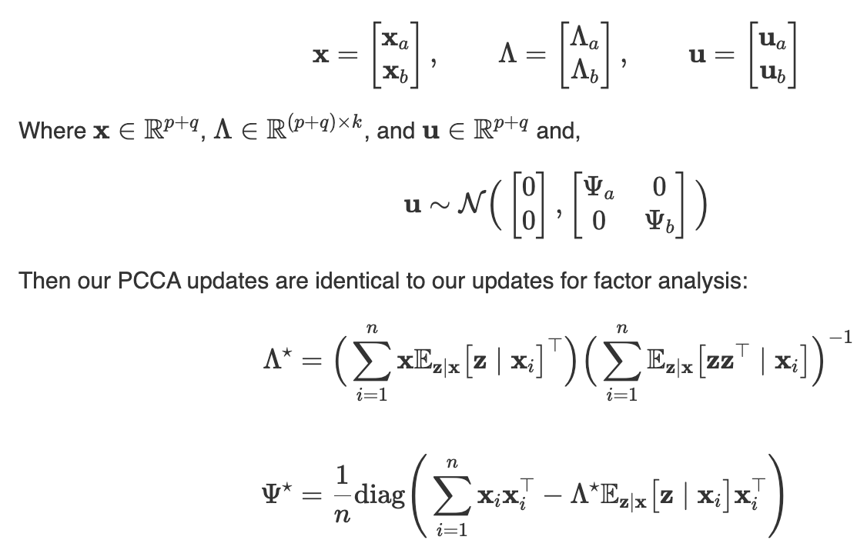
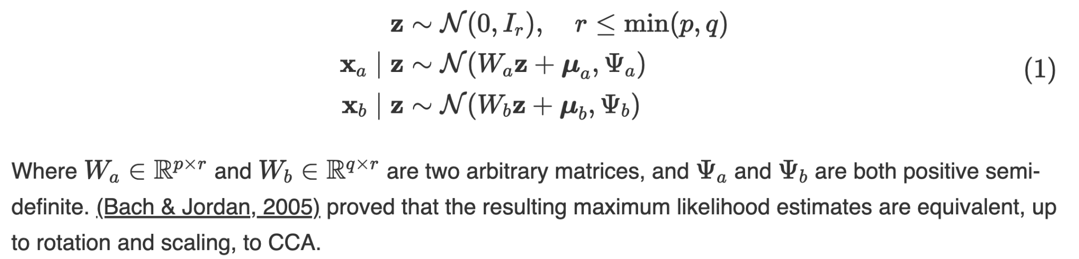
Probabilistic CCA
Model:
Maximum Likelihood Estimates:
*understand lambda, and EM
https://gregorygundersen.com/blog/2018/09/10/pcca/#klami2015group
Notes:
PCCA is a probabilistic interpretation of CCA
Latent variable is z, we assume it follows this distribution centered at 0 with variance 1
z generates two sets of n observations of each random variable, xa and xb
Learning the parameters, lambda and psi, iteratively
The parameters will give us insights into how the datasets are related

Slide 4
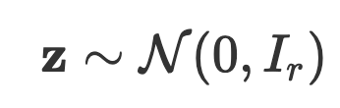
CCA Property | Probabilistic CCA Assumption
Correlate z_{a} and z_{b} | Shared latent variable,
Canonical variables are orthogonal | Latent variables are independent with an isotropic covariance matrix
Canonical variables have unit length | z has unit variance
https://gregorygundersen.com/blog/2018/09/10/pcca/#klami2015group

