Slide 1
MVC
Engorged Wicket Pandoras

Slide 2
MODEL
MAIN CLASSES
Account
Transaction
Withdrawal
Deposit
(Not in code yet)

Slide 3
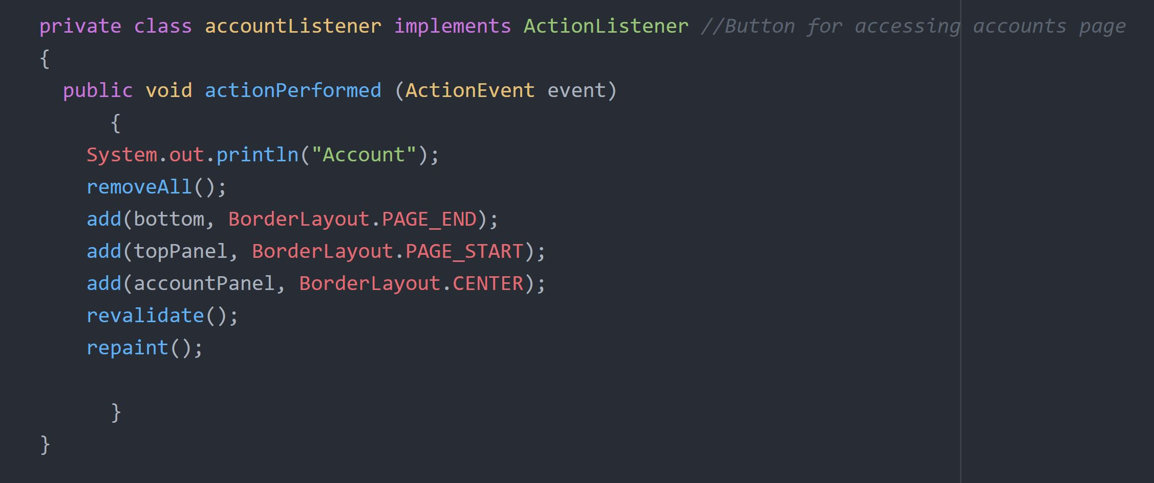
Controller
CODE EXAMPLES:
LISTENERS
ActionListeners for all JButtons:
Home
Logout
Account
Etc.

Slide 4
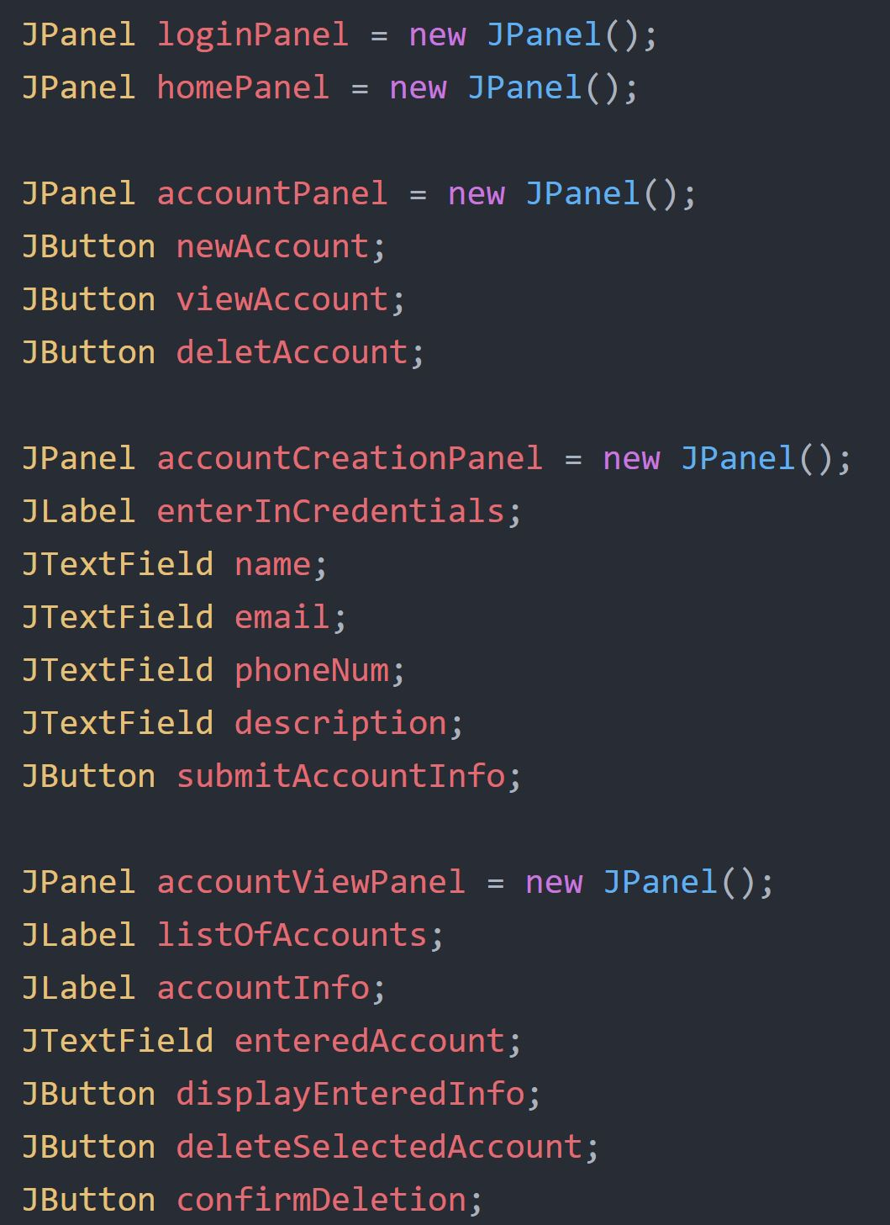
VIEW
CODE EXAMPLE:
MAIN FRAME
PANELS
LogInPanel
HomePanel
AccountPanel
Etc.
PANEL CONTENT
JLabels
JButtons
JTextFields

Slide 5
CONTROLLER
DIAGRAM
MODEL
VIEW

