Slide 1
MVC
Engorged Wicket Pandoras

Slide 2
CONTROLLER
DIAGRAM
MODEL
VIEW

Slide 3
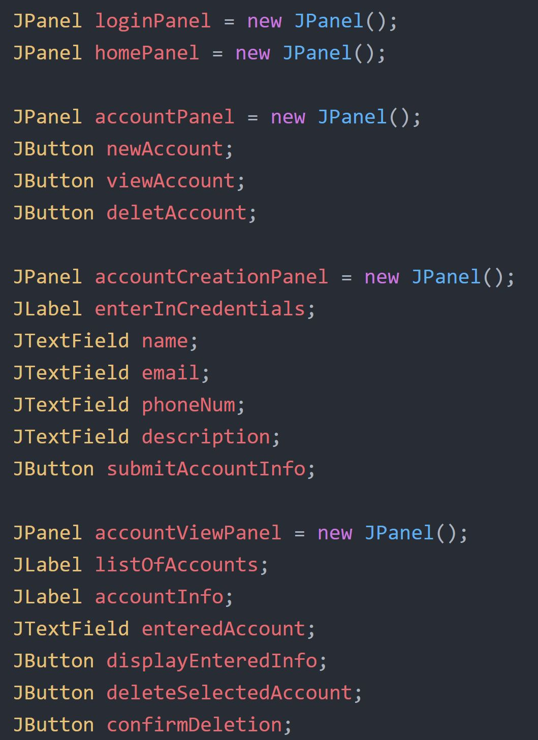
VIEW
CODE EXAMPLE:
MAIN FRAME
PANELS
LogInPanel
HomePanel
AccountPanel
Etc.
PANEL CONTENT
JLabels
JButtons
JTextFields

Slide 4
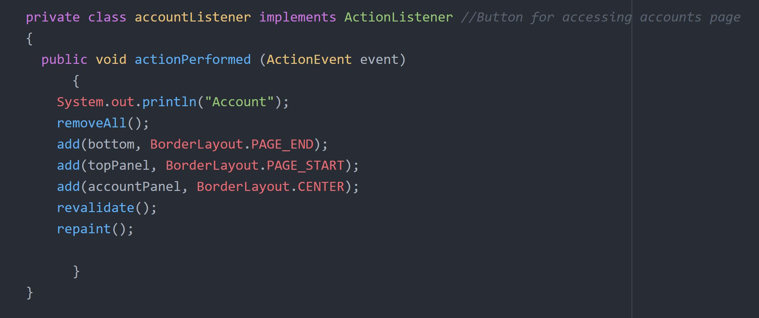
Controller
CODE EXAMPLES:
LISTENERS
ActionListeners for all JButtons:
Home
Logout
Account
Etc.

Slide 5
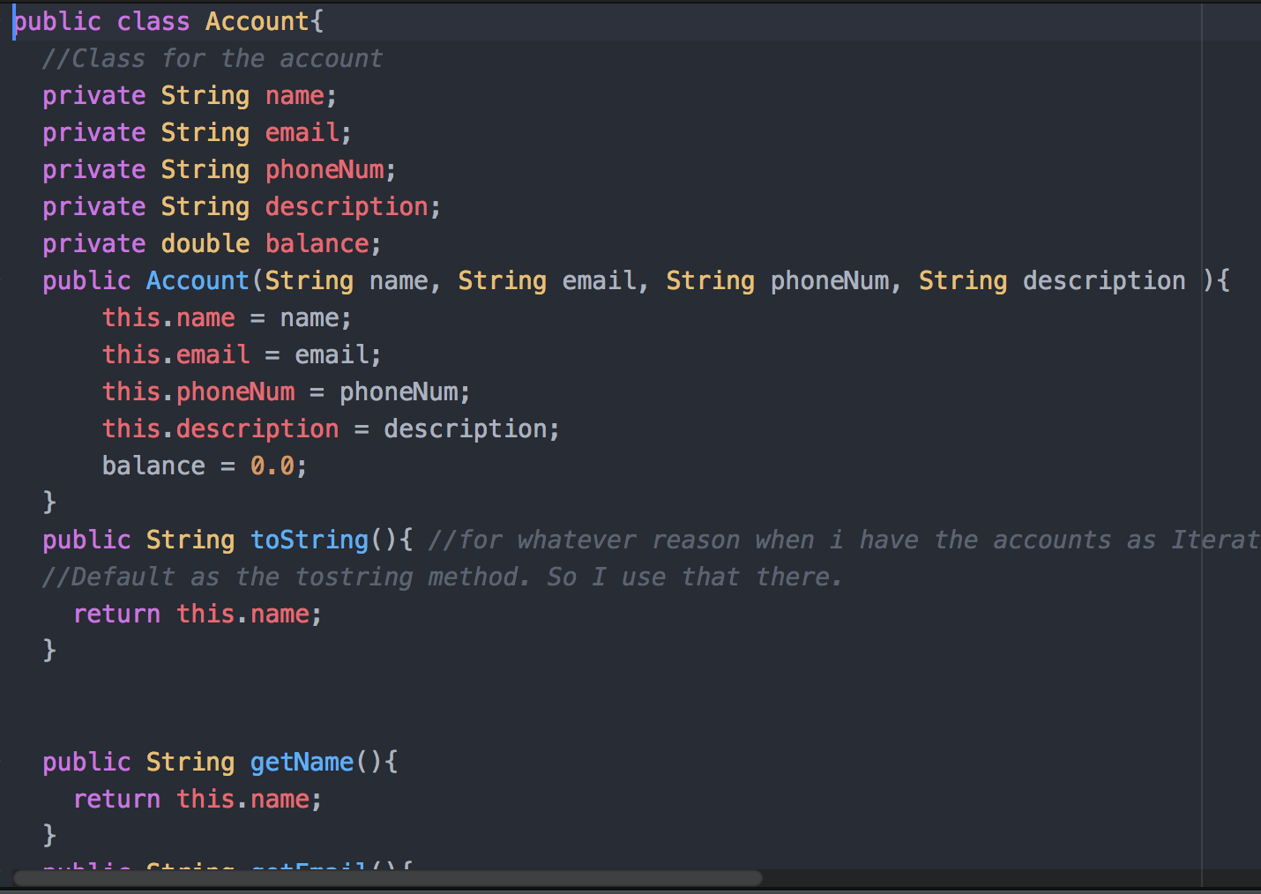
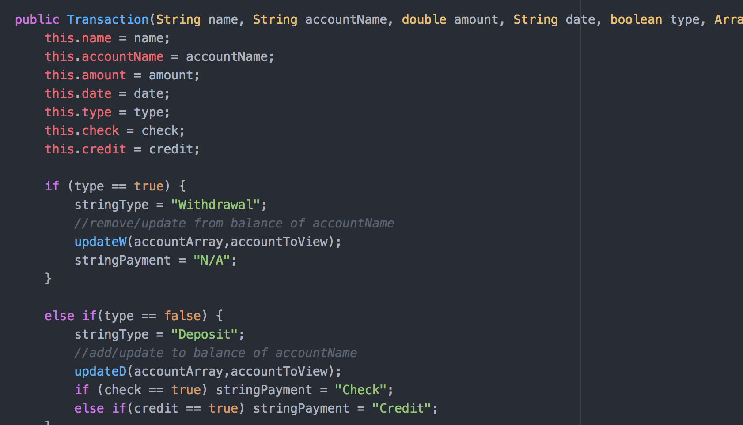
MODEL
MAIN CLASSES
Account
Transaction
Withdrawal
Deposit

