Slide 1
MVC
Engorged Wicket Pandoras

Slide 2
Sprint 3 editions
New Credit Card or Check Format
Password Protection
Dropdown Menu for View Account
To be implemented as well for the account choice on withdrawal and deposit
Logo Creation & Implementation
Expense Codes for Deposits
Dropdown menu as well
Main Account Implementation
Everything subtracted and added from and to

Slide 3
MODEL
MAIN CLASSES
Account
Transaction
Withdrawal
Deposit
(Not in code yet)

Slide 4
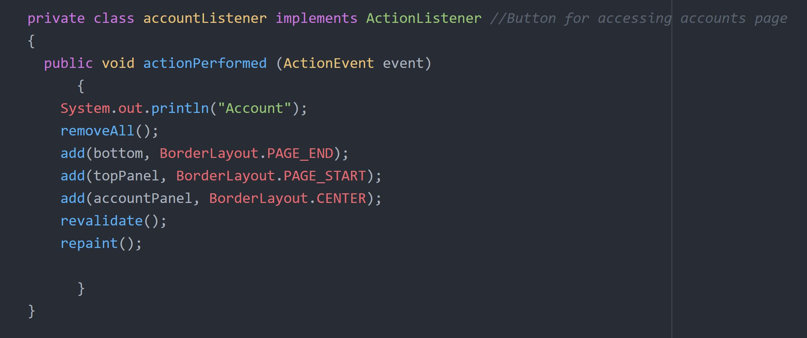
Controller
CODE EXAMPLES:
LISTENERS
ActionListeners for all JButtons:
Home
Logout
Account
Etc.

Slide 5
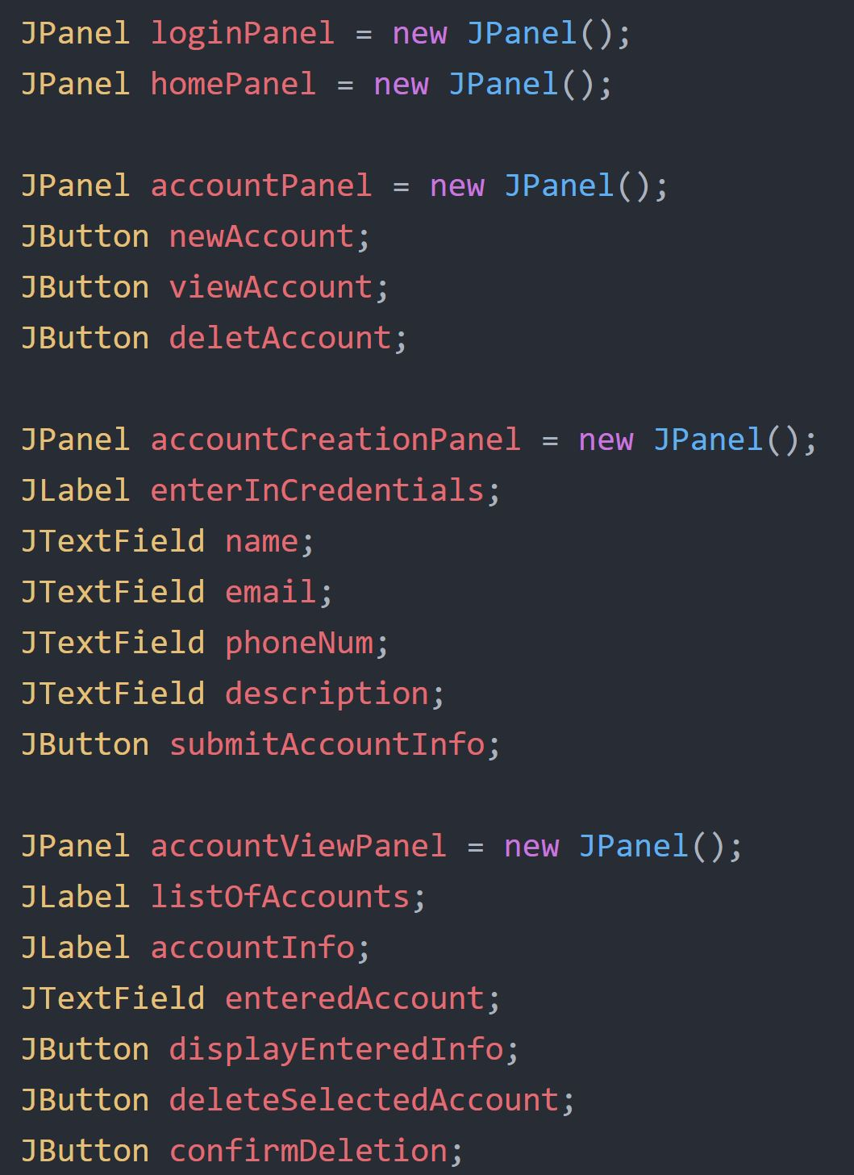
VIEW
CODE EXAMPLE:
MAIN FRAME
PANELS
LogInPanel
HomePanel
AccountPanel
Etc.
PANEL CONTENT
JLabels
JButtons
JTextFields

Slide 6
CONTROLLER
DIAGRAM
MODEL
VIEW

