Slide 1

Log-in
Welcome to your Calorie Tracker
ID
Password
Log In
Register

Slide 2
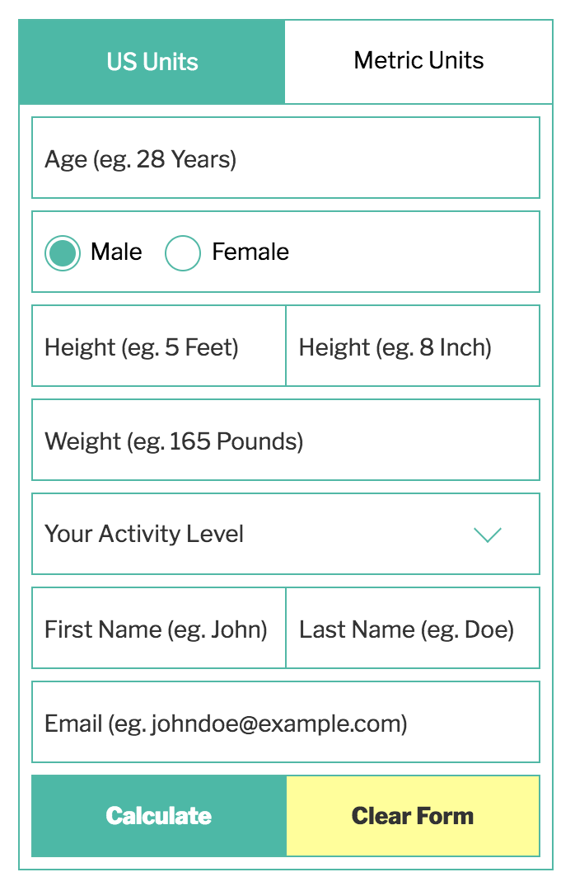
Register
ID
Password
Advanced: calculate the goal calorie for the user
Name
Goal Calorie
kcal
Submit

Slide 3


Basic version
Hi Hae Seung! Your Calorie Goal on {today date} is 3000 kcal
3000
Cal left
CARBS
Number (g)r
PROTEIN
FAT
SUGAR
Breakfast
Search what you ate:
Add
Lunch
Search what you ate:
Add

