Slide 1


Graph8Rop Rules of procedure (ROP)
Work it, make it, Do it, makes us Harder, Better, Faster, Stronger

Slide 2
ROP general information
Specifications
XML4EP_STS_EN_v3-0-0-Final.docx
XML4EP_STS_EN_annex_RulesOfProcedure_3.0.0_v0-06.docx
Publications
\\epades\public\reglement\2025\07-07\EP-PE_REGL(2025)07-07_EN.pdf
https://www.europarl.europa.eu/doceo/document/RULES-10-2024-07-16-TOC_EN.html
https://www.europarl.europa.eu/RegData/reglement/2025/07-07/EP-PE_REGL(2025)07-07_EN.pdf

Slide 3
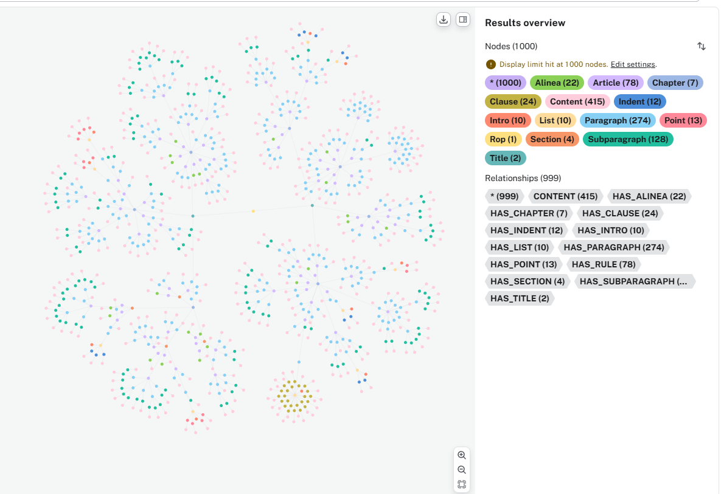
ROP: Graph overview

Slide 4

ROP: High level Structure & Basic unit
Use case : THE ROP IS SUBDIVIDED INTO ARTICLES AND, DEPENDING ON THEIR LENGTH
AND COMPLEXITY, INTO TITLES, CHAPTERS AND SECTIONS.
Designation FR /EN | XML4EP structure | Usage
TITRE I, TITLE I | <title> | Mandatory
CHAPITRE 1 / CHAPTER 1 | <chapter> | Optional
SECTION 1 / SECTION 1 | <section> | Optional
ARTICLE 1 / RULE 1 | <article> | Mandatory
 XML4EP Rules:
Title hierarchy structure
Chapter hierarchy structure
Section hierarchy structure
The standard Unit is a Article
LegalDocML 3.0 does not recognize any structure for the mark-up of annex

Slide 5
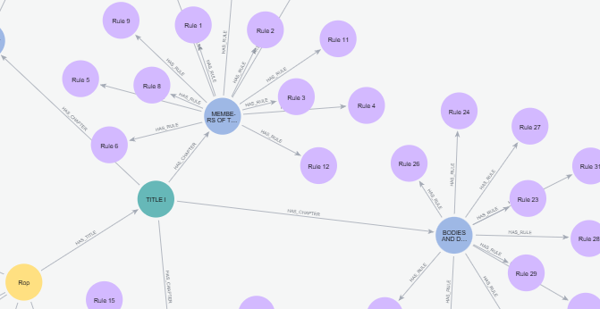
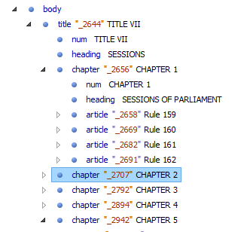
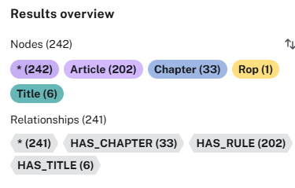
ROP: Title, Chapter & Article
Use case : THE ROP IS SUBDIVIDED INTO ARTICLES AND, DEPENDING ON THEIR LENGTH
AND COMPLEXITY, INTO TITLES, CHAPTERS AND SECTIONS.
 XML4EP Rules:
XML instance can have only single title
A Title can be split by Chapter
Chapter can be split by Rule
The standard Unit is the Article

Slide 6
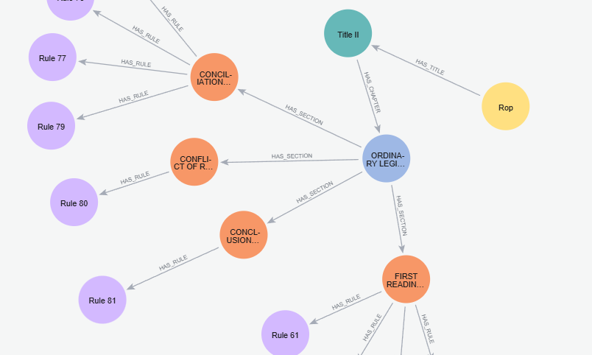
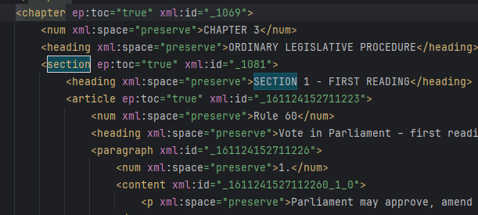
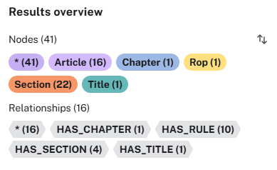
ROP: Title, Chapter, Section & Article
Use case : THE ROP IS SUBDIVIDED INTO ARTICLES AND, DEPENDING ON THEIR LENGTH
AND COMPLEXITY, INTO TITLES, CHAPTERS AND SECTIONS.
 XML4EP Rules:
XML instance always split by Title
A Title can be split by Chapter
A Chapter can be split by Section
The standard Unit is Article
AT4LEX use markup <division> instead of <section> in the ROP

Slide 7
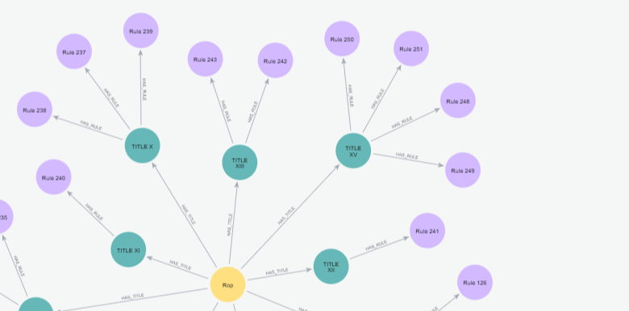
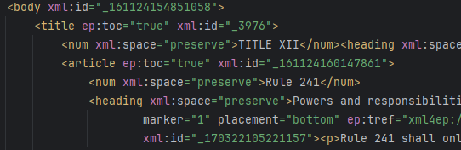
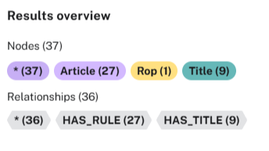
ROP: Body - Title & Article
Use case : THE ROP IS SUBDIVIDED INTO ARTICLES AND, DEPENDING ON THEIR LENGTH
AND COMPLEXITY, INTO TITLES, CHAPTERS AND SECTIONS.
 XML4EP Rules:
XML instance always split by Title
A Title can be split by Chapter
Chapter can be spread by Rule
The standard Unit is always the Rule

Slide 8
ROP: Body – Low level Structure
Use case : THE ROP IS SUBDIVIDED INTO ARTICLES AND, DEPENDING ON THEIR LENGTH
AND COMPLEXITY, INTO TITLES, CHAPTERS AND SECTIONS.
Designation | XML4EP structure
Numbered paragraph | <paragraph>
Unnumbered paragraph | <alinea>
List | <list>
Indent | <indent>
Subparagraph | <subparagraph>
Point | <point>
Clause | <clause>
 XML4EP Rules:
division only allow inside an <Article> or in the body of <Annex>.
numbered paragraph can be split in subparagraph,
unnumbered paragraph mark with <Alinea>,
List can support different elements (indent, clause, point),

Slide 9
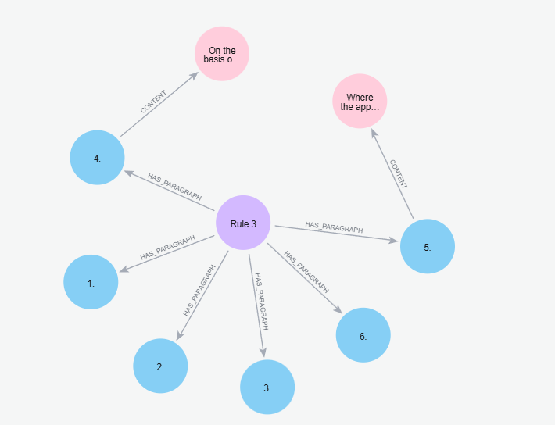
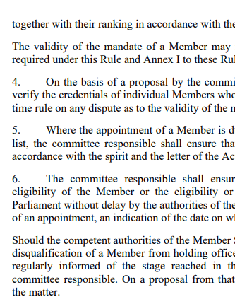
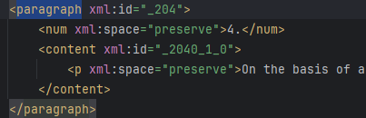
ROP: Numbered Paragraph
USE CASE: subdivisions of an article with numbered paragraphes
 XML4EP Rules:
division of <article> is <paragraph>
use <num> is mandatory
use <content> directly with <p>

Slide 10
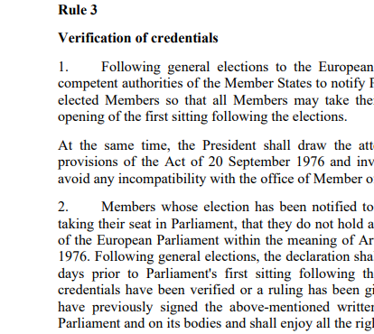
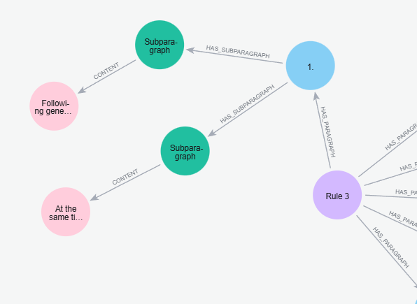
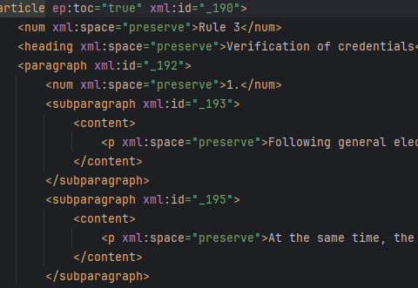
ROP: Numbered Paragraph division
USE CASE: subdivisions of a paragraph with subparagraphs
 XML4EP Rules:
division of <paragraph>
<num> is not allow in <subparagraph>
use <content> directly with <p>

Slide 11
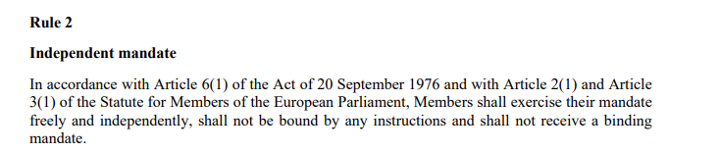
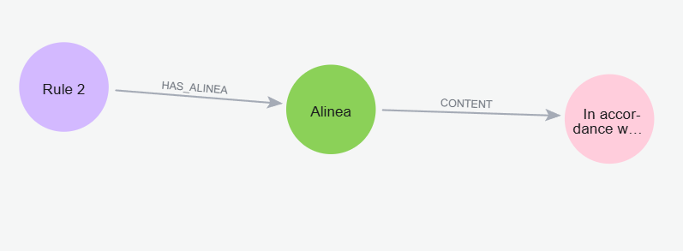
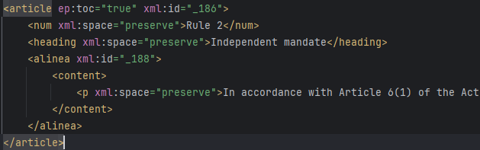
ROP: Unnumbered paragraph
USE CASE: subdivisions of an article with unnumbered paragraphes
 XML4EP Rules:
use <alinea> element inside <article>
<num> is not allowed
use <content> directly with <p>

Slide 12
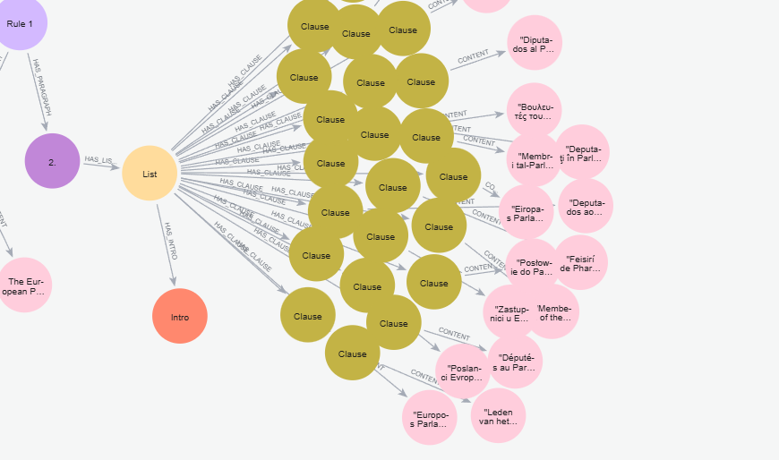
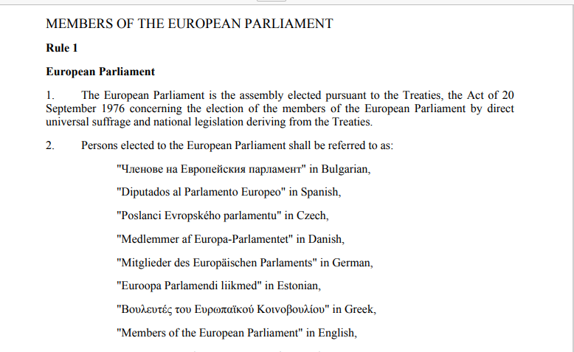
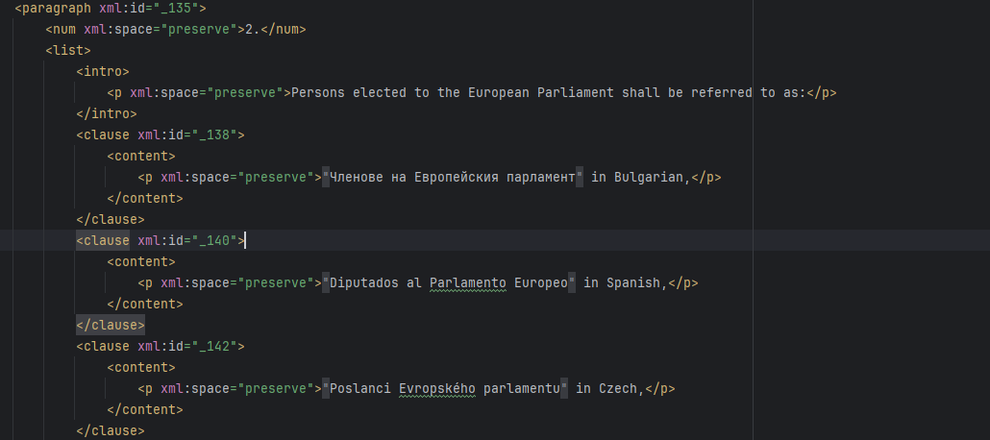
ROP: List of Point, Indent, CLause
WHEN AN ARTICLE CONTAINS A LIST, EACH ITEM ON THE LIST SHOULD BE IDENTIFIED BY A
NUMBER OR A LETTER RATHER THAN AN INDENT (*).
 XML4EP Rules:
List always starts with an <intro>
with <clause> do not use <num> element
use <content> directly with <p>
never use <list> directly inside <article>, should have <paragraph>, or <alinea>, or any other subdivison

Slide 13
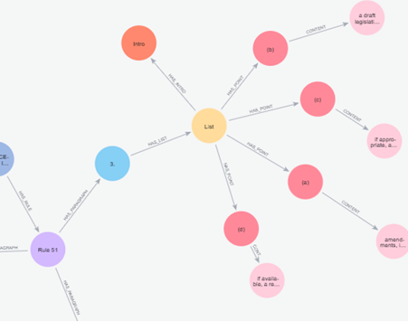
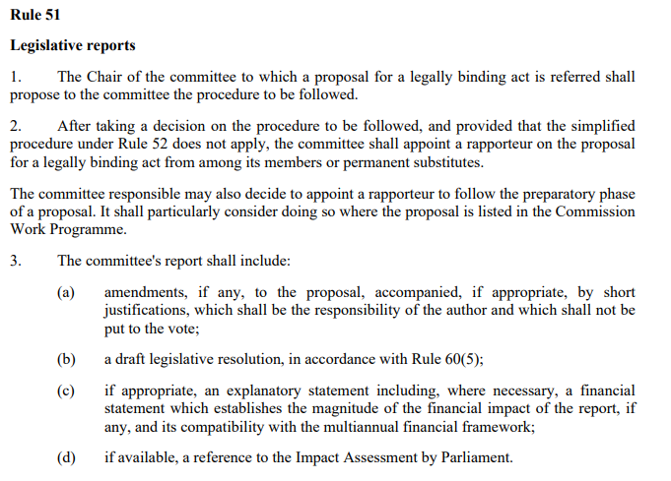
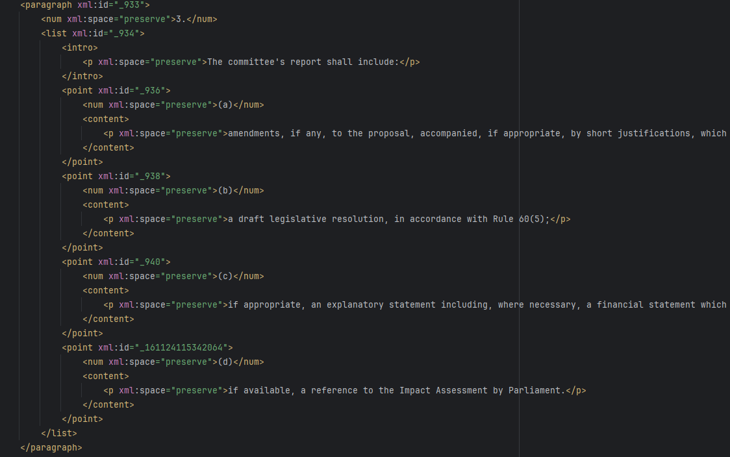
ROP: List of Point – mark-up XML4EP
WHEN AN ARTICLE CONTAINS A LIST, EACH ITEM ON THE LIST SHOULD BE IDENTIFIED BY A
NUMBER OR A LETTER RATHER THAN AN INDENT (*).

Slide 14
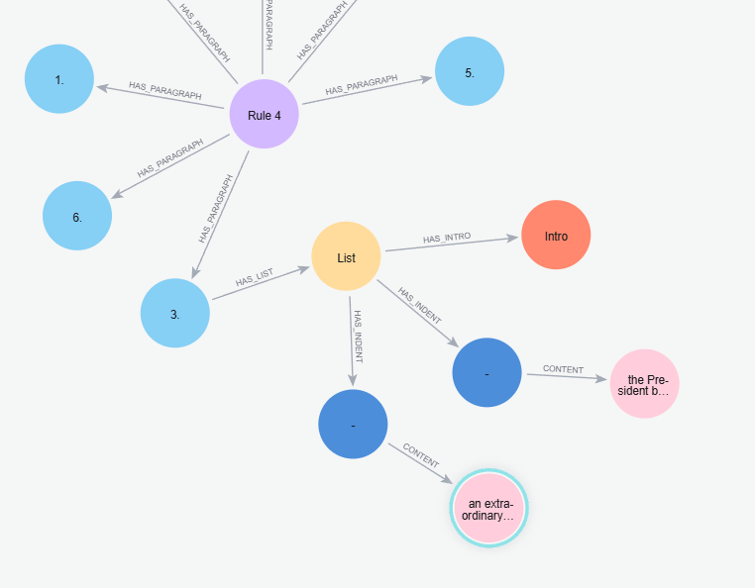
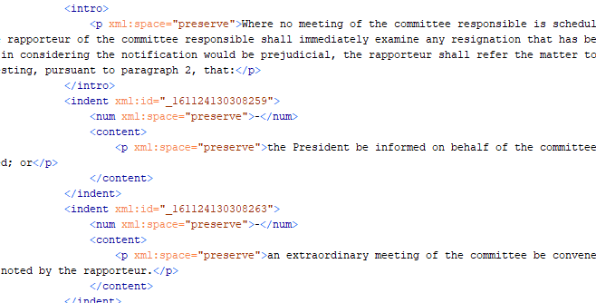
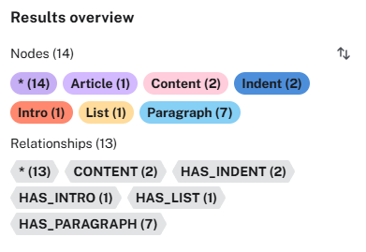
ROP: List of Indent – mark-up XML4EP
Rule:
Indent has repetitive <num>

Slide 15
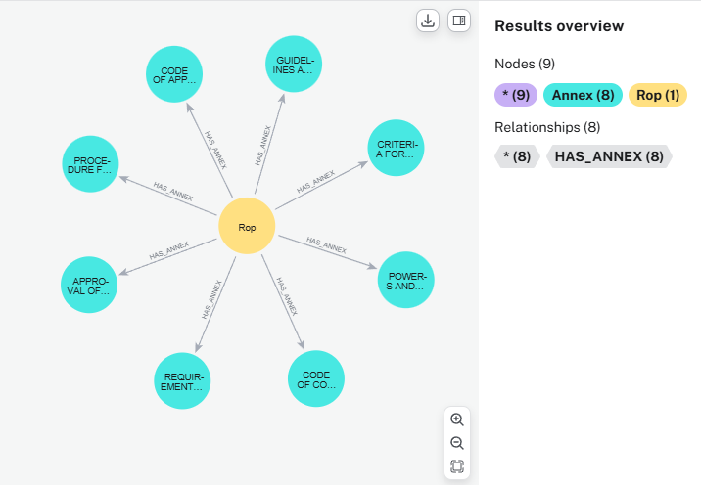
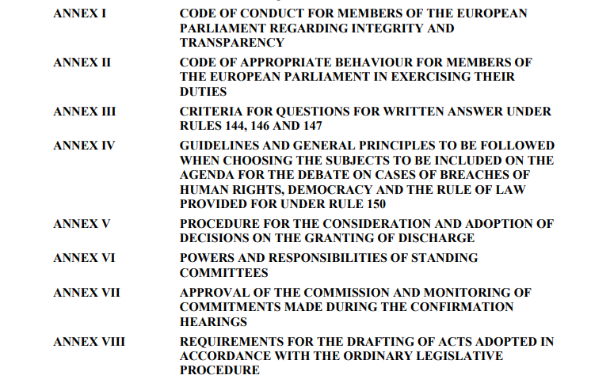
ROP : Annexes

Slide 16
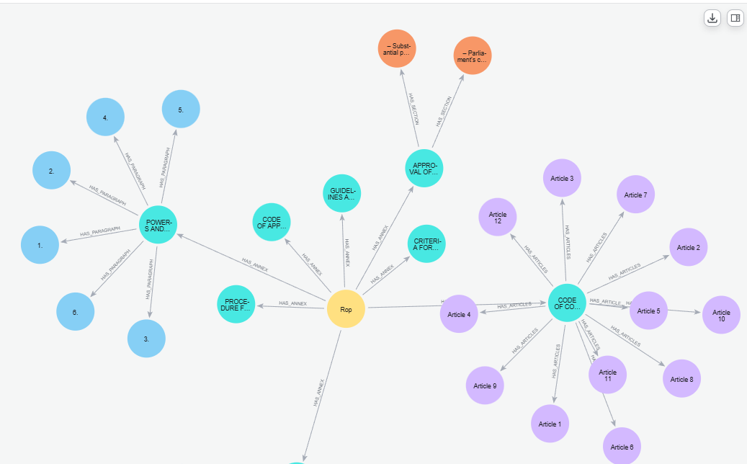
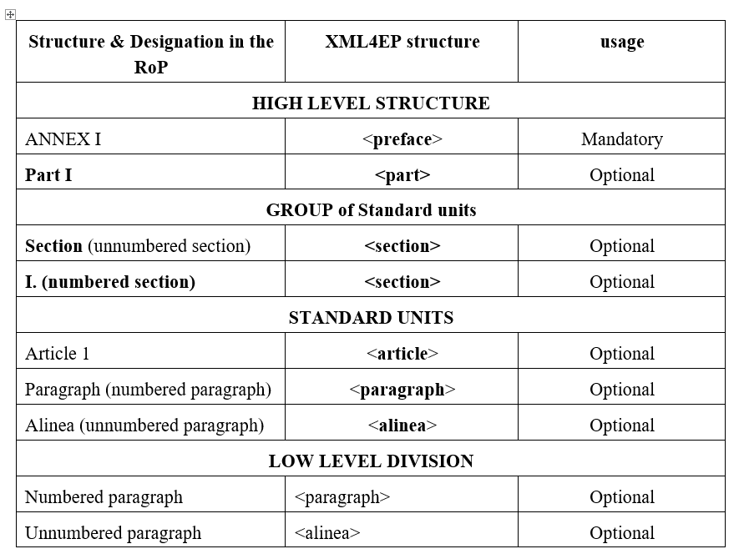
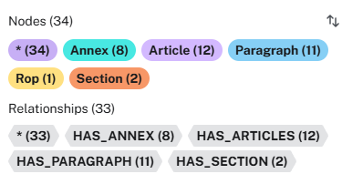
ROP : Annex Structure & division

Slide 17
Thank you

