Slide 1
Azure Deployment Framework
ADF

Slide 2
What is ADF?
A declarative way to build Cloud Infrastructure and Services.
Combines two common idempotent technologies for Automation
Infrastructure as Code:
Azure Resource Manager (ARM) Deployment Templates
Configuration as Code:
PowerShell Desired State Configuration (DSC)
Follows a DevOps mindset for Deployment
Useful for IaaS or PaaS services + monitoring + security + +

Slide 3
Why use ADF?
The focus of the toolkit is the initial training (ramp up) and allows the customer to get to production in Azure faster/efficiently.
By using Infrastructure and Configuration as Code
All code is checked into source control
Promotes teamwork
Easy sharing of code between the team
Allows ongoing support for the customer throughout the application lifecycle
Documentation as Code
We use the exact same code for the full application lifecycle
Development → Test → QA → Production → Development
Allows the ability to easily spin up Multiple instances of Application environments (side by side)

Slide 4
When to use ADF?
To walk through the layers of Azure and understand the customer application step by step.
Document requirements as you go.
Ideal for lift and shift, with focus on full Automation (not imaging).
Best suited to Application migrations (not full datacenter migrations).
Easier to implement for Developers, over Operators? (IaC).
Should I use IaaS or PaaS?
What are my naming standards?
What governance models does Azure use?
What topology should my network be?

Slide 5
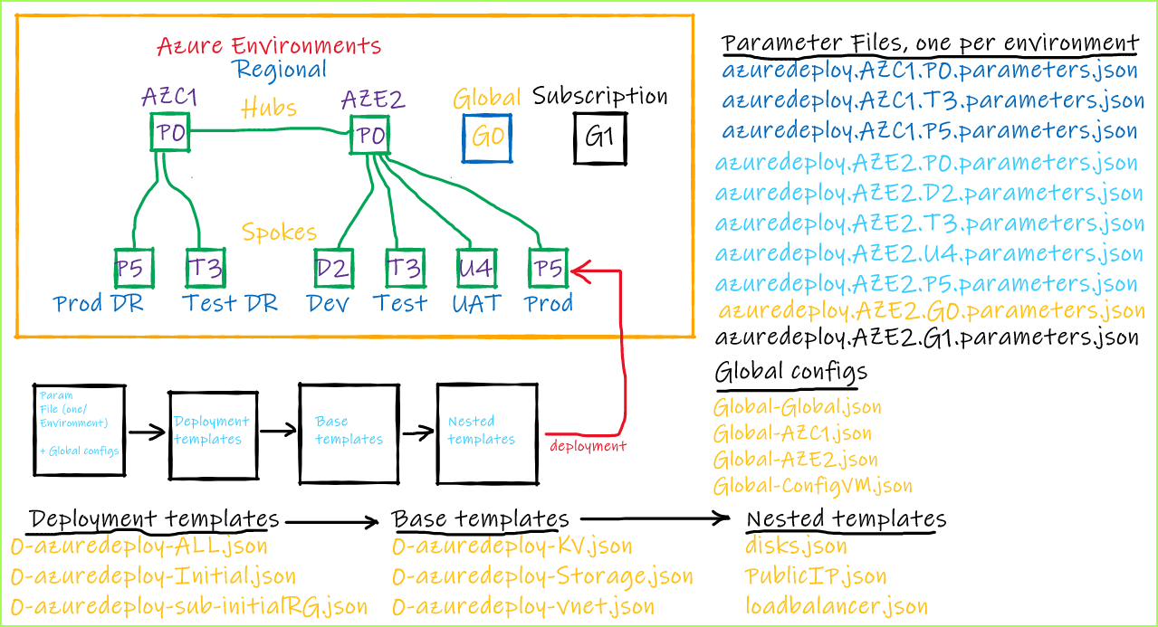
How to get started? (Understand what ADF can do)

Slide 6
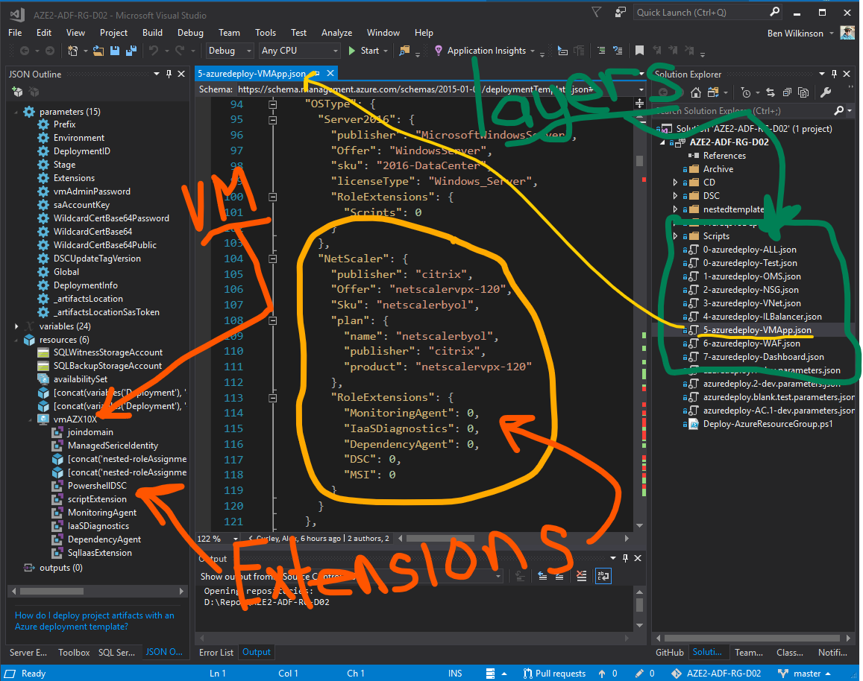
How to get started? (Understand what ADF can do)

Slide 7
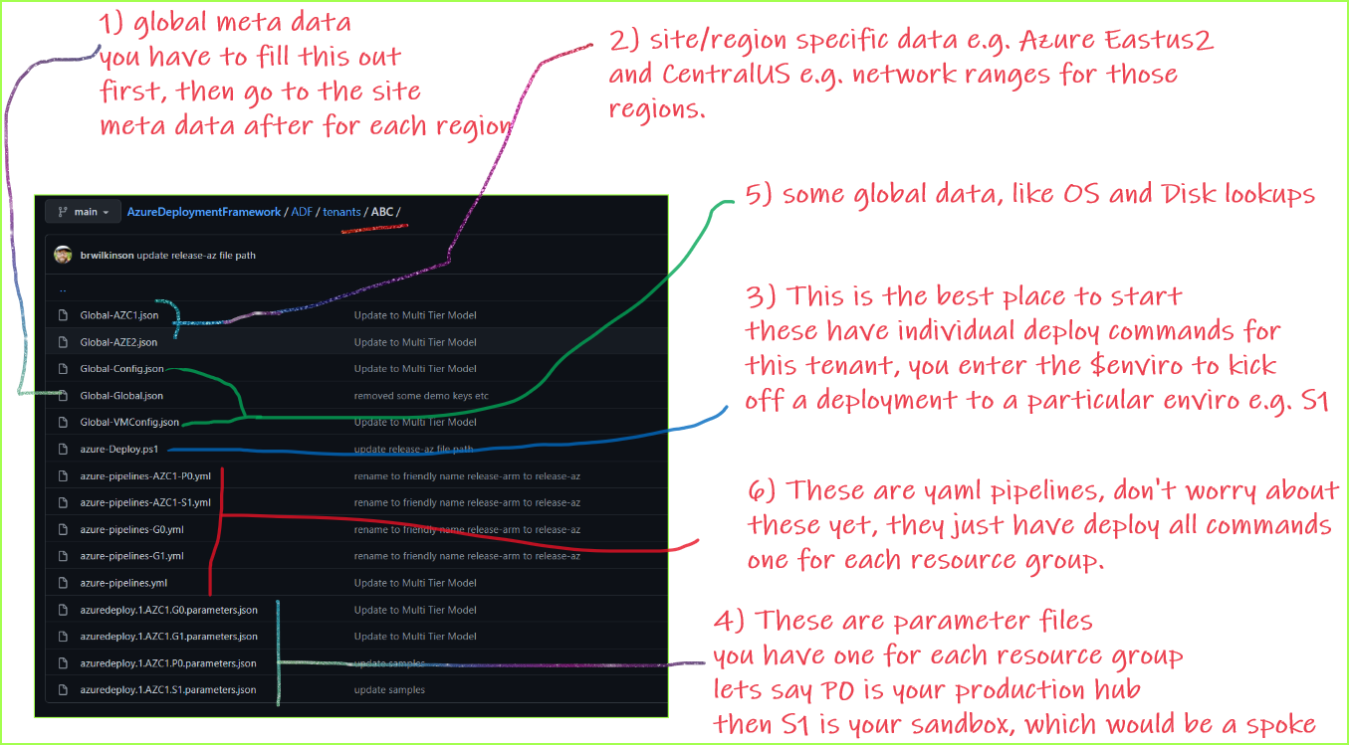
How to get started? (Which files to look at)

Slide 8
How to get started?
Become familiar with the tools and processes used in ADF
Start deploying straight away
Start to work on the DSC configurations for the Application
Discuss Azure capabilities and build the configurations
Log Analytics
Virtual Networks
Topology
Subnet sizes
NSG’s
Load Balancers
Virtual Machines
Linux
Windows
Appliances
Web Application Firewalls

Slide 9
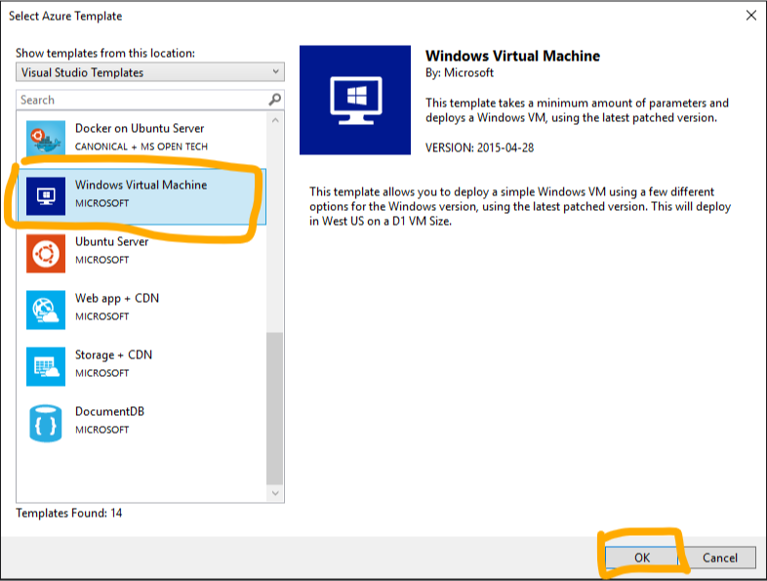
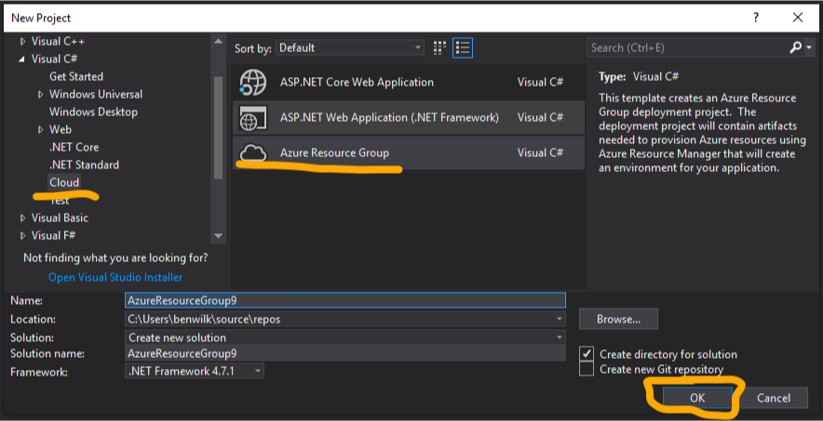
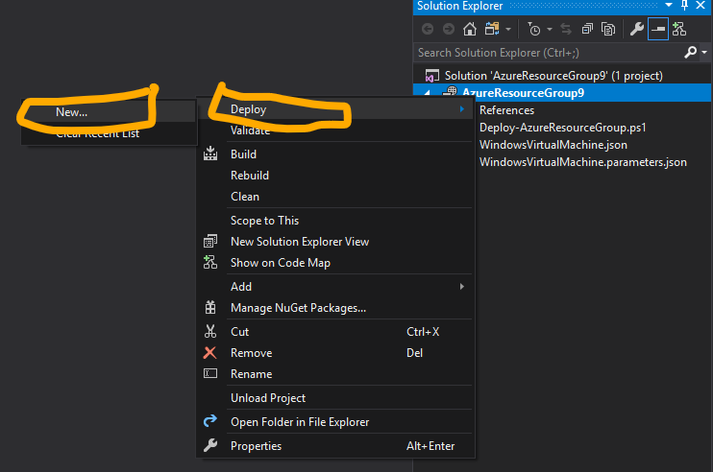
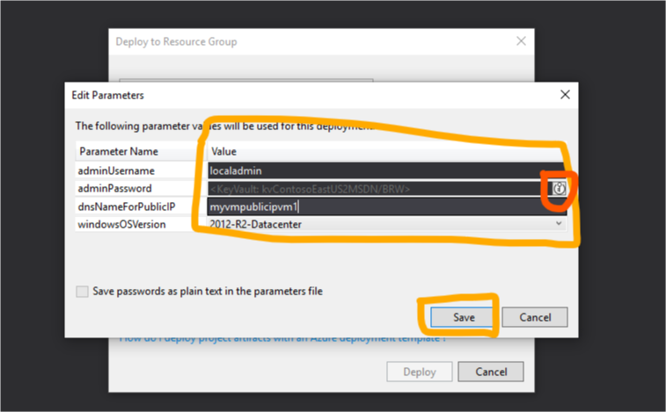
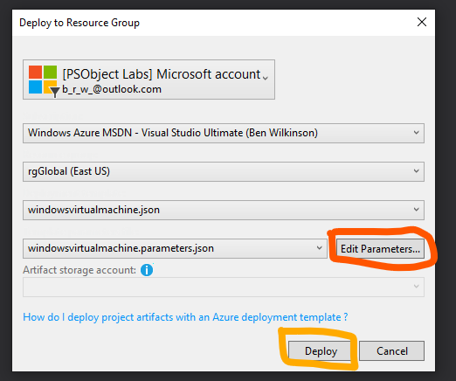
How to get started? (start deploying with ARM)

Slide 10
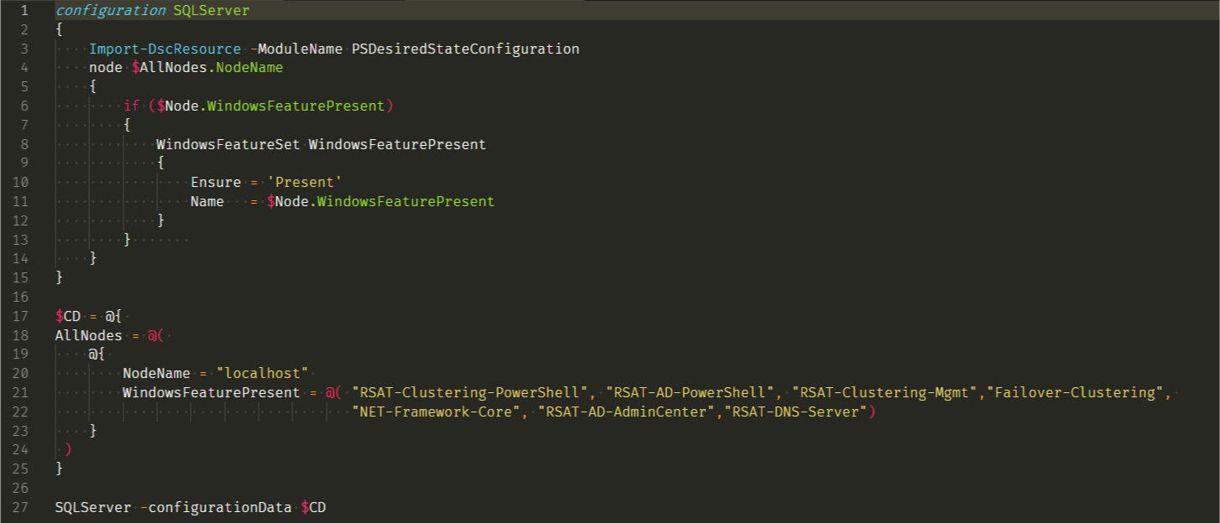
How to get started? (Become familiar with DSC)

Slide 11
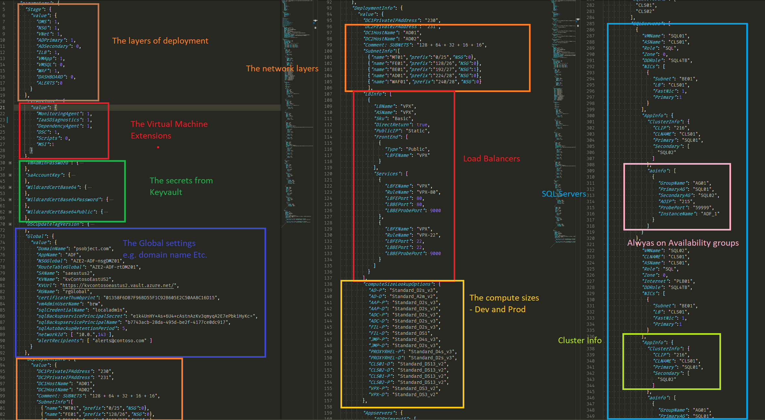
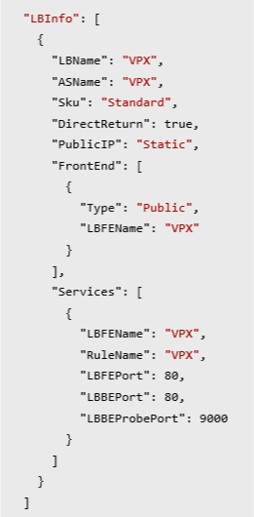
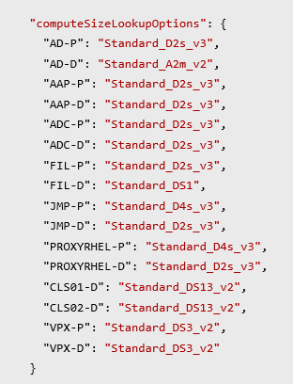
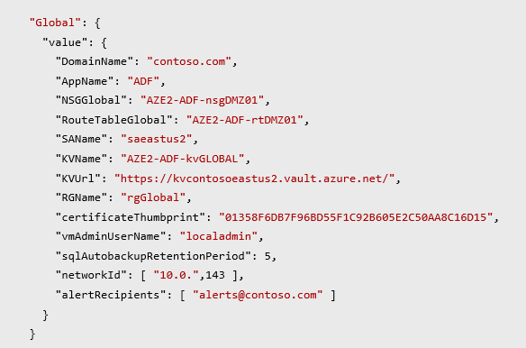
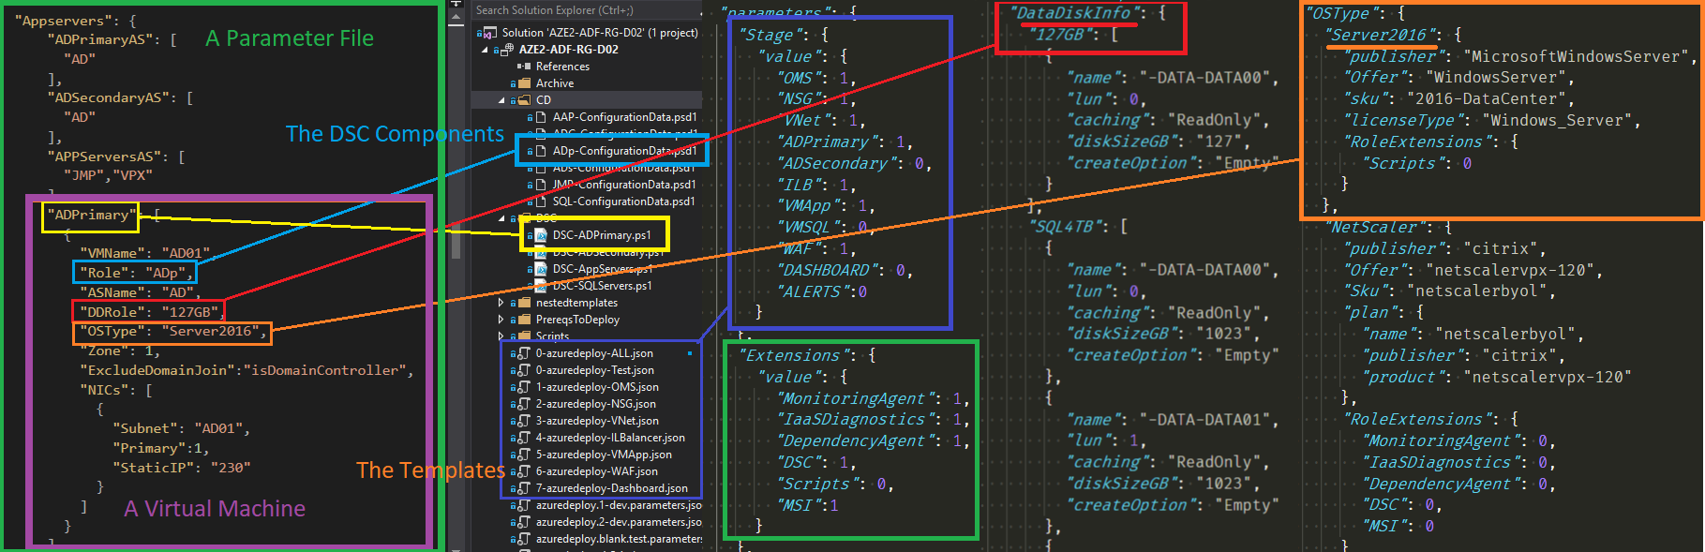
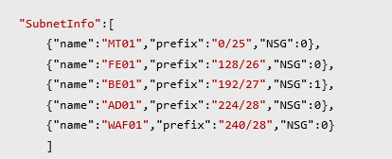
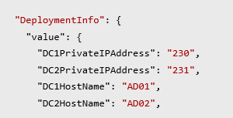
One parameter file per Application Environment.

Slide 12
Questions?
Links
Sample projects
https://github.com/brwilkinson/AzureDeploymentFramework
Template Information
https://docs.microsoft.com/en-us/azure/templates/
Feel free to reach out directly for other private projects
Assistance with Templates / DSC / PowerShell
All feedback is welcome . . . The ADF is always changing.

