Slide 1
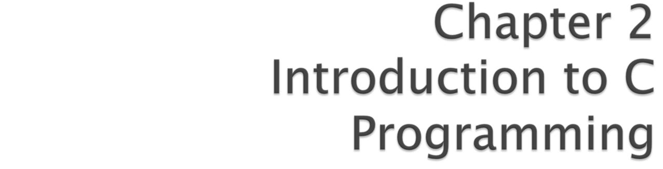
C How to Program, 7/e
©1992-2013 by Pearson Education, Inc. All Rights Reserved.

Slide 2
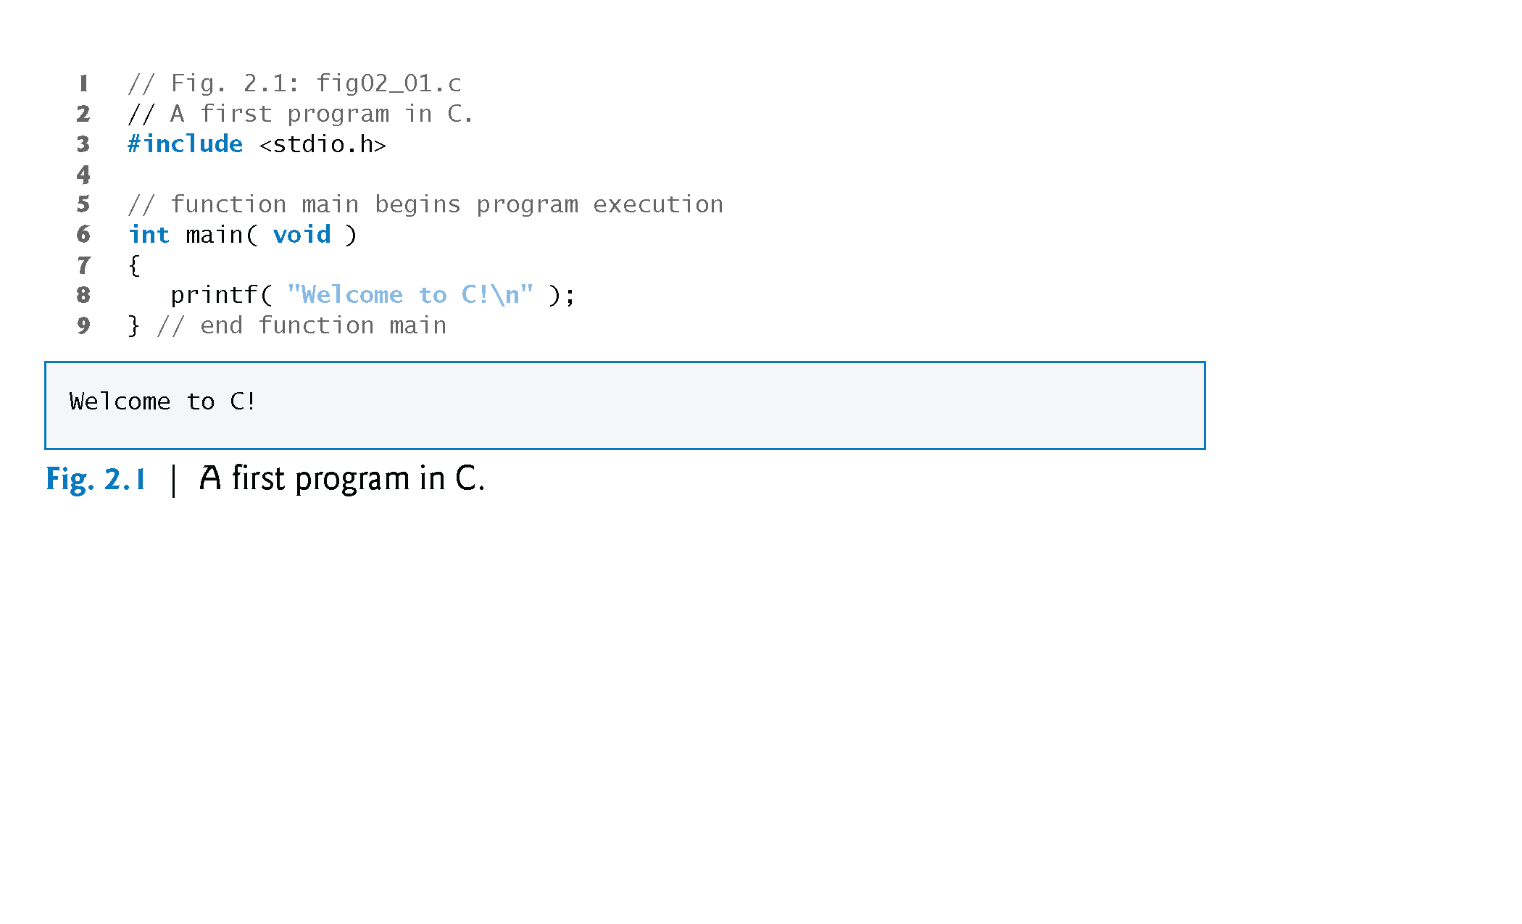
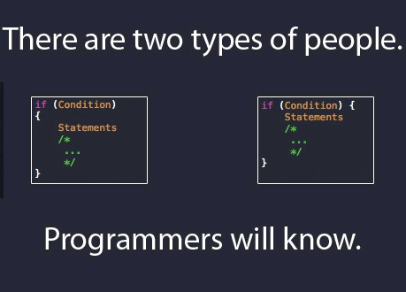
©1992-2013 by Pearson Education, Inc. All Rights Reserved.

Slide 3
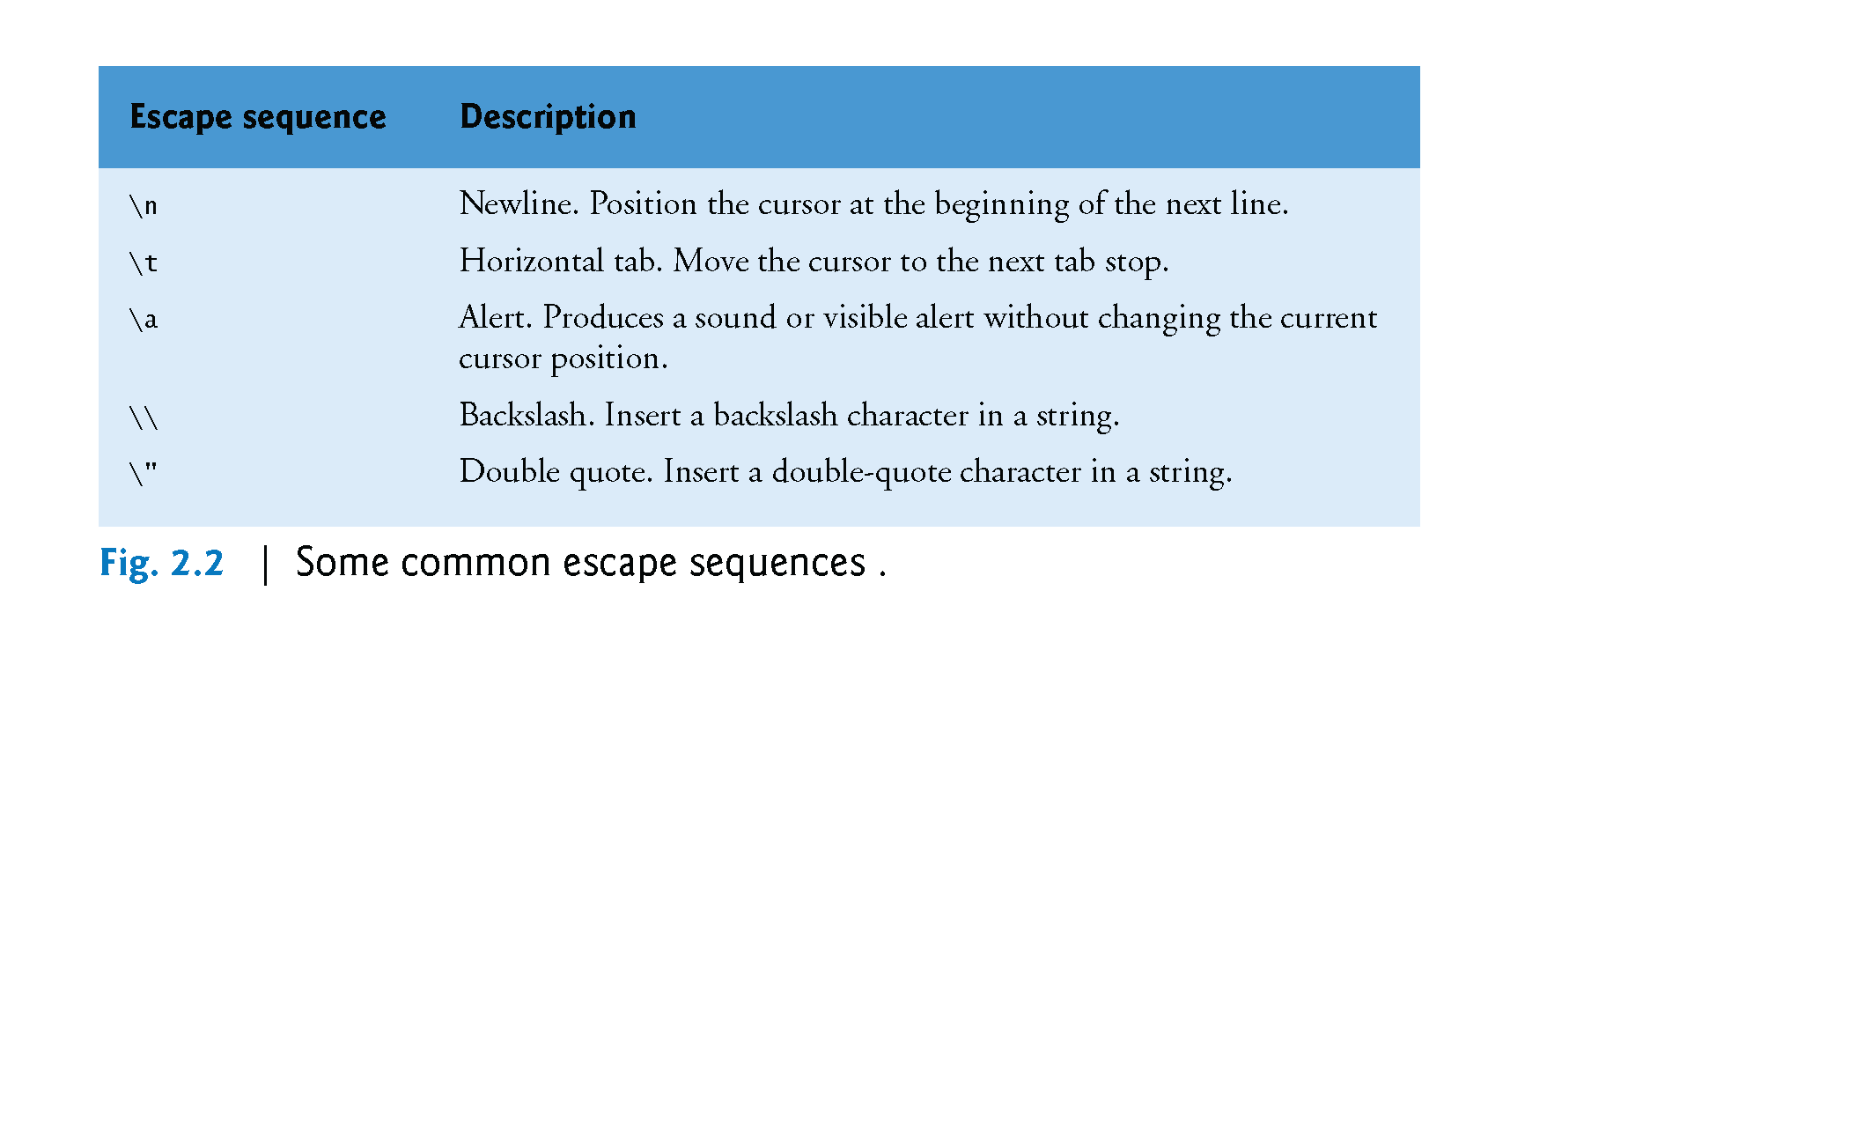
©1992-2013 by Pearson Education, Inc. All Rights Reserved.

Slide 4
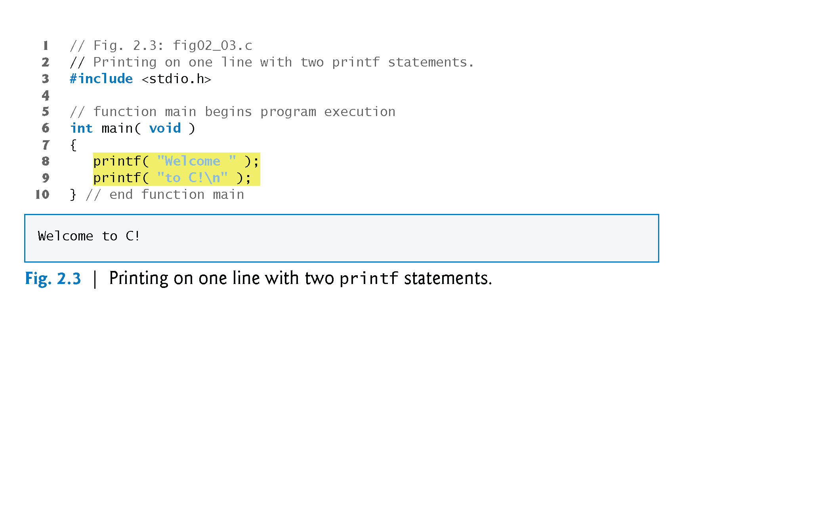
©1992-2013 by Pearson Education, Inc. All Rights Reserved.

Slide 5
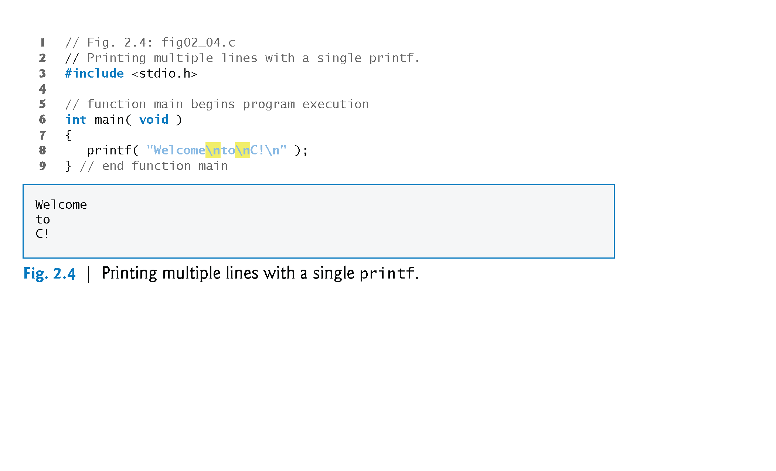
©1992-2013 by Pearson Education, Inc. All Rights Reserved.

Slide 6
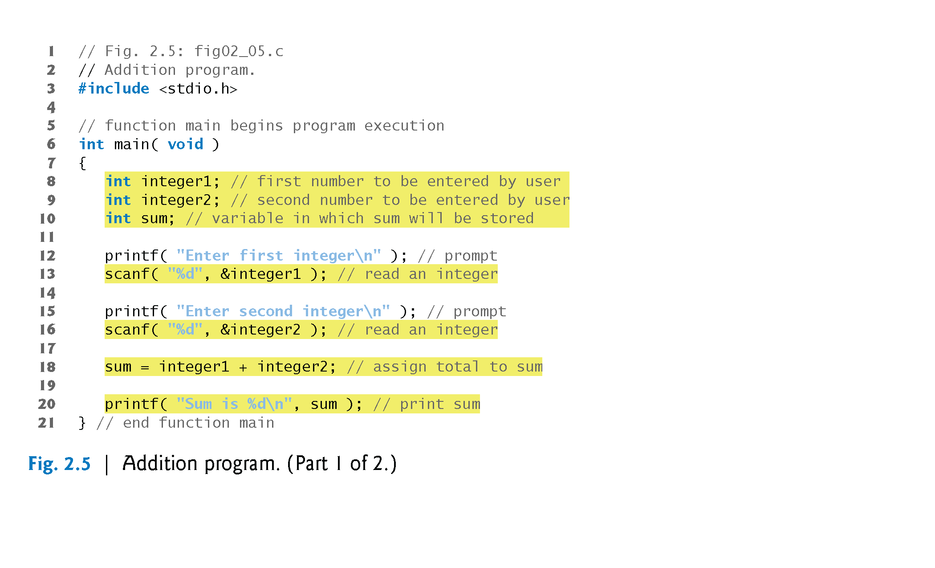
©1992-2013 by Pearson Education, Inc. All Rights Reserved.

Slide 7
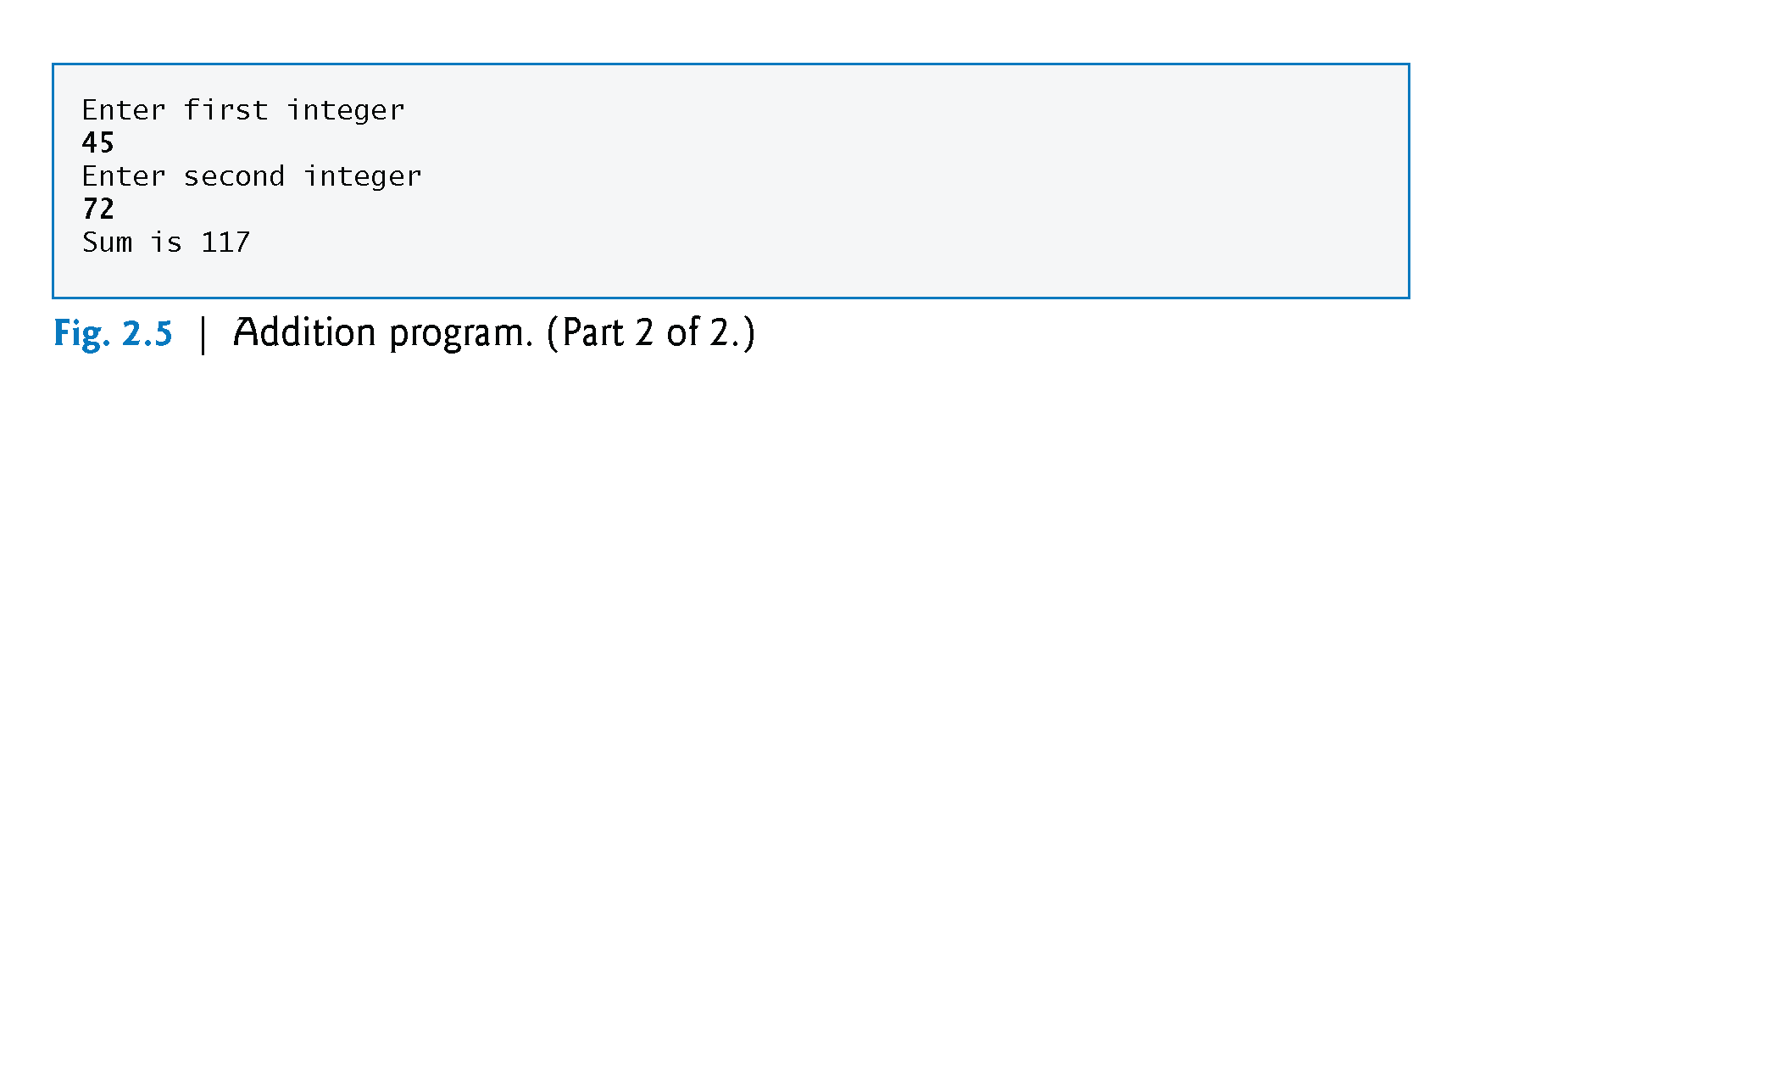
©1992-2013 by Pearson Education, Inc. All Rights Reserved.

Slide 8
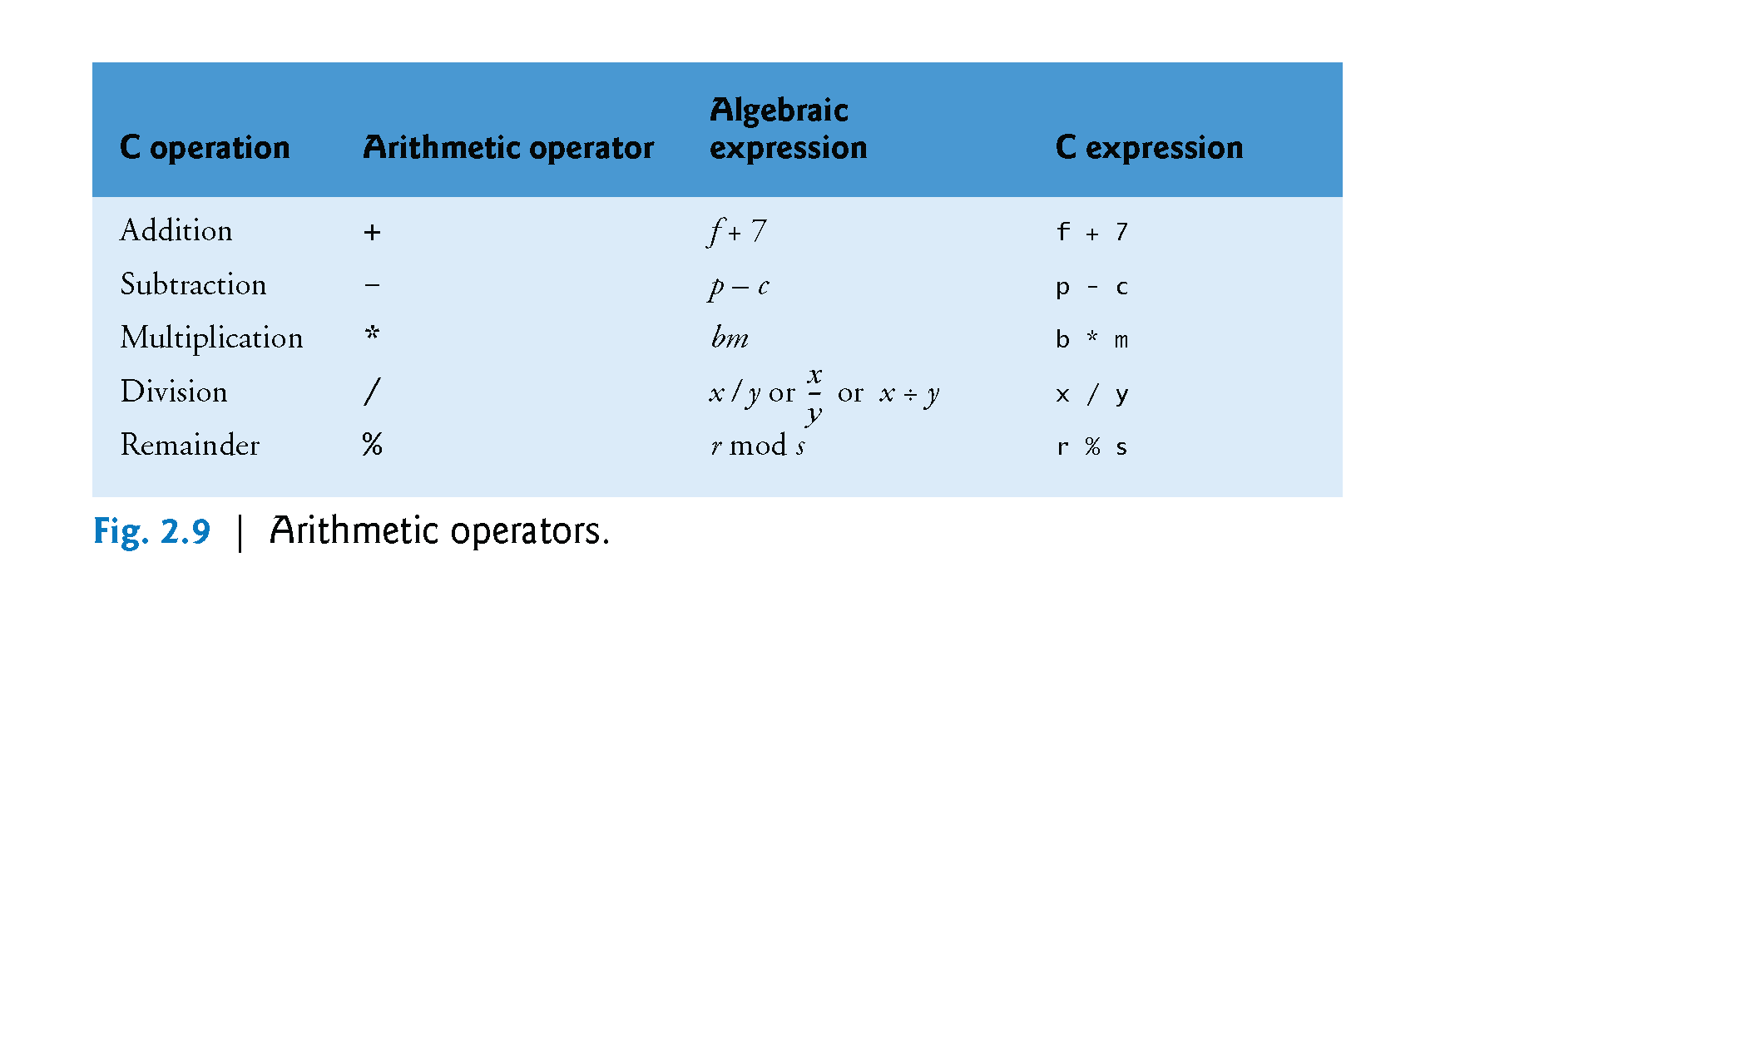
©1992-2013 by Pearson Education, Inc. All Rights Reserved.

Slide 9

Integer Division and the Remainder Operator
Integer division yields an integer result.
For example, the expression 7 / 4 evaluates to 1 and the expression 17 / 5 evaluates to 3.
C provides the remainder operator, %, which yields the remainder after integer division.
The remainder operator is an integer operator that can be used only with integer operands.
The expression x % y yields the remainder after x is divided by y.
Thus, 7 % 4 yields 3 and 17 % 5 yields 2.
©1992-2013 by Pearson Education, Inc. All Rights Reserved.

Slide 10
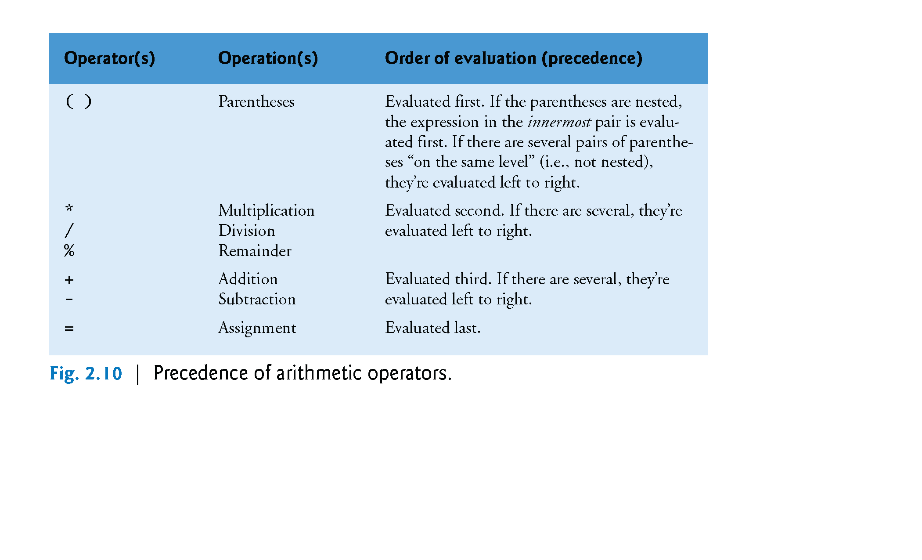
©1992-2013 by Pearson Education, Inc. All Rights Reserved.

Slide 11
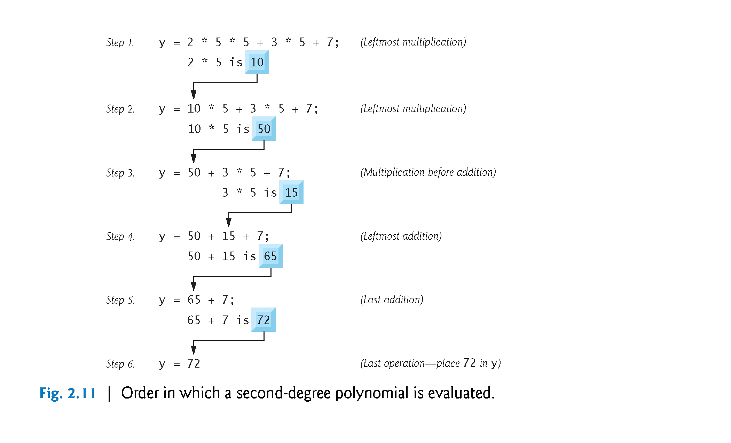
©1992-2013 by Pearson Education, Inc. All Rights Reserved.

Slide 12
As in algebra, it’s acceptable to place unnecessary parentheses in an expression to make the expression clearer.
These are called redundant parentheses.
©1992-2013 by Pearson Education, Inc. All Rights Reserved.

Slide 13
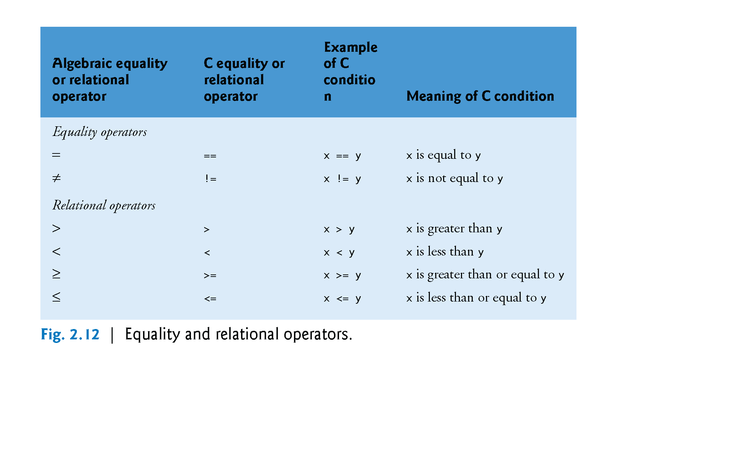
©1992-2013 by Pearson Education, Inc. All Rights Reserved.

Slide 14
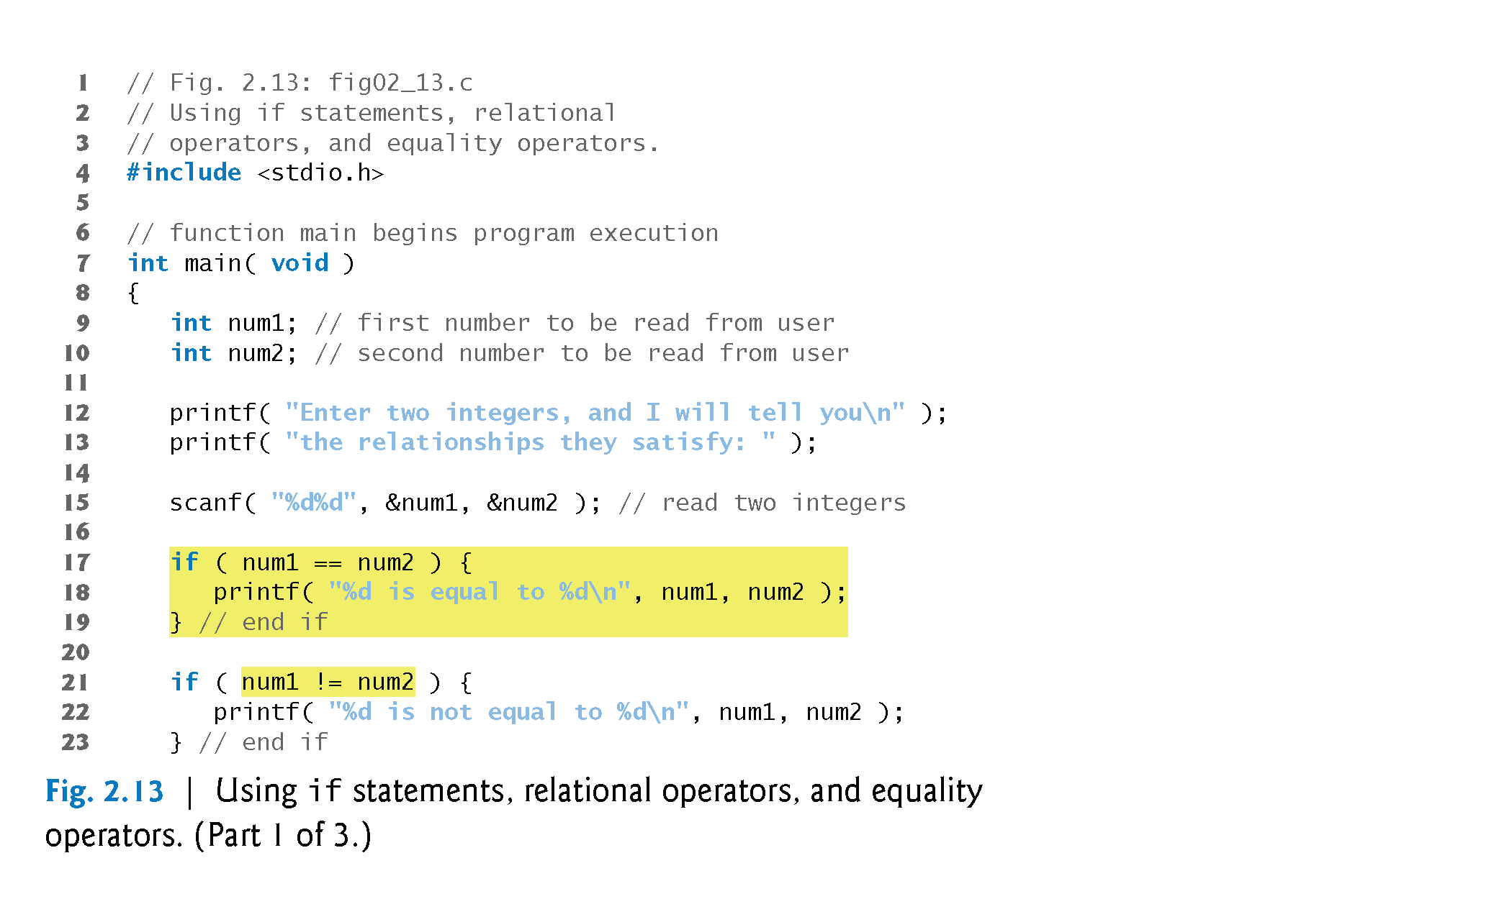
©1992-2013 by Pearson Education, Inc. All Rights Reserved.

Slide 15
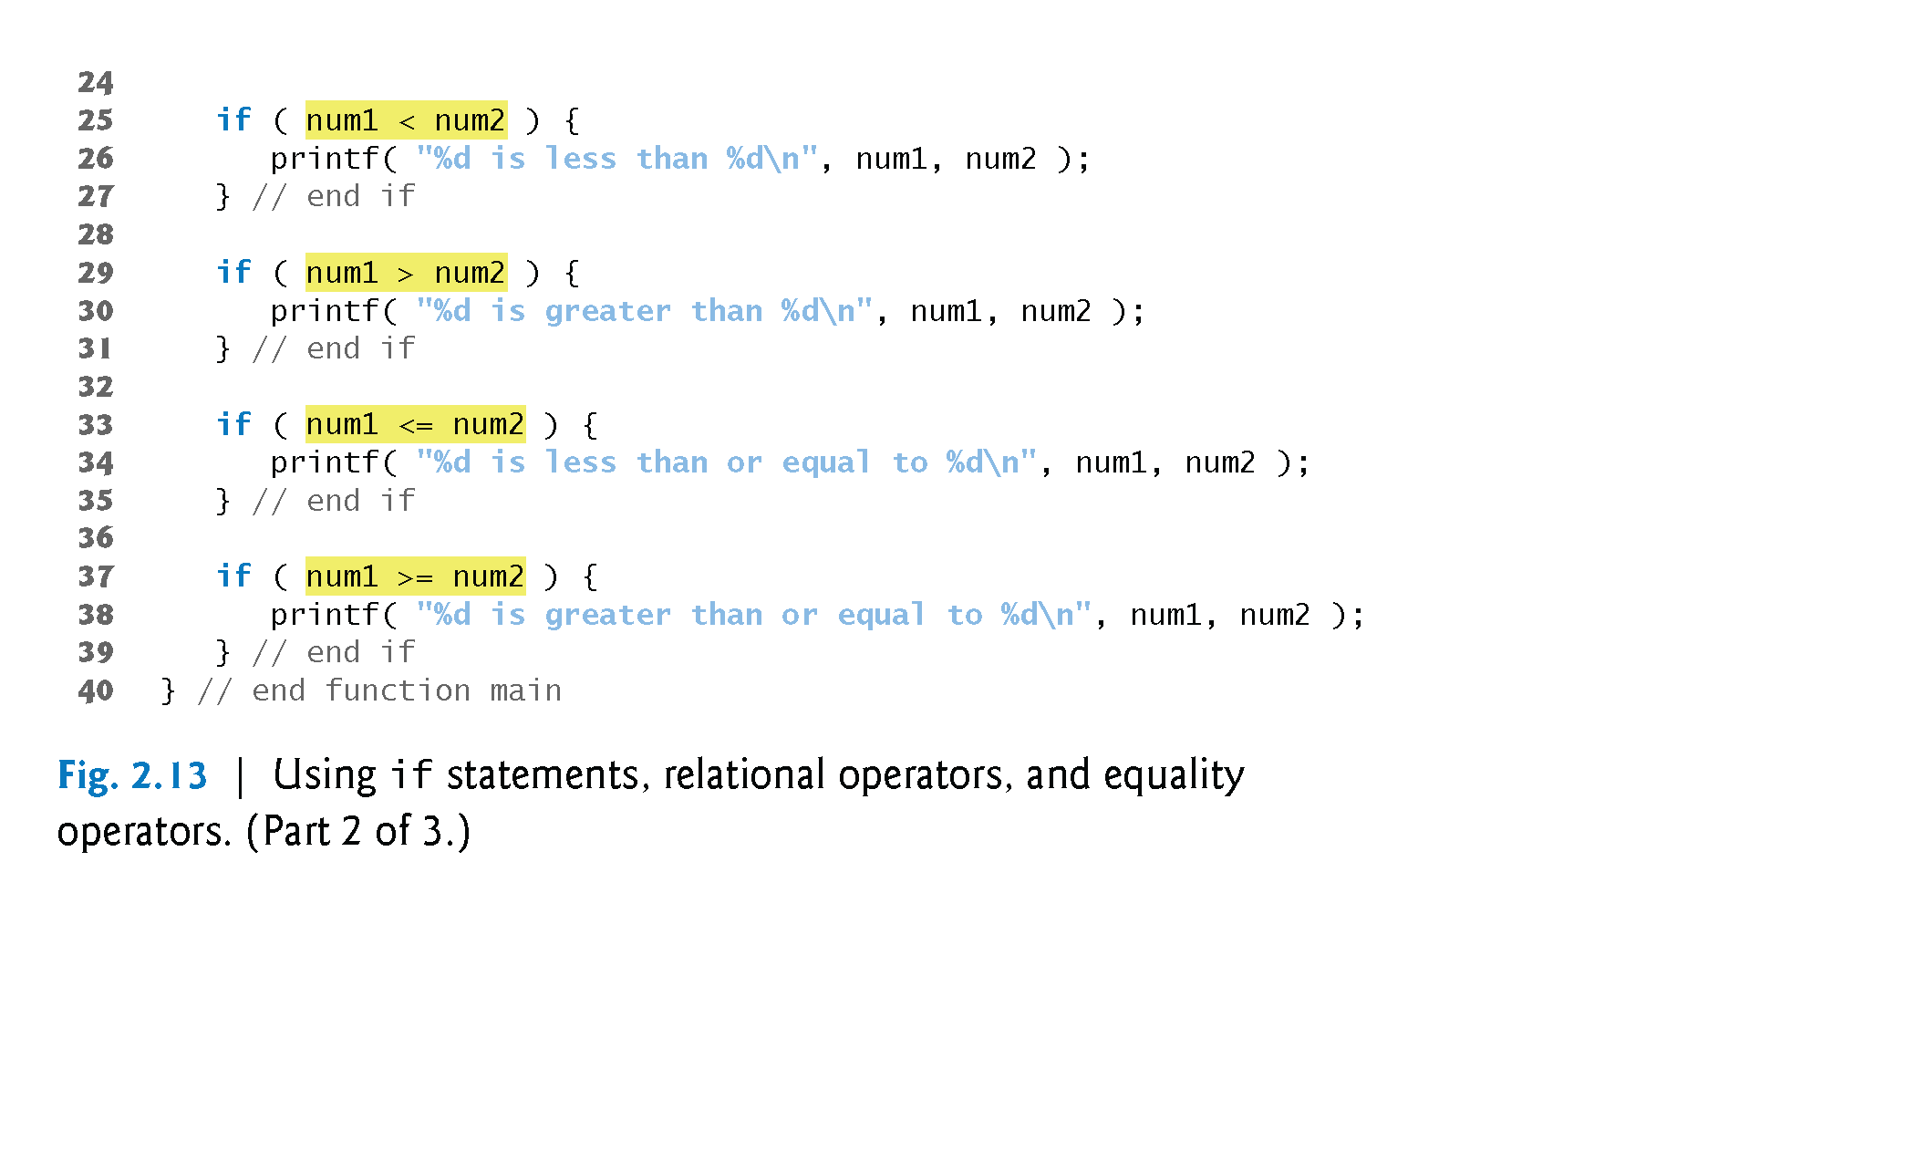
©1992-2013 by Pearson Education, Inc. All Rights Reserved.

Slide 16
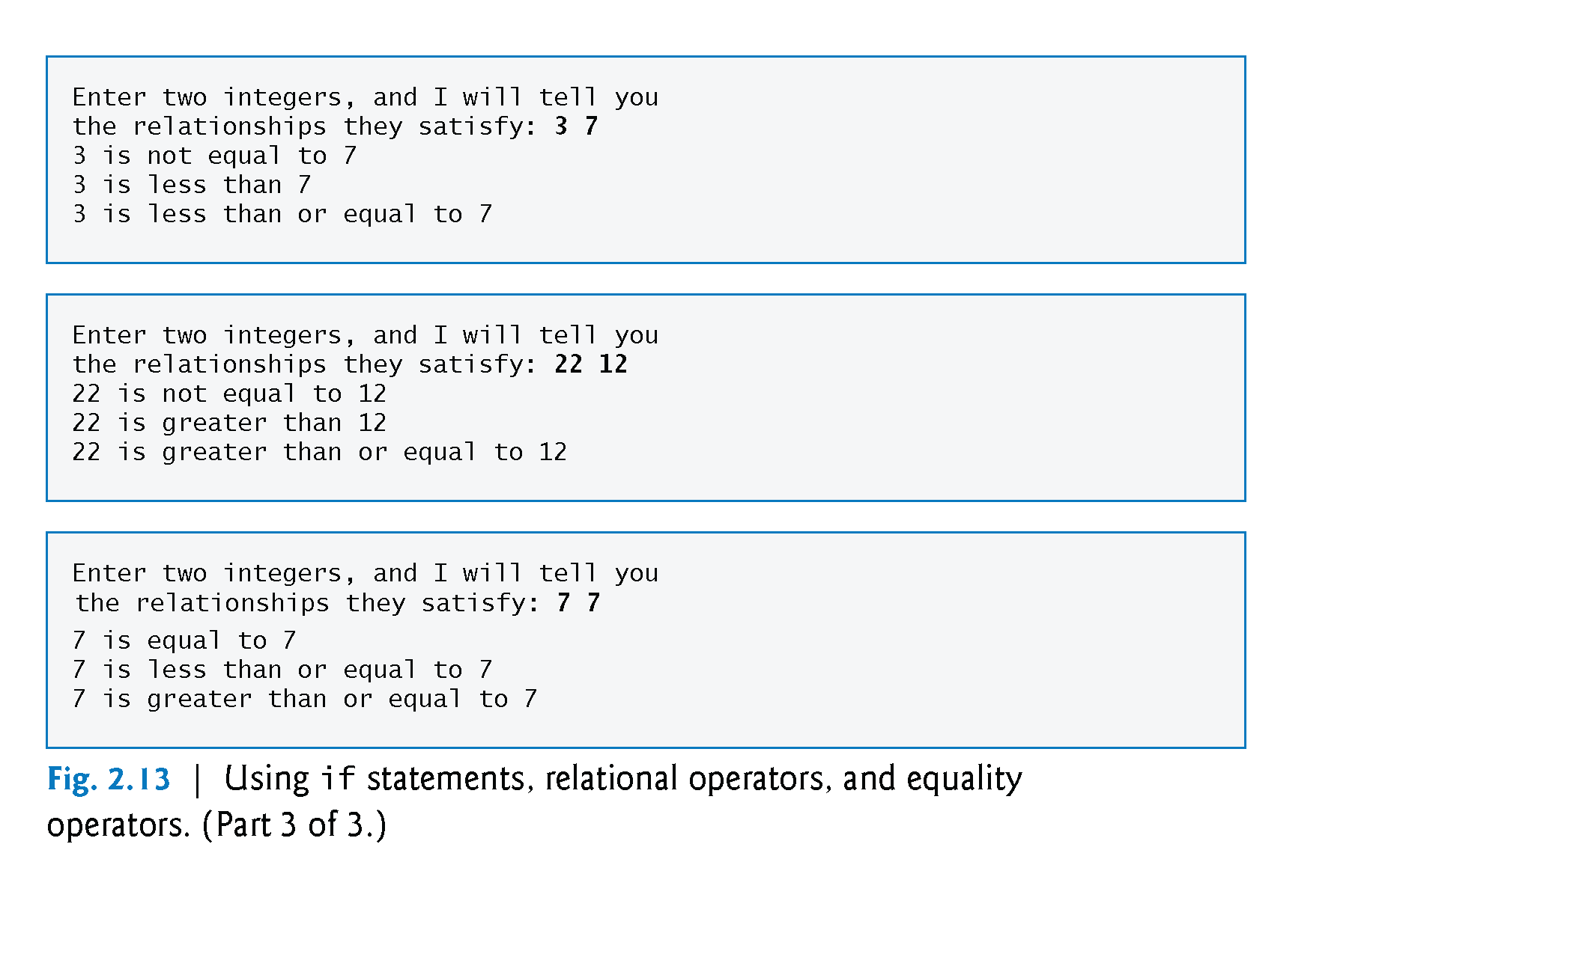
©1992-2013 by Pearson Education, Inc. All Rights Reserved.

Slide 17
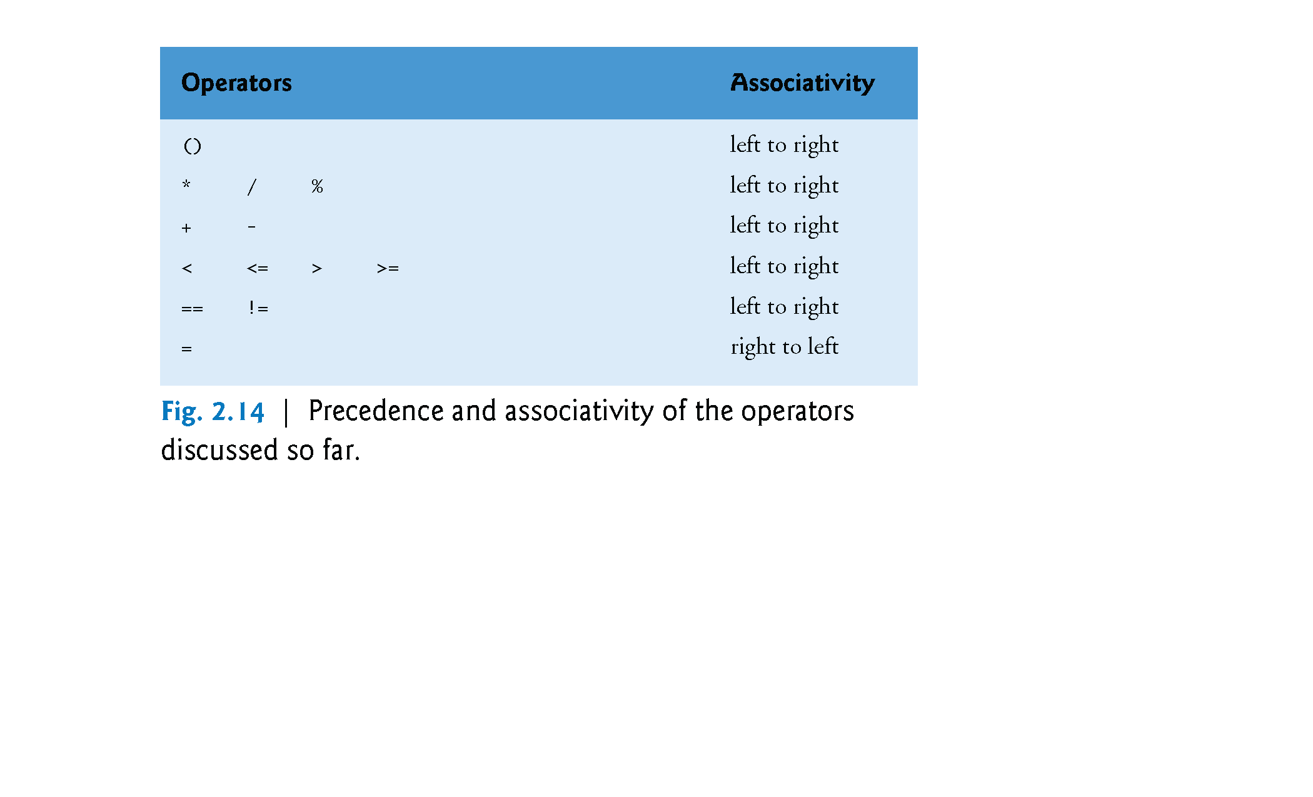
©1992-2013 by Pearson Education, Inc. All Rights Reserved.

Slide 18
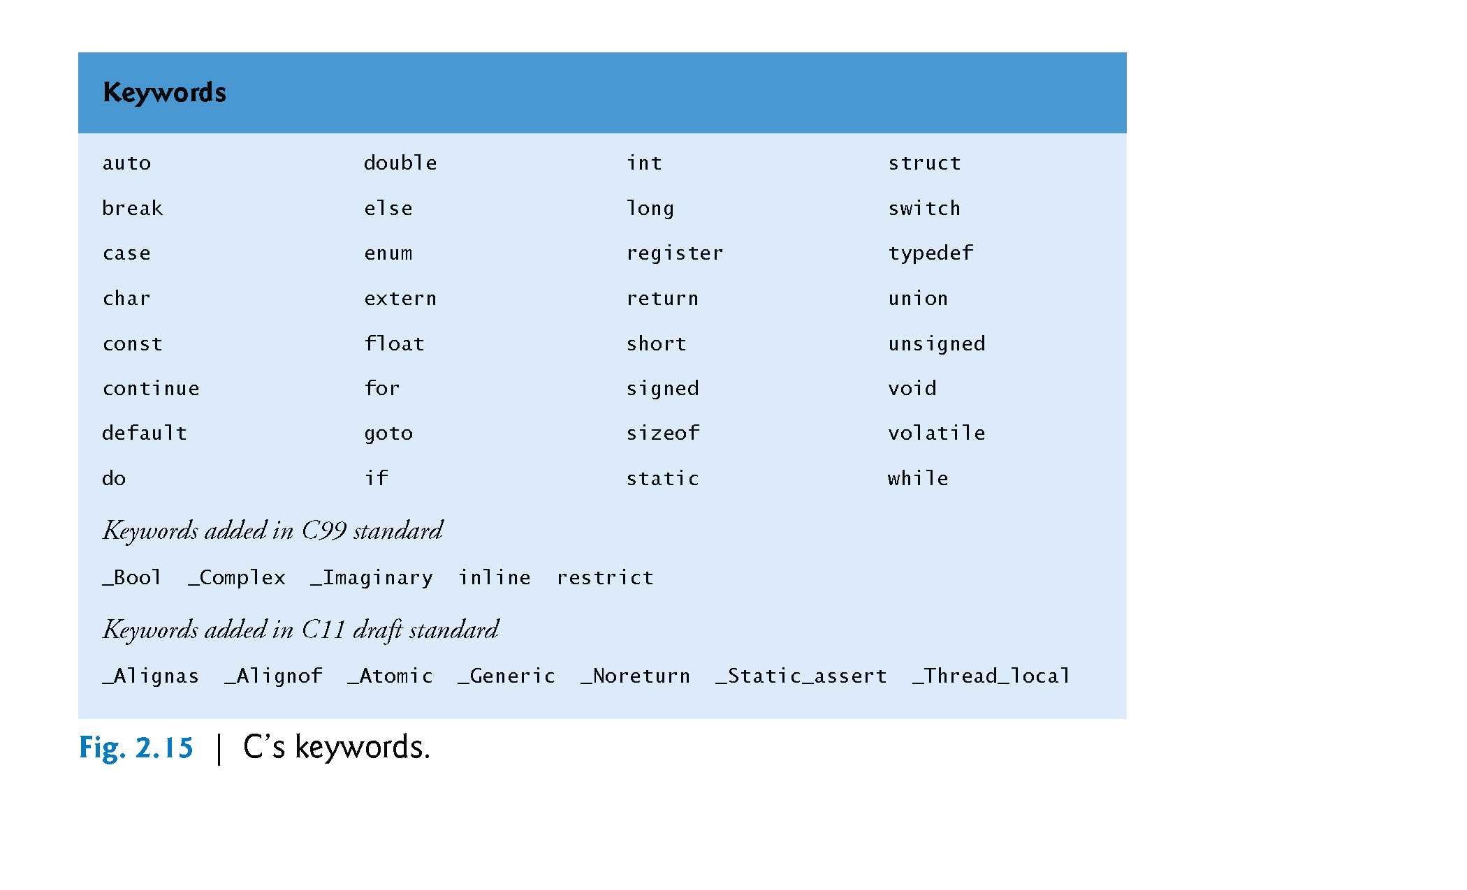
©1992-2013 by Pearson Education, Inc. All Rights Reserved.

