Slide 1
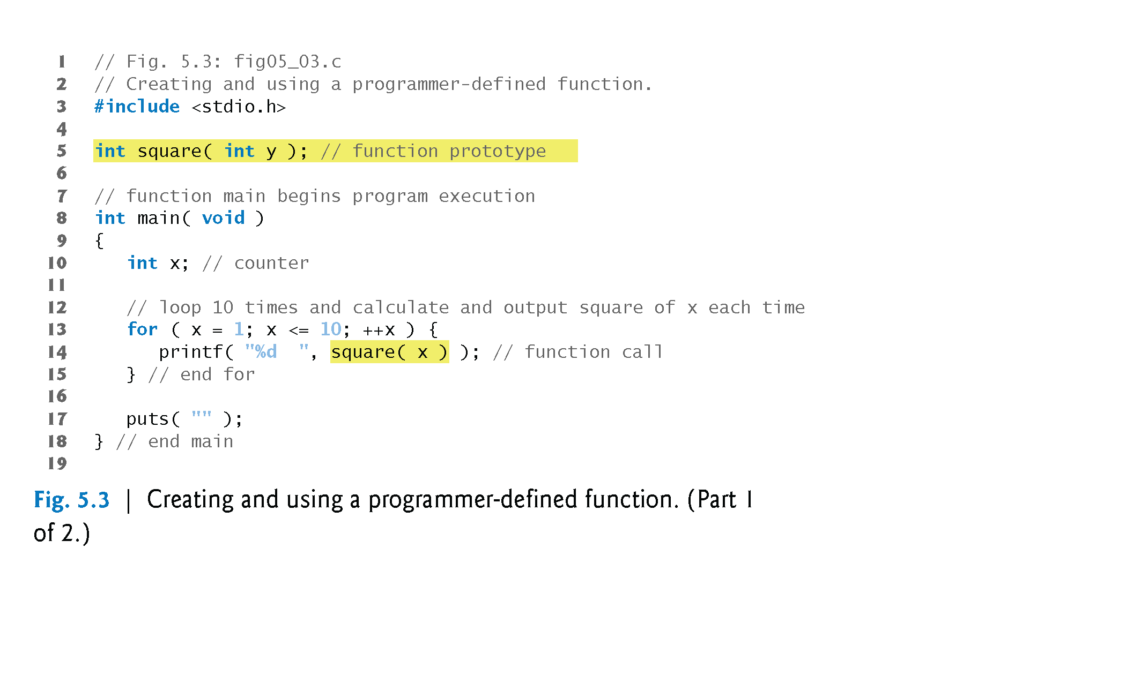
©1992-2013 by Pearson Education, Inc. All Rights Reserved.

Slide 2
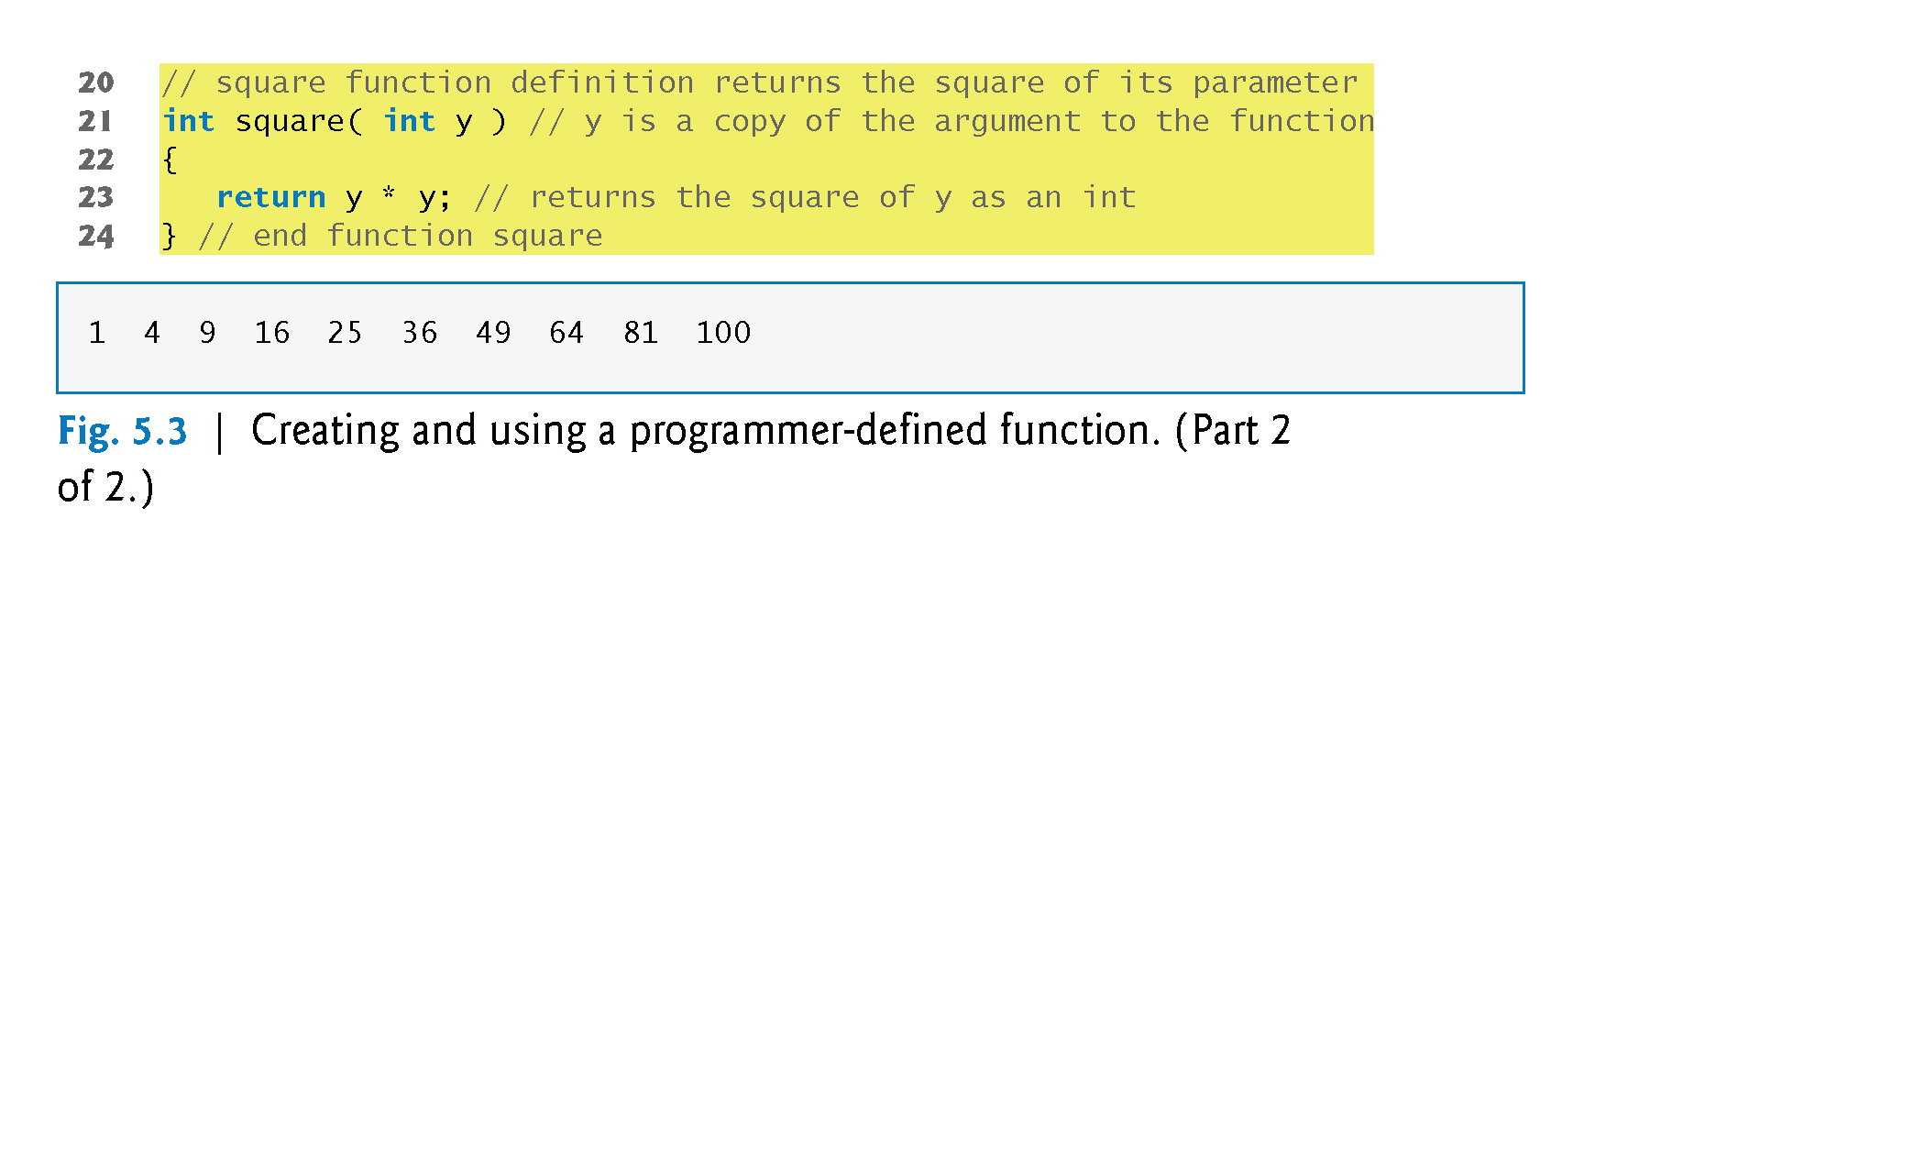
©1992-2013 by Pearson Education, Inc. All Rights Reserved.

Slide 3
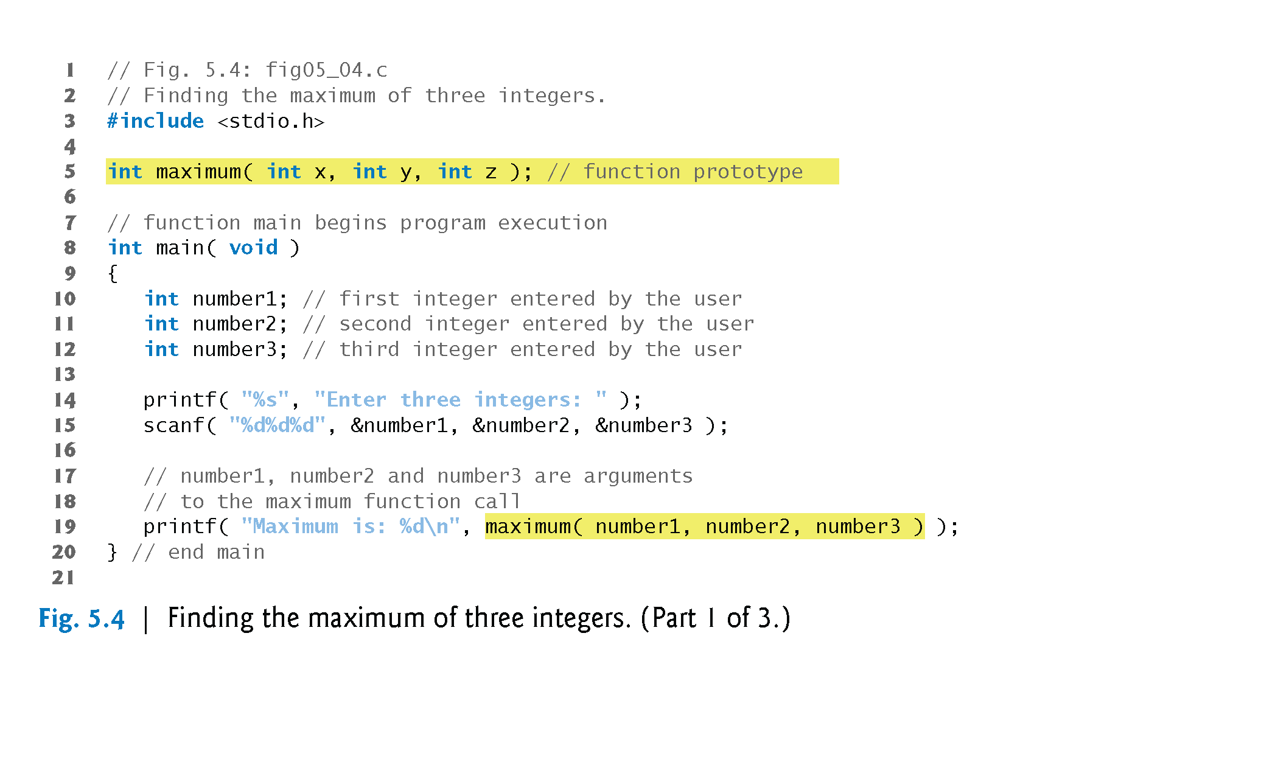
©1992-2013 by Pearson Education, Inc. All Rights Reserved.

Slide 4
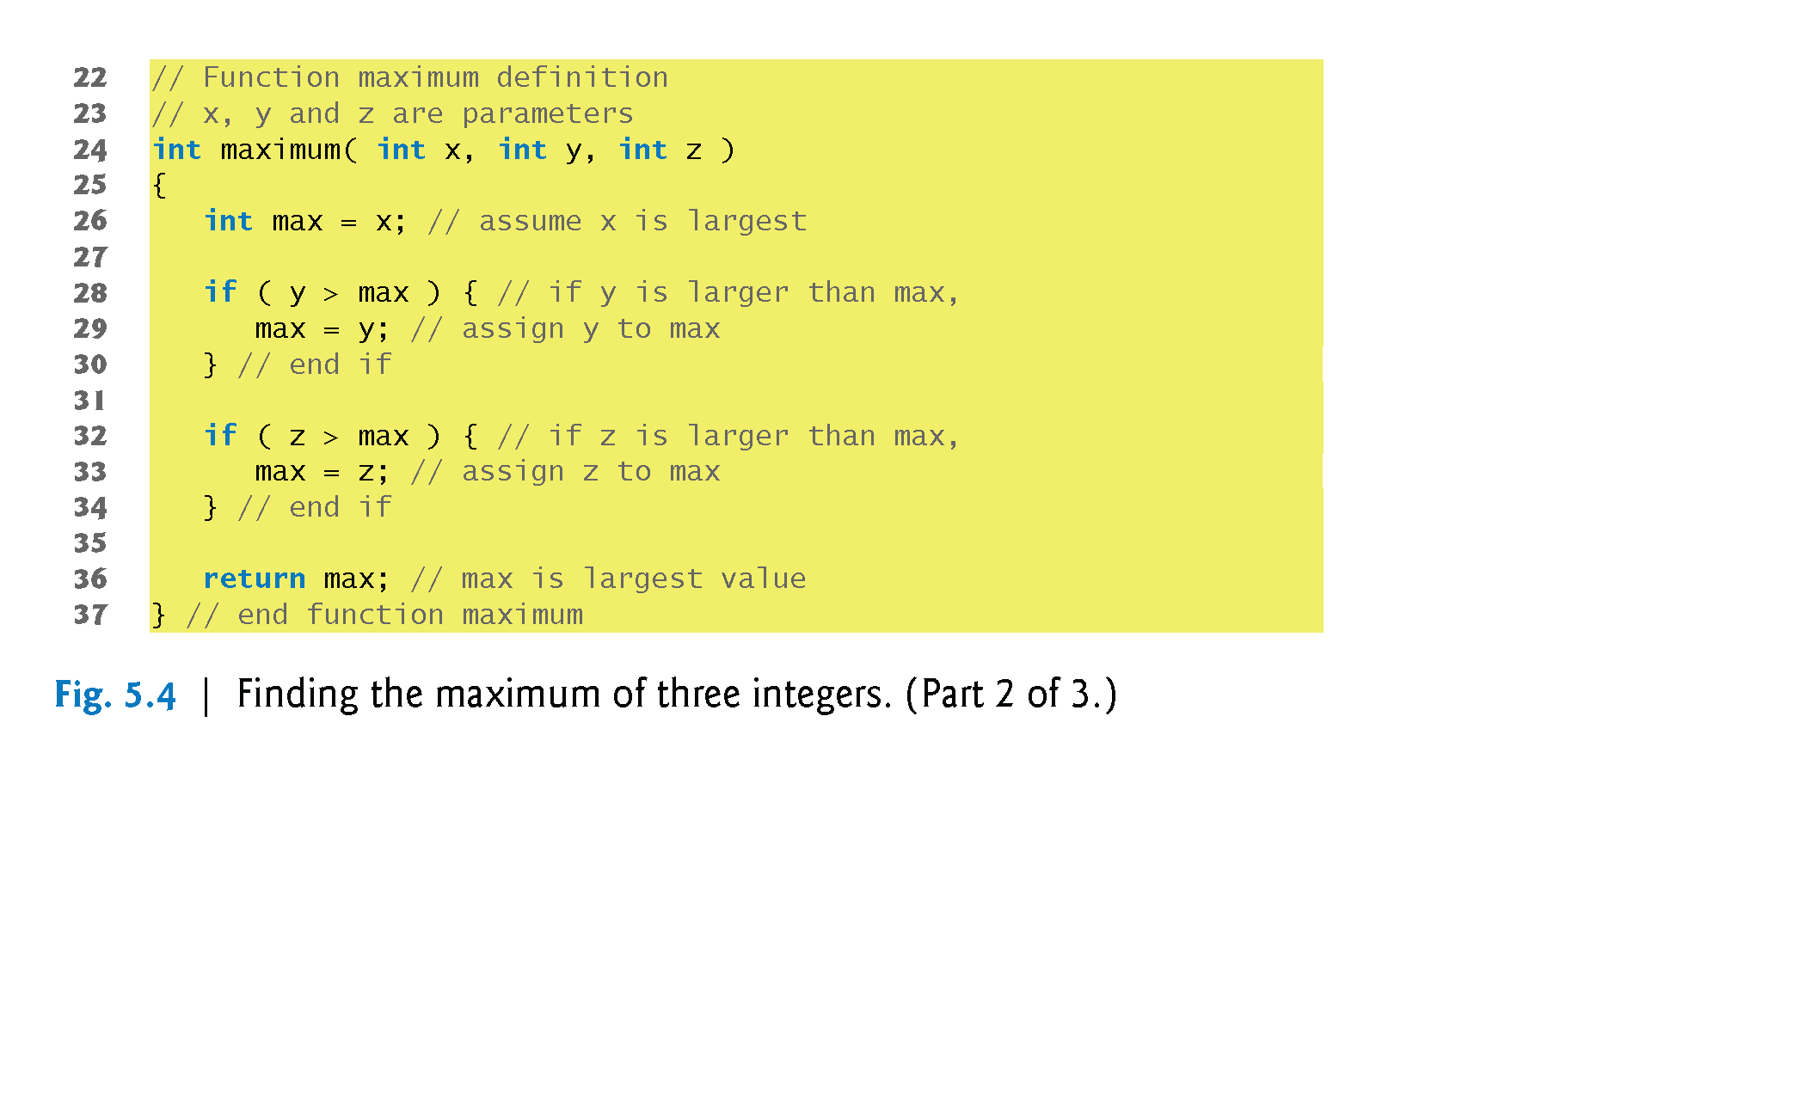
©1992-2013 by Pearson Education, Inc. All Rights Reserved.

Slide 5
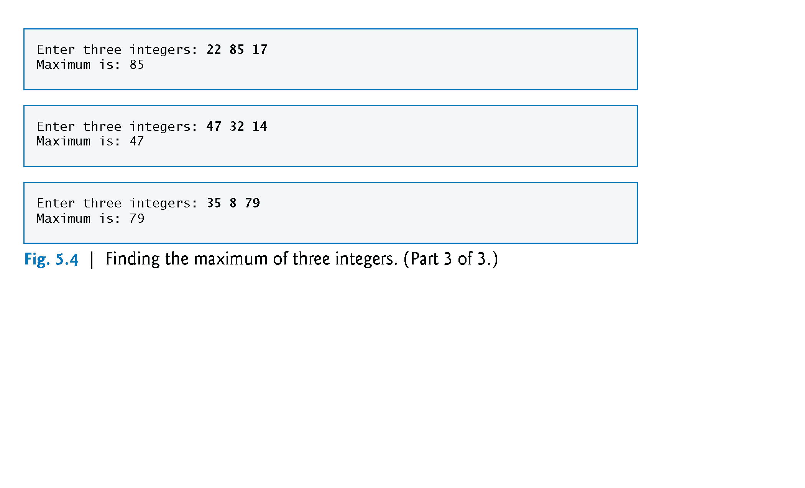
©1992-2013 by Pearson Education, Inc. All Rights Reserved.

Slide 6
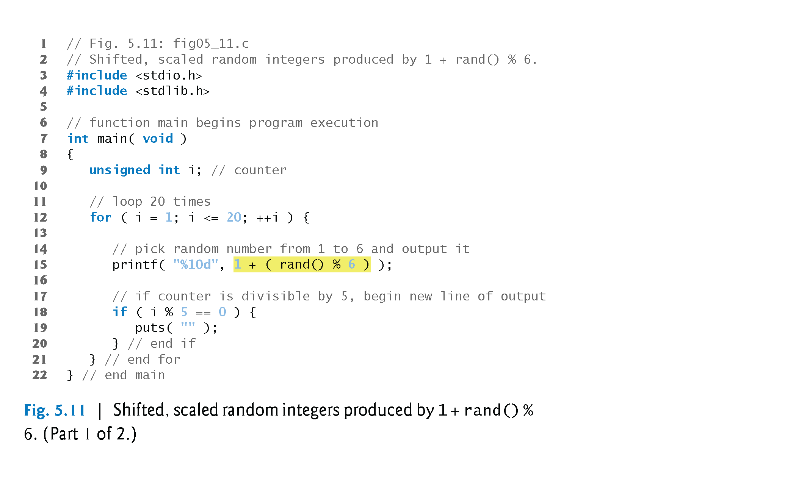
©1992-2013 by Pearson Education, Inc. All Rights Reserved.

Slide 7
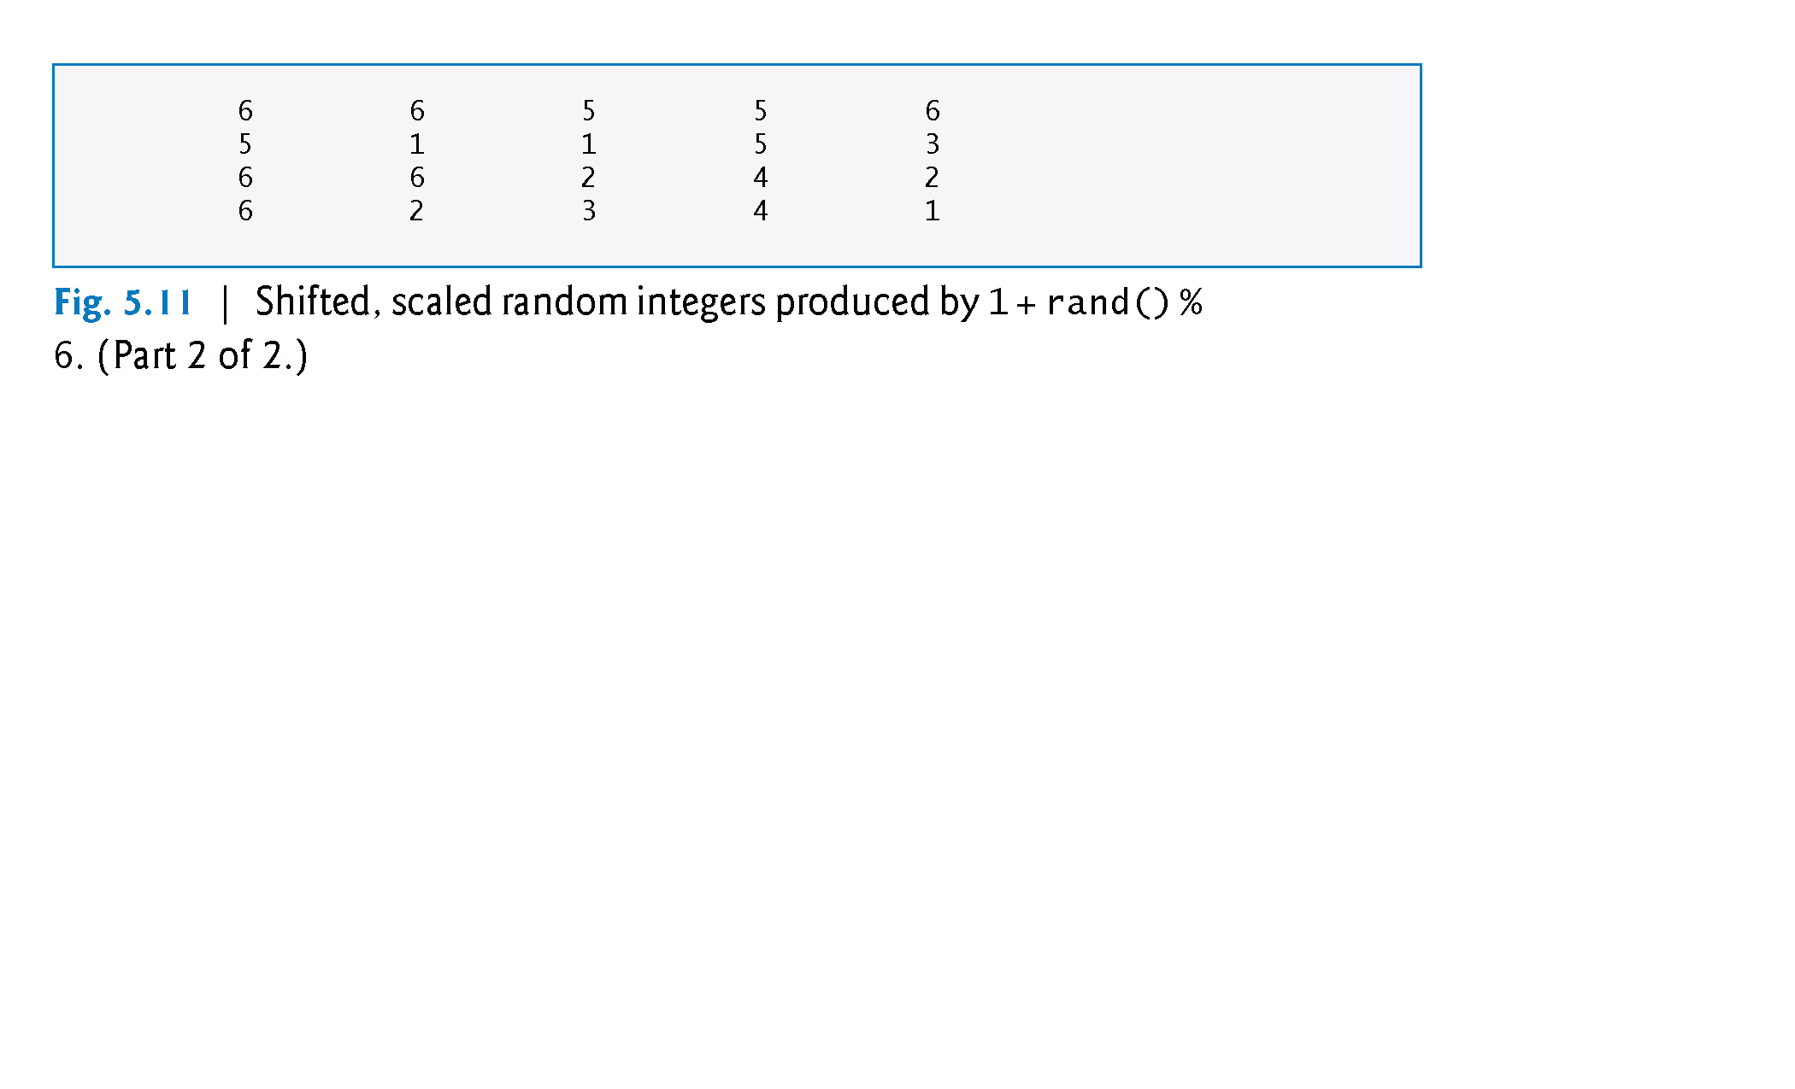
©1992-2013 by Pearson Education, Inc. All Rights Reserved.

Slide 8
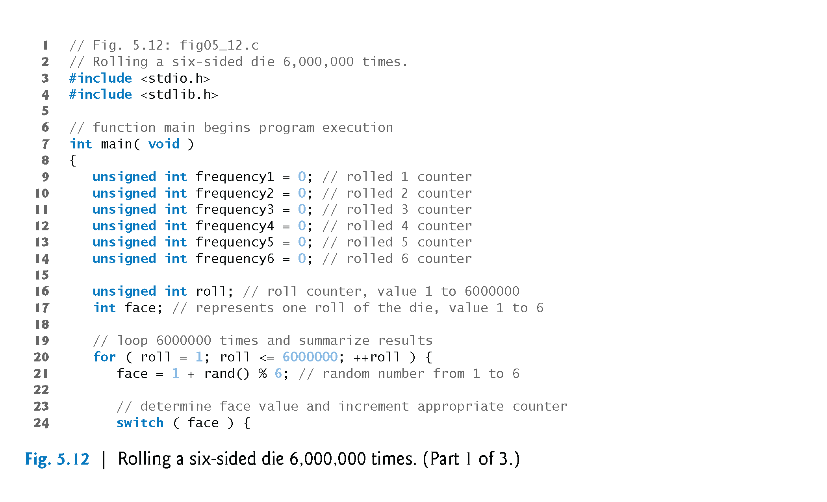
©1992-2013 by Pearson Education, Inc. All Rights Reserved.

Slide 9
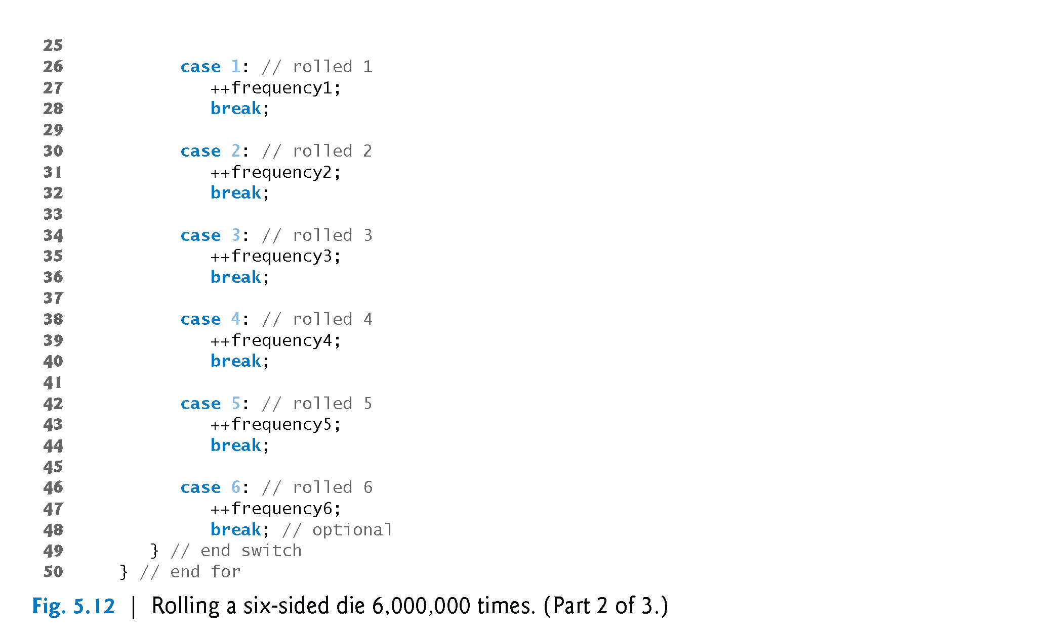
©1992-2013 by Pearson Education, Inc. All Rights Reserved.

Slide 10
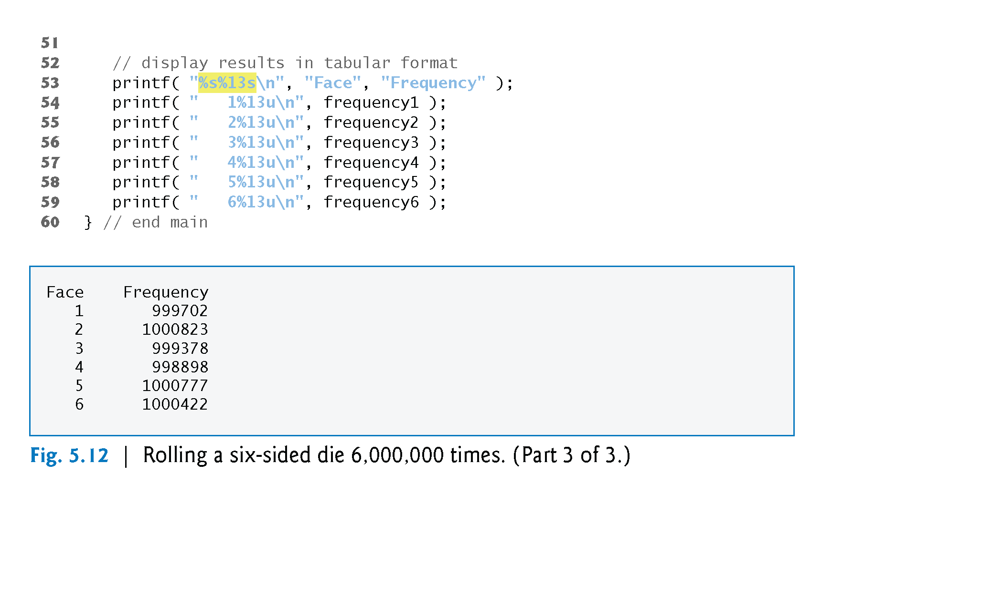
©1992-2013 by Pearson Education, Inc. All Rights Reserved.

Slide 11

©1992-2013 by Pearson Education, Inc. All Rights Reserved.

Slide 12
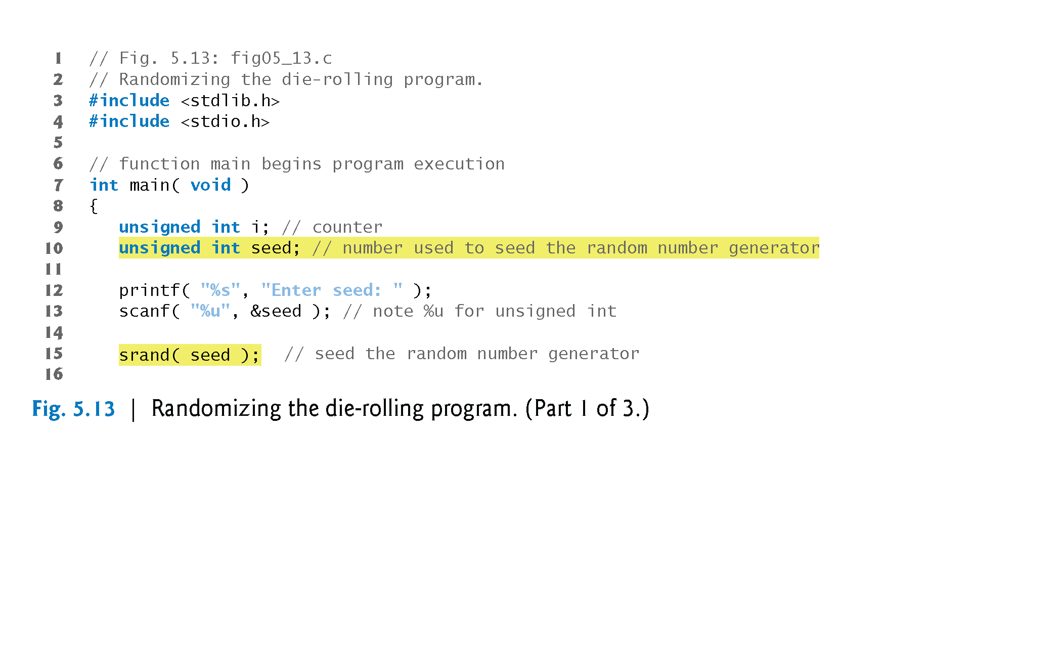
©1992-2013 by Pearson Education, Inc. All Rights Reserved.

Slide 13
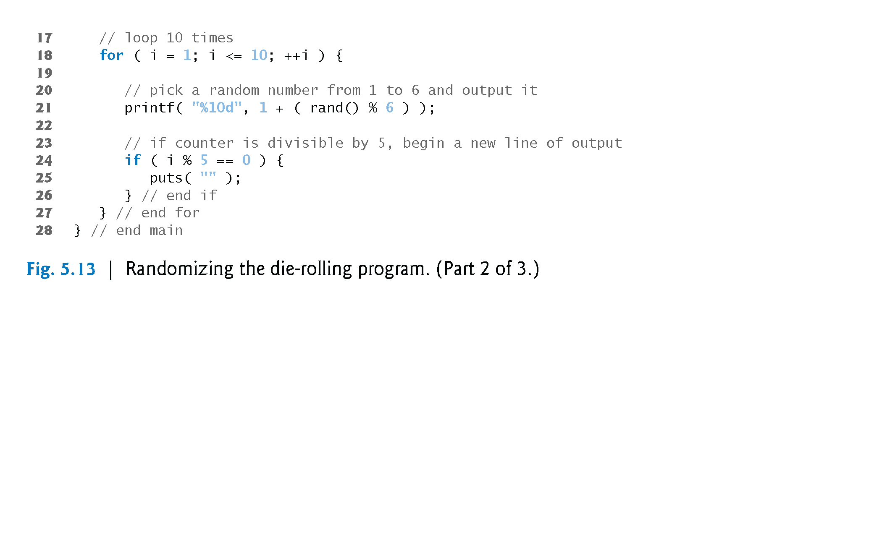
©1992-2013 by Pearson Education, Inc. All Rights Reserved.

Slide 14
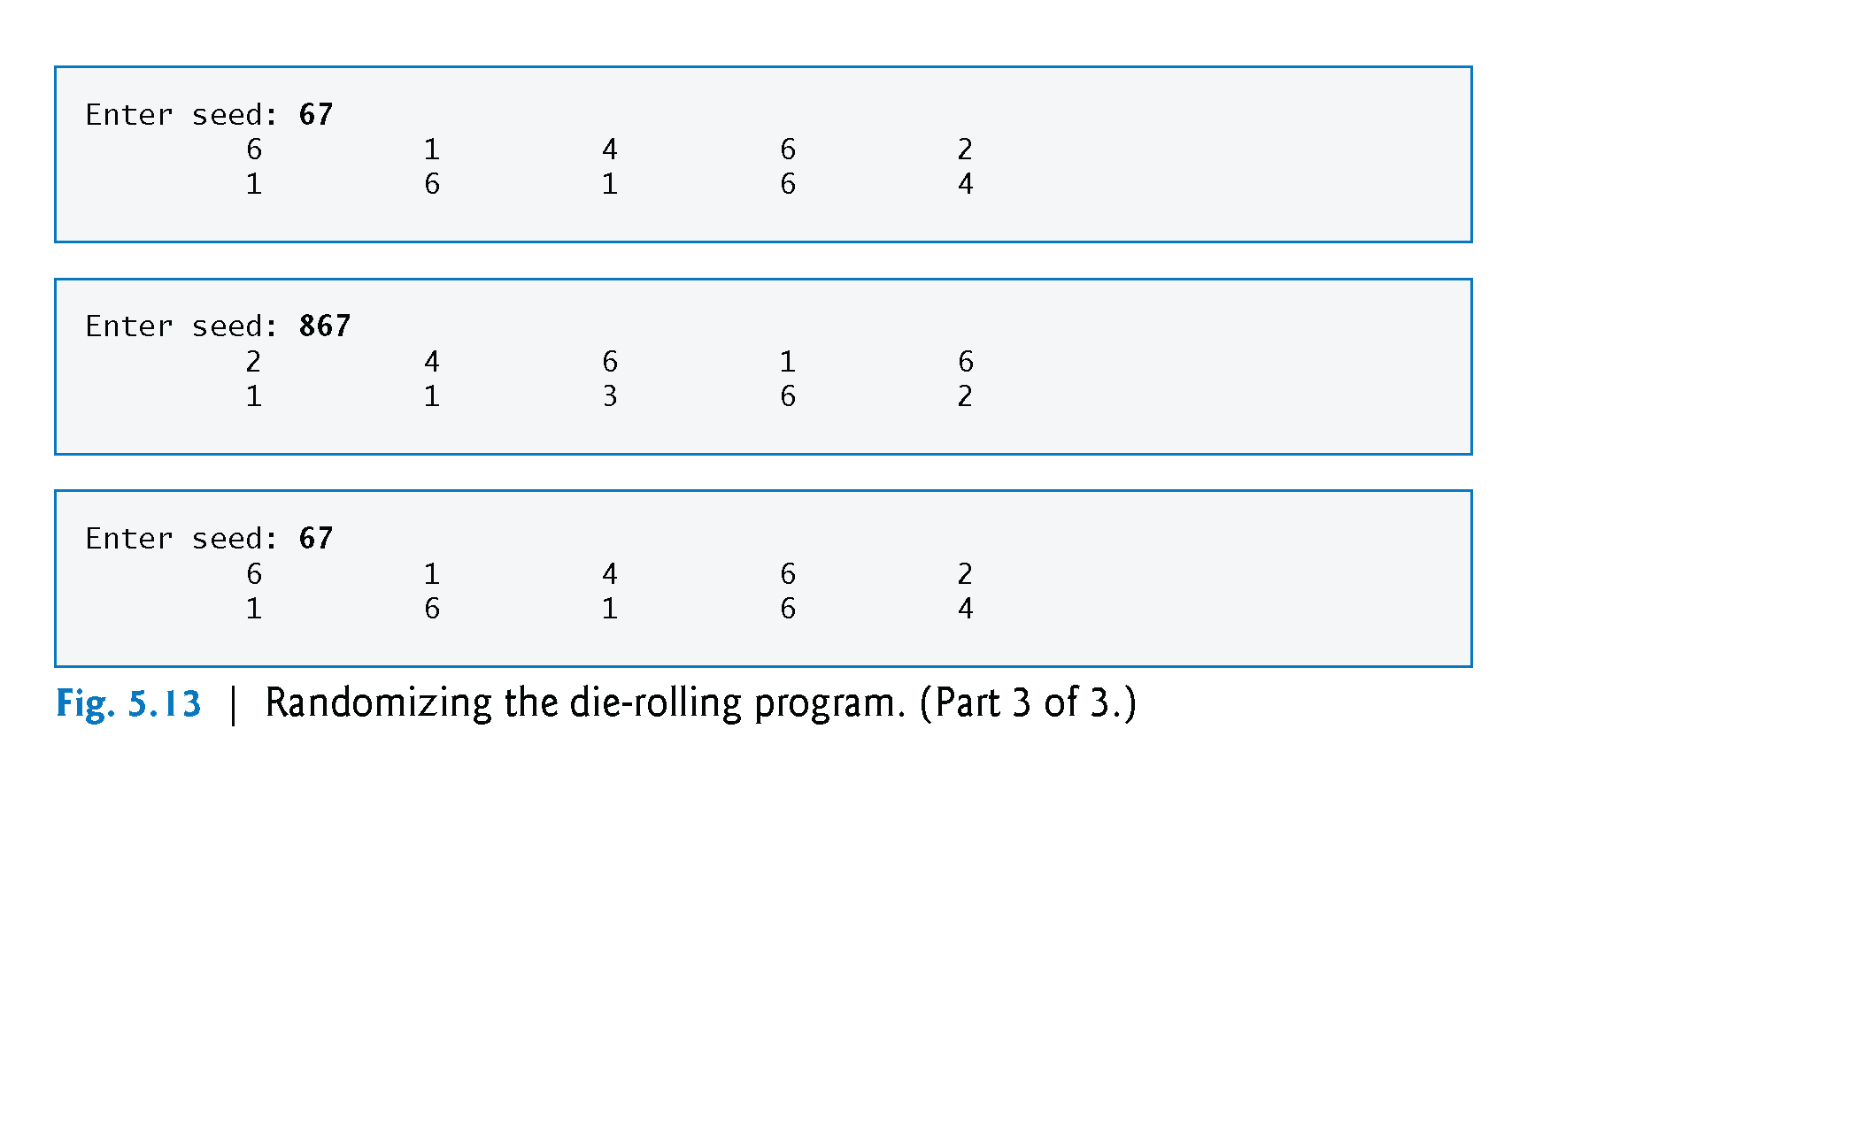
©1992-2013 by Pearson Education, Inc. All Rights Reserved.

Slide 15
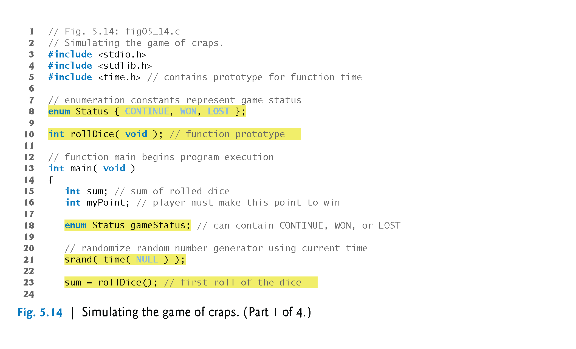
©1992-2013 by Pearson Education, Inc. All Rights Reserved.

Slide 16
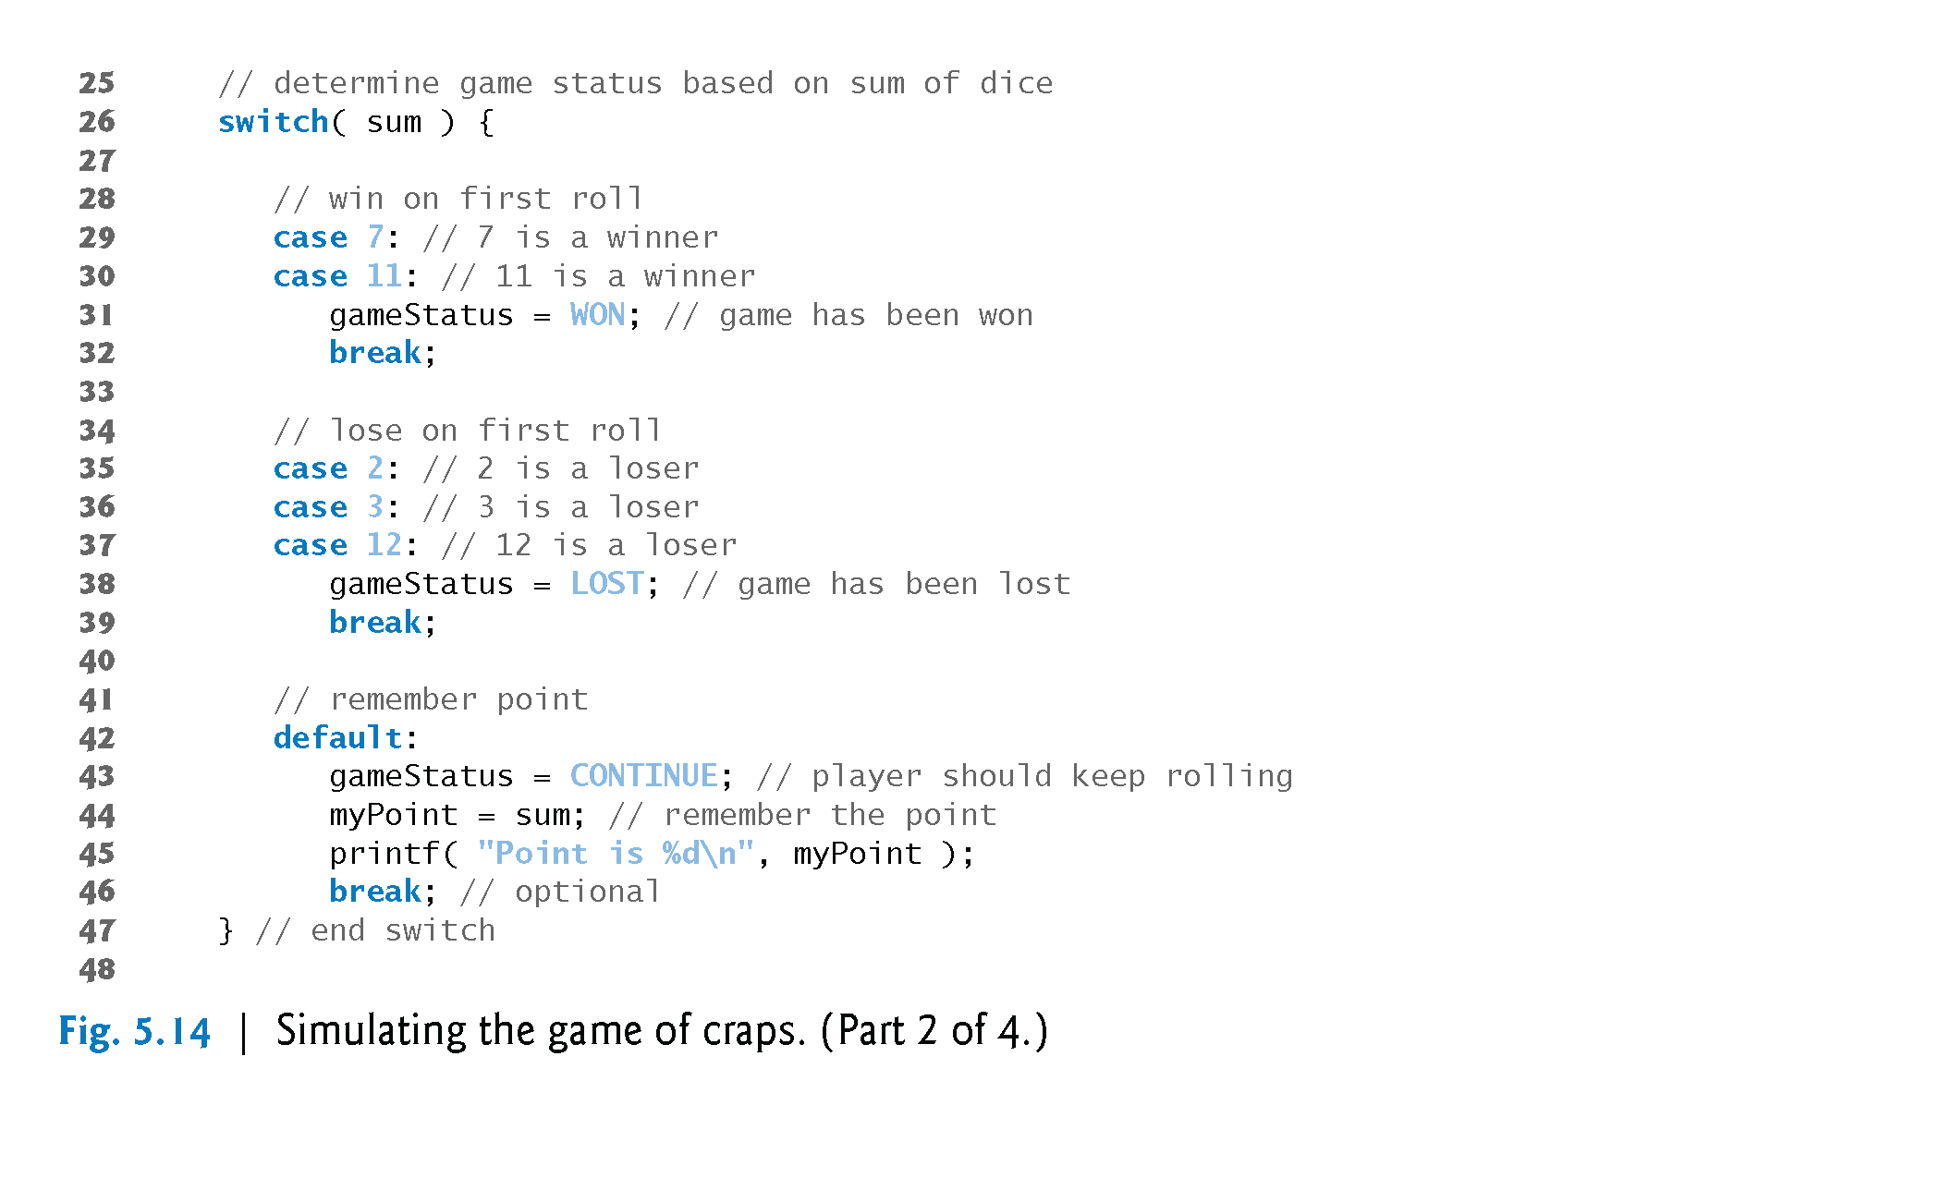
©1992-2013 by Pearson Education, Inc. All Rights Reserved.

Slide 17
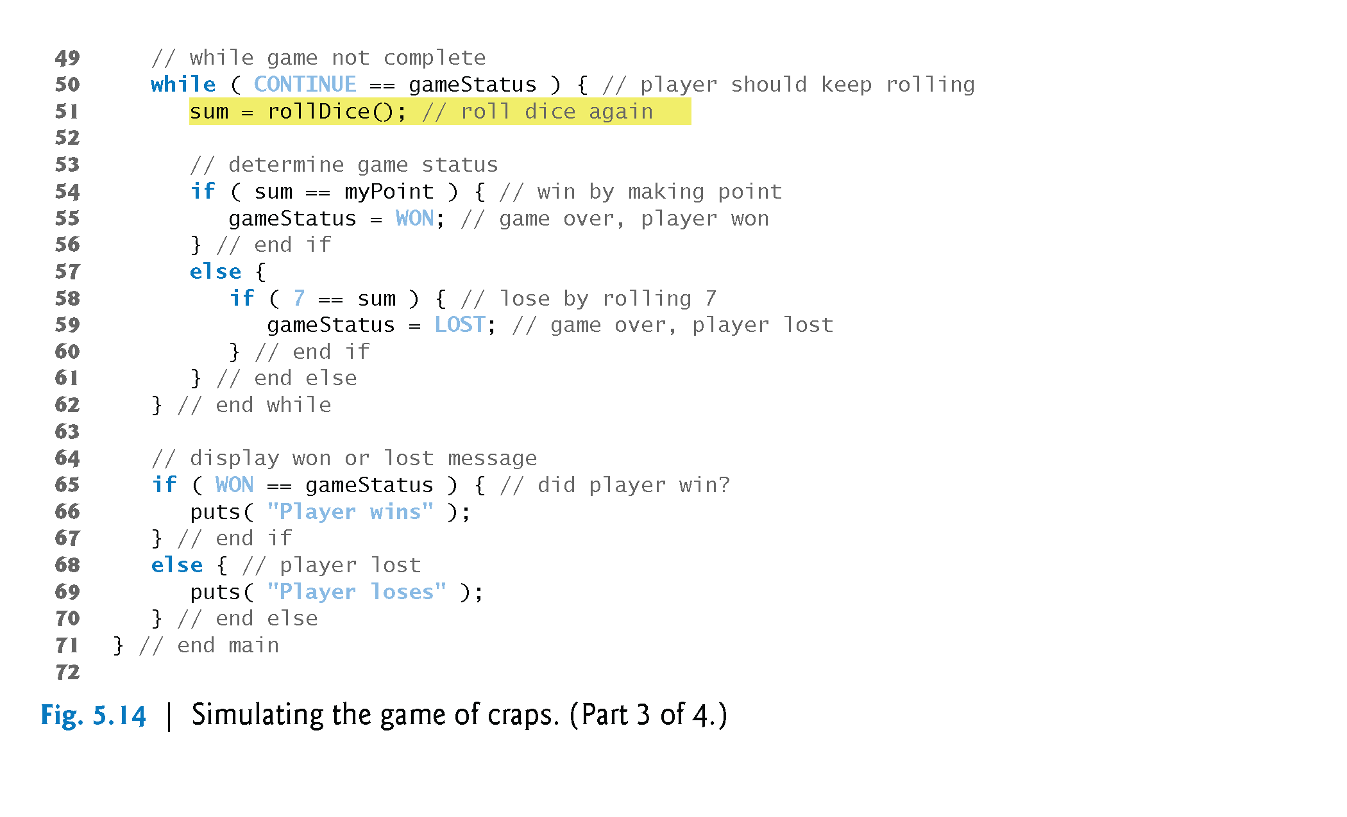
©1992-2013 by Pearson Education, Inc. All Rights Reserved.

Slide 18
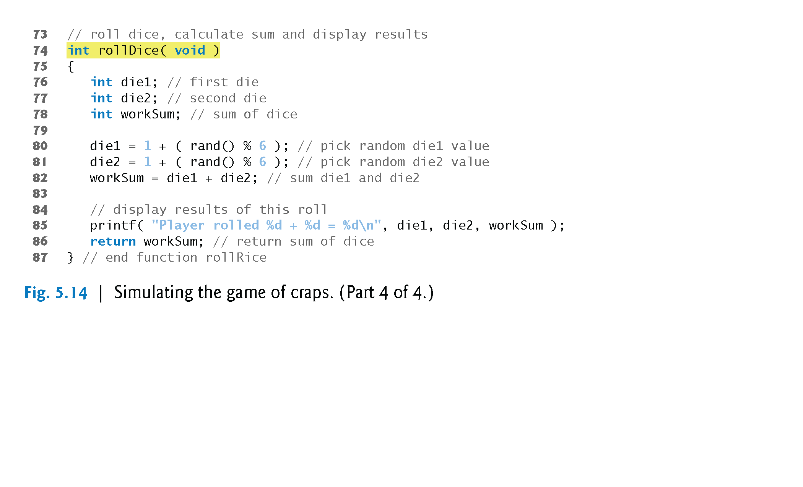
©1992-2013 by Pearson Education, Inc. All Rights Reserved.

Slide 19
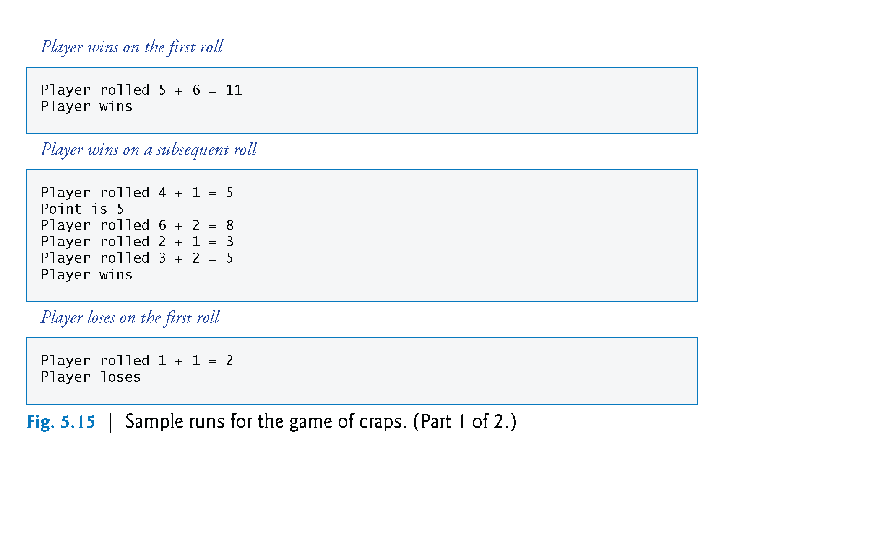
©1992-2013 by Pearson Education, Inc. All Rights Reserved.

Slide 20
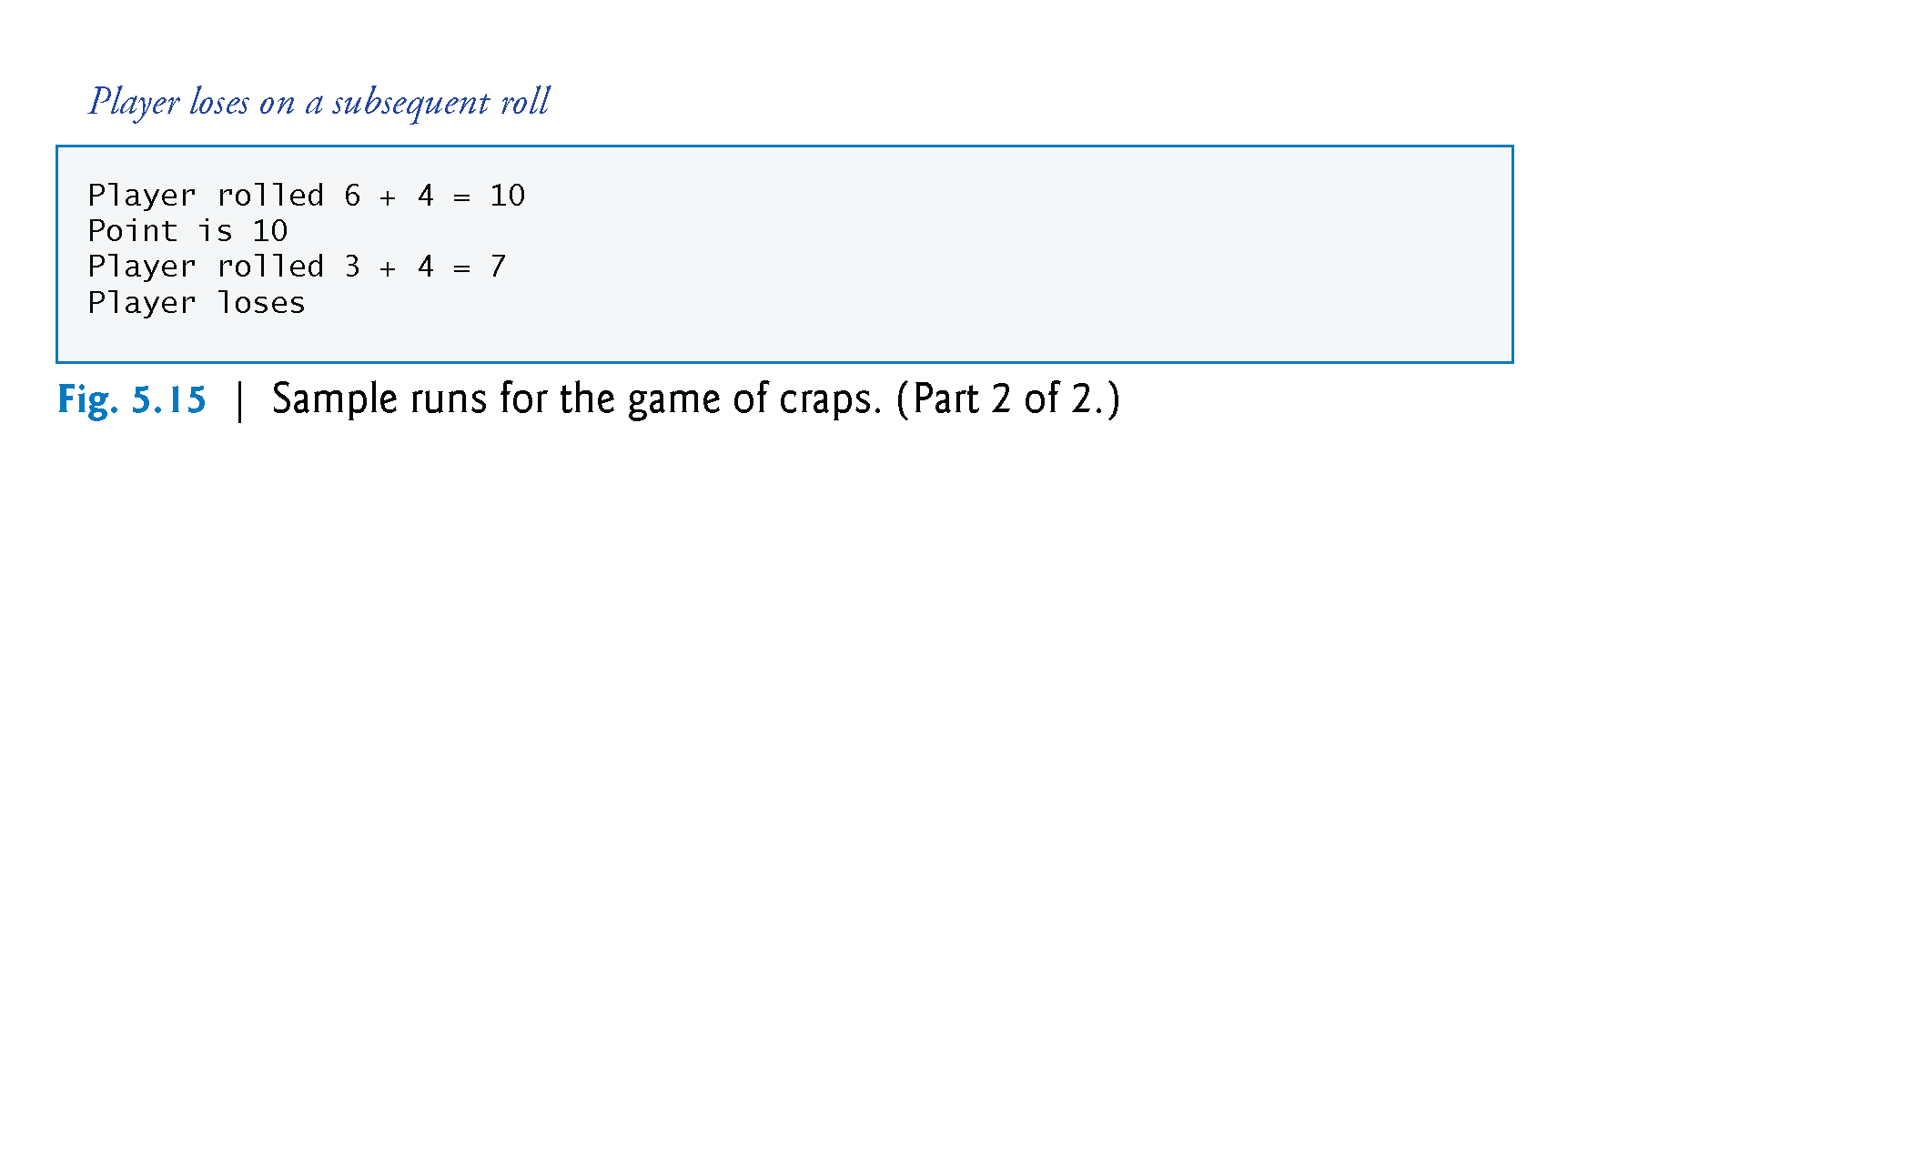
©1992-2013 by Pearson Education, Inc. All Rights Reserved.

Slide 21
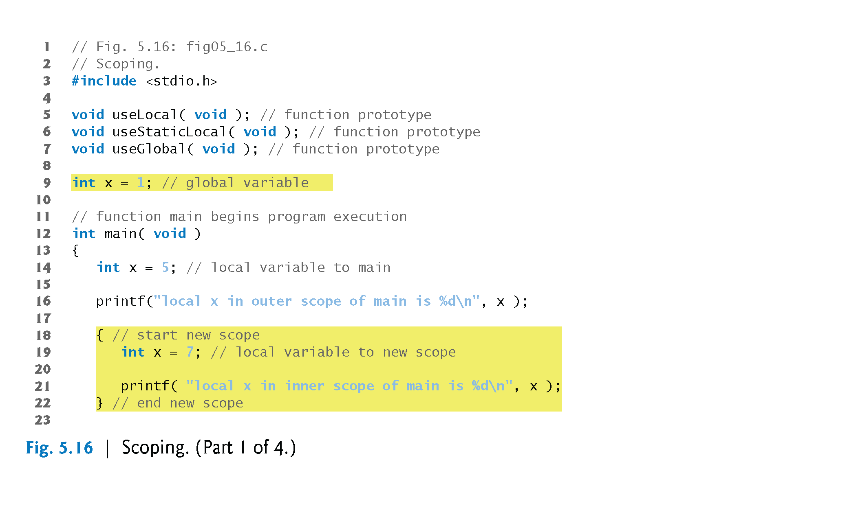
©1992-2013 by Pearson Education, Inc. All Rights Reserved.

Slide 22
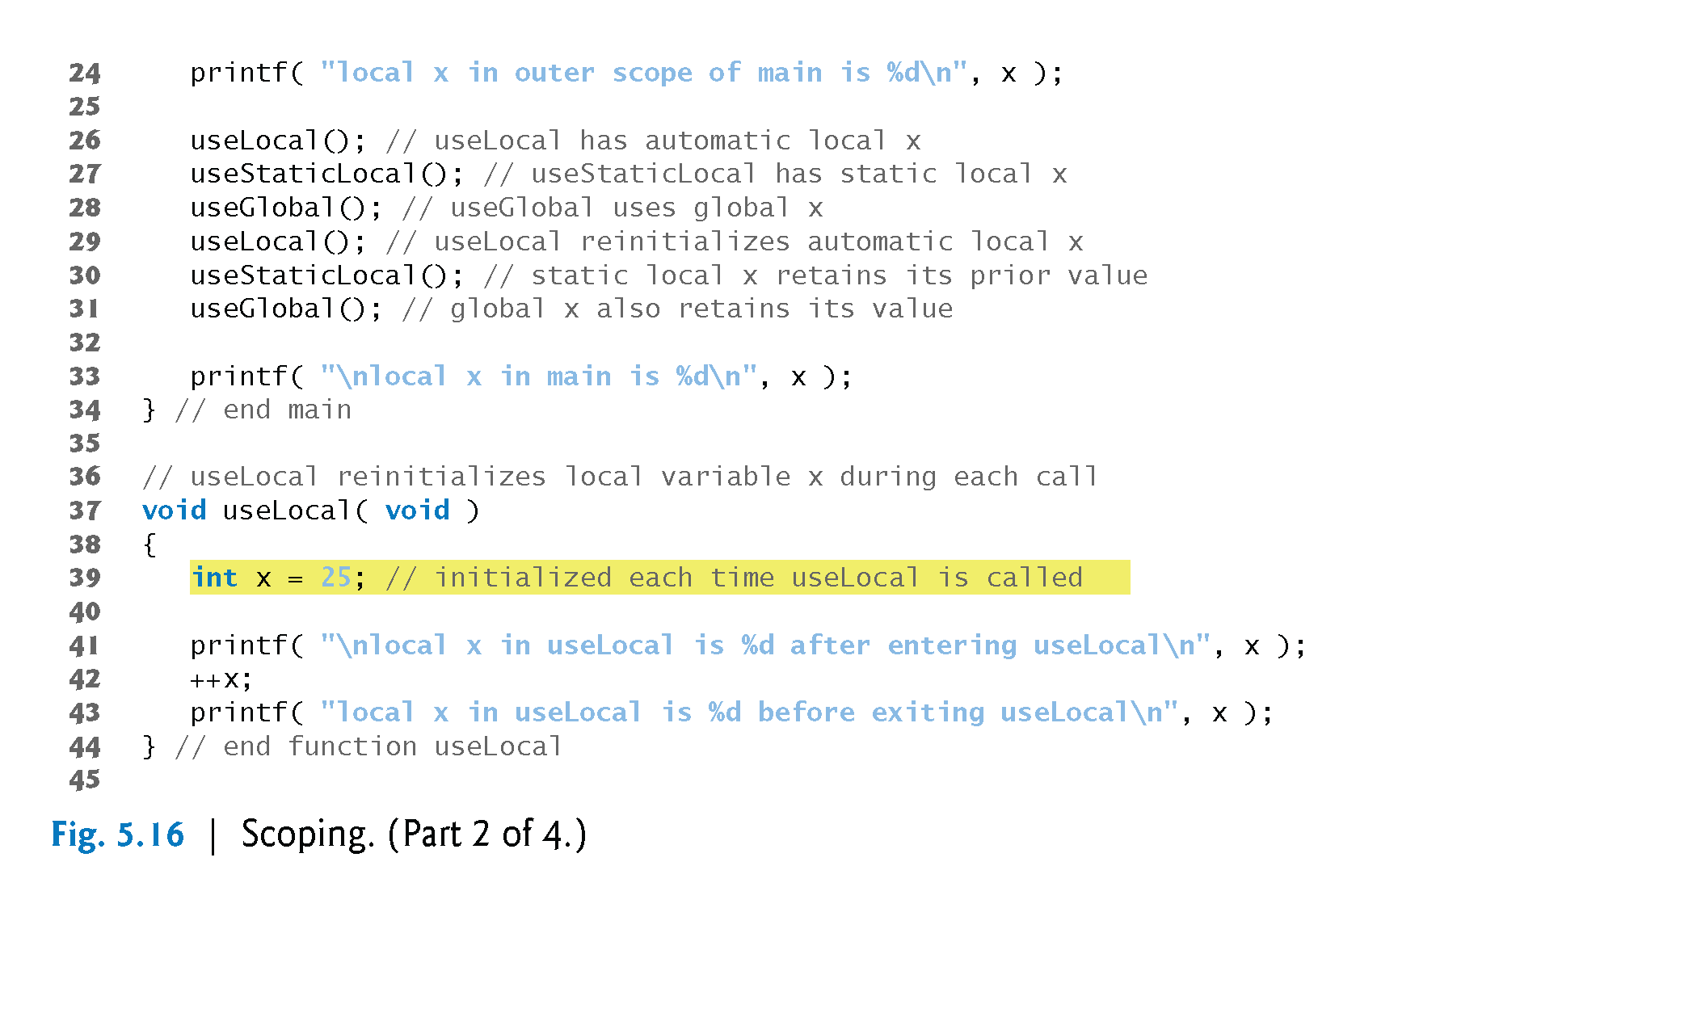
©1992-2013 by Pearson Education, Inc. All Rights Reserved.

Slide 23
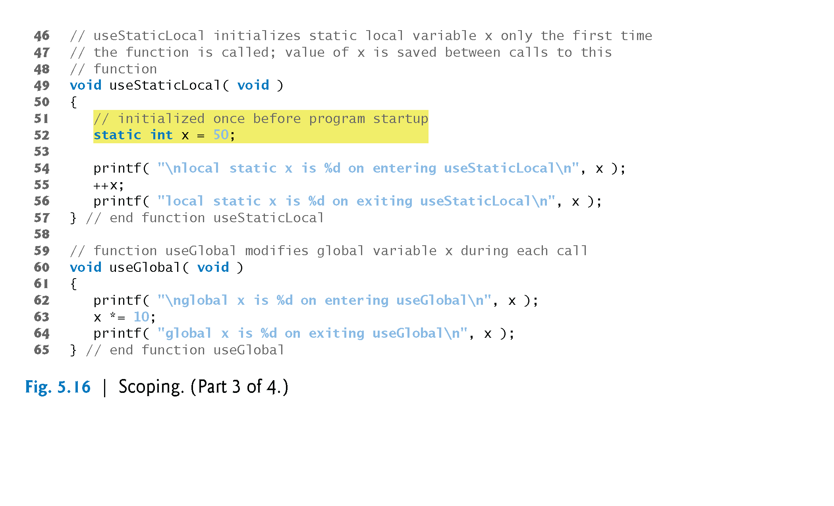
©1992-2013 by Pearson Education, Inc. All Rights Reserved.

Slide 24
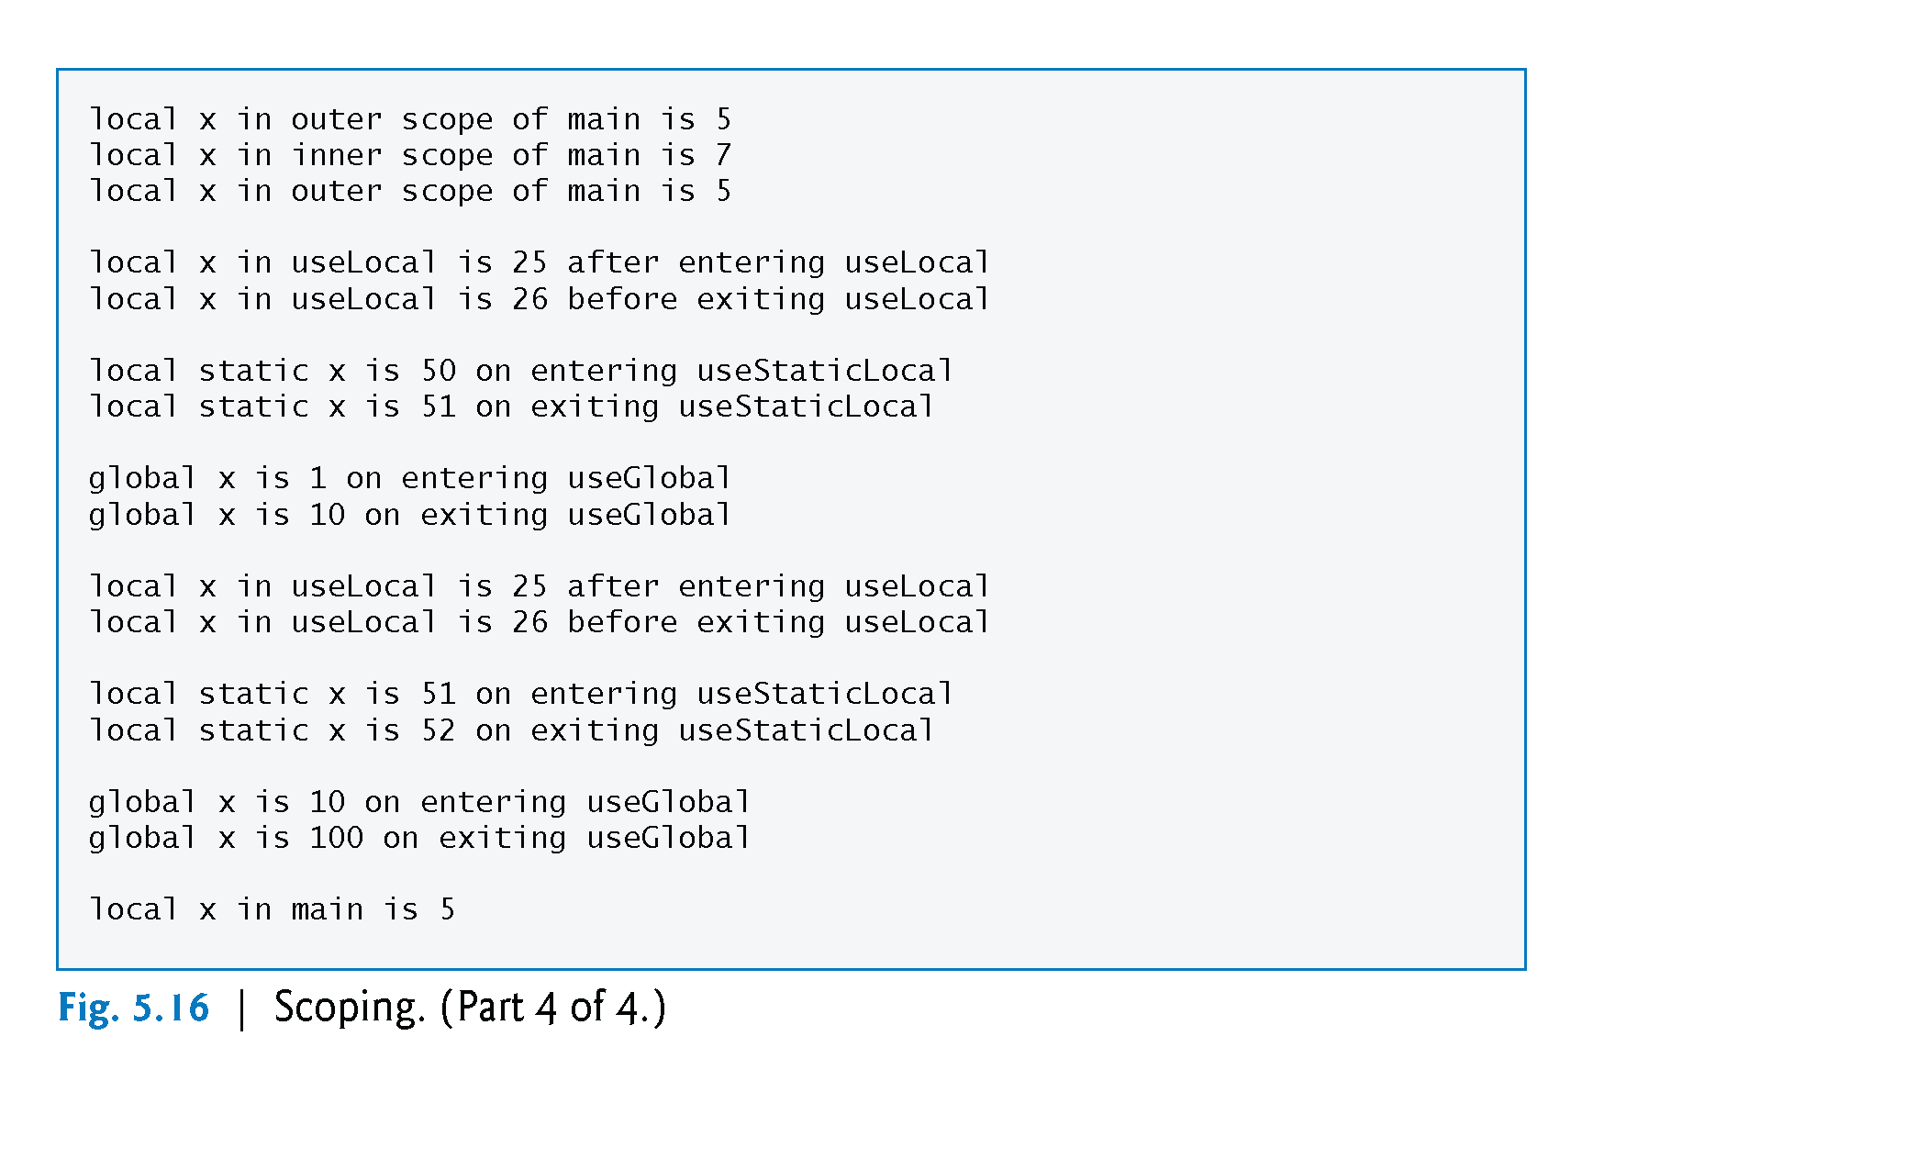
©1992-2013 by Pearson Education, Inc. All Rights Reserved.

Slide 25
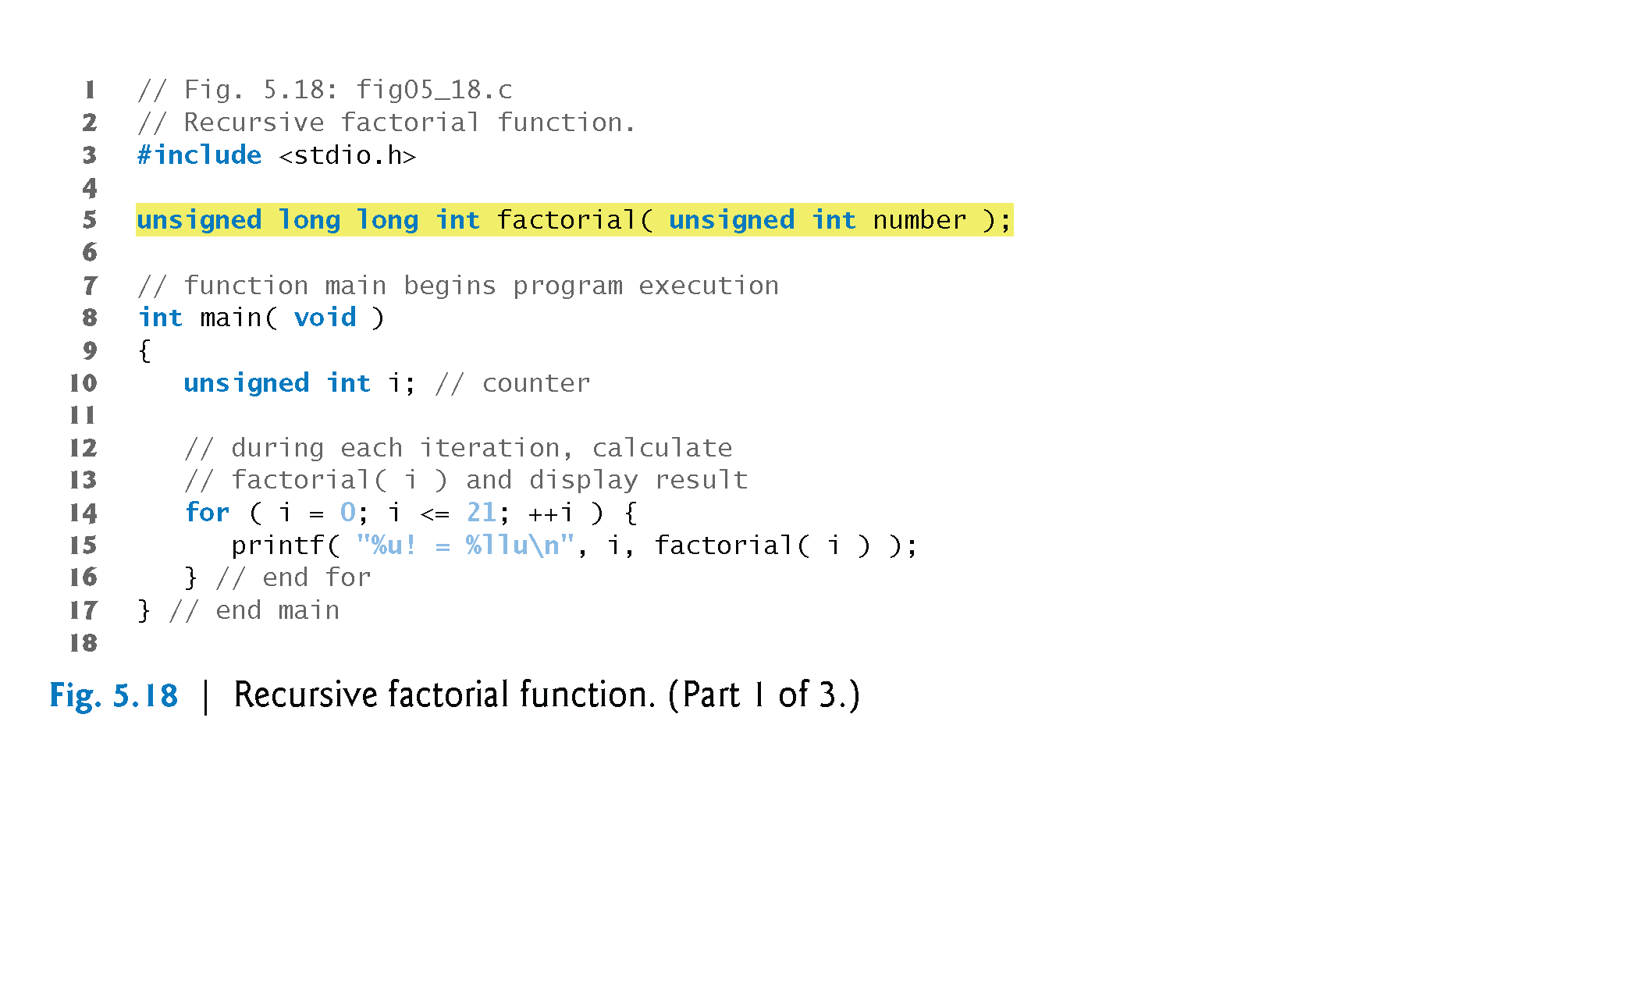
©1992-2013 by Pearson Education, Inc. All Rights Reserved.

Slide 26
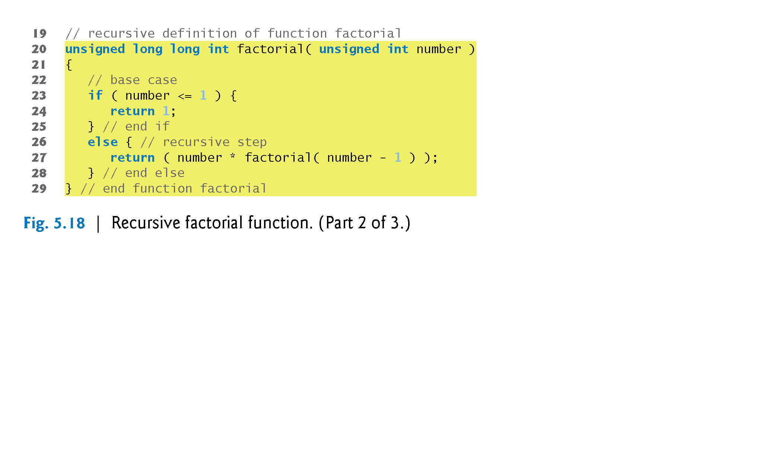
©1992-2013 by Pearson Education, Inc. All Rights Reserved.

Slide 27
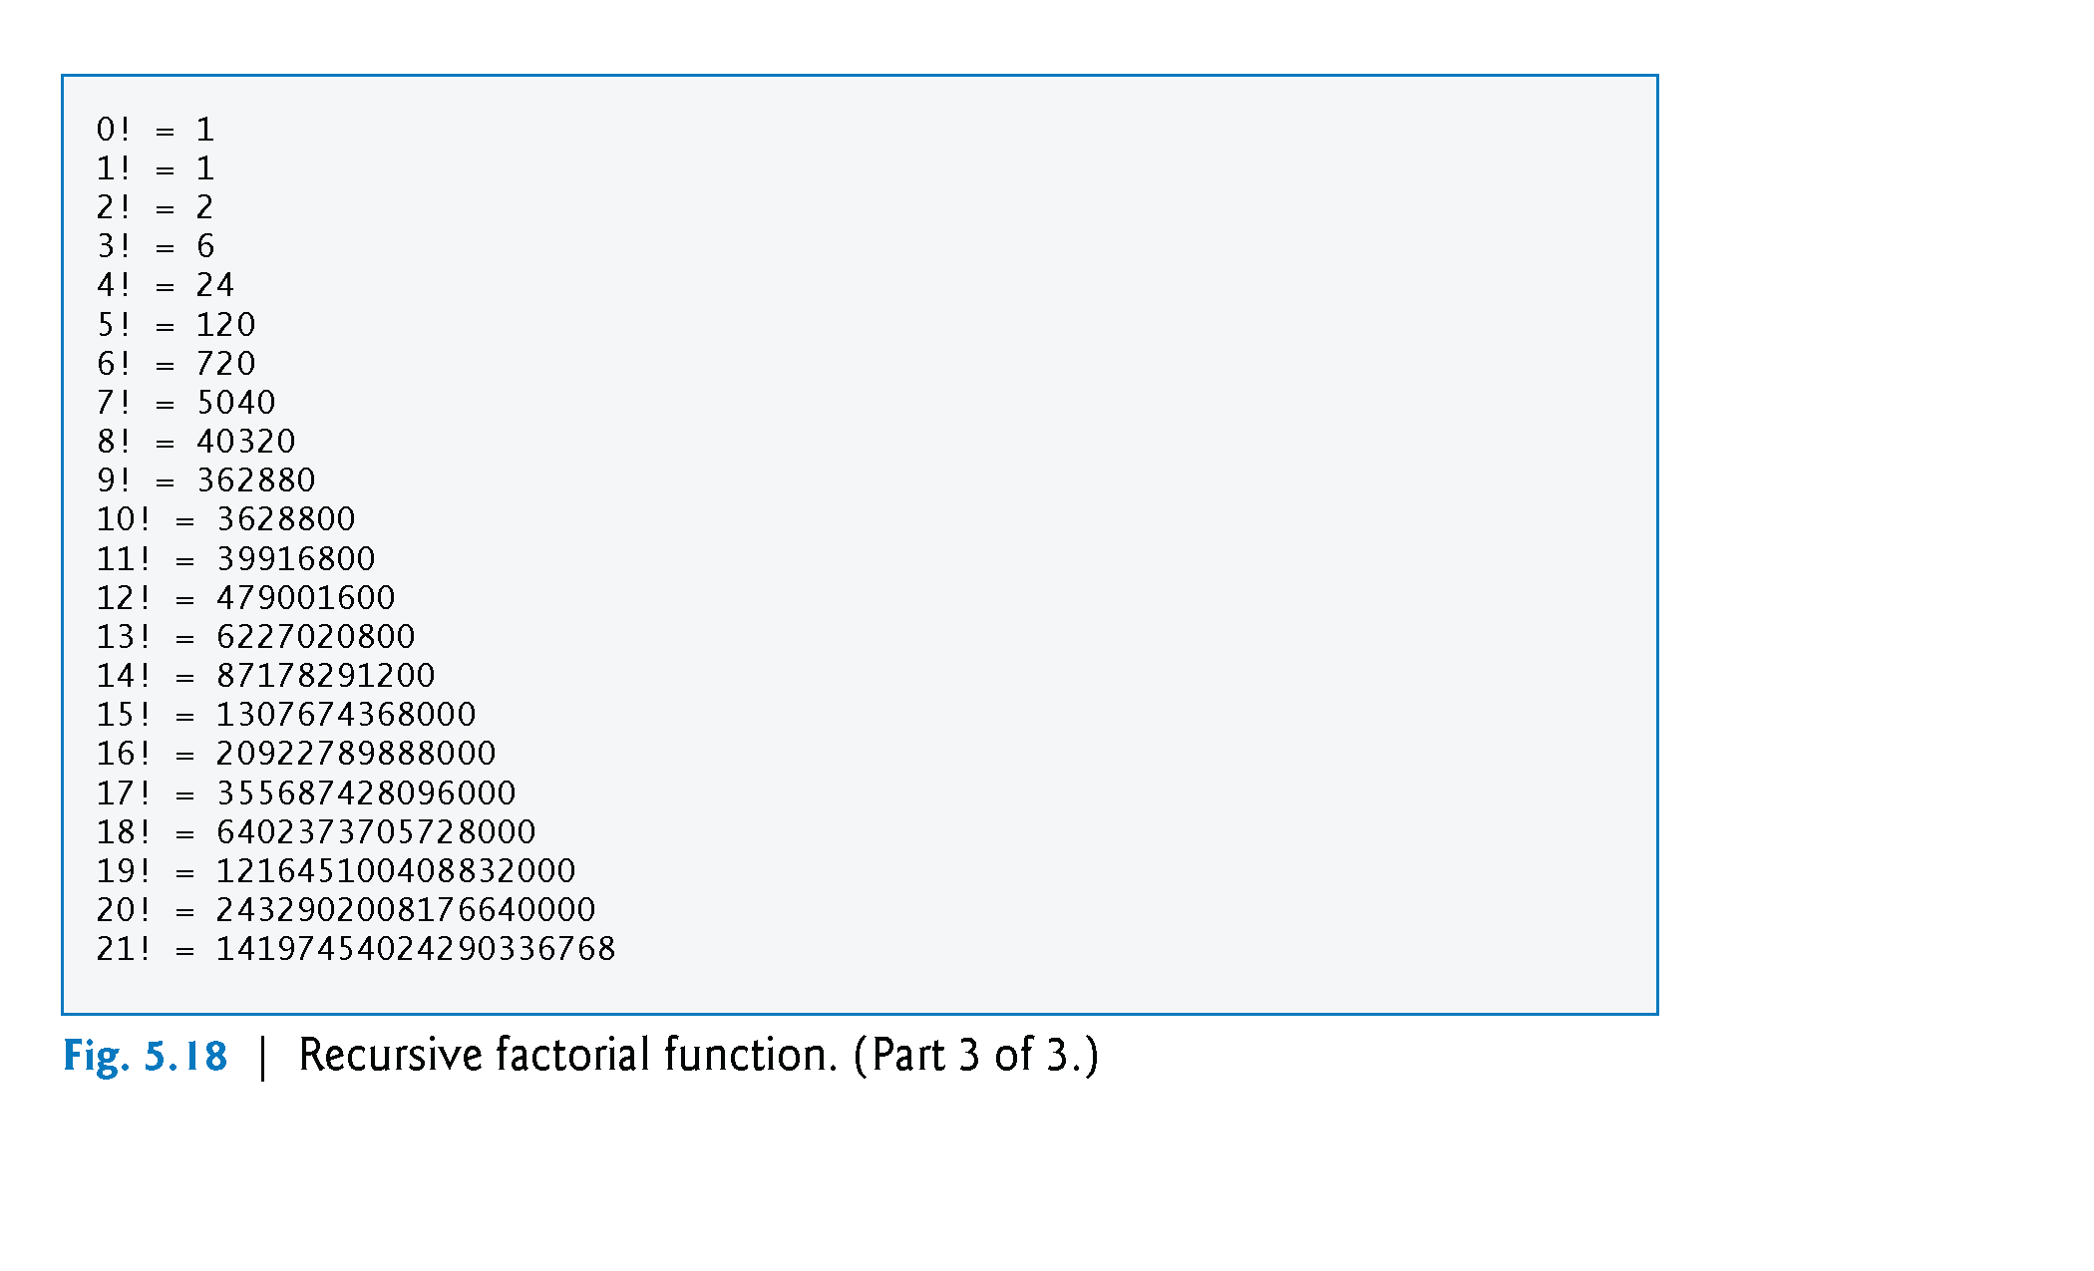
©1992-2013 by Pearson Education, Inc. All Rights Reserved.

Slide 28
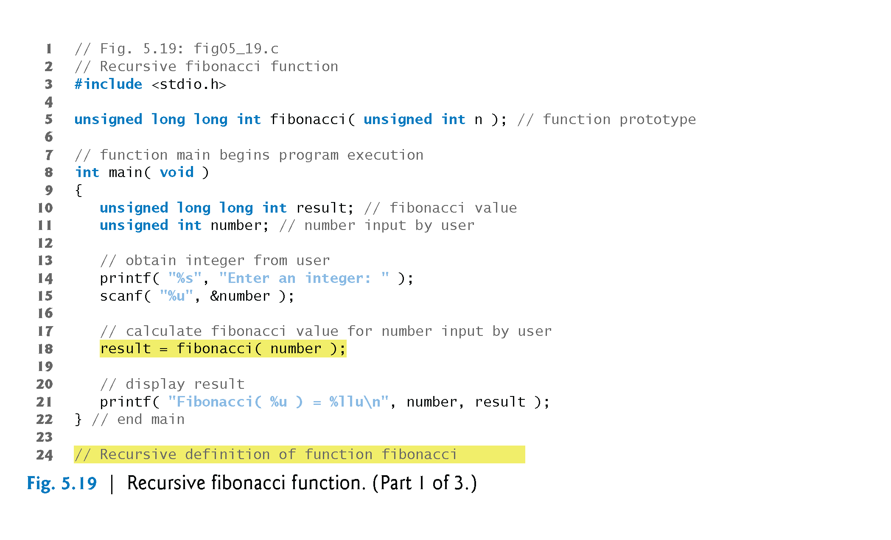
©1992-2013 by Pearson Education, Inc. All Rights Reserved.

Slide 29
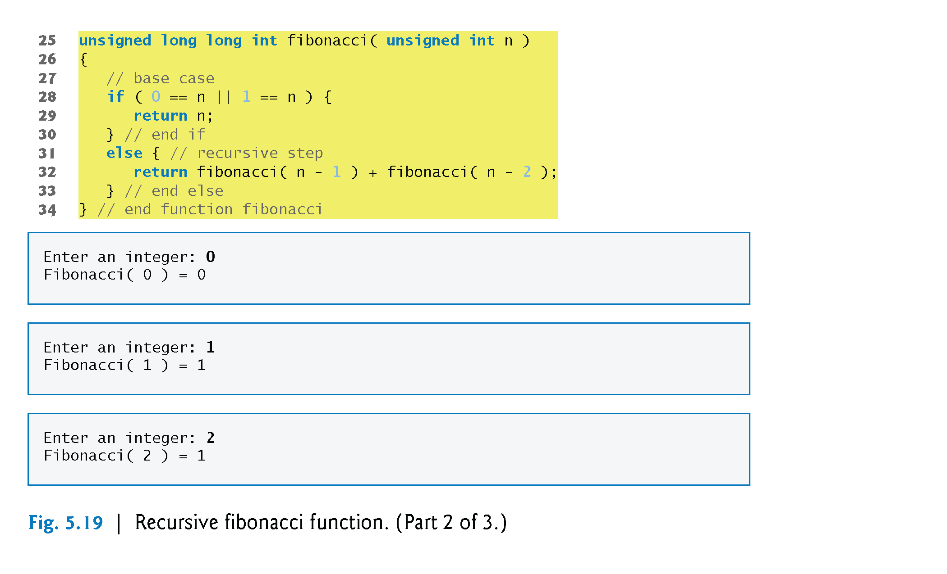
©1992-2013 by Pearson Education, Inc. All Rights Reserved.

Slide 30
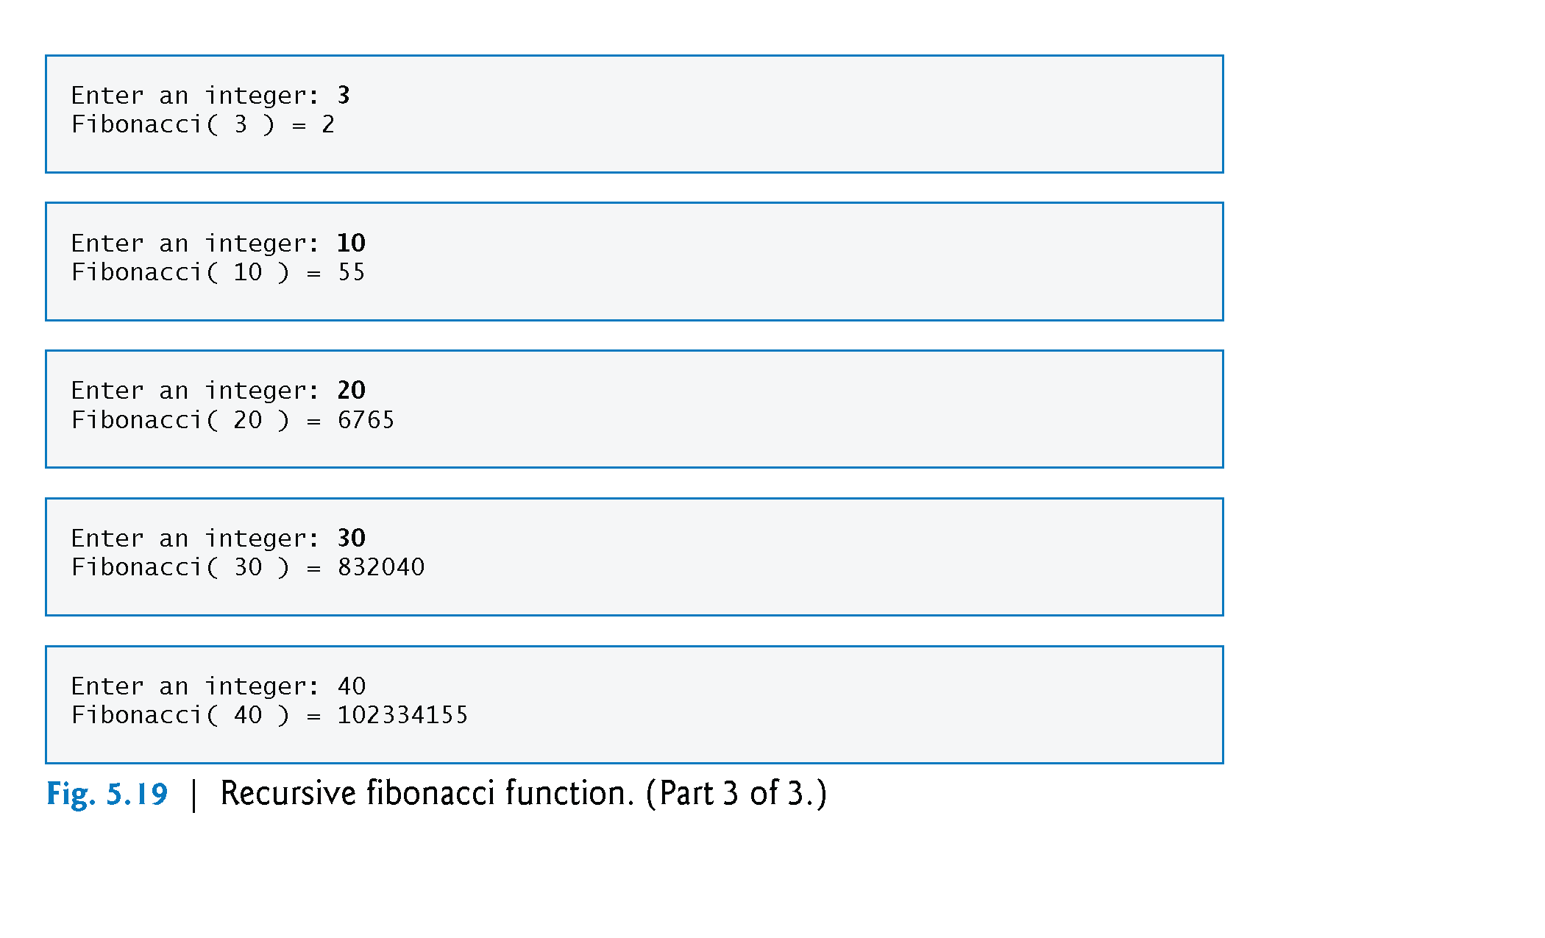
©1992-2013 by Pearson Education, Inc. All Rights Reserved.

