Slide 1


Engineering human-centred intelligence
PRAVERSE TECH PVT LTD
ENTERPRISE AI · HEALTHCARE · PHARMA · PHOTONICS
Enterprise AI for healthcare, pharma and regulated industries — and the high-speed interconnect layer for India's sovereign AI data centres.
praversetech.com · inquiry@praversetech.com · +91 93132 47264 · Vadodara, Gujarat, India
Notes:
Opening. Praverse Tech is an India-based enterprise AI company. Two things to land in the first 30 seconds: we build AI systems that survive real, regulated workflows with experts in the loop, and we are now building the physical connectivity layer for India's sovereign AI data centres.

Slide 2




One company, four focused business lines
AT A GLANCE
2023
Vadodara
2026
1
Idea began
Headquarters · Gujarat, India
Praverse Tech Pvt Ltd incorporated
Healthcare product in development (MENNIE)
NEW
Enterprise AI & Agents
Pharma & Regulatory AI
Healthcare AI
Photonics & AI Data Centres
Agents, copilots, RAG search and production ML that live inside real workflows.
FDA 483 responses, CAPA, data integrity and inspection readiness — every output expert-reviewed.
MENNIE, our voice-first patient assistant, plus imaging and screening support.
High-speed copper and optical interconnect for India's sovereign AI data centres, with our USA technology partner.
Agents · RAG · MLOps
GMP · 21 CFR 211 · ICH
MENNIE · Imaging · Edge AI
800G · 1.6T · India partner
Notes:
Snapshot. Four business lines, not eight. The first three are AI software; the fourth is the photonics and AI data-centre infrastructure line, built with our USA technology partner. Lead with whichever line matches the audience.

Slide 3
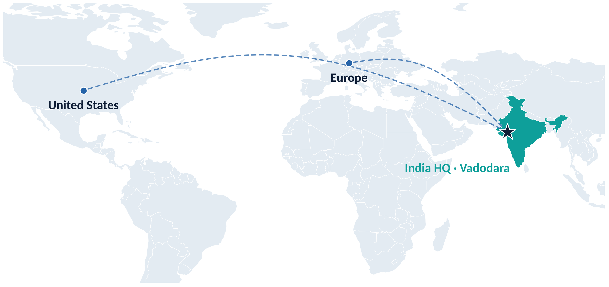




Built in India. Delivered to India, the US and Europe
WHERE WE WORK
Headquarters
Vadodara, Gujarat, India
Markets
India · United States · Europe
Technology partner
Our USA technology partner — interconnect
Pharma advisory
SWATI Spentose · V-Group, est. 1952
India-first engineering, built to global standards for domestic and export markets.
Notes:
Footprint. Engineering is in India; clients and partners span India, the US and Europe. Refer to our USA technology partner for the photonics line, and SWATI Spentose as the pharma advisory backbone.

Slide 4


Most enterprise AI stalls between the demo and the workflow
WHY WE EXIST
Where AI usually stalls
How we build instead
The model works in a notebook — and nowhere else
We learn the workflow before we design the system
No evidence trail, so regulated teams cannot sign off
Every output links to the source it came from
Built without domain experts, so it answers the wrong question
Human review is designed in, not bolted on
Black-box outputs that teams must trust, not verify
Audit trails by default: who asked, what surfaced, who decided
No plan for monitoring, drift or changing data
Production deployment with monitoring from day one
Notes:
The problem. In healthcare and pharma the blocker is rarely model accuracy. It is evidence, oversight, traceability and workflow fit. That gap is why Praverse exists.

Slide 5



AI should not replace experts. It should amplify them
OPERATING PRINCIPLE
“
Evidence-based review
Every suggestion links to the document, record or observation it came from. No invented answers.
The system drafts. Your team decides.
Audit trails by default
Who asked, what the system surfaced and what the expert decided — captured for every interaction.
That hierarchy is not a policy layered on top of the architecture — it is the architecture.
Expert judgment first
The system analyses, drafts and flags. Qualified people approve. High-stakes decisions stay in human hands.
Notes:
Say it plainly: the system drafts, analyses and flags; your experts decide. This principle runs through every product, from pharma to MENNIE.

Slide 6




Enterprise AI systems, not demos
ENTERPRISE AI · CORE CAPABILITIES
What clients hire us to design, build and run in production.
Machine learning & applied AI
AI agents & copilots
Document intelligence
Full ML lifecycle — model design to monitored production, with MLOps built in.
Domain agents that analyse documents, write reports, search knowledge and automate steps.
RAG and knowledge systems that turn unstructured files into sourced answers.
NLP · Predictive ML · MLOps
Agents · Copilots · Automation
RAG · Knowledge graphs · Search
Vision & medical imaging
Decision intelligence
Federated & edge AI
Computer vision for fundus and ultrasound imaging, inspection and multimodal systems.
Dashboards and predictive decision support that give teams clear, explainable answers.
Privacy-preserving training and on-site inference where data cannot leave its home.
Vision · Imaging · Multimodal
Dashboards · Forecasting
Federated · Edge · DPDP-aware
Notes:
Six capability areas a client can actually buy. Use this as the menu, then go deep on the one that matches the client's problem.

Slide 7


Agents that do the work — with an expert in the loop
ENTERPRISE AI · AGENTS
Every consequential step is reviewed, traceable and reversible.
Your data & documents
Praverse agent
Expert review
Action & audit trail
SOPs, records, tickets, drives, databases
Retrieves, reasons across tools and drafts
Your team checks, edits and approves
Report, decision or update — fully logged
01
02
03
04
Document review agents
Regulatory & research agents
Data analysis agents
Knowledge search agents
Parse, classify and cross-reference thousands of pages, with evidence attached.
483 response drafting, guidance tracking and compliance support.
Ask enterprise data questions in plain English; get explainable answers and charts.
One question across wikis, drives, tickets and archives — one grounded answer.
Notes:
The agent era. Four agent types a client can buy today. The flow on top is the point: the expert-review step is built into the architecture.

Slide 8
Quality systems, with a second brain
PHARMA & REGULATORY INTELLIGENCE
In a GMP environment, a wrong answer from an AI system is worse than no answer at all.
Evidence-linked
Each suggestion cites its source observation or record.
So every observation maps to evidence, every CAPA draft traces back to its source document, and every output is a starting point for qualified expert judgment — never a substitute for it.
Inspection-ready trail
Full interaction history captured automatically.
DESIGNED AROUND
Approved by QA
USFDA 21 CFR 211
ICH Q9
ICH Q10
ALCOA+
Quality professionals sign off every output before use.
Notes:
Pharma is our deepest domain, backed by three decades of specialty-pharma advisory. The non-negotiable constraint: a wrong AI answer in GMP is worse than none.

Slide 9







Eight modules for the quality system
PHARMA AI SUITE
Each output is traceable, reviewable and grounded in evidence.
FDA 483 response assist
OOS / OOT analysis
Data integrity review
Document intelligence
Faster, evidence-backed drafts using enforcement-trend patterns.
Speeds up root-cause analysis for out-of-spec and out-of-trend results.
Checks records against ALCOA+ and flags possible anomalies.
SOP drafting, search and gap detection across the quality system.
CAPA reasoning
Quality risk management
Human error investigation
Inspection readiness
Structured root cause and corrective-action drafts with evidence trails.
Risk signals across deviations, OOS, complaints and recalls.
Separates systemic causes from individual ones.
Continuous readiness scoring, so audits stop being a crisis.
Highlighted: the usual entry points.
Notes:
Walk through only the two or three modules that match the prospect's pain. 483 responses and inspection readiness are the usual entry points.

Slide 10




Five stages, fully traceable
HOW IT WORKS
Every AI interaction in a regulated environment follows the same pipeline.
01 Ingest
02 Analyse
03 Draft
04 Review
05 Archive
Documents and records enter with full provenance tracking.
AI finds patterns, flags deviations and maps observations to frameworks.
Evidence-grounded responses, CAPA plans or SOP content.
Qualified people review, edit and approve every output.
Approved outputs stored with a full audit trail.
All AI outputs are drafts that need final review by qualified personnel. No diagnosis, compliance guarantee or automated decision-making is implied.
Notes:
Dwell on stage four: qualified personnel review and approve every output before it is used anywhere.

Slide 11
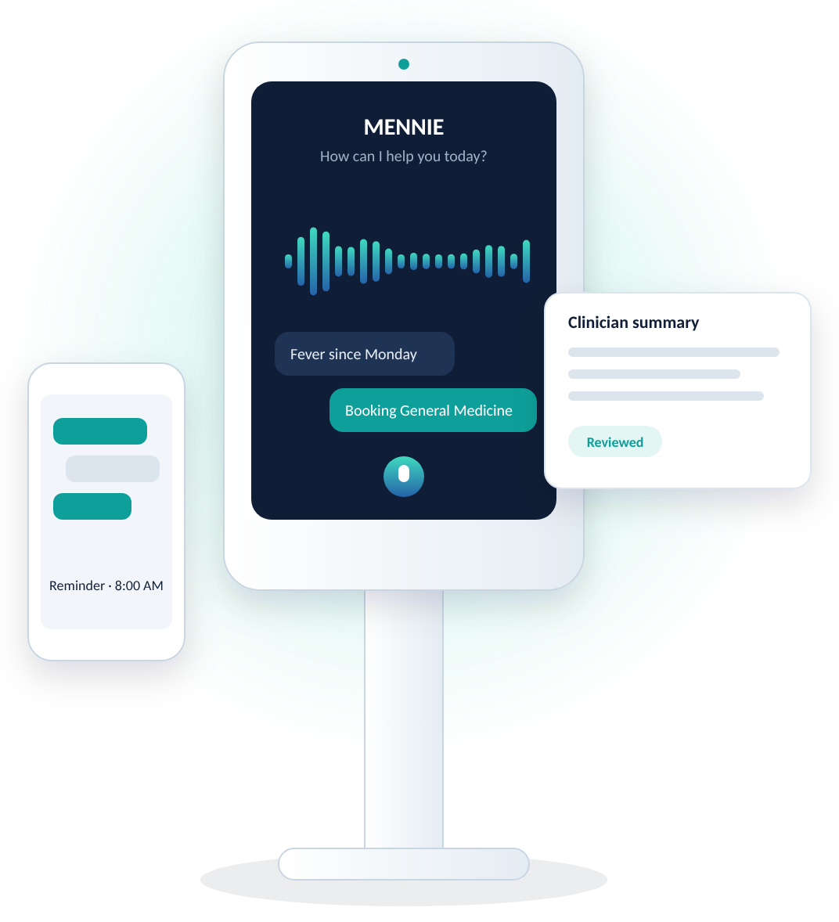




MENNIE: healthcare that listens
FLAGSHIP · HEALTHCARE AI
Medical Empowerment and Neural Navigation Intelligence Engine — a voice-first assistant that meets patients at the door, the kiosk or on their phone, and hands clinicians a clear, structured picture.
Voice-first intake
Doctor matching support
Conversational symptom intake — kiosk, mobile or in person, in multiple languages.
Routes patients to the right specialty and the right appointment.
Smart reminders
Clinician-ready summaries
Medication and follow-up nudges that keep care plans on track.
Consultations start with context, not questions.
MENNIE supports care workflows under clinical oversight. It does not diagnose, treat or replace medical professionals.
Notes:
MENNIE is the flagship healthcare product and is in development. Be explicit: it supports intake, navigation and clinician handoff; it does not diagnose or treat. Make no claim about patents. Illustration is a concept rendering, not a product photo.

Slide 12


A staged path from pilot to institution
MENNIE · DEPLOYMENT
PHASE 1 · Private beta
PHASE 2 · Pilot workflows
PHASE 3 · Institutional rollout
Select healthcare partners; real-world workflow testing under close clinical supervision.
Intake, routing and clinician-handoff pipelines in live settings.
Kiosk deployment, edge inference and multilingual support at operational scale.
Kiosk workflows
Privacy by architecture
Next: assistive robot (R&D)
Self-service intake and navigation stations for hospital lobbies — voice-first and multilingual.
Federated learning and edge inference keep health data on-site, encrypted and auditable (DPDP-aware).
An assistive form factor, tested in digital-twin simulation before any physical use.
Notes:
Rollout is staged, with clinical supervision at every step. Insert real pilot dates and partner names only once they are agreed. The robot form factor is R&D only — do not present it as a product, and make no claim about patents.

Slide 13
Systems we have already built
TRACK RECORD · HEALTHCARE AI
2023
2023
2024
Now
Edge eye screening
DME detection
PCOS screening
MENNIE
A real-time edge AI system for ophthalmic screening in low-resource settings, published at a peer-reviewed conference. Our first deployed healthcare AI.
A convolutional model for detecting and grading diabetic macular edema from fundus images, as screening support for ophthalmologists. Results are reported in the published paper.
Computer vision on ultrasound images plus EHR data to support early PCOS detection.
Voice-first patient assistant for intake, routing and clinician handoff.
Research behind it: Peer-reviewed work in medical imaging, edge AI and simulation. Full publication list available on request.
Notes:
Use this to answer 'have you shipped anything?'. All imaging work is built for diagnostic support — flagging patterns for expert review, not issuing verdicts. Quote no accuracy figure and no venue that is not in the paper in front of you.

Slide 14
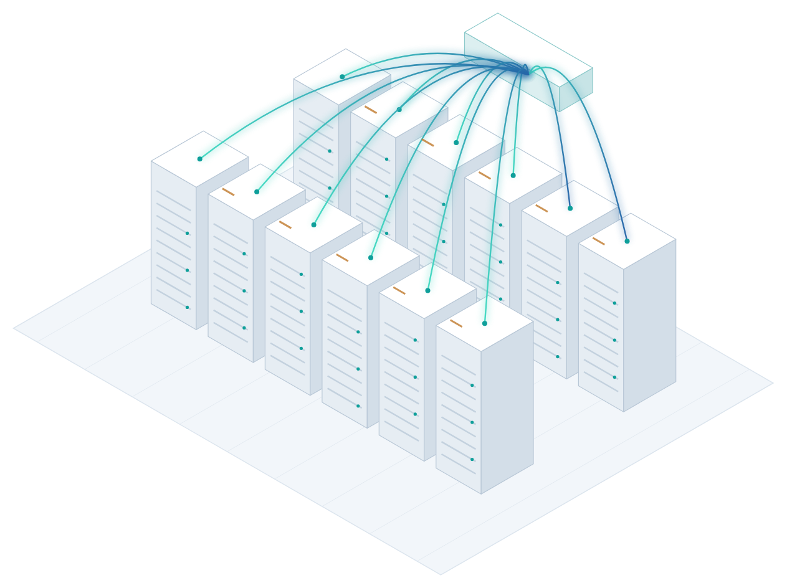


The physical layer for India's sovereign AI
NEW BUSINESS LINE · PHOTONICS & AI INFRASTRUCTURE
AI models run on GPUs — but GPUs only work as a cluster when thousands of high-speed links connect them. We are building the India capability to supply, design in and support that connectivity layer.
India partner
Our USA technology partner builds the interconnect; we bring it to Indian projects.
Design-in & integration
Indian architecture, selection, integration and support for AI data-centre projects.
Roadmap to localisation
Indian testing and qualification first; local assembly as volumes justify it.
Notes:
New business line. Be precise about what we are and are not: our USA technology partner builds the interconnect, and we do the India-side engineering, integration and support. We do not manufacture in India today; localisation is a roadmap step tied to volumes. Name the partner only where we have their agreement to.

Slide 15
India's data-centre capacity is set to multiply by 2030
WHY NOW
24×
Growth in AI-dedicated capacity, 2025–2030: 275 MW → 6.5 GW (Wood Mackenzie)
38,000+
GPUs onboarded for common compute under the IndiaAI Mission (MeitY, Mar 2026)
₹10,372 cr
IndiaAI Mission outlay over five years (Union Cabinet, 2024)
Sources: MeitY (2020 and 2025 actuals, Mar 2026); Savills India (Jul 2025); Colliers (May 2025); Wood Mackenzie via IANS (Jul 2026). Forecasts differ widely — treat 2030 as a range, not a point.
Notes:
Capacity grew from about 375 MW in 2020 to over 1,500 MW in 2025 (MeitY). 2030 forecasts range from about 4 GW (Savills) to 12 GW (Wood Mackenzie). The AI-dedicated slice grows fastest — and AI racks need far more high-speed interconnect than traditional racks. That is our market.

Slide 16
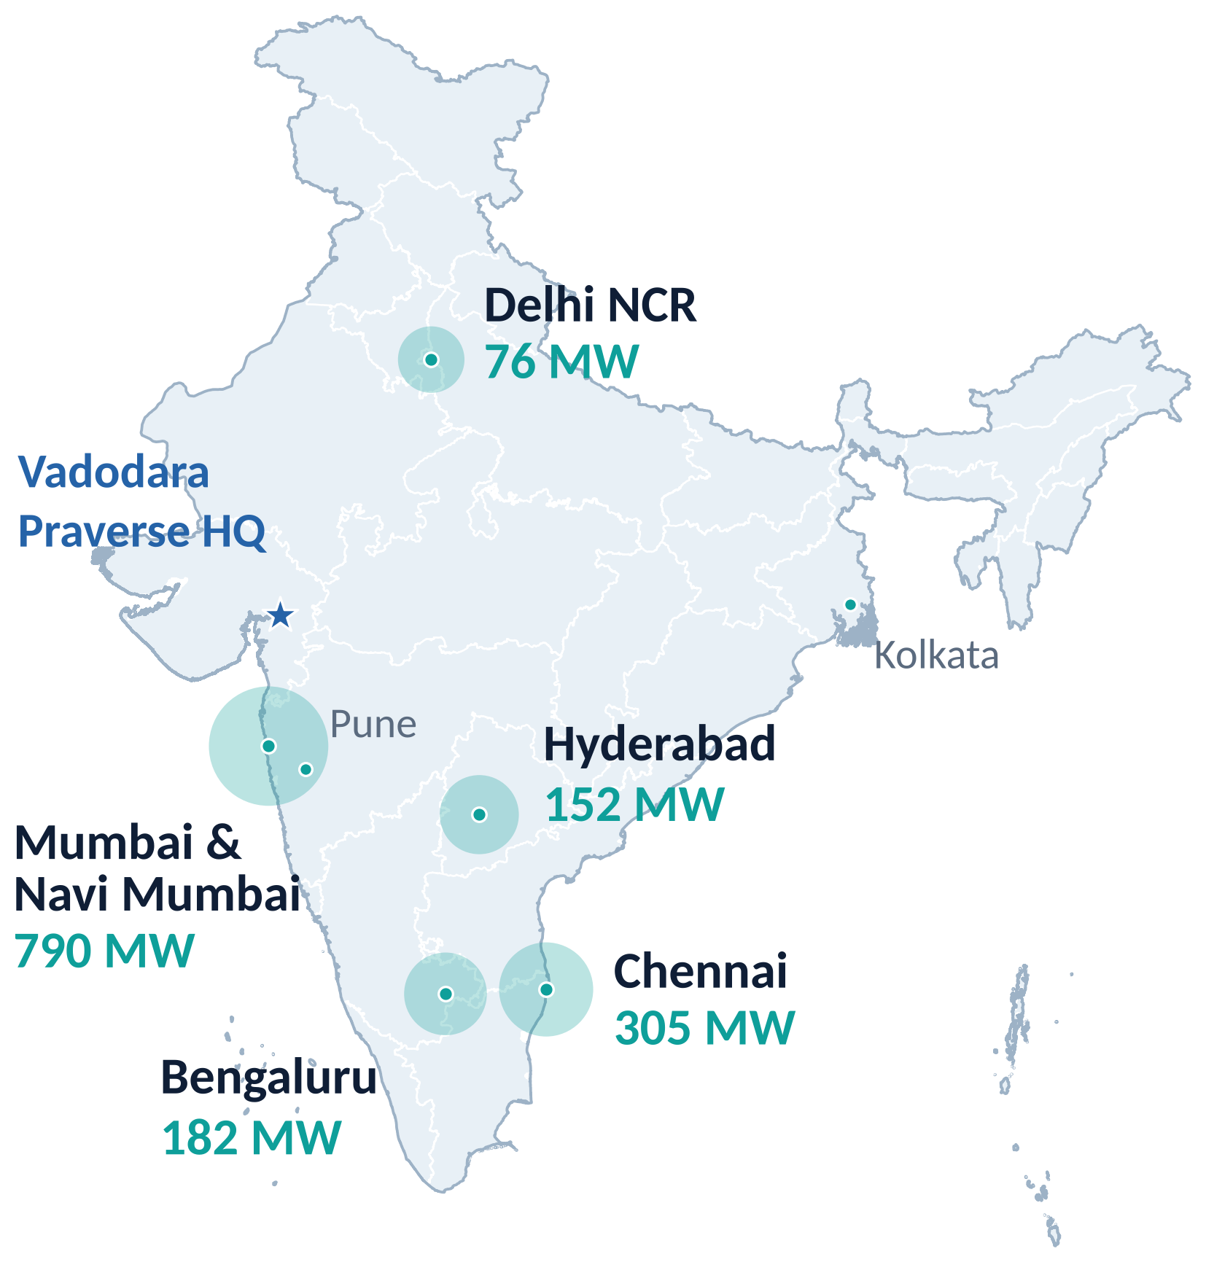
AI build-outs will land first in a few hubs
WHERE CAPACITY SITS
~52%
of listed capacity is in Mumbai & Navi Mumbai — 790 of ~1,520 MW
~65%
of installed IT load sits in Maharashtra and Tamil Nadu (Wood Mackenzie)
~400 km
Vadodara HQ to Mumbai — close to India's largest data-centre cluster
What it means for us: sovereign AI clusters will be built in these hubs first, so that is where interconnect demand — and our first deployments — will land.
Source: MeitY reply in Lok Sabha (Mar 2026), operational capacity by city; Pune and Kolkata together ~15 MW. Map boundary: Survey of India outline (DataMeet).
Notes:
Capacity is highly concentrated. Mumbai alone holds about half. Distances are approximate. Map uses the official Survey of India boundary.

Slide 17
Copper inside the rack, optics across the hall
THE CONNECTIVITY LAYER
Every GPU server connects to the fabric. Link reach decides whether copper or optics is used.
Spine switch
Spine switch
Leaf switch
Leaf switch
Leaf switch
GPU
server
GPU
server
GPU
server
GPU
server
GPU
server
GPU
server
Optical — AOC & transceivers, across rows and halls
Copper — DAC / ACC / AEC, inside and next to the rack
Reach values are typical maximums at 400G–800G and vary by product and speed; the AEC figure is our partner's 9 m 800G specification. Indicative, for architecture discussions.
Notes:
Simple rule: short links inside and next to the rack use copper (cheaper, lower power). Anything across rows and halls needs optics. AI clusters need both, in very large numbers, which is why the interconnect bill is a meaningful share of AI data-centre cost.

Slide 18





Interconnect from 100G to 1.6T
PORTFOLIO · VIA OUR USA TECHNOLOGY PARTNER
Direct attach copper (DAC)
Active copper (ACC)
Active electrical (AEC)
Passive copper for ultra-low-latency, in-rack links.
Linear redriver signal conditioning for extra reach.
Retimer/DSP copper — 800G up to 9 m.
Active optical (AOC)
Optical transceivers
Fibre cable assemblies
Integrated-transceiver cables for dense, longer runs.
Pluggable modules for multi-mode and single-mode links.
Patch cords, trunks and high-density breakouts.
SPEED ROADMAP
400G
Installed base
800G
Mainstream for AI clusters
1.6T
Ramping now
3.2T
Next generation
Form factors: SFP · QSFP · QSFP112 · QSFP-DD · OSFP · OSFP-XD · Ethernet and InfiniBand · Custom assemblies on request
Notes:
Portfolio available through our USA technology partner. Copper products (amber) for short links, optical (teal) for longer ones. Speed roadmap is indicative of the market, not a dated commitment. Confirm current SKUs and lead times with the partner before quoting.

Slide 19


Global technology, Indian capability, sovereign data centres
OUR MODEL
Global technology
Praverse in India
Sovereign AI data centres
Our USA technology partner
India partner
Data stays in India
Proven copper and optical interconnect, 200G–1.6T, for AI clusters
Architecture, design-in, integration, qualification and local support
GPU servers, switches, racks and networks ready for 800G and beyond
ROADMAP
NOW
Supply & design-in
NEXT
Indian test & qualification
LATER
Localised assembly
Partner products, architecture support and integration for Indian AI data-centre projects.
Build local testing, qualification and technical-support capability as deployments grow.
Explore assembly and manufacturing in India with partners, step by step, as volumes justify it.
Why sovereign: data stays under Indian law (DPDP Act 2023) · resilient domestic supply · engineers and support in India
Notes:
This is the honest framing: we do not manufacture chips or hold large component stock in India today. Step one is partner supply plus Indian engineering; local test capability and assembly follow demand. Never describe a facility we do not have, and quote no location, capacity or date until one is signed.

Slide 20


From problem to production in four stages
HOW WE WORK
01
02
03
04
Discover
Design
Build
Deploy & evolve
We learn your domain, workflow, data and constraints before proposing any AI.
Architecture, model strategy, guardrails and human-oversight design mapped to your risk.
Working prototypes early. You see real outputs, not slides.
Production rollout with monitoring, evaluation and continuous improvement.
Domain immersion · Data audit · Feasibility
Architecture · Guardrails · Risk
Prototypes · Iteration · Evaluation
MLOps · Monitoring · Improvement
Tell us what you are trying to solve. We will tell you honestly whether AI is the right answer — and send a written plan within two business days.
Notes:
What matters to a buyer: real outputs early, and monitoring and evaluation built into the handover.

Slide 21
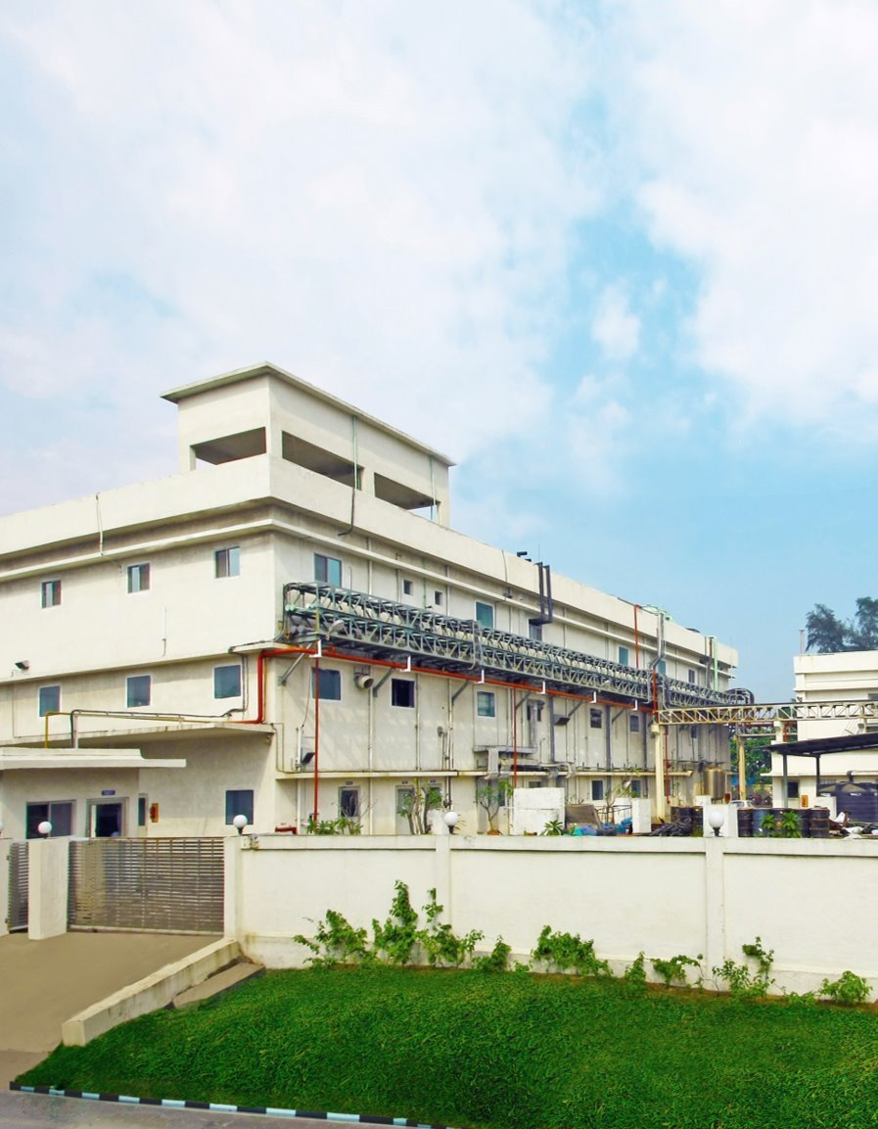

Industry depth, engineering velocity
WHY PRAVERSE
Three decades of pharma depth
Peer-reviewed foundations
Advisory from a 30-year specialty-pharma career: GMP floors, regulatory strategy and global launches.
Applied work anchored in published research in imaging, edge AI and simulation.
Human-in-the-loop by design
India-first, globally deployable
Built for industries where a wrong answer has consequences: traceable, reviewable, reversible.
Indian engineering talent, built to global standards for domestic and export markets.
Pharma advisory backed by SWATI Spentose
V-Group, est. 1952 · USFDA, EU-GMP, PMDA Japan, WHO-GMP approvals · 3 units in Vapi, Gujarat
Notes:
Strongest card: three decades of specialty-pharma depth behind an AI engineering team. Most AI vendors cannot offer that. Photo shows a SWATI Spentose facility (advisory partner), not a Praverse site.

Slide 22
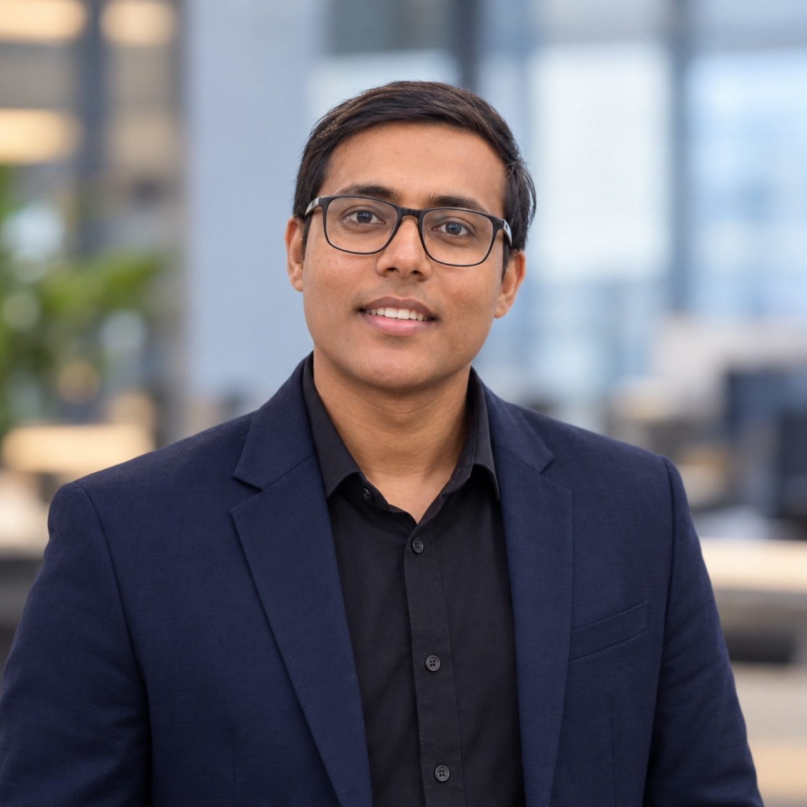
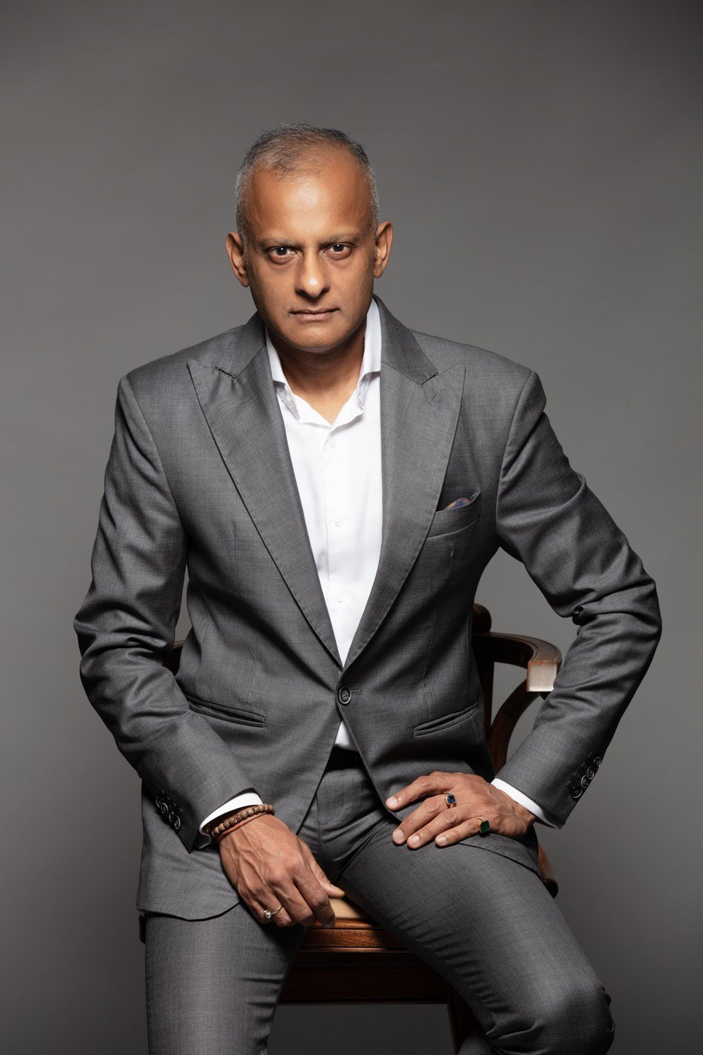
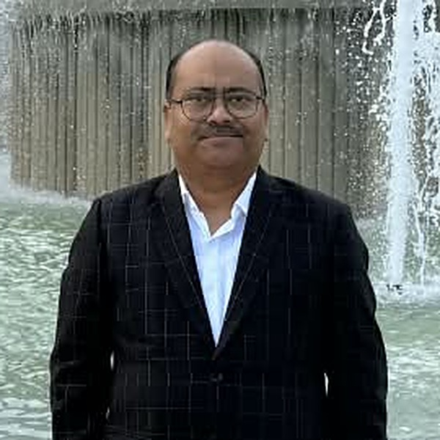
AI engineering, backed by deep pharma expertise
LEADERSHIP & ADVISORS
Pratham Shrivastav
Vishal Jajodia
Ashwani Shrivastav
Founder & CEO
Praverse Tech Pvt Ltd
Strategic Advisor
MD, SWATI Spentose
Managing Director
Nexgen Pharma Solutions Pvt Ltd
Began Praverse in 2023 as a research question; incorporated it in 2026
Peer-reviewed work in imaging, edge AI and simulation
Leads the full stack: pharma AI, MENNIE and photonics
30+ years in specialty pharma, from formulation to global regulatory strategy
Guides our sovereign AI data centre and photonics direction
IDMA-APTAR Innovation of the Year 2022
Pharma quality expert: QMS, QA, QC and DMF filings in eCTD format
Inspection support: USFDA, EU-GMP, WHO-GMP, EDQM, ANVISA, MFDS (Korea)
Brings hands-on GMP and inspection practice to our pharma AI
Notes:
Lead with Vishal and Ashwani for pharma prospects, and with Pratham for technical or infrastructure prospects. The point: AI engineering plus decades of pharma manufacturing, quality and inspection experience.

Slide 23
Four ways to start working with us
ENGAGE
Enterprise AI
Pharma & regulatory AI
Custom agents, copilots, RAG systems, vision pipelines and production ML.
483 responses, CAPA, data integrity, SOP intelligence, inspection readiness.
Healthcare AI
AI data-centre interconnect
MENNIE pilots, patient-flow intelligence, imaging and screening support.
Architecture reviews, design-in and supply for 400G–1.6T AI clusters.
1. Share the problem, domain and timeline
2. Receive a written plan within 2 business days
3. Start with a scoped discovery or pilot
Notes:
Close by asking for their specific problem, not a generic follow-up meeting.

Slide 24


Let's build what your industry needs
PRAVERSE TECH PVT LTD
From AI agents to healthcare platforms, regulatory intelligence and AI data-centre connectivity — we turn hard problems into deployed systems.
inquiry@praversetech.com
+91 93132 47264
praversetech.com
Vadodara, Gujarat, India
Notes:
Repeat the one-line promise and hand over contact details.

