Slide 1


Engineering human-centred intelligence
PRAVERSE TECH PVT LTD
COMPANY INTRODUCTION
Enterprise AI for healthcare, pharma and regulated industries — and the high-speed interconnect layer for India's sovereign AI data centres.
praversetech.com · inquiry@praversetech.com · +91 93132 47264 · Vadodara, Gujarat, India
Notes:
Short introduction deck — designed to be sent ahead of a first meeting.

Slide 2
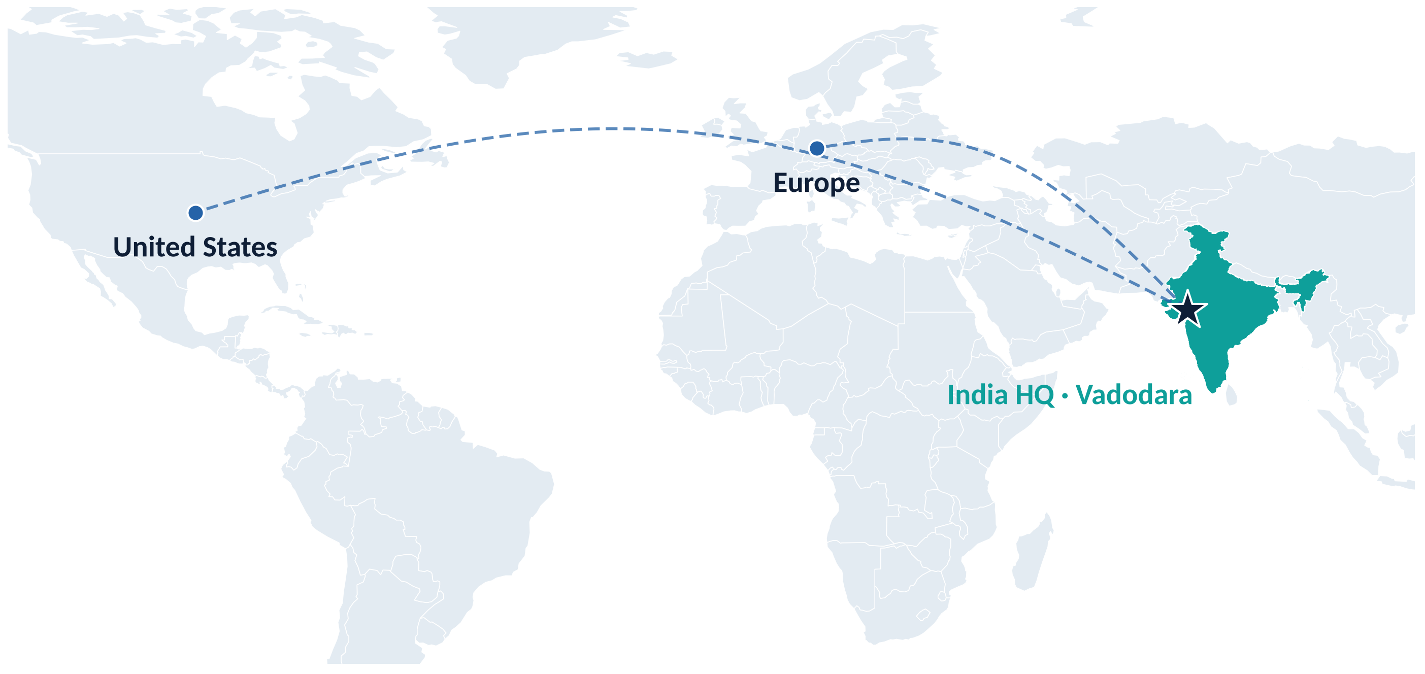
An Indian enterprise AI and infrastructure company
WHO WE ARE
Praverse Tech builds AI systems that hold up in regulated, high-stakes work — and keeps a qualified expert in control of every important decision.
2023
Vadodara
Idea began
HQ, Gujarat
India · US · EU
MENNIE
Interconnect technology: our USA partner · Pharma advisory: SWATI Spentose (V-Group, est. 1952)
Markets served
Healthcare AI, in development

Slide 3




Four focused business lines
WHAT WE DO
NEW
Enterprise AI & Agents
Pharma & Regulatory AI
Healthcare AI
Photonics & AI Data Centres
Agents, copilots, RAG search and production ML that live inside real workflows.
FDA 483 responses, CAPA, data integrity and inspection readiness — every output expert-reviewed.
MENNIE, our voice-first patient assistant, plus imaging and screening support.
High-speed copper and optical interconnect for India's sovereign AI data centres, with our USA technology partner.
Agents · RAG · MLOps
GMP · 21 CFR 211 · ICH
MENNIE · Imaging · Edge AI
800G · 1.6T · India partner
One rule across all four: the system drafts, analyses and flags — qualified people decide.

Slide 4
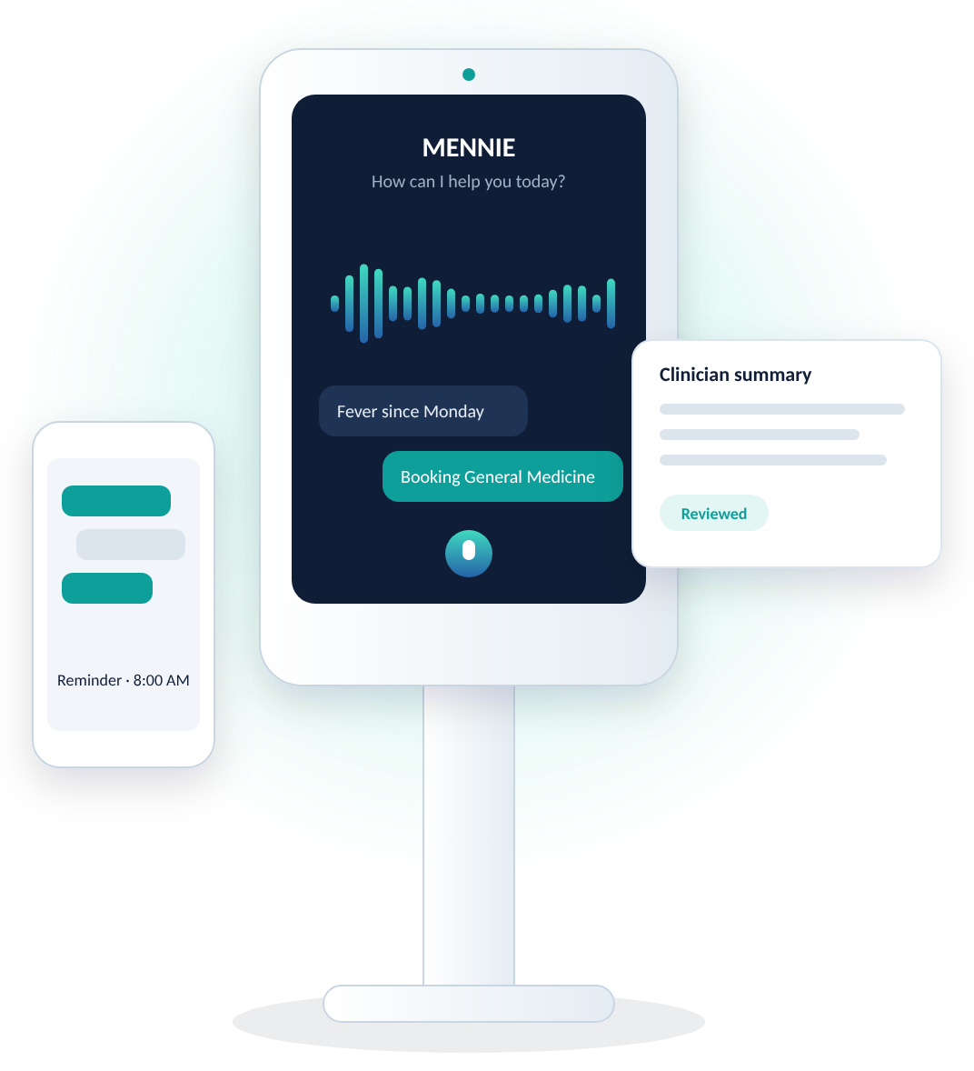
Deployed where a wrong answer has consequences
PHARMA & HEALTHCARE AI
Pharma AI suite
MENNIE
Voice-first patient assistant: intake, doctor matching, reminders and clinician-ready summaries.
Eight quality-system modules, each evidence-linked and approved by QA before use:
FDA 483 response assist
OOS / OOT analysis
Data integrity (ALCOA+)
Documentation intelligence
CAPA reasoning
Quality risk management
Track record
Edge eye screening (2023) · Retinal imaging for diabetic macular edema (2023) · Ultrasound screening pipeline (2024)
Human error investigation
Inspection readiness
Designed around USFDA 21 CFR 211 · ICH Q9 · ICH Q10

Slide 5








Agents that do the work — your experts decide
ENTERPRISE AI
Agents, copilots, RAG search and production ML, built around one rule: the system drafts, your team decides.
Your data & documents
Praverse agent
Expert review
Action & audit trail
SOPs, records, tickets, drives, databases
Retrieves, reasons across tools and drafts
Your team checks, edits and approves
Report, decision or update — fully logged
Document intelligence
Decision intelligence
Vision & imaging
Federated & edge AI
Sourced answers from thousands of pages
Explainable dashboards and forecasts
Inspection, imaging, multimodal
Data stays where it belongs

Slide 6



Connectivity for India's sovereign AI data centres
NEW · PHOTONICS & AI DATA CENTRES
India partner for AI-cluster interconnect
Copper and optical interconnect for AI clusters, 100G to 1.6T.
Indian engineering & support
Architecture, design-in, integration and qualification for Indian projects.
Roadmap to localisation
Local testing first; assembly in India as volumes justify it.
Sources: MeitY (actuals, Mar 2026); Savills India (Jul 2025); Colliers (May 2025); Wood Mackenzie via IANS (Jul 2026). Forecasts vary widely.

Slide 7
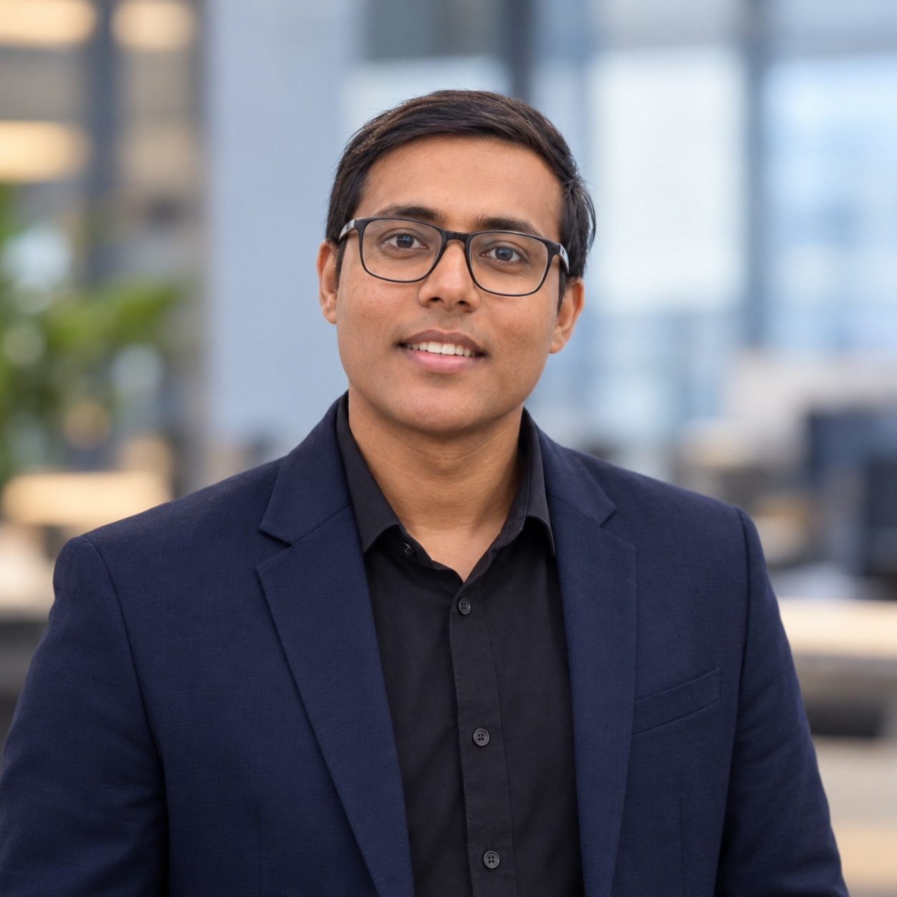
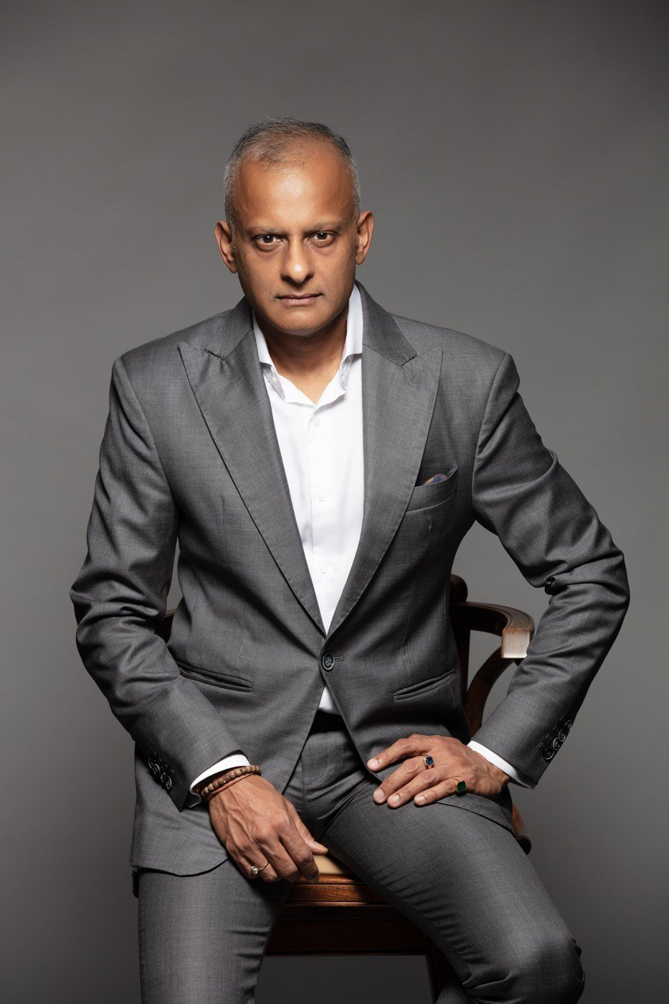
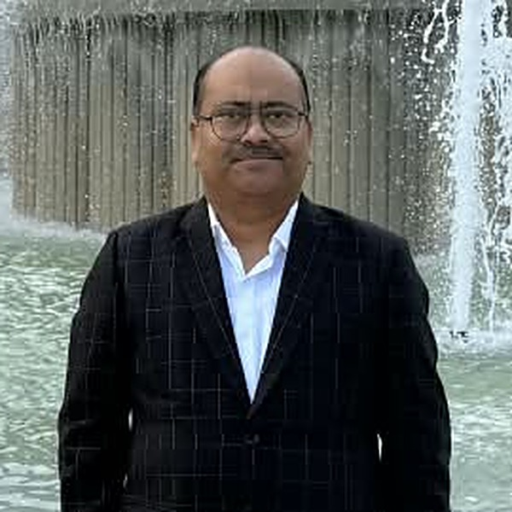
AI engineering, backed by deep pharma expertise
LEADERSHIP & ADVISORS
Pratham Shrivastav
Vishal Jajodia
Ashwani Shrivastav
Founder & CEO
Praverse Tech Pvt Ltd
Strategic Advisor
MD, SWATI Spentose
Managing Director
Nexgen Pharma Solutions Pvt Ltd
Began Praverse in 2023 as a research question; incorporated it in 2026
Peer-reviewed work in imaging, edge AI and simulation
Leads the full stack: pharma AI, MENNIE and photonics
30+ years in specialty pharma, from formulation to global regulatory strategy
Guides our sovereign AI data centre and photonics direction
IDMA-APTAR Innovation of the Year 2022
Pharma quality expert: QMS, QA, QC and DMF filings in eCTD format
Inspection support: USFDA, EU-GMP, WHO-GMP, EDQM, ANVISA, MFDS (Korea)
Brings hands-on GMP and inspection practice to our pharma AI

Slide 8




Let's solve the right problem together
PRAVERSE TECH PVT LTD
Share your problem, domain and timeline. We reply with a written plan within two business days.
inquiry@praversetech.com
+91 93132 47264
praversetech.com
Vadodara, Gujarat, India

