Slide 1
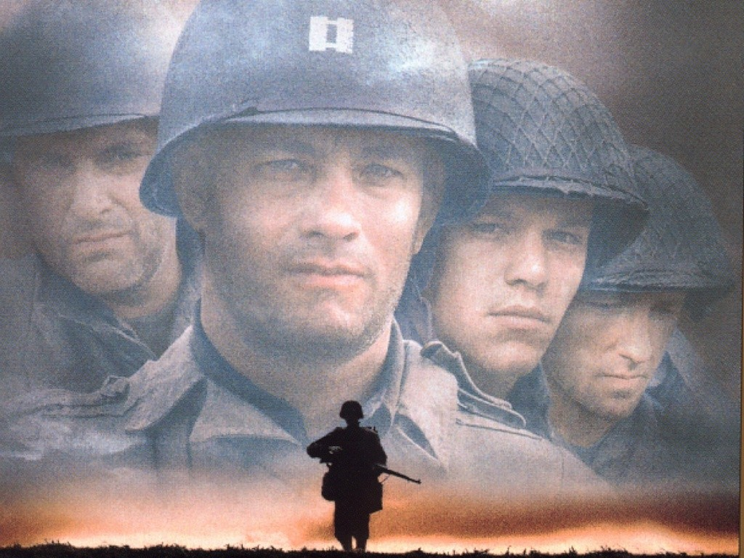
War
1940’s
By:
Hyung il Nam
Soloman Kim
Jonathan Lee
Kevin Nguyendo

Slide 2
1940’s
The early years of the 1940s were unfortunate for the American film industry due to the late 1941 attack on Pearl Harbor by the Japanese, and the loss of foreign markets.
Fortunately, Hollywood film production got back on its feet and reached its profitable climax of efficiency from 1943 to 1946.
Advances in sound recording, lighting, special effects, cinematography, and the use of color gave film a more “modern” and “viewable” aspect to it.

Slide 3
1940’s cont.
Following the end of WW2, Hollywood’s most profitable year in the 40s was 1946, with all-time highs recorded for theatre attendance.
The movie industry, in the early to mid 1940s, responded to the national war effort by making films, producing many war-time favorites, and enlisting stars such or having them report for duty.
Several war-time films, with a wide range of subjects and tones, presented both the flag-waving heroics and action of the war in addition to the realistic, mundane, and misery of the experience. Several examples of such films were Sahara (1943), Thirty Seconds Over Tokyo (1944), and The Story of G.I. Joe (1945).

Slide 4
1940’s cont
Films began to take on a more realistic rather than escapist tone, as they had done during during the Great Depression.
Charlie Chaplin directed and starred in his first talkie, The Great Dictator (1940). It was a war-time, anti-fascist, satirical mockery of Hitler and the Third Reich.
The most subtle of all wartime propaganda films was Michael Curtiz’ 40s studio film Casablanca (1942). It was a romantic story about a disillusioned nightclub owner (Humphrey Bogart) and a former lover (Ingrid Bergman) separated in Paris due to WW2. This quintessential 40s film is best remembered for its amazing script and memorable dialogue. It was awarded Best Picture, Best Director, and Best Screenplay for that year (1942).

Slide 5
1940’s cont
Technicolor continuously became more and more popular during the 1940s following the success of the richly-colorful films of the 1930s. Yet, during the war years, Technicolor became limited and was rarely used in films, besides musicals, in an effort to cut costs.
Orson Welles, also known as the twenty three year old boy-wonder, was granted an RKO Studios contract in 1939. In the 1940s, he then created one of the greatest American film of all time known as Citizen Kane (1941). The film consisted of many flashbacks, included a memorable musical score, and demonstrated absorbing photographic techniques such as close-ups, moving camera, low-key lighting, overlapping dialogue and innovative sound editing, deep focus, optical effects, ceiling sets and innovative camera angles.

Slide 6
1940’s cont
By World War II's end, the genre most characteristic of the era and most associated with 1940s Hollywood was film noir. The film noir genre reflected the way Hollywood felt as it faced its greatest challenges during the war and post-war periods.
The first example was one of the best detective pictures ever made: director John Huston's remarkable debut film The Maltese Falcon (1941).
In addition to film noir, the gangster film was revived with one of Warner Bros. finest examples of the genre: director Raoul Walsh's High Sierra (1941), starring Humphrey Bogart as an aging gangster with a heart of gold.

Slide 7
1940’s cont
Other films either provided escapist entertainment or seemed to look back to a lost era in America: Holiday Inn (1942), Meet Me in St. Louis (1944), The Adventures of Mark Twain (1944), and Miracle on 34th Street (1947), and A Letter to Three Wives (1949).
Frank Capra’s most "Capra-esque" film was his appealing, sentimental, Christmas holiday film, It's A Wonderful Life (1946), yet this film was surprisingly a major failure at the time of its original release. It only became famous after continuous re-runs on TV during the holidays.

Slide 8
1940’s cont
Val Lewton influenced the horror genre by initiating a series of literate, intelligent, low-budget, understated, moody B-movie films that were more than just horror films. His collection of films were rather more film noir and subtle than true horror films.
Jacques Tourneur's The Cat People (1942), one of Lewton's first produced films, was a low-key, dark, horror film about a Serbian girl who could be transformed into a threatening, man-eating panther when aroused.
John Ford influenced the Western genre with an expanded string of classic Westerns to chronicle America's pioneer past. A few examples of his films during this era were The Long Voyage Home (1940), The Grapes of Wrath (1940), and How Green Was My Valley (1941).

Slide 9
1940’s cont
In the 1940s, the remedy for escape from the terrors of the war years was provided by film musicals and their elaborate production numbers, simplistic plots, and music. Post-war films reflected the desire of audiences to put the war behind them. Hollywood enjoyed its greatest financial year in history in 1946. An all-time peak in annual box-office receipts, at $4.5 billion, was achieved.
Arthur Freed was the powerhouse behind MGM studios, and he sparked the growth of the musical genre in the 40s and 50s. Gene Kelly made his official screen debut as a song-and-dance man in hit musical produced by Freed known as For Me and My Gal (1942). The turn-of-the century Meet Me in St. Louis (1944), and the all-black musical Cabin in the Sky (1943) were also both produced by Arthur Freed.

Slide 10
1940’s cont
Towards the end of the decade, the world was a more cynical, doubtful place as if it were in a film noir movie. The motion picture industry came across its greatest challenge as the Cold War was slowing approaching. The rise of television greatly influenced potential moviegoers by forcing them to remain at home. Blacklisting and McCarthyism greatly impacted Hollywood and motion picture industries as well. Inflation of film production costs, rise of studio labor unions, and gradual decline of theatre-attending audiences also made it quite difficult for the studios and movie industries to flourish and prosper.
The studios had to achieve box-office success based not on their economic ability but on the quality of their films. The foundation of the studio system marketing was severely threatened and on the verge of collapsing. Studios would be gradually reduced to production and distribution organizations and forced to give up or deprive themselves of their vast theater holdings. In addition, they would be prohibited from fixing admission prices, and forcing their lesser products onto independent exhibitors. The end of the 1940s dawned an era of competition among movie industries to strive and overcome so great a crisis.

Slide 11
Themes/values
Some of the themes in war films often include combat, survivor and escape stories, tales of gallant sacrifice and struggle, effects of war on society and the exploration of moral and human issues.

Slide 12
Character
Some war films do balance the soul-searching, tragic consequences and inner turmoil of combatants or characters with action-packed, dramatic spectacles, enthusiastically illustrating the excitement and turmoil of warfare. And some 'war' films concentrate on the homefront rather than on the conflict at the military war-front. But many of them provide decisive criticism of senseless warfare.

Slide 13
Setting
Settings for war movies are usually set in other countries depending on what time period it was set in. If it was in the past it would be in the open fields and the more modern ones are usually in villages and cities (black hawk down).

Slide 14
Plot device
Usual plot devices in war films involve the main hero/heroes battling through a warzone to a rally point or a target area, in order to help another squad or to take out the enemy’s base/leader.

Slide 15
Conflict
Conflicts involve 2 or more factions one being good and one bad. Although there are several conflicts occurring at the same time, the film takes the perspective of either one man or one group and centers around them. There are also interpersonal conflicts within each character, whether to save a comrade’s life, kill the enemy while they’re defenseless, kill innocent civilians to obey an order, which centers around the conflicts of man (man vs. machine/man/himself/nature).

Slide 16
Symbolism
Most common symbol in war films are dogtags, in which after a soldier has fallen, another comrade comes and tears the tags from their neck as a token of respect/remembrance and brotherhood (“No one gets left behind”). ***The “first Kill”- usually when a rookie soldier gets drafted into the warzone they are inexperienced killers, some of which have never taken a human life or used a firearm, and when they achieve their “first kill” they undergo dramatic changes in their character. They can either be overridden with guilt and shame, becoming traumatized or deal with it and become a “trigger-happy hero”***Propaganda- one of the explicit symbols which signifies a decrease in moral, the trespassing into occupied territory, and a character’s reevaluation of their cause for fighting. ***The film itself can be used as a symbol, in order to present a different perspective on a certain war, the morality/ethics of war itself, or to inspire national pride. *** nicknames- (“commies, krauts, reds”) soldiers would normally use nicknames to “degrade” the idea of their enemy to a point where they would no longer distinguish them as fellow humans, but rather as monsters , thus making it morally easier to kill them. It’s also used to distinguish the good guys from the bad guys.

Slide 17
Hero-code
A pretty well known hero code is “leave no man behind”.
When you watch a war movie you usually always see a certain person who got shot being taken away to a safer place by a fellow soldier.

Slide 18
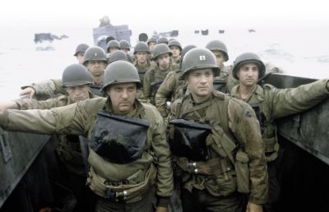
Costume
Helmet
Shirt
Pants
Boots
They all look
alike. Same uniforms.

