Slide 1
Movies

Slide 2
Novelty stage

Slide 3
Novelty Stage
How do you make images MOVE???
Flip book
Eadweard Muybridge: pioneer
  12 cameras/trotting horse

Slide 4
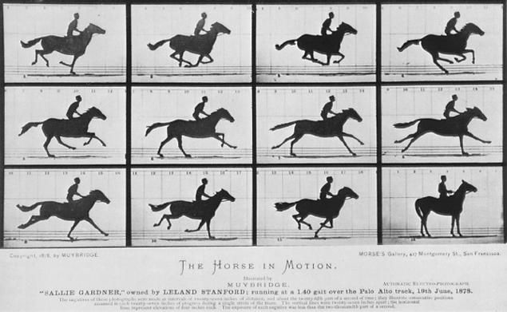
Novelty Stage
How do you make images MOVE???
Flip book
Eadweard Muybridge: pioneer
  700 cameras/trotting horse

Slide 5
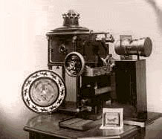
Novelty Stage
Muybridge’s Zoopraxiscope

Slide 6
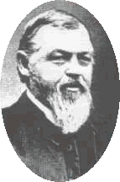
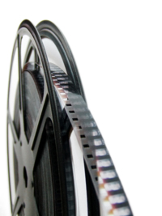
Early Technology
Hannibal Goodwin -
celluloid, 1889
(used name Photographic pellicle)

Slide 7
Early Technology
Invention Timeline
1840s: telegraph
1850s: Martinville/sound recording
1877: Edison’s phonograph
1889: CELLULOID FILM
1891: Edison’s kinetoscope/graph
1894: wireless telegraph (Marconi)
Very exciting era for media technology

Slide 8
Entrepreneurial stage

Slide 9
Entrepreneurial Stage
1891: Thomas Edison
  kinetograph (early film camera)
  kinetoscope (single viewer projection)
KINE=movement (e.g. kinetic energy)

Slide 10
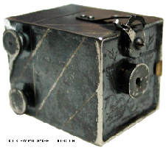
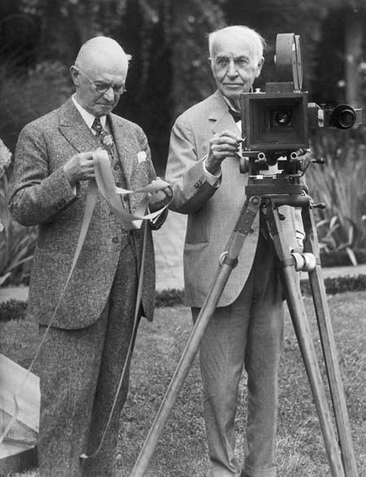
Entrepreneurial Stage
Kinetograph, 1891 Edison + Eastman, 1928

Slide 11
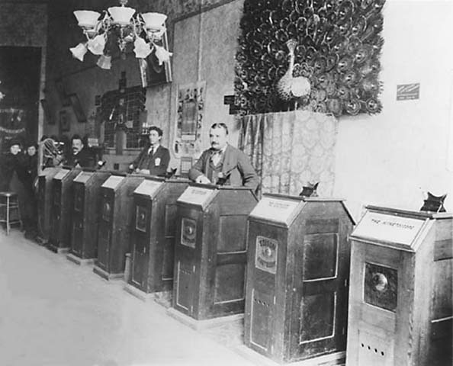
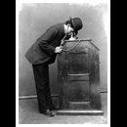
Kinoscope Kinparlors

Slide 12
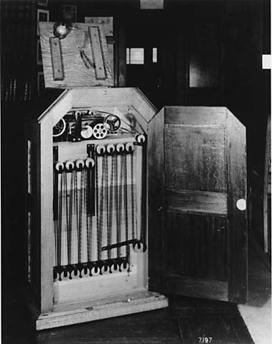
Kinoscope

Slide 13
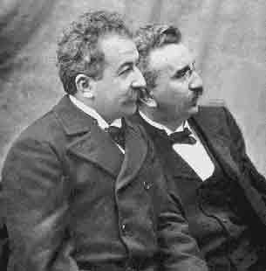
Entrepreneurial Stage
Lumiere brothers in Paris/cafes

Slide 14
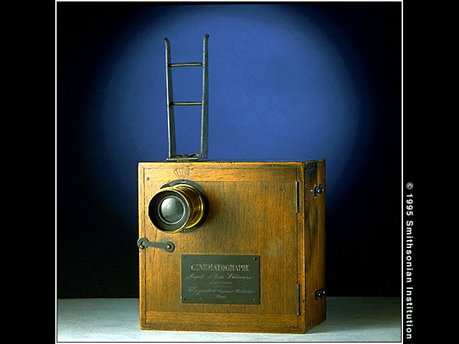

Slide 15
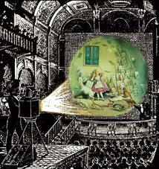
Entrepreneurial Stage
1896, Lumières demonstrated their cinematograph--the first successful machine that could show moving photographs--to an audience,

Slide 16
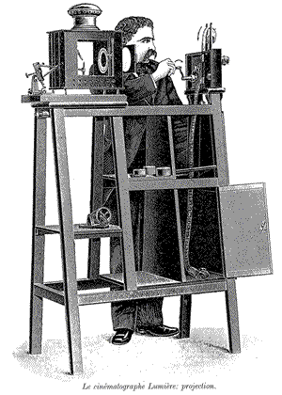

Slide 17
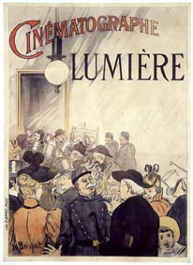

Slide 18
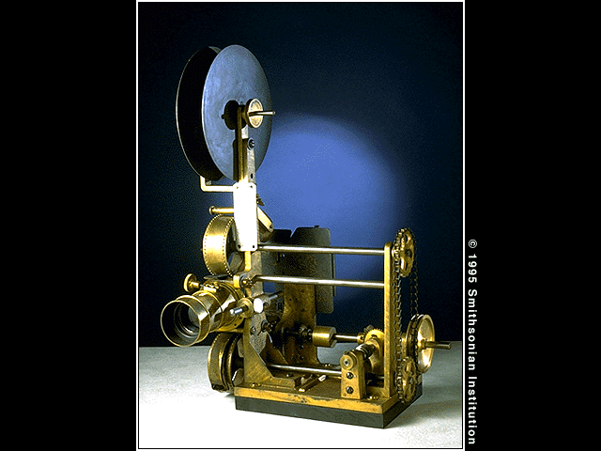
Entrepreneurial Stage
Edison: vitascope
  Made viewing by larger audiences possible
  Sandow-1894
  Bike-1899
  Kiss-1900
  Eggs-1902
  School-1904
Vita=life
Scope=view
“lifeViewer”

Slide 19
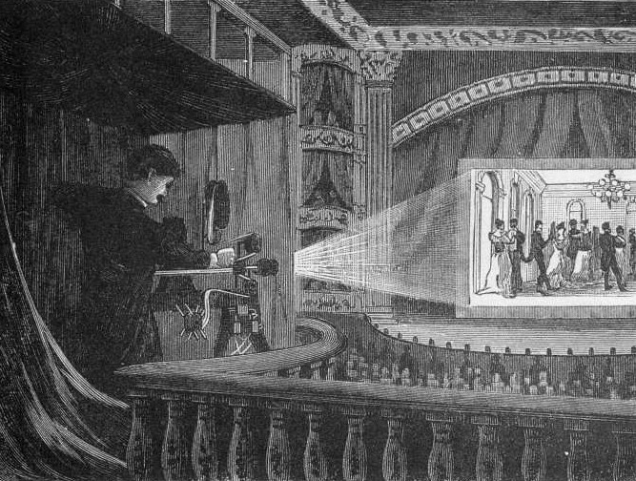

Slide 20
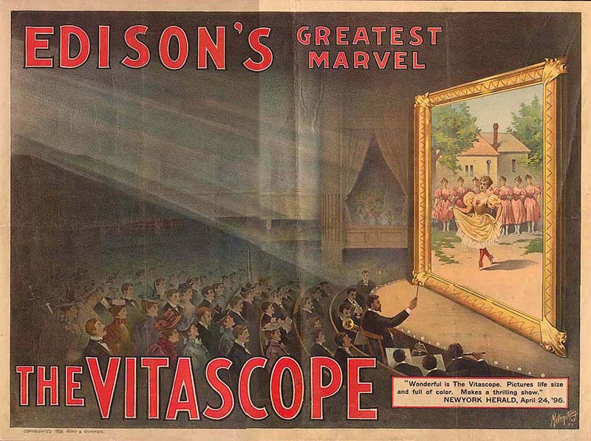

Slide 21
Mass medium stage

Slide 22
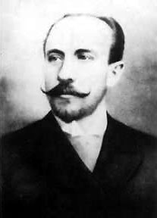
Mass Medium Stage
Narratives engage
the audience’s imagination
George Melies
  Opened first theater
  in France, 1896
  The conjurer, 1899
  Trip to the Moon, part 1
  Trip to the moon, part 2
  (1902)

Slide 23
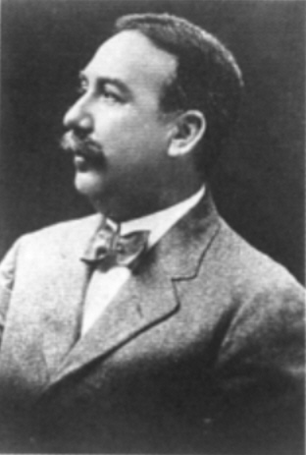
Mass Medium Stage
Edwin Porter in U.S.
  Shot America’s first narrative film, Life of an American Fireman (1902).
  Shot scenes out of order -- later edit in sequence.
  Shot first close-up….

Slide 24
Mass Medium Stage
Edwin Porter in U.S.
  Shot America’s first narrative film, Life of an American Fireman (1902).
  Shot scenes out of order -- later edit in sequence.
  Shot first close-up (fire alarm)

Slide 25
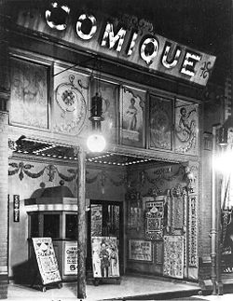
Mass Medium Stage
Nickelodeons:
storefront theatres in early 1900s.
Nickel + Odeon
=
Nickelodeon
Nickelodeon in Toronto, 1910

Slide 26
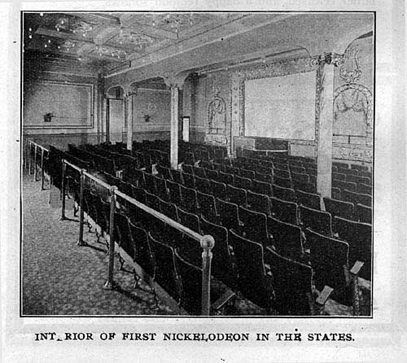
Mass Medium Stage
Nickelodeons:
storefront theatres in early 1900s.
Nickel + Odeon
=
Nickelodeon

Slide 27
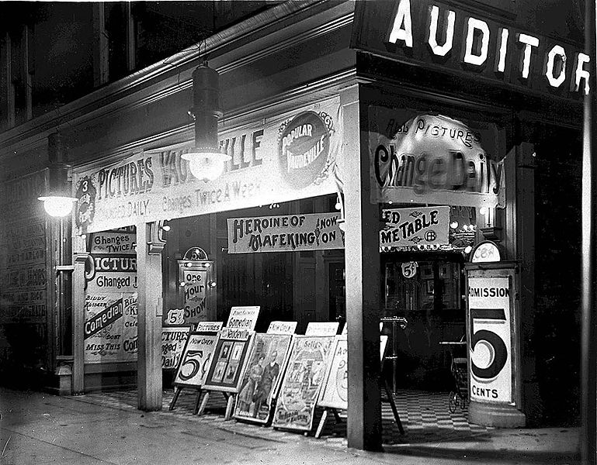

Slide 28
Mass Medium Stage
The rise of the Studio System
By late 1910s, studios controlled:
  Production
  Distribution
  Exhibition
=Vertical integration

Slide 29
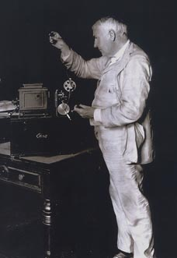
Studio System controlling production
  1. Motion picture Patents Company
    Made up of Edison’s Film Manufacturing company; biograph company, other members
    pooled patents, 1908
    “The edison Trust”
    If filmmakers wanted to produce
    a film, they had to use the trust’s equipment, their film stock, their theaters
Notes:
http://www.cobbles.com/simpp_archive/mary-pickford_brownlo.htm

Slide 30
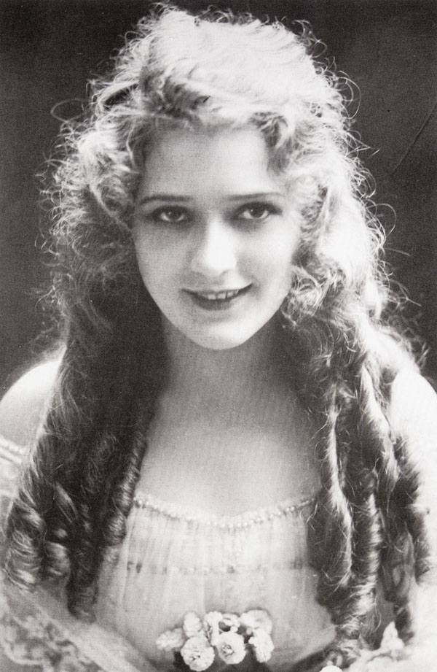
Studio System controlling production
  2. Studio system of STARS
  under exclusive contract
  Independents defied trust,
  moved to Hollywood;
  Created star system
  Mary Pickford, early star.
  (One of founders of United Artists)
Notes:
http://www.cobbles.com/simpp_archive/mary-pickford_brownlo.htm

Slide 31
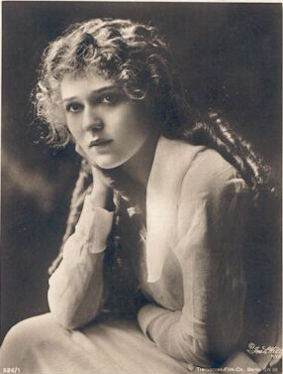

Slide 32
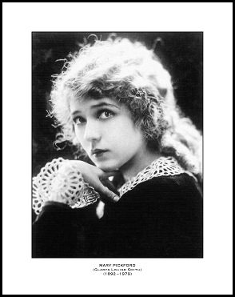
Mary Pickford, 1910
Mary Pickford, 1920

Slide 33
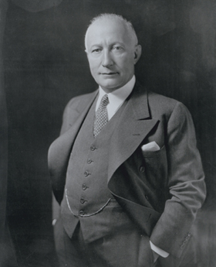
Studio System controlling production
Adolph Zukor
Lured Pickford
to work for him
Paramount
Notes:
http://www.cobbles.com/simpp_archive/mary-pickford_brownlo.htm

Slide 34
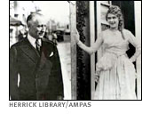

Slide 35

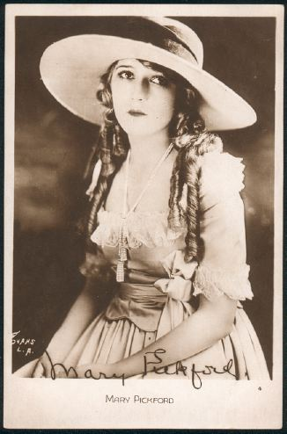
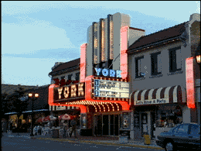

Studio System
CONTROLLING DISTRIBUTION
Zukor
+ =
Controlling Distribution by Block booking
Notes:
Zukor: http://www.pbs.org/wgbh/amex/pickford/peopleevents/p_zukor.html
Pickford: http://members.rogers.com/rkukan2101/pickford.html
Theater: http://www.organman.com/tivoli.sht

Slide 36
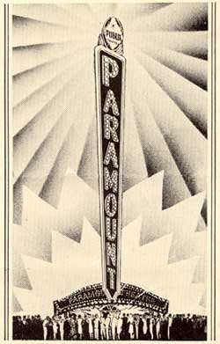
Studio System
Controlling exhibition
Building and buying
  MOVIE PALACES
  (first-run theatres in downtowns)
  --PARAMOUNT THEATER CHAIN
        Zukor + PARAMOUNT
Zukor

Slide 37
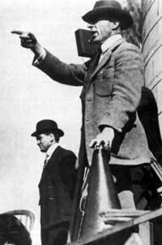

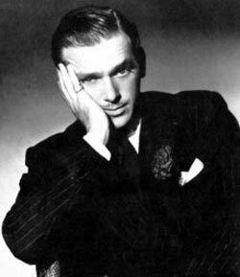

Studio System
United Artists broke away from studio system:
Mary douglas Charlie D.W.
Pickford Fairbanks Chaplin Griffiths
Notes:
Mary: http://www.cobbles.com/simpp_archive/mary-pickford_brownlo.htm
Douglas: http://www.famous-couple.com/famous_couple-douglas_fairbanks_jr-joan_crawford.htm
Charlie: http://www.ex.ac.uk/bill.douglas/Schools/stars/stars3.htm
Griffith: http://silentgents.com/PGriffithDW.html

Slide 38
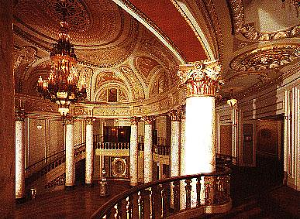
Mass Medium Stage
The rise of movie palaces
Notes:
http://www.alma-mahler.at/engl/info_hollywood/spielort.html

Slide 39
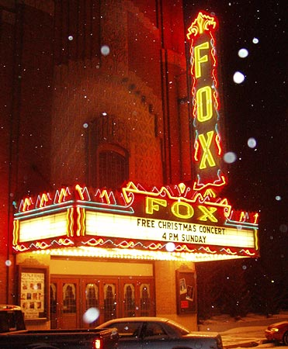
Mass Medium Stage
Notes:
http://www.alma-mahler.at/engl/info_hollywood/spielort.html

Slide 40
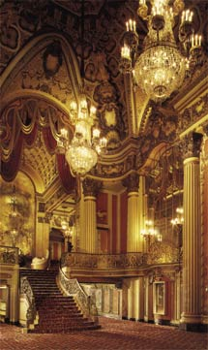
Notes:
http://www.alma-mahler.at/engl/info_hollywood/spielort.html

Slide 41
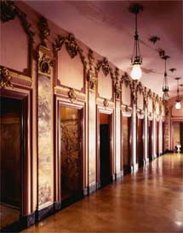

Slide 42
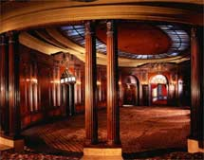
Mass Medium Stage
Notes:
http://www.alma-mahler.at/engl/info_hollywood/spielort.html

Slide 43
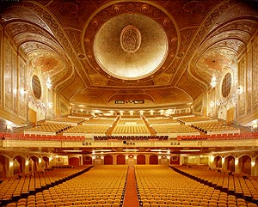
Mass Medium Stage
Notes:
http://www.alma-mahler.at/engl/info_hollywood/spielort.html

Slide 44
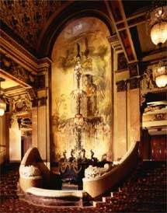
Mass Medium Stage
Notes:
http://www.alma-mahler.at/engl/info_hollywood/spielort.html

Slide 45
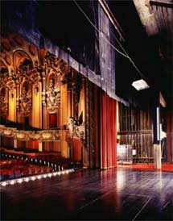
Notes:
http://www.alma-mahler.at/engl/info_hollywood/spielort.html

Slide 46
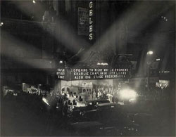
Mass Medium Stage
Notes:
http://www.alma-mahler.at/engl/info_hollywood/spielort.html

Slide 47
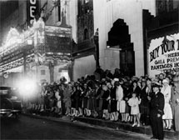
Mass Medium Stage
Notes:
http://www.alma-mahler.at/engl/info_hollywood/spielort.html

Slide 48
Let’s go to the Movies

Slide 49
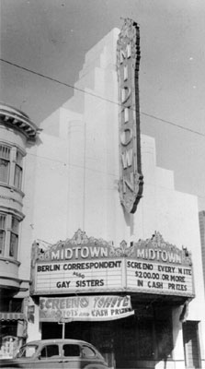
  Mid-town theatres
  (near major intersections
  in neighborhoods.)

Slide 50
Studio System
BIG FIVE
Paramount
MGM
RKO
Warner Bros.
Twentieth Century Fox
LITTLE THREE
Columbia
Universal
United Artists

Slide 51
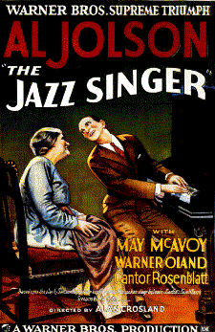
Triumph of Hollywood Storytelling
Storytelling
enhanced by sound
Al Jolson
  Jazz Singer, 1927
  Singing fool, 1928
Notes:
http://www.parlorsongs.com/bios/aljolson/aljolson.asp

Slide 52
Triumph of Hollywood Storytelling
Hollywood Narrative:
  Story: What happens to whom
  Discourse: The way the story is told

Slide 53
Triumph of Hollywood Storytelling
Hollywood Genres
by making films that fall into genres, Hollywood provides familiar models that can be imitated. (romance, horror, etc)
  Product standardization
  Product differentiation

Slide 54
Triumph of Hollywood Storytelling
Hollywood “authors”

Slide 55
Triumph of Hollywood Storytelling
Alternatives to Hollywood
Foreign Films
Bollywood
China
Hong Kong
Japan
S. Korea

Slide 56
Triumph of Hollywood Storytelling
Alternatives to Hollywood
Independent Cinema
Documentary
Errol Morris; Michael Moore; Ken Burns

Slide 57
Transformation of
Hollywood System
1946: peak attendance:
  90 million/week
FOUR KEY EVENTS

Slide 58
Transformation of
Hollywood System
1. The Hollywood Ten: 1947, House UnAmerican Activities Committee (HUAC) TEN went to Prison

Slide 59
Transformation of
Hollywood System
1. The Hollywood Ten: 1947, House UnAmerican Activities Committee (HUAC)
2. Paramount Decision, 1948. Ends vertical integration

Slide 60
Transformation of
Hollywood System
1. The Hollywood Ten: 1947, House UnAmerican Activities Committee (HUAC)
2. Paramount Decision, 1948. Ends vertical integration
3. Moving to the suburbs

Slide 61
Transformation of
Hollywood System
1. The Hollywood Ten: 1947, House UnAmerican Activities Committee (HUAC)
2. Paramount Decision, 1948. Ends vertical integration
3. Moving to the suburbs
4. Television changes Hollywood

Slide 62
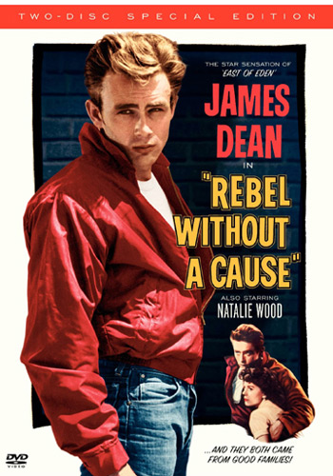
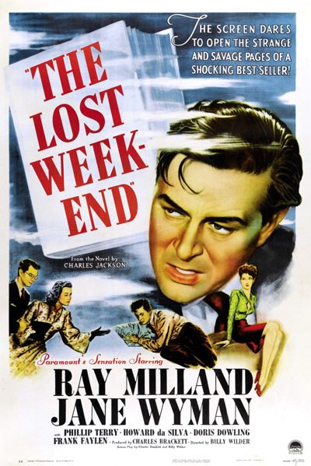
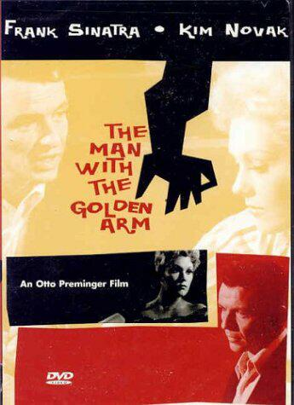
Movies begin to tackle more controversial topics

Slide 63
Economics of the Movie Business

Slide 64
Economics of Movie Business
Total average cost in 2007 was $106.6 million.
      $70.8 M to produce
      $35.9 M to Market
To recover these costs, studios receive money from at least 6 sources:

Slide 65
Economics of Movie Business
Box office revenues (20%)
(Studios only get part of take…split on sliding scale)
2. DVD sales and rentals (50%)
PPV and premium cable
Distribution in foreign markets
Distribution of independent films
Product placements and marketing “synergy” (Behind the Screens)

Slide 66
1940s Studios
BIG FIVE
Paramount
MGM
RKO
Warner Bros.
Twentieth Century Fox
LITTLE THREE
Columbia
Universal
United Artists

Slide 67
TODAY: BIG SIX in order of hugeness
20th Century Fox
Disney
Sony
GE/ NBC Universal
Time warner
Viacom/Paramount
The Weinstein Co.
Lion’s gate
$1,048,000,000
$997,000,000
$988,000,000
$741,000,000
$712,000,000
$554,800,000
$189,500,000
$176,100,000

Slide 68
Blockbusters
Star Wars (1977)
Empire Strikes Back (1980)
The Return of the Jedi (1983)
The three films earned $1.3 Billion in Box Office, and $4 Billion in merchandising.

Slide 69
Blockbuster mentality
  Big-budget summer/holiday releases (expensive promotion)
  Merchandising tie-ins
  Young target audience
  Tendency toward franchise films/sequels

Slide 70
Shift from Film to Digital Format
Digital production -- shoot with digital, not film cameras.
Digital distribution -- can save $millions in making prints and sending out reels.
Digital exhibition -- digital projectors.
Online exhibition
  The Princess of Nebraska

Slide 71
Popular Movies and Implications for Democracy
    Commercial U.S. films function as consensus narratives by providing shared cultural experiences.
    With the rise of international media conglomerates, however, movie diversity and a public debate over America’s domination of the global film business falls by the wayside.

