Slide 1
Multi Site
Global Searchbox
SearchHub = SiteName, Tab=All
QPL = Search
Main Interface
SearchHub = SiteName, Tab = All, Products
QPL = Search
Listing1
SearchHub = Listings, Tab=SiteNameListName
QPL = Listing
Listing2
SearchHub = Listings, Tab = SiteNameListName
QPL = Listing
Recommendations
ContentType=News
originLevel1=SiteName QPL = Recommendations

Slide 2
Single Site
SITE1
QPL
ML Models
ART_Site1
QS_Site1
Search
Listings
Recommendations
ML Models
ART_Listings
ML Models
Rec_Site1

Slide 3
Single Site
SITE1
QPL
ML Models
ART_Site1
QS_Site1
Search
Listings
Recommendations
ML Models
ART_Site1
QS_Site1
Rec_Site1
ML Models
ART_Listings
ML Models
Rec_Site1
ART_Listings

Slide 4
Multi Site
CLIENT ORG
SITE1
SITE2
SITE3
QPL: Search
ML Models: * ART_Site1 * QS_Site1
QPL: Search
ML Models: * ART_Site2 * QS_Site2
QPL: Search
ML Models: * ART_Site2 * QS_Site2
QPL: Recommend ML Models: * Rec_Site1
Listings QPL: Listings OriginLevel1: Listings OriginLevel2: ListSite2
Listings QPL: Listings OriginLevel1: Listings OriginLevel2: ListSite1
QPL: Recommend ML Models: * Rec_Site2
QPL: Recommend ML Models: * Rec_Site2
Listings QPL: Listings OriginLevel1: Listings OriginLevel2: ListSite2

Slide 5
Multi Site
SITE1
QPL
ML Models
ART_Site1
QS_Site1
Search
Listings
Recommendations
ML Models
ART_Site1
QS
Rec
ML Models
ART_Listings
ML Models
Rec_Site1
SITE2
QPL
Search
ML Models
ART_Site2
QS_Site2
Listings
ML Models
ART_Listings
Recommendations
ML Models
Rec_Site2
Rec_Site2
ART
ART_Site2
QS_Site1
QS_Site2
Rec_Site1
ART_Listings

Slide 6
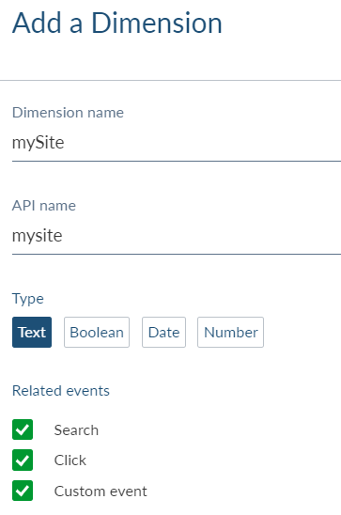
Recommendations
Dimension:
Create a new Dimension called mySite

Slide 7
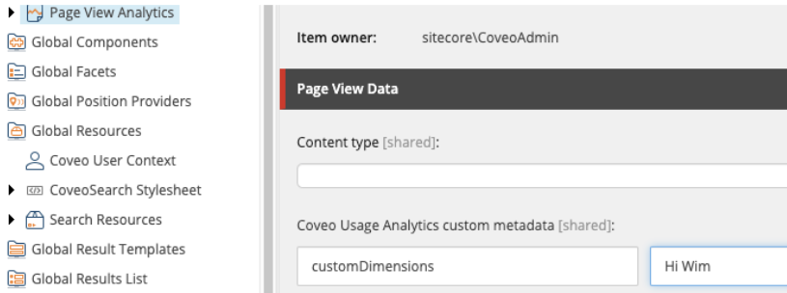
Recommendations
PageViews:
Set ContentType to ‘News’, ‘Articles’ https://docs.coveo.com/en/1818/coveo-machine-learning/sending-usage-analytics-view-events
Set in your ‘Page View Analytics’ component the Coveo Usage Analytics custom data to: mySite = SITENAME (in the above example: customDimensions = Hi Wim)
Search:
Set a proper SearchHub = SITENAME (same as OriginLevel1)
Analytics:
Set a the proper originLevel1 = SITENAME (same as OriginLevel1)
Query Pipeline:
Only create a new one if requirements change (Like thesaurus, ranking expressions)

Slide 8
Recommendations
For all search pages ([YOUR_SITECORE_INSTANCE]\Views\Coveo Hive\Search Interfaces\Coveo Search Interface.cshtml)
Add the following script: var root = document.body;
Coveo.$$(root).on('changeAnalyticsCustomData', function(e, args) {
args.metaObject['mySite'] = CURRENTSITE;
})

Slide 9
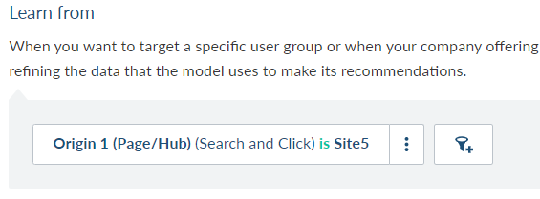
Recommendations
ML Models:
Recommendations:
Use ‘Edit JSON’ after creating an ‘Event Recommendation model’: "viewEventFilter": "(c_mysite=~'SITENAME')"
ART/QS:

Slide 10
Summary
Use only a Query Pipeline if you have different rules
For every site use a dedicated ML Model, with ‘Learn from rules’. The ‘learn from’ will filter on OriginLevel1 = Sitename
Recommendations need an additional contextKey (if needed) contentKey is only needed when recommendations should be split (Like News, Articles)
Recommendations are using the c_mysite eventfilter

Slide 11
Changes Needed – Back-end
Conditions
For every SiteName you need a condition (OriginLevel1 = SiteName)
Query Pipelines:
Search
Reference multiple QS models, with conditions set on the SiteName
Reference multiple ART models, with conditions set on the SiteName
Listings
Reference ART model, with conditions set on the SiteName (Listings)
Recommendations
Reference Recommendations_Site ML Model, with conditions set on the c_mysite
ML Models:
For each SiteName:
QS_SiteName
ART_SiteName
Recommendations_SiteName

