Slide 1


Umpire-CricketScorer: Your Comprehensive Cricket Companion
Umpire-CricketScorer is a user-friendly website designed to revolutionize the way you score and analyze cricket matches. It's your one-stop solution for managing cricket scores, tracking statistics, and reviewing past matches.
by Vaibhav Solanki

Slide 2
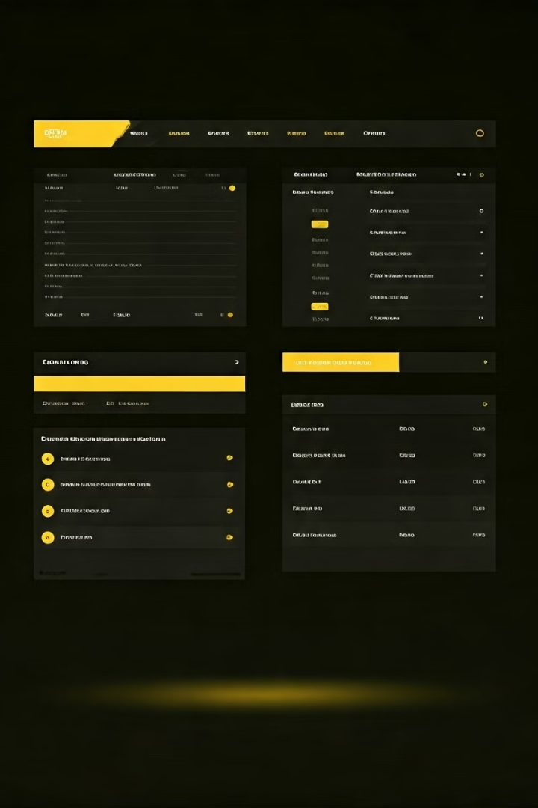
Features of Umpire-cricketScorer
1
Scoring and Statistics
2
Match History
Record scores, wickets, boundaries, and more. Analyze detailed statistics for batsmen, bowlers, and teams.
Review past matches and track performance over time. Access detailed summaries and individual statistics.
3
Team Management
4
User-Friendly Interface
Create and manage teams with ease. Track player records.
Enjoy a smooth and intuitive interface designed for efficiency and ease of use. Access all features with simple clicks and navigation.

Slide 3
Scoring and Statistics
Batsmen
Bowlers
Teams
Track individual batsmen's runs, strike rates, and boundaries. Analyze their performance over various matches.
Monitor bowlers' wickets, economy rates, and overs bowled. Evaluate their effectiveness and identify areas for improvement.
View overall team performance with total wins, losses, and total match played. Analyze strengths and weaknesses across different matches.

Slide 4
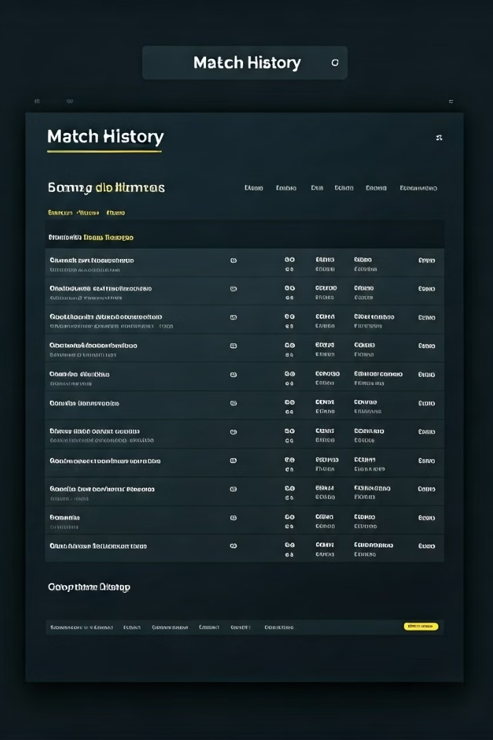
Displaying Previous Match Details
1
Match Summary
View concise summaries of past matches including scores, wickets, and match results.
2
Match Report
Access detailed reports with inning-wise scores, player statistics, and highlights for in-depth analysis.
3
Team Comparison
Compare team performance over various matches, analyze head-to-head records, and identify trends.

Slide 5

Advantages of Using Umpire-CricketScorer
Accurate and Detailed Statistics
Gain insights from comprehensive and reliable data for better decision-making.
Time-Saving and Efficient
Simplify scorekeeping and analysis with user-friendly tools, saving valuable time.
Enhanced Match Analysis
Uncover trends, identify weaknesses, and develop effective strategies for future matches.
Improved Team Performance
Optimize performance with data-driven insights and a deeper understanding of player strengths and weaknesses.

Slide 6
Thank You!
We appreciate your interest in Umpire-CricketScorer. Your feedback helps us improve our platform. We strive to provide you with the best cricket scoring and analysis tools.

