Slide 1
Park Kibum (Polar)
Skip-Thought Vector
Skip-Though Vector (2015)

Slide 2
CONTENTS
Background
Introduction
Approach
Questions
Reference

Slide 3
Skip-Thought Vector
Background
Abstract & Background Knowledge

Slide 4
01
Abstract
paragraph vector (doc2vec)
- An approach for unsupervised learning of a generic, distributed sentence encoder.
- An approach for unsupervised learning of a generic, distributed sentence encoder.
- Using the continuity of text from books, we train an encoder-decoder model that tries to reconstruct the surrounding sentences of an encoded passage.
- Using the continuity of text from books, we train an encoder-decoder model that tries to reconstruct the surrounding sentences of an encoded passage.
- Sentences that share semantic and syntactic properties are thus mapped to similar vector representations.
- Sentences that share semantic and syntactic properties are thus mapped to similar vector representations.
- We next introduce a simple vocabulary expansion method to encode words that were not seen as part of training.
- We next introduce a simple vocabulary expansion method to encode words that were not seen as part of training.
Skip-Gram, extend to sentences.

Slide 5
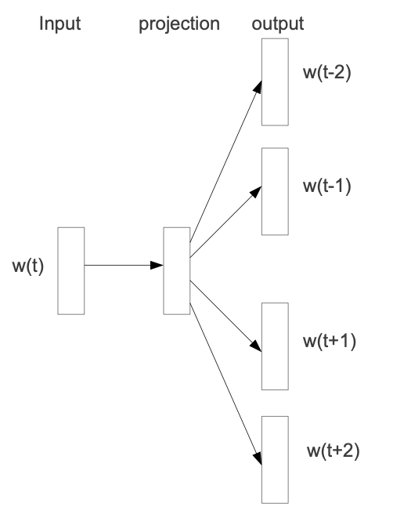
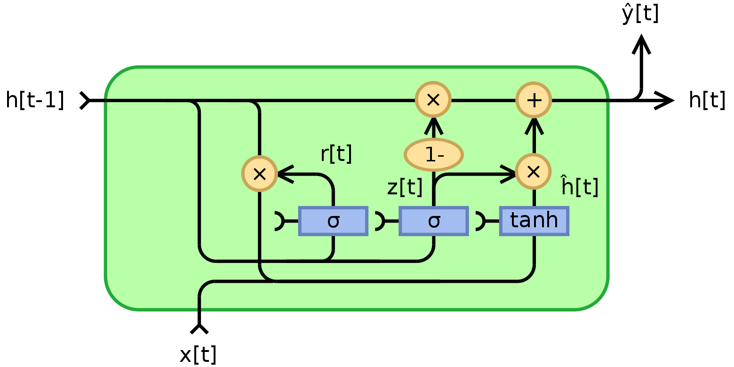
01
BG Knowledge
Word2Vec : Skip-Gram + doc2vec
RNN : Gated Recurrent Unit
출처: https://commons.wikimedia.org/wiki/File:Gated_Recurrent_Unit,_type_1.svg
출처: Distributed Representations of Words and Phrases and their Compositionality

Slide 6
Skip-Thought Vector
Introduction
논문의 방법론

Slide 7
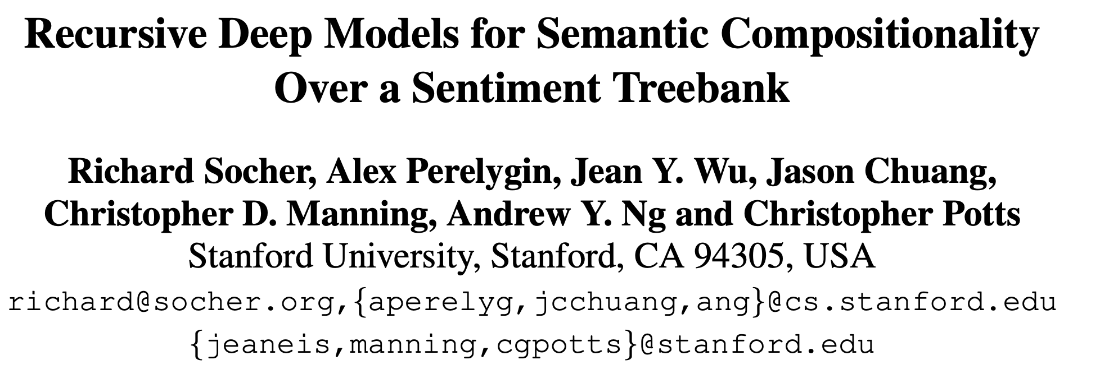
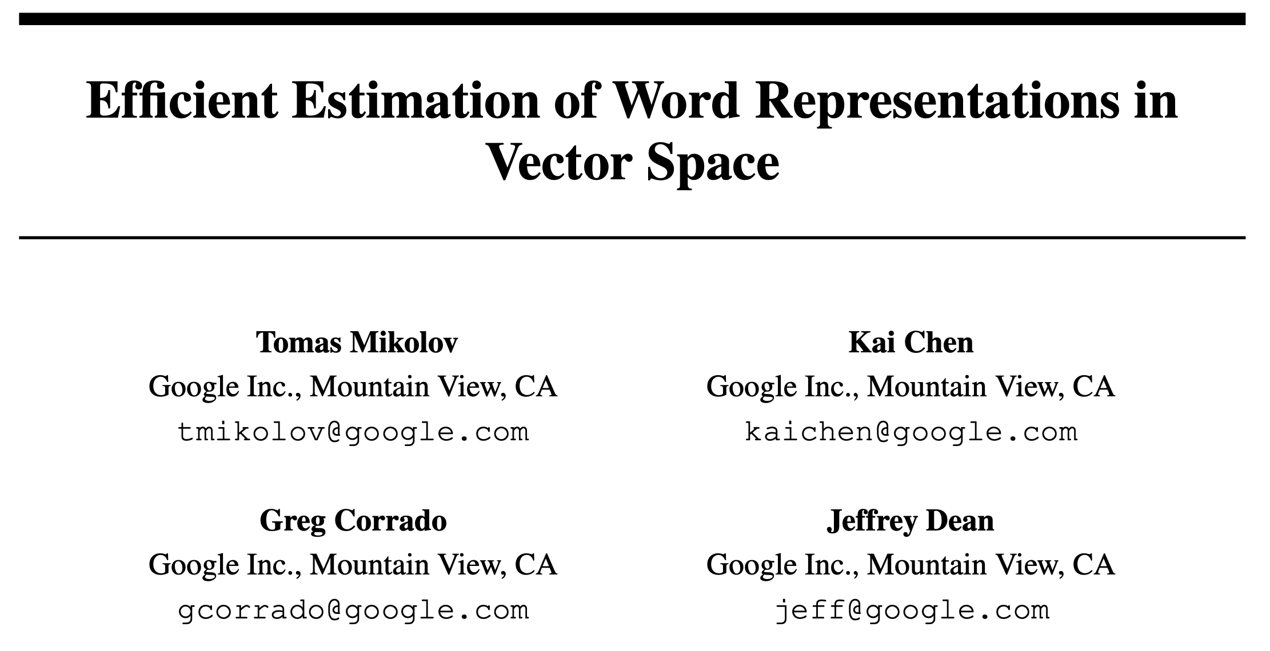
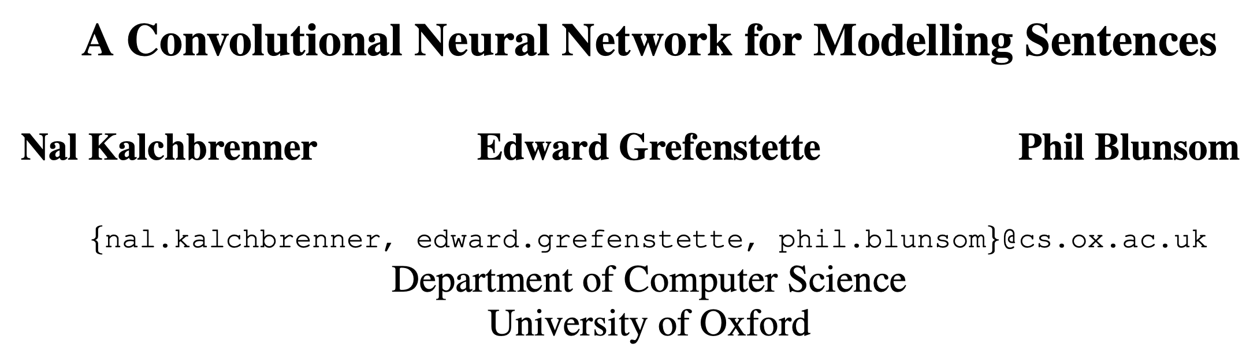

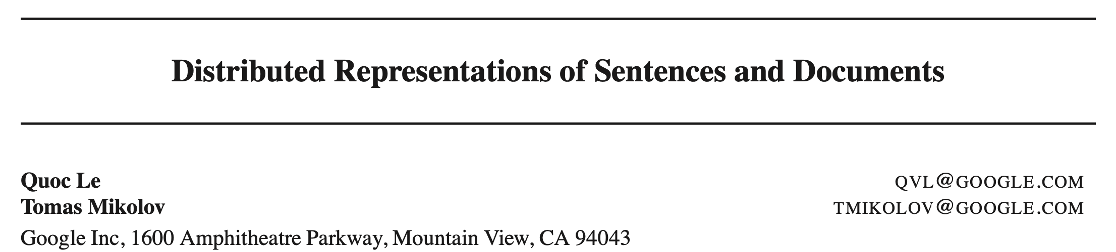
02
Introduction
문제 제기

Slide 8
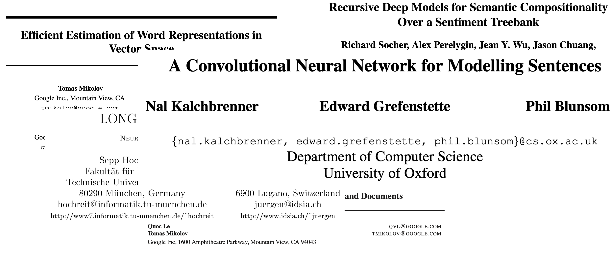
02
Introduction
문제 제기
기존의 방법론 : supervised task
tuned only respective task
= not generally
+
Vocabulary Expansion

Slide 9
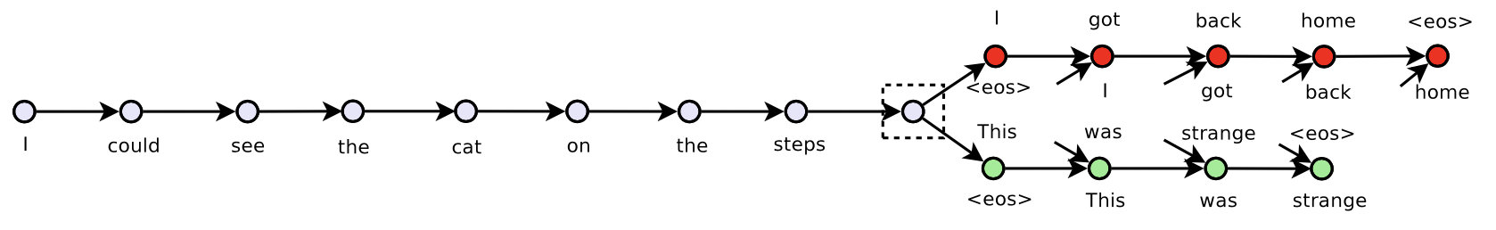
02
Introduction
Paper Targets
: Skip-thoughts (Skip-Gram sentence version)
- Is there a task and a corresponding loss that will allow us to learn highly generic sentence representations?
I got back home. I could see the cat on the steps. This was strange.

Slide 10
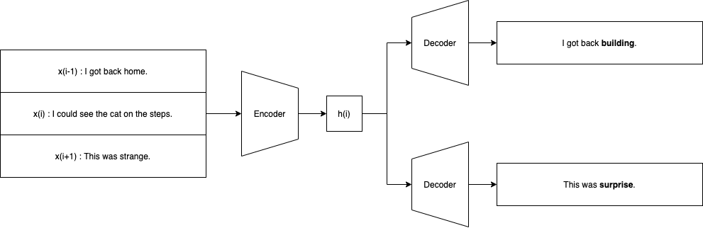
02
Introduction

Slide 11
Skip-Thought Vector
Approach
Encoder / Decoder / Objective

Slide 12
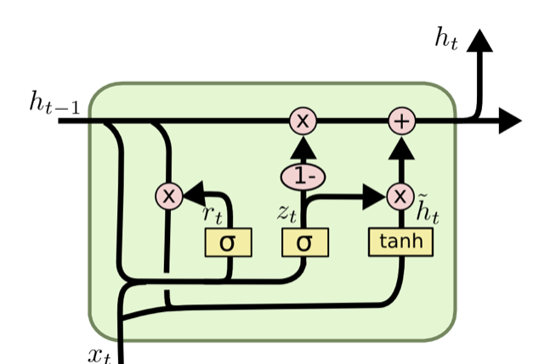
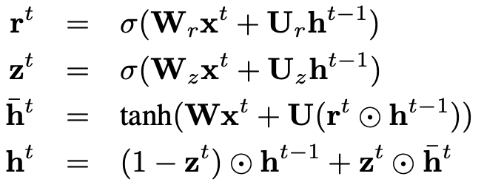

03
Approach
Encoder : sentence → vector
sentence $s_{i}$ = $(w_{i}^{0}, w_{i}^{1} , ⋯, w_{i}^{t}, ⋯, w_{i}^{n})$ (length : n)
embedding $𝕩_{i}$ = $(𝕩_{i}^{0}, 𝕩_{i}^{1} , ⋯, 𝕩_{i}^{t}, ⋯, 𝕩_{i}^{n})$ (length : n)
sentence tuple : $(s_{i−1}, s_{i}, s_{i+1})$

Slide 13
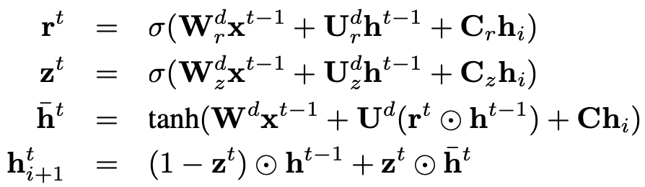
03
Approach
Decoder : vector → sentence
sentence $s_{i}$ = $(w_{i}^{0}, w_{i}^{1} , ⋯, w_{i}^{t}, ⋯, w_{i}^{n})$ (length : n)
embedding $𝕩_{i}$ = $(𝕩_{i}^{0}, 𝕩_{i}^{1} , ⋯, 𝕩_{i}^{t}, ⋯, 𝕩_{i}^{n})$ (length : n)
sentence tuple : $(s_{i−1}, s_{i}, s_{i+1})$
(i+1) sentence case

Slide 14

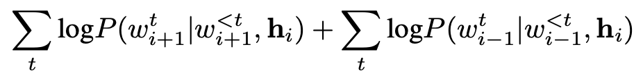
03
Approach
Objective
sum of log-probabilities
모든 training tuple의 합이 최종 objective

Slide 15
03
Approach
Vocabulary Expansion
One difficulty in building a model to handle sentences is that a single word can be changed and yet the meaning of the sentence is the same.
문장은 단어가 1개가 바뀌어도 동일한 뜻을 지님
pre-trained CBOW word2vec을 사용해서 단어번역(translate)을 통해 훈련셋에 없는 단어를 학습
One challenge in building a model to handle sentences is that a single word can be changed and yet the meaning of the sentence is the same.

Slide 16
Skip-Thought Vector
Questions
Github Issues

Slide 17
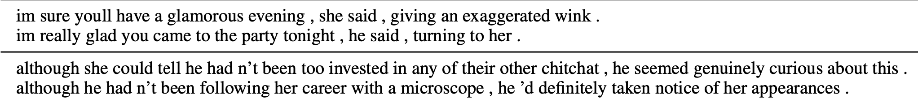
04
Questions
Q. 데이터 셋의 편향성이 정말로 없는가?
A. 있습니다.
Romance와 Fantasy 데이터가 많다 보니 모델의 생성 문장이 외설적(salacious)이라고 합니다.
sourced by) https://www.kdnuggets.com/2016/11/deep-learning-group-skip-thought-vectors.html

Slide 18

04
Questions
Q. Vocab matrix가 학습단계에서 어떤 방식으로 활용되고 조정되는지 궁금합니다.
A. Pre-trained CBOW Word2Vec의 결과를 활용합니다.
We solve this problem by learning a mapping that transfers word representations from one model to another.
Using pre-trained word2vec representations learned with a continuous bag-of-words model, we learn a linear mapping from a word in word2vec space to a word in the encoder’s vocabulary space.
The mapping is learned using all words that are shared between vocabularies. After training, any word that appears in word2vec can then get a vector in the encoder word embedding space
$$ν_{w2v} ⊃ν_{rnn}$$
아마도요…?

Slide 19
Skip-Thought Vector
Reference

Slide 20
05
Reference
1. Deep Learning Reading Group: Skip-Thought Vectors,
https://www.kdnuggets.com/2016/11/deep-learning-group-skip-thought-vectors.html
2. Skip-Thought Vector의 PyTorch 구현,
http://www.nextobe.com/2020/05/14/skip-thought-vector의-pytorch-구현/
3. dennybritz/deeplearning-papernotes,
https://github.com/dennybritz/deeplearning-papernotes/blob/master/notes/skip-thought-vectors.md
4. paperswithcode: skip-thought (ryankiros/skip-thoughts 참고),
https://paperswithcode.com/paper/skip-thought-vectors

Slide 21
Skip-Thought Vector
THANK YOU

