Slide 1
Welcome To Math 463: Introduction to Mathematical Biology

Slide 2
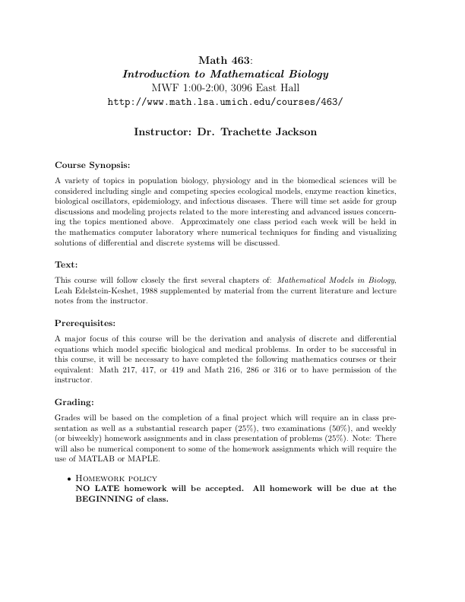

Slide 4
What is Mathematical Modeling?
A mathematical model is the formulation in mathematical terms of the assumptions believed to underlie a particular real-world problem
Mathematical modeling is the process of deriving such a formulation

Slide 5
Why is it Worthwhile to Model Biological Systems
To help reveal possible underlying mechanisms involved in a biological process
To help interpret and reveal contradictions/incompleteness of data
To help confirm/reject hypotheses
To predict system performance under untested conditions
To supply information about the values of experimentally inaccessible parameters
To suggest new hypotheses and stimulate new experiments

Slide 6
What are some Limitations of Mathematical Models
Not necessarily a ‘correct’ model
Unrealistic models may fit data very well leading to erroneous conclusions
Simple models are easy to manage, but complexity is often required
Realistic simulations require a large number of hard to obtain parameters

Slide 7
Disclaimer
Models are not explanations and can never alone provide a complete solution to a biological problem.

Slide 8
How Are Models Derived?
Start with at problem of interest
Make reasonable simplifying assumptions
Translate the problem from words to mathematically/physically realistic statements of balance or conservation laws

Slide 9
What do you do with the model?
Solutions—Analytical/Numerical
Interpretation—What does the solution mean in terms of the original problem?
Predictions—What does the model suggest will happen as parameters change?
Validation—Are results consistend with experimental observations?

Slide 10
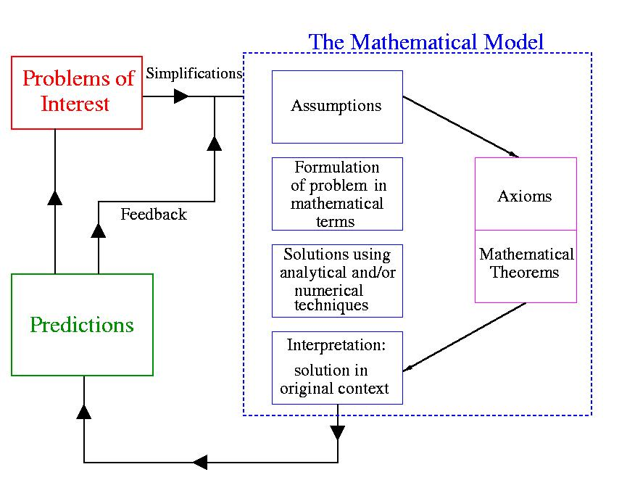
The Modeling Process

Slide 11
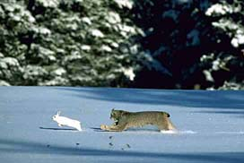
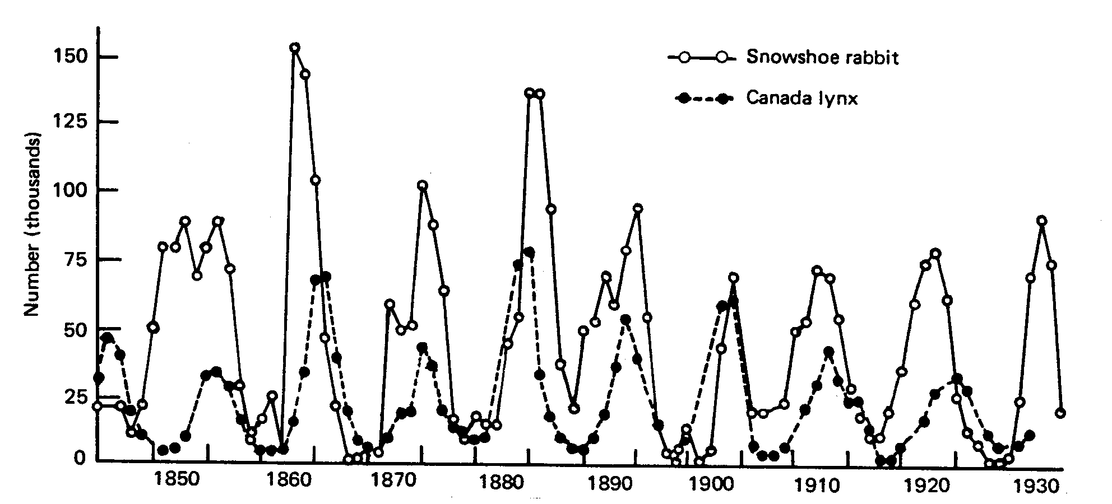
Modeling Has Made a Difference
Example 1: Population Ecology
Canadian lynx and snowshoe rabbit
Predator-prey cycle was predicted by a mathematical model

Slide 12
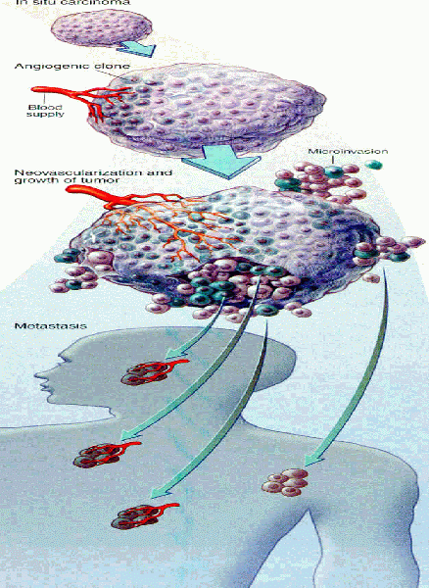
Modeling Has Made A Difference Example 2: Tumor Growth
Mathematical models have been developed that describe tumor progression and help predict response to therapy.

Slide 13
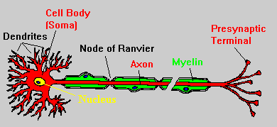
Modeling Has Made a Difference
Example 3: Electrophysiology of the Cell
In the 1950’s Hodgkin and Huxley introduced the first model to designed to reproduce cell membrane action potentials
They won a nobel prize for this work and sparked the a new field of mathematics—excitable systems

Slide 14
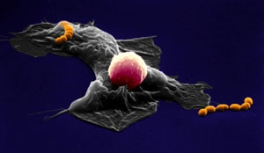
Modeling Has Made a Difference
Example 4: Microbiology/Immunology
How do immune cells find a bacterial target?
Under what conditions can the immune system control a localized bacteria infection?
If the immune system fails, how will the bacteria spread in the tissue?

Slide 15

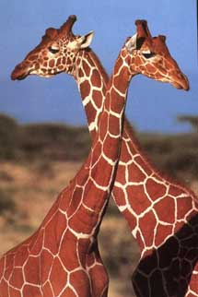
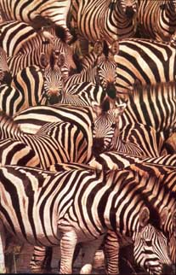
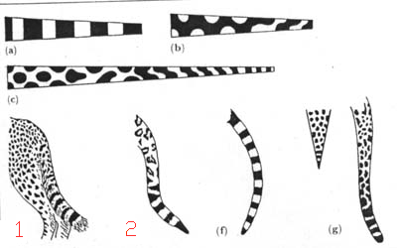
Modeling Has Made a Difference
Example 5: Biological Pattern Formation
How did the leopard get its spots?
A single mechanism can predict all of these patterns

Slide 16
Course Goals
Critical understanding of the use of differential equation methods in mathematical biology
Exposure to specialized mathematical/computations techniques which are required to study ODEs that arise in mathematical biology
By the end of this course you will be able to derive, interpret, solve, understand, discuss, and critique discrete and differential equation models of biological systems.

Slide 17
Discrete-Time Models
Lecture 1

Slide 18
When To Use Discrete-Time Models
Discrete models or difference equations are used to describe biological phenomena or events for which it is natural to regard time at fixed (discrete) intervals.
Examples:
The size of an insect population in year i;
The proportion of individuals in a population carrying a particular gene in the i-th generation;
The number of cells in a bacterial culture on day i;
The concentration of a toxic gas in the lung after the i-th breath;
The concentration of drug in the blood after the i-th dose.

Slide 19
What does a model for such situations look like?
Let x_{n} be the quantity of interest after n time steps.
The model will be a rule, or set of rules, describing how x_{n} changes as time progresses.
In particular, the model describes how x_{n+1} depends on x_{n} (and perhaps x_{n-1}, x_{n-2}, …).
In general: x_{n+1} = f(x_{n}, x_{n-1}, x_{n-2}, …)
For now, we will restrict our attention to:
x_{n+1} = f(x_{n})

Slide 20
Terminology
The relation x_{n+1} = f(x_{n}) is a difference equation; also called a recursion relation or a map.
Given a difference equation and an initial condition, we can calculate the iterates x₁, x₂ …, as follows:
x₁ = f(x₀)
x₂ = f(x₁)
x₃ = f(x₂)
.
.
.
The sequence {x₀, x₁, x₂, …} is called an orbit.

Slide 21
Question
Given the difference equation x_{n+1} = f(x_{n}) can we make predictions about the characteristics of its orbits?

Slide 22
Modeling Paradigm
Future Value = Present Value + Change x_{n+1} = x_{n} + Δ x_{n}
Goal of the modeling process is to find a reasonable approximation for Δ x_{n} that reproduces a given set of data or an observed phenomena.

Slide 23
Example: Growth of a Yeast Culture
The following data was collected from
an experiment measuring the growth of a yeast culture:
Time (hours) Yeast biomass Change in biomass
n p_{n} Δp_{n} = p_{n+1} - Δp_{n}
0 9.6 8.7
1 18.3 10.7
2 29.0 18.2
3 47.2 23.9
4 71.1 48.0
5 119.1 55.5
6 174.6 82.7
7 257.3

Slide 24
Change in Population is Proportional to the Population
Change in biomass vs. biomass
Δp_{n}
Δp_{n} = p_{n+1} - p_{n} ~ 0.5p_{n}
Change in biomass
100
50
p_{n}
50 100 150 200
Biomass

Slide 25
Explosive Growth
From the graph, we can estimate that Δp_{n} = p_{n+1} - p_{n} ~ 0.5p_{n} and we obtain the model
p_{n+1} = p_{n} + 0.5p_{n} = 1.5p_{n}
The solution is:
p_{n+1} = 1.5(1.5p_{n-1}) = 1.5[1.5(1.5p_{n-2})] = … = (1.5)^{n+1} p₀
p_{n} = (1.5)^{n}p₀.
This model predicts a population that increases forever.
Clearly we should re-examine our data so that we can come up with a better model.

Slide 26
Example: Growth of a Yeast Culture Revisited
Time (hours) Yeast biomass Change in biomass
n p_{n} Δp_{n} = p_{n+1} - Δp_{n}
0 9.6 8.7
1 18.3 10.7
2 29.0 18.2
3 47.2 23.9
4 71.1 48.0
5 119.1 55.5
6 174.6 82.7
7 257.3 93.4
8 350.7 90.3
9 441.0 72.3
10 513.3 46.4
11 559.7 35.1
12 594.8 34.6
13 629.4 11.5
14 640.8 10.3
15 651.1 4.8
16 655.9 3.7
17 659.6 2.2
18 661.8

Slide 27
Yeast Biomass Approaches a Limiting Population Level
700
100
Yeast biomass
5 10 15 20
Time in hours
The limiting yeast biomass is approximately 665.

Slide 28
Refining Our Model
Our original model: Δp_{n} = 0.5p_{n} p_{n+1} = 1.5p_{n}
Observation from data set: The change in biomass becomes smaller as the resources become more constrained, in particular, as p_{n} approaches 665.
Our new model: Δp_{n} = k(665- p_{n}) p_{n} p_{n+1} = p_{n} + k(665- p_{n}) p_{n}

Slide 29
Testing the Model
We have hypothesized Δp_{n} = k(665-p_{n}) p_{n} ie, the change in biomass is proportional to the product (665-p_{n}) p_{n} with constant of proportionality k.
Let’s plot Δp_{n} vs. (665-p_{n}) p_{n} to see if there is reasonable proportionality.
If there is, we can use this plot to estimate k.

Slide 30
Testing the Model Continued
100
Change in biomass
10
50,000 100,000 150,000
(665 - p_{n}) p_{n}
Our hypothesis seems reasonable, and the constant of
Proportionality is k ~ 0.00082.

Slide 31
Comparing the Model to the Data
Our new model: p_{n+1} = p_{n} + 0.00082(665-p_{n}) p_{n}
700
100
Experiment
Model
Yeast biomass
5 10 15 20
Time in hours

Slide 32
The Discrete Logistic Model
x_{n+1 =} x_{n} + k(N - x_{n}) x_{n}
Interpretations
  Growth of an insect population in an environment with limited resources
    x_{n} = number of individuals after n time steps (e.g. years)
    N = max number that the environment can sustain
  Spread of infectious disease, like the flu, in a closed population
    x_{n} = number of infectious individuals after n time steps (e.g. days)
    N = population size

Slide 33
Two Models Examined So Far
Model 1 (linear): Geometric Growth
  x_{n+1} = x_{n} + kx_{n} →
  x_{n+1} = rx_{n}, where r = 1+k
Model 2 (nonlinear): Logistic Growth
  x_{n+1 =} x_{n} + k(N - x_{n}) x_{n} →
  x_{n+1 =} rx_{n}(1-x_{n}/K), where r = 1+kN and K = r/k

Slide 34
Model 1: Geometric Growth
The Model: x_{n+1} = rx_{n}
The Solution: x_{n =} x₀r^{n}
x_{n}
r >1
0 < r < 1
n
r < -1
-1 < r < 0

Slide 35
Model 2: Logistic Growth
x_{n+1 =} rx_{n}(1-x_{n}/K)
There is no explicit solution
  That is we cannot write down a formula for x_{n} as a function of n and the initial condition, x₀.
However, given values for r and K we can predict happens to x_{n} in the long run (very interesting behavior arises)
But first we’ll explore linear models in more detail

Slide 36
Friday
Meet in B735 Computer Lab
MATLAB Tutorial and Computer Assignment #1

