Slide 1
K Nearest Neighbors (KNN) Method ML ALGORITHM

Slide 2
Machine Learning Methods Machine Learning is a branch of data science based on the idea that systems can learn from data, identify patterns and make decisions with minimal human intervention.

Slide 3
MACHINE LEARNING METHODS
There is lot of overlapping between statistical modeling and machine learning. The Regression Models are used extensively in ML applications.
Logistic Regression
Support Vector Machines
K Nearest Neighbours Method (KNN)
Random Forest
Decision Trees
Naive Bayes Classifier
Linear Regression
Regression and Machine Learning Algorithms

Slide 4
Classical Statistical Models vs. Machine Learning Methods
There is lot of overlapping between statistical modeling and machine learning. The Regression Models are used extensively in ML applications.
Statistical Model has model equation, set of regression coefficients and hypothesis testing is performed to test the significance of coefficients.
Machine Learning Algorithms do not follow above approach but end output is comparable- Either predicted probabilities and predicted values

Slide 5
Introduction
KNN is a a simple algorithm that stores all available cases and classifies new cases based on a similarity measure.
In this method, K neighbors of a new case are obtained from training data. The classification is performed using ‘majority vote’ concept.
There is no model equation like logistic regression.
KNN is conceptually simple, yet able to solve complex problems . The k-NN algorithm is among the simplest of all machine learning algorithms.
KNN is one of the lazy learning algorithm. (The term "lazy" refers to the fact that KNN doesn't do any work during the training phase besides storing the data. It defers the processing to the prediction phase, where it actively searches through the stored data to make predictions.)
Memory and CPU cost is high.

Slide 6
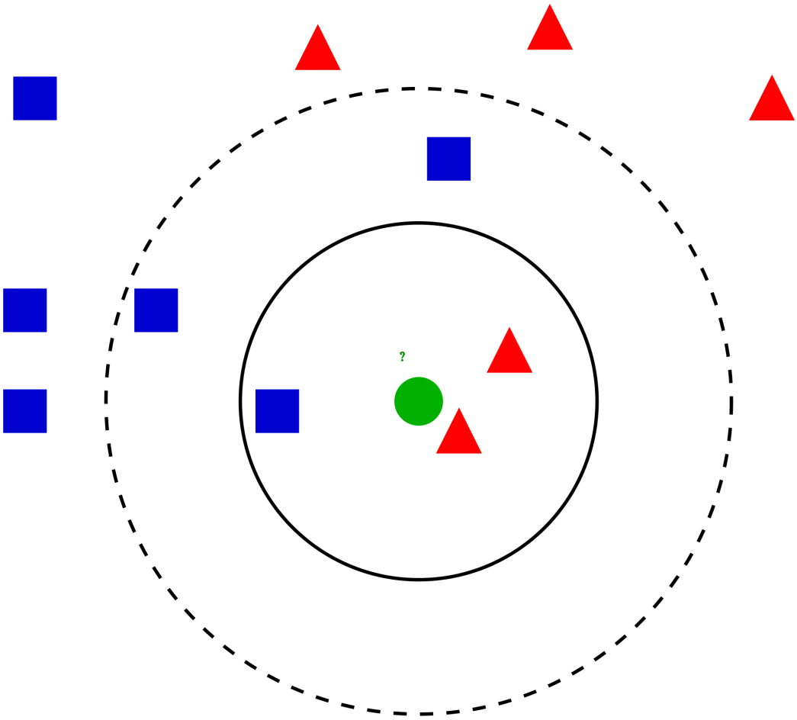
KNN Classification
There are 2 types of objects:
Y=0
Y=1
What is the “class” of new object
(green circle)?
Analyze neighbors
Class of new object

Slide 7
KNN Classification – Distance Concept to Find Neighbor
Age | Current Debt | Default | Distance
25 | 40,000 | 0 | 102000
35 | 60,000 | 0 | 82000
45 | 80,000 | 0 | 62000
20 | 20,000 | 0 | 122000
35 | 120,000 | 0 | 22000
52 | 18,000 | 0 | 124000
23 | 95,000 | 1 | 47000
40 | 62,000 | 1 | 80000
60 | 100,000 | 1 | 42000
48 | 220,000 | 1 | 78000
33 | 150,000 | 1 | 8000
 |  |  | “Blue case is new case. Red cases are 3 neighbours of new case based on Distances. Two out of 3 are defaulters. So new case is predicted as defaulter”
48 | 142,000 | ?

Slide 8
KNN Classification Distance Based On Standardized Variables
Age | Current Debt | Default | Distance
0.125 | 0.11 | 0 | 0.7652
0.375 | 0.21 | 0 | 0.5200
0.625 | 0.31 | 0 | 0.3160
0 | 0.01 | 0 | 0.9245
0.375 | 0.50 | 0 | 0.3428
0.8 | 0.00 | 0 | 0.6220
0.075 | 0.38 | 1 | 0.6669
0.5 | 0.22 | 1 | 0.4437
1 | 0.41 | 1 | 0.3650
0.7 | 1.00 | 1 | 0.3861
0.325 | 0.65 | 1 | 0.3771
0.7 | 0.61 | ?
Can also use usual (X-mean)/SD
Note that now out of 3 nearest neighbors
2 are non defaulters.

Slide 9
Classification Using KNN Method
If K=1 then the case is classified using nearest neighbor.
Usually K is greater than 1. The case is classified to most frequent class of K neighbors. A simple approach to select k is set K=sqrt(n) where n is number of observations in training data.
KNN can be used to solve regression problem. The estimated value for the case is average of K neighbors.
Imagine data of millions of customers. Memory and CPU cost is high since distances are to be stored and sorted.

Slide 10
Snapshot of the Data
AGE | EMPLOY | ADDRESS | DEBTINC | CREDDEBT | OTHDEBT | DEFAULTER
3 | 17 | 12 | 9.30 | 11.36 | 5.01 | 1
1 | 10 | 6 | 17.30 | 1.36 | 4.00 | 0
2 | 15 | 14 | 5.50 | 0.86 | 2.17 | 0
3 | 15 | 14 | 2.90 | 2.66 | 0.82 | 0
1 | 2 | 0 | 17.30 | 1.79 | 3.06 | 1
3 | 5 | 5 | 10.20 | 0.39 | 2.16 | 0
2 | 20 | 9 | 30.60 | 3.83 | 16.67 | 0
3 | 12 | 11 | 3.60 | 0.13 | 1.24 | 0
1 | 3 | 4 | 24.40 | 1.36 | 3.28 | 1
2 | 0 | 13 | 19.70 | 2.78 | 2.15 | 0
1 | 0 | 1 | 1.70 | 0.18 | 0.09 | 0
1 | 4 | 0 | 5.20 | 0.25 | 0.94 | 0
Age groups: 1 ( <28 years), 2(28-40 years), 3 (>40 years)

Slide 11
Training and Testing Data Sets
#Import csv data BankloanKNN
bankloan<-read.csv(file.choose(),header=T)
library(caret)
index<-createDataPartition(bankloan$SN,p=0.7,list=FALSE)
#Remove variables AGE,SN and DEFAULTER from the data.
#Note that KNN syntax in R requires data without dependent variable.
bankloan2<-subset(bankloan,select=c(-AGE,-SN,-DEFAULTER))
bankloan3<-scale(bankloan2)
traindata<-bankloan3[index,]
testdata<-bankloan3[-index,]
#create class vectors
Ytrain<-bankloan$DEFAULTER[index]
Ytest<-bankloan$DEFAULTER[-index]
Now we have training and testing data sets
ready. In addition, we need vector of dependent
variable for training and testing data.

Slide 12
Running KNN Algorithm in R
library(class)
Ytest_pred<-knn(traindata,testdata,k=17,cl=Ytrain) #model stores classification
table(Ytest,Ytest_pred)
________________________________________________________________
Ytest_pred
Ytest 0 1
0 52 11
1 16 37
Knn function requires training data set, testing
data set and class vector of training data set.
K=17 specifies number of neighbors.
For each observation in the test data,17 neighbors are
obtained. The classification of the observation is based
on majority votes.
Sensitivity=37/53=0.70
Specificity=52/63=0.83
Note: Can use confusionMatrix function in caret
confusionMatrix(as.factor(Ytest_pred),as.factor(Ytest),positive ="1")

Slide 13
KNN Method: Majority Voting
A drawback of the basic "majority voting" classification occurs when the class distribution is skewed. (Imbalanced data problem)
That is, examples of a more frequent class tend to dominate the prediction of the new example, because they tend to be common among the k nearest neighbors due to their large number.
One option to remove this drawback is to create training data with equal class frequency. This is possible only if data is sufficiently large.

Slide 14
k-Nearest Neighbour Regression
KNN algorithm can also be used for regression problems.
The estimated value for the case is average of K neighbors.
Use knnreg function in caret package to perform k-nearest neighbor regression.

Slide 15
Note
KNN is a non-parametric algorithm, meaning it doesn't make assumptions about the underlying data distribution.
KNN can be computationally expensive, especially with large datasets, because it requires storing and searching through the entire training dataset for each prediction.
While both KNN and binary logistic regression can be used for binary classification tasks, they have different characteristics and are suited for different scenarios.
KNN may be preferred when interpretability is less important, and computational resources are not a constraint, while logistic regression may be preferred when interpretability and scalability are important considerations.
KNN (K-Nearest Neighbors) is primarily a classification technique, although it can also be used for regression tasks.

Slide 16
THANK YOU!!

