Slide 1
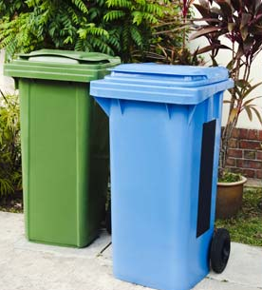
responsiBin
A smart dustbin for the responsible citizen

Slide 2
PRESENTATION OUTLINE
1
PROBLEM DOMAIN
2
PROJECT IDEA
3
STATE OF ART
4
RESEARCH GAP
5
PROBLEM STATEMENT
6
METHODOLOGY
7
RESULTS
8
REFERENCES

Slide 3
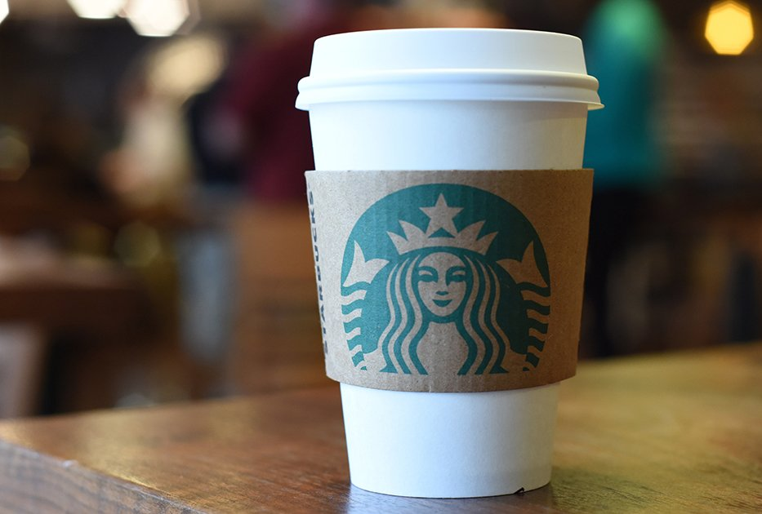
Picture this: You’re standing in front of two dustbins- colour coded Green and Blue, and you have a coffee cup in hand. Which dustbin would you throw it in?
BLUE: Go ahead, your coffee cup is ready to be recycled.
GREEN: Wrong bin! Our responsiBin can help you.

Slide 4
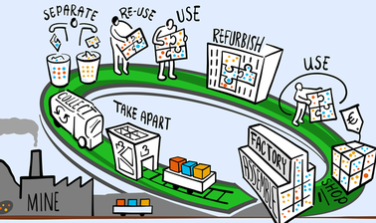
Most of the time, people throw waste without seeing the colour of the bin. The reasons are simple-
careless attitude
no awareness
lack of uniformity in colour codes of these bins across the country
However, citizens fail to realise that the first step towards better waste management starts from their homes, offices and streets.
Swati Singh Sambyal, Programme Manager from Centre for Science and Environment added, “No one knows why and where to put what type of waste.”
This is where responsiBin comes in handy. We use Deep Learning to make this happen.
PROBLEM DOMAIN

Slide 5
EXISTING SYSTEM
In the existing system, citizens dispose waste into the wrong colour-coded bins.
Waste is also seen overflowing from the dustbin onto the streets.
Garbage collection takes place once in 2 or more days, by the corporation due to poor coordination and mis-management.
The odour is heavy, turns into an air pollutant and also causes the spread of diseases.
Street dogs, cows and other such animals consume harmful plastics present in the garbage thrown on the roadside.
These drawbacks are harmful for the environment as well as pedestrians or residents of a particular area.

Slide 6
DISADVANTAGES OF EXISTING SETUP
Some major disadvantages of the existing system, such as:
Lack of recycling due to improper segregation of waste at the initial stages.
Waste of time, effort and man-power.
Trucks being sent to empty bins which are not full yet, while other dustbins are overflowing with waste.
Unhygienic environment and poor maintenance of cities.
These are being addressed by our project.

Slide 7
PROJECT IDEA:
To make a smart dustbin which can categorize waste based on biodegradability, using Deep Learning.
With the help of an Ultrasonic Sensor and camera module, the images of waste must be captured before being disposed.
The image must be processed correctly by the Neural Network and classified.
According to the classification, the corresponding lid of the dustbin must open.
Additionally, an Ultrasonic sensor must detect when the dustbin is filled upto 95% or above to alert the cleaning authorities.
PARTS USED
Camera module -1
Servo motor -2
Raspberry pi -1
Ultrasonic Sensor -1
GPS Sensor -1

Slide 8
Use of innovative technologies in waste management is at least a century old and it
keeps on getting more greener, cleaner and efficient. In this current age, IOT is bringing the tech used in factories to Nano scale where it can be implemented at primary stages and on a larger scale.
Some of the latest technologies are:
Underground Collection system
Web based GIS (Geographical information system) technology
Waste Bin monitoring technology using Global System of mobile (GSM)
Automated Sorting
Modern sorting plants are converting to sensor based sorting systems to improve sorting efficiency. This technology has exempted the low technology or manual sorting options.
STATE OF ART

Slide 9
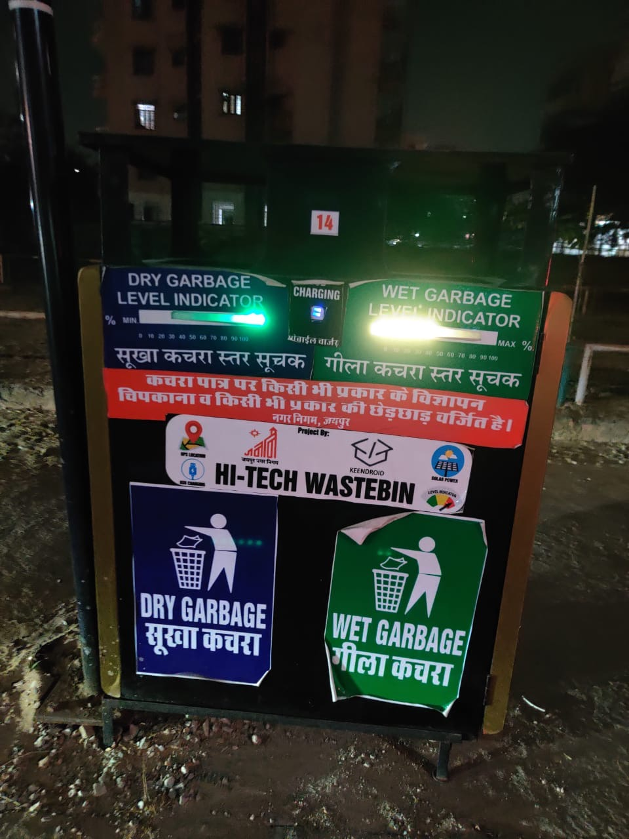
This picture shows a dustbin with waste level indicators in Jaipur.
They have made a separation for Blue waste which includes Dry Garbage and the Green waste which comprises of Wet Garbage. T
The LED indicators have been used to show the levels to which each bin is filled.
Some other models and technologies in the same field include the following features:
PROJECT | Ultrasonic Sensor for Opening | Ultrasonic Sensor for level | IR Sensor for level | Motion Sensor | Servo Motor for Opening | Automatic lid opening | Waste Level detection | Waste Segregation
Model 1 |  | ✅ |  |  |  |  | ✅
Model 2 |  |  |  | ✅ |  | ✅
Model 3 | ✅ |  | ✅ |  |  |  | ✅
Model 4 | ✅ |  |  |  | ✅ | ✅
responsiBin | ✅ | ✅ |  |  | ✅ | ✅ | ✅ | ✅

Slide 10
PROS & CONS OF EXISTING MODELS
PROS
Senses the presence of a human hand, and opens the lid automatically using motion sensor or Ultrasonic sensor.
Detects the level of waste in the bin using Ultrasonic sensor.
Makes use of Servo motor to ensure the lid of the dustbin opens.
CONS
Just a dustbin which opens its lid automatically.
It may or may not prevent the mixing of organic and inorganic wastes.
Does not ensure that the right waste goes into the right bin.
Does not accurately keep track of the level of waste in the bin which results in overflow of litter.
All features are not present within the same dustbin.

Slide 11
RESEARCH GAP
AUTOMATIC WASTE CATEGORIZATION:
In developing countries, Municipal solid waste recycling relies on household separation via scavengers and garbage collectors.
There are a number of important reasons that we encourage waste segregation at the initial stage:
Segregated waste is often cheaper to dispose of because it does not require as much manual or mechanical sorting as mixed waste.
Effective segregation of wastes means less waste goes to the landfill which makes it better for the environment.
Most recyclable waste ends up in a dump yard as it is disposed into the wrong bin.
Management expense i.e. the high cost of manual waste classification.
Since most citizens are unaware of how important it is to separate wastes right at their homes or streets, Recycling has not reached its optimum potential.
This brings to light the need to automate the process of waste categorization, and develop efficient technologies in this area.

Slide 12
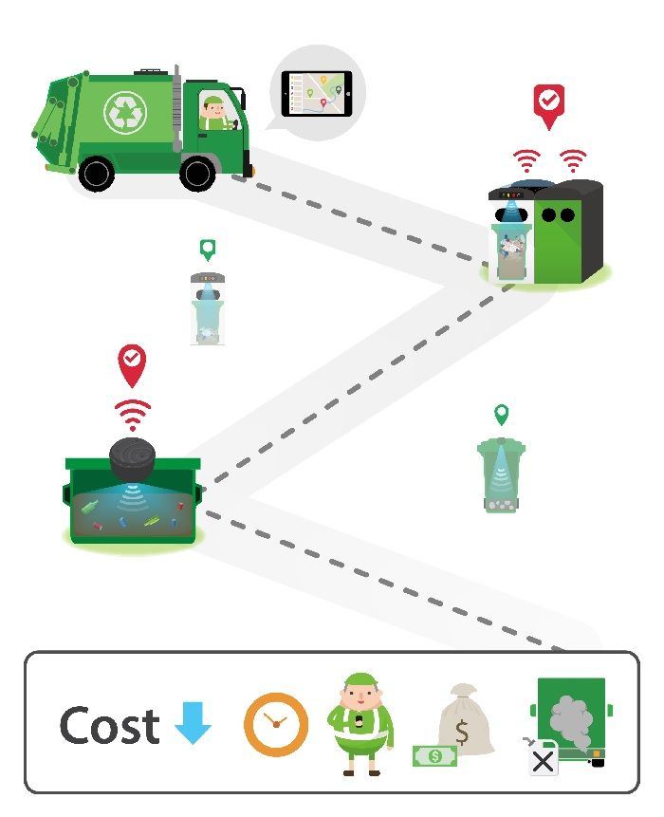
Currently there is no fully effective system for segregation of various types of wastes at the primary stage.
PROBLEM STATEMENT:
The purpose of our project is to make a simple, low cost and user-friendly segregation system for urban cities to process waste management more effectively in India. It aims to make the process of recycling and waste overflow detection easier.

Slide 13
METHODOLOGY
Data collection using web scrapper, Bing API and ImageNet database.
Development of Neural Network model in Python deployed using Keras and TensorFlow 2.0 later converted to TensorFlow Lite for use in Raspberry Pi.
Ultrasonic sensors are used for interaction and level detection.
GPS sensor collects location data.
Camera module which is activated after response of interaction from Ultrasonic sensor is used to capture images.
Images captured from camera module are processed by pre-trained model resulting in waste criteria.
Result from pre trained model is used to signal Servo motors which then opens the correct lid.
Raspberry Pi embedded Wi-Fi module is used to upload data on Google cloud where project Pub/Sub is already set-up.
The respective authorities will be alerted, when the waste level in the dustbin crosses 95%.
Red and green light indicators are used to inform the user whether the lid will open or not.

Slide 14
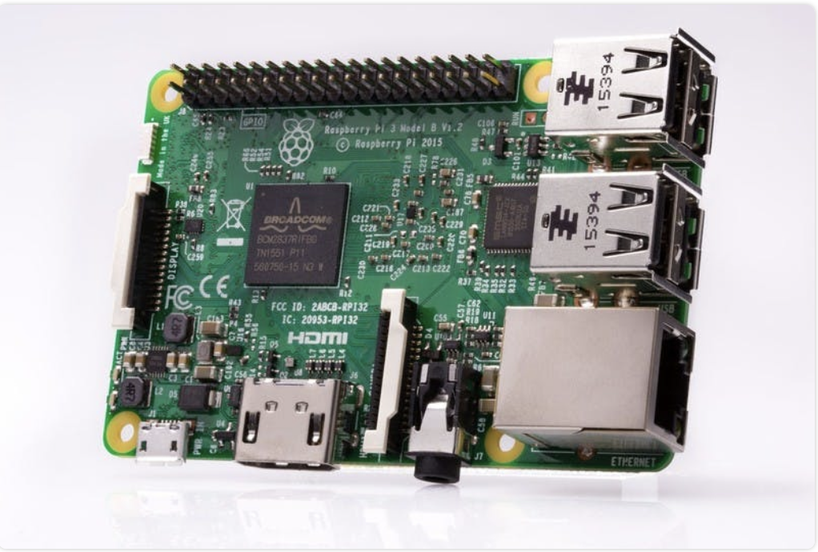
RASPBERRY PI 3 -single board computer -wireless LAN + bluetooth connectivity -used to connect to the cloud -used to attach camera module to capture images -to upload GPS coordinates+ waste level data

Slide 15
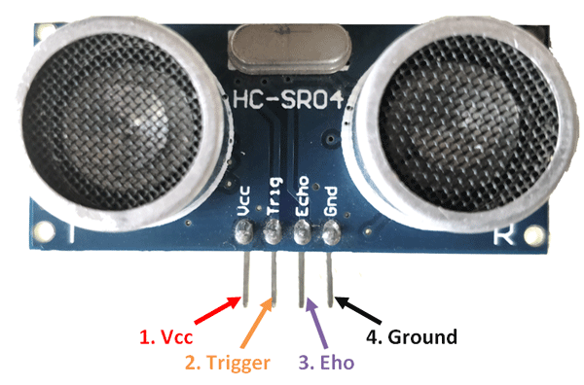
ULTRA SONIC SENSOR -proximity sensor -emit sound waves toward an object and determines its distance from the reflected waves -detect human interaction upto 30 cm range -detect waste level in dustbin

Slide 16
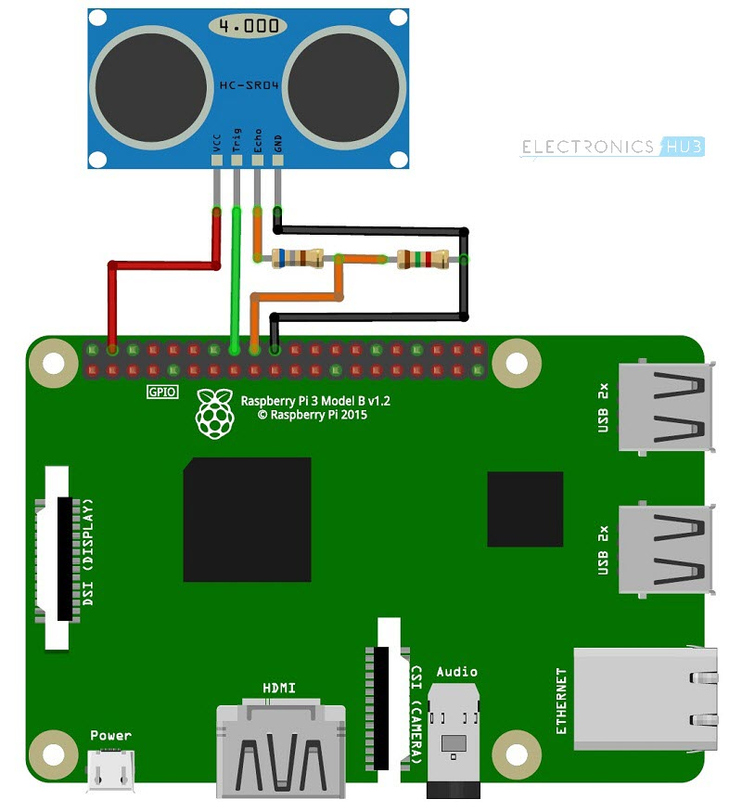
INTERFACING RASPBERRY PI WITH ULTRA SONIC SENSOR -to signal camera module to capture image of the waste - to send waste level data to the cloud
PIN- VCC
PIN- Trig
PIN- Echo
PIN- GND

Slide 17
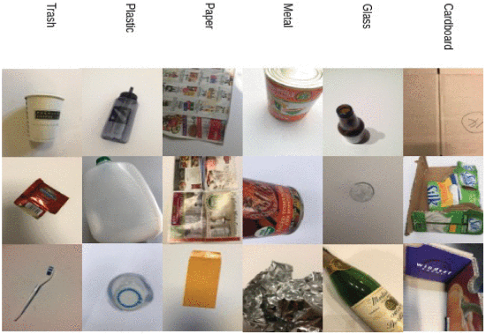
CATEGORIES OF WASTE CLASSIFICATION
There are 7 different Categories: 1. Cardboard, 2. Glass, 3. Metal, 4. Paper, 5. Plastic, 6. Organic, 7. Trash

Slide 18
Neural Network Model
No. of Conv2d Layers=2 filter 16
No. of SepearableConv2d:
2 filter 32
2 filter 64
2 filter 128
2 filter 256
No. of Dense layers:1 unit 512, 1 unit 128, 1 unit 64, 1 unit 1
Echos=10
Activation=relu
Output activation=softmax
Optimizer=adam

Slide 19
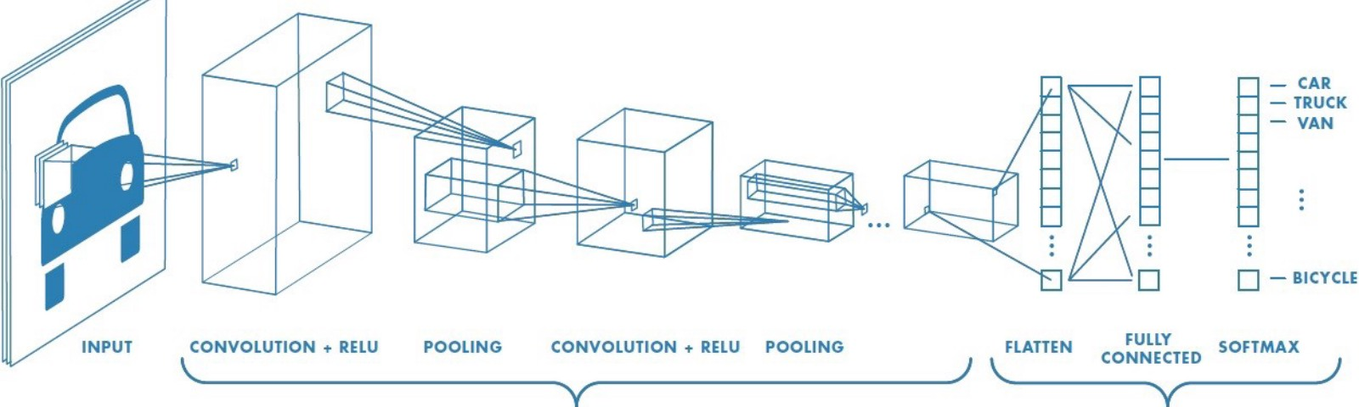
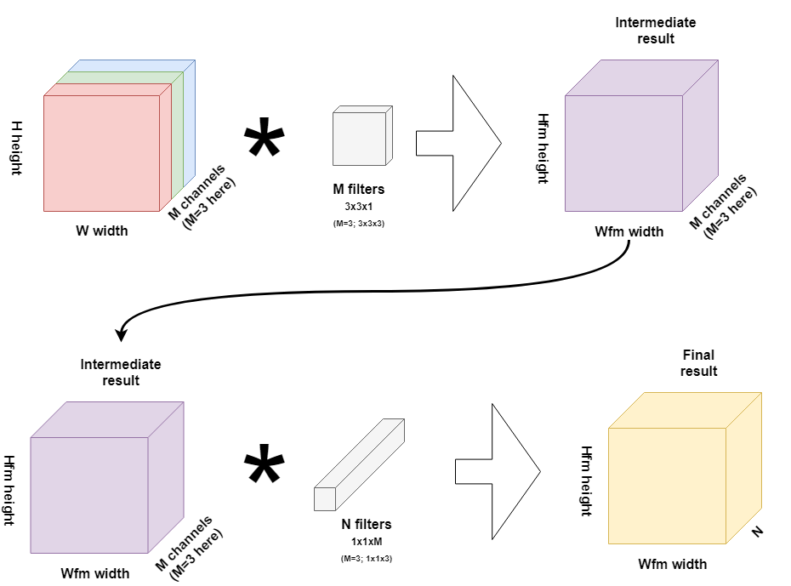
Network Structure

Slide 20
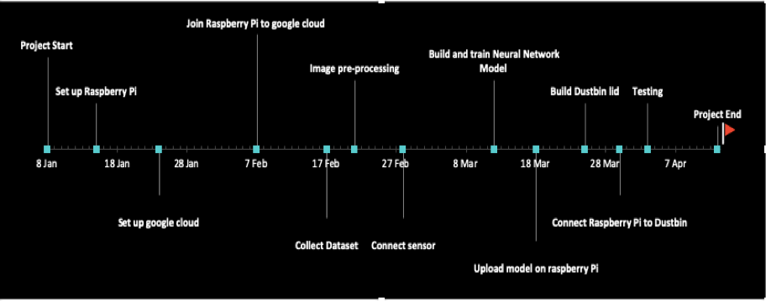
TIMELINE OF PROGRESS
GANTT CHART

Slide 21
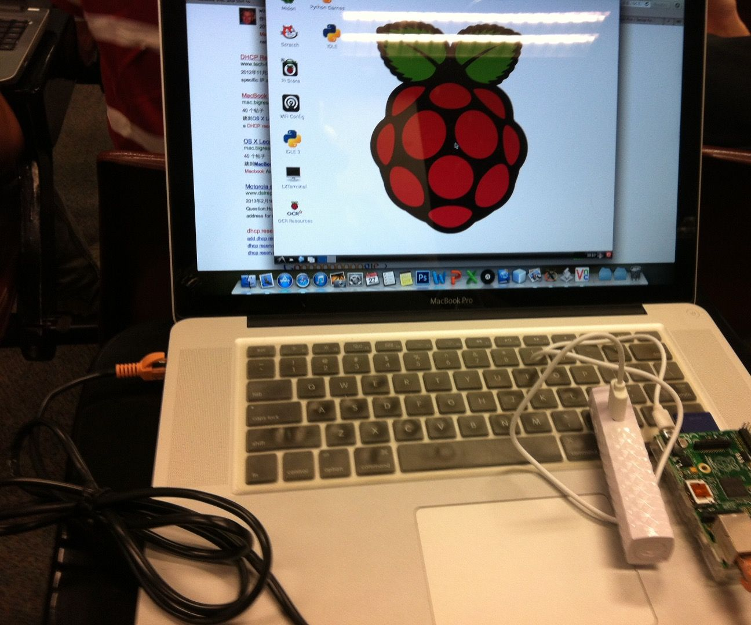
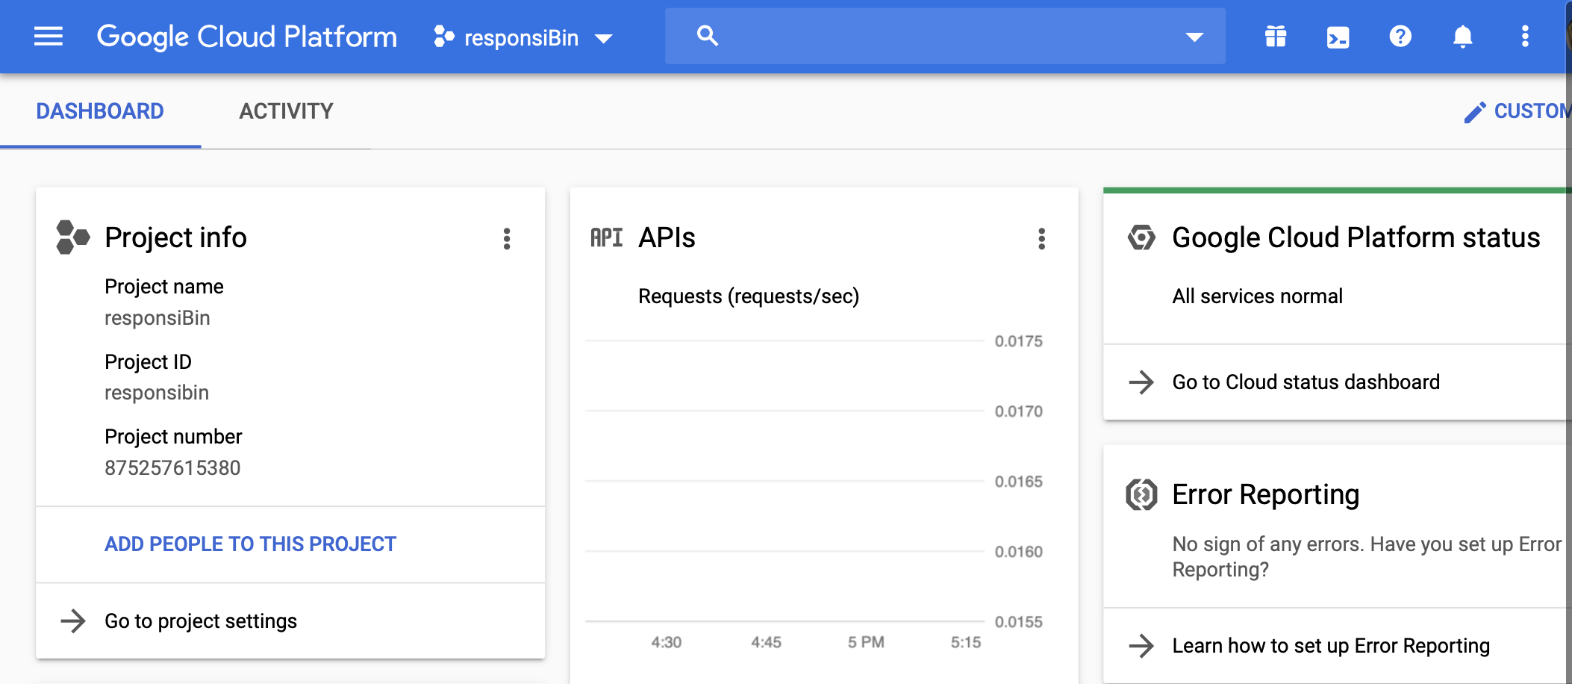
RESULTS
Setting up Raspberry Pi
Setting up Google Cloud Platform

Slide 22
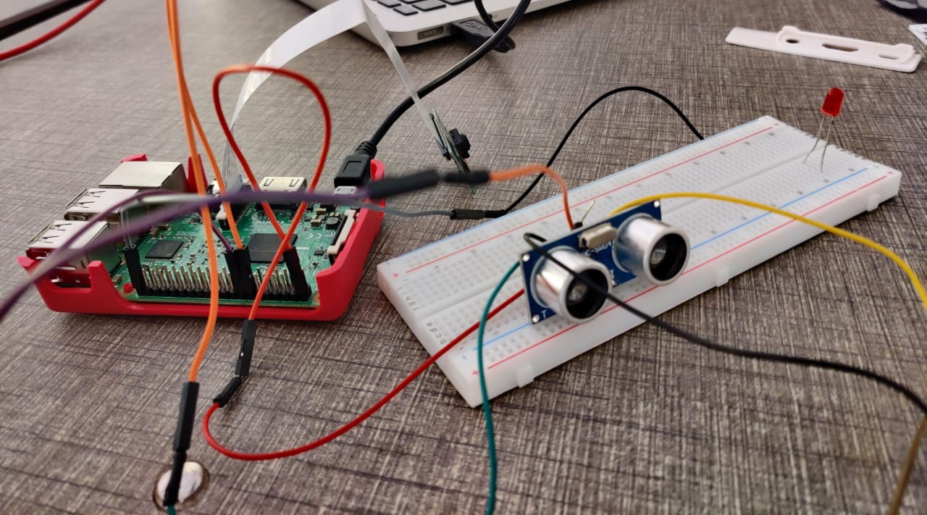
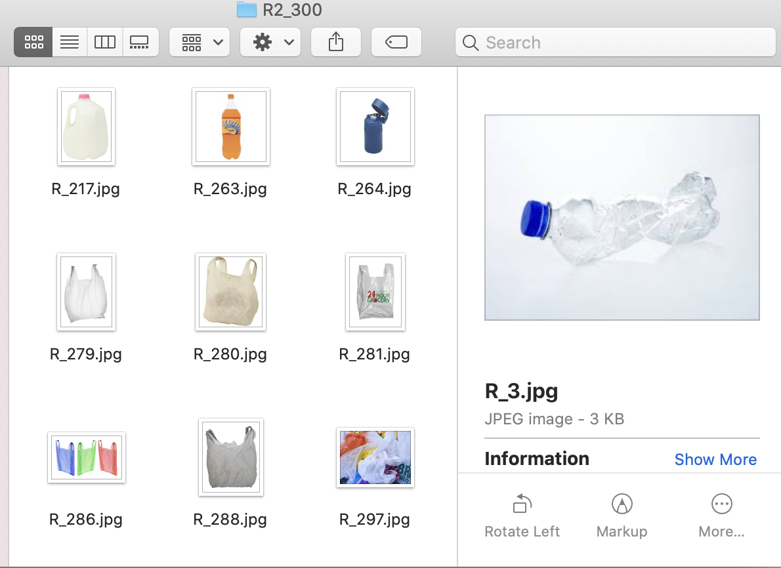
Interfacing the Ultrasonic sensor with Raspberry Pi
Collection and labelling of dataset to train model
RESULTS

Slide 23
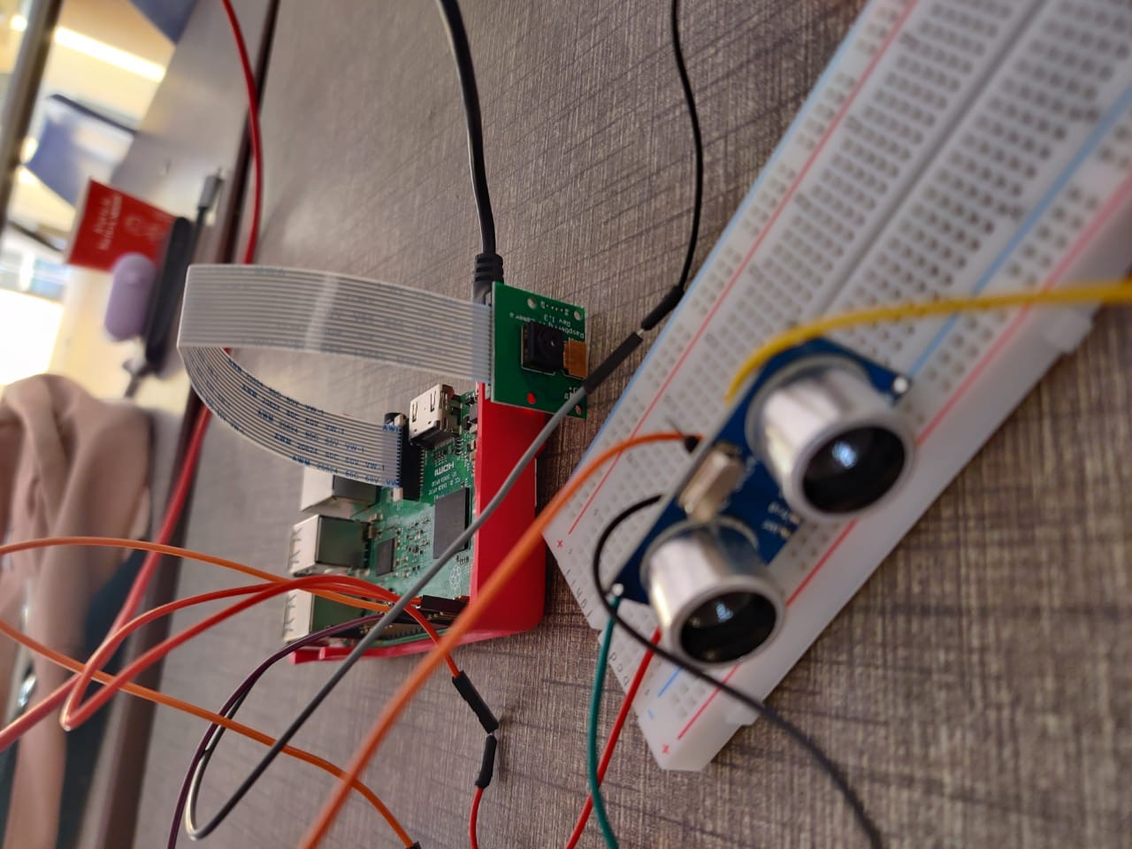
RESULTS
Enabling camera module in Raspberry Pi to capture images

Slide 24
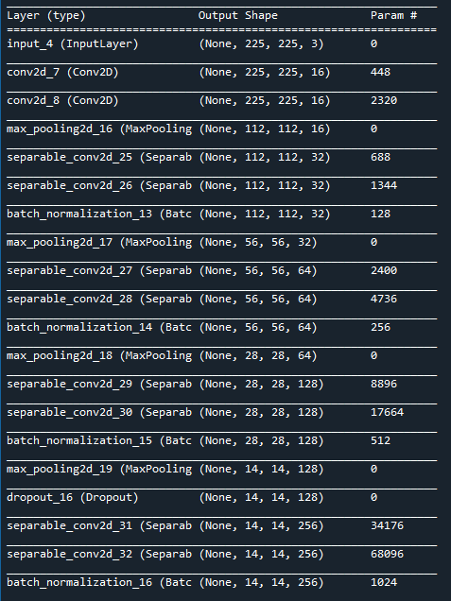
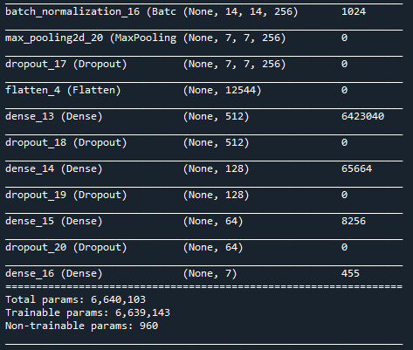
RESULTS
Model Summary: Use of Separable Convolution layers

Slide 25
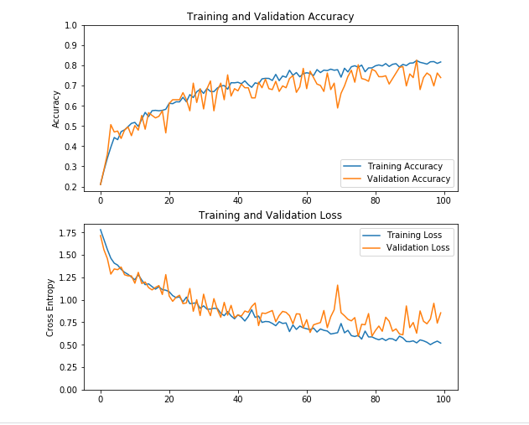
RESULTS

Slide 26
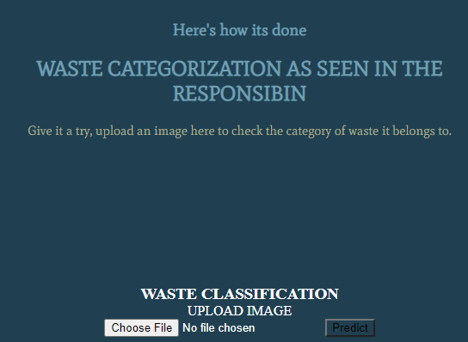
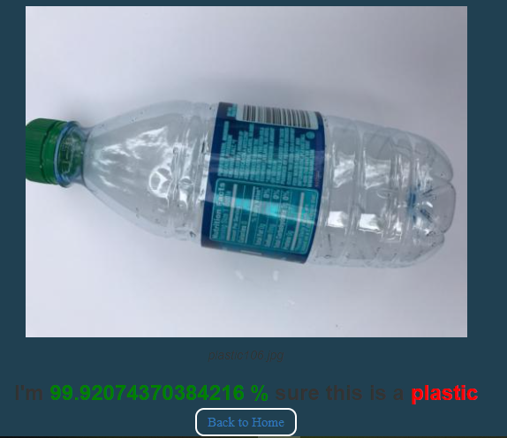
RESULTS

Slide 27
REFERENCES
https://hackernoon.com/tf-serving-keras-mobilenetv2-632b8d92983c
https://www.huffingtonpost.in/entry/psychology-of-why-people-dont-recycle_n_57697a7be4b087b70be605b3
https://en.wikipedia.org/wiki/Waste_sorting
https://swachhindia.ndtv.com/expert-opinion-two-bin-waste-segregation-system-india-launches-world-environment-day-8178/
https://www.em-solutions.co.uk/insights/why-should-i-segregate-my-waste-properly/
https://www.downtoearth.org.in/blog/waste/india-s-challenges-in-waste-management-56753
https://nevonprojects.com/smart-dustbin-with-iot-notifications/
https://www.ijeat.org/wp-content/uploads/papers/v8i6/F9359088619.pdf
https://tutorials-raspberrypi.com/raspberry-pi-ultrasonic-sensor-hc-sr04/
https://www.ijeat.org/wp-content/uploads/papers/v8i6/F9359088619.pdf

Slide 28
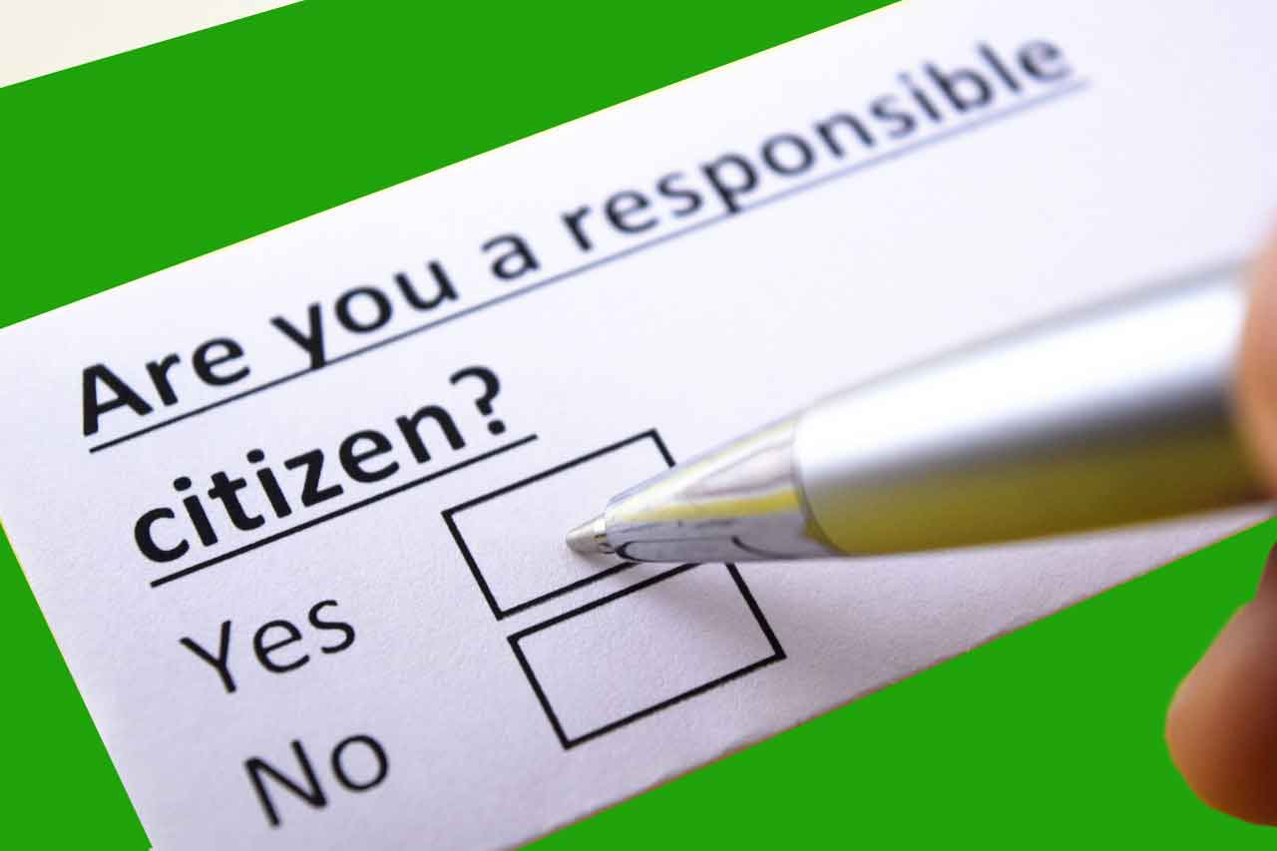
Q&A
THANK YOU!

