Slide 1
Summary of Prevastatin Analysis
5/30/2023

Slide 2
Data analyzed
C:\Users\cowen\Documents\GitHub\LID_Ketamine_String_Pulling\Questions_stephen\Drugs_and_LID_2022
KETStat_LAO Summary_mjb032023.xlsx
Q1_does_prevastatin_reduce_LID.R
I can make all of these figures high-res and nice once we agree on the ones to keep.
Getting a nice figure
Import to Ppt as a .svg.
Edit basics in ppt.
Save as .svg (not as tiff as ppt tiffs are low resolution for some reason).
Import to illustrator
Edit if more editing is needed (or do it all in ppt)
Export as tiff with 600 dpi and cmyk

Slide 3
A
B
Day 0
C
40
40
40
30
30
*
30
*
20
20
*
20
10
10
10
0
0
0
D
E
Day 7
F
****
**
***
40
**
40
**
40
30
30
30
L-DOPA-Induced AIMS
20
20
20
10
10
10
0
0
0
G
H
Day 14
I
40
*
*
40
**
**
40
30
30
30
20
20
20
10
10
10
0
0
0
V
K
KP
V
K
KL
V
P
L

Slide 4
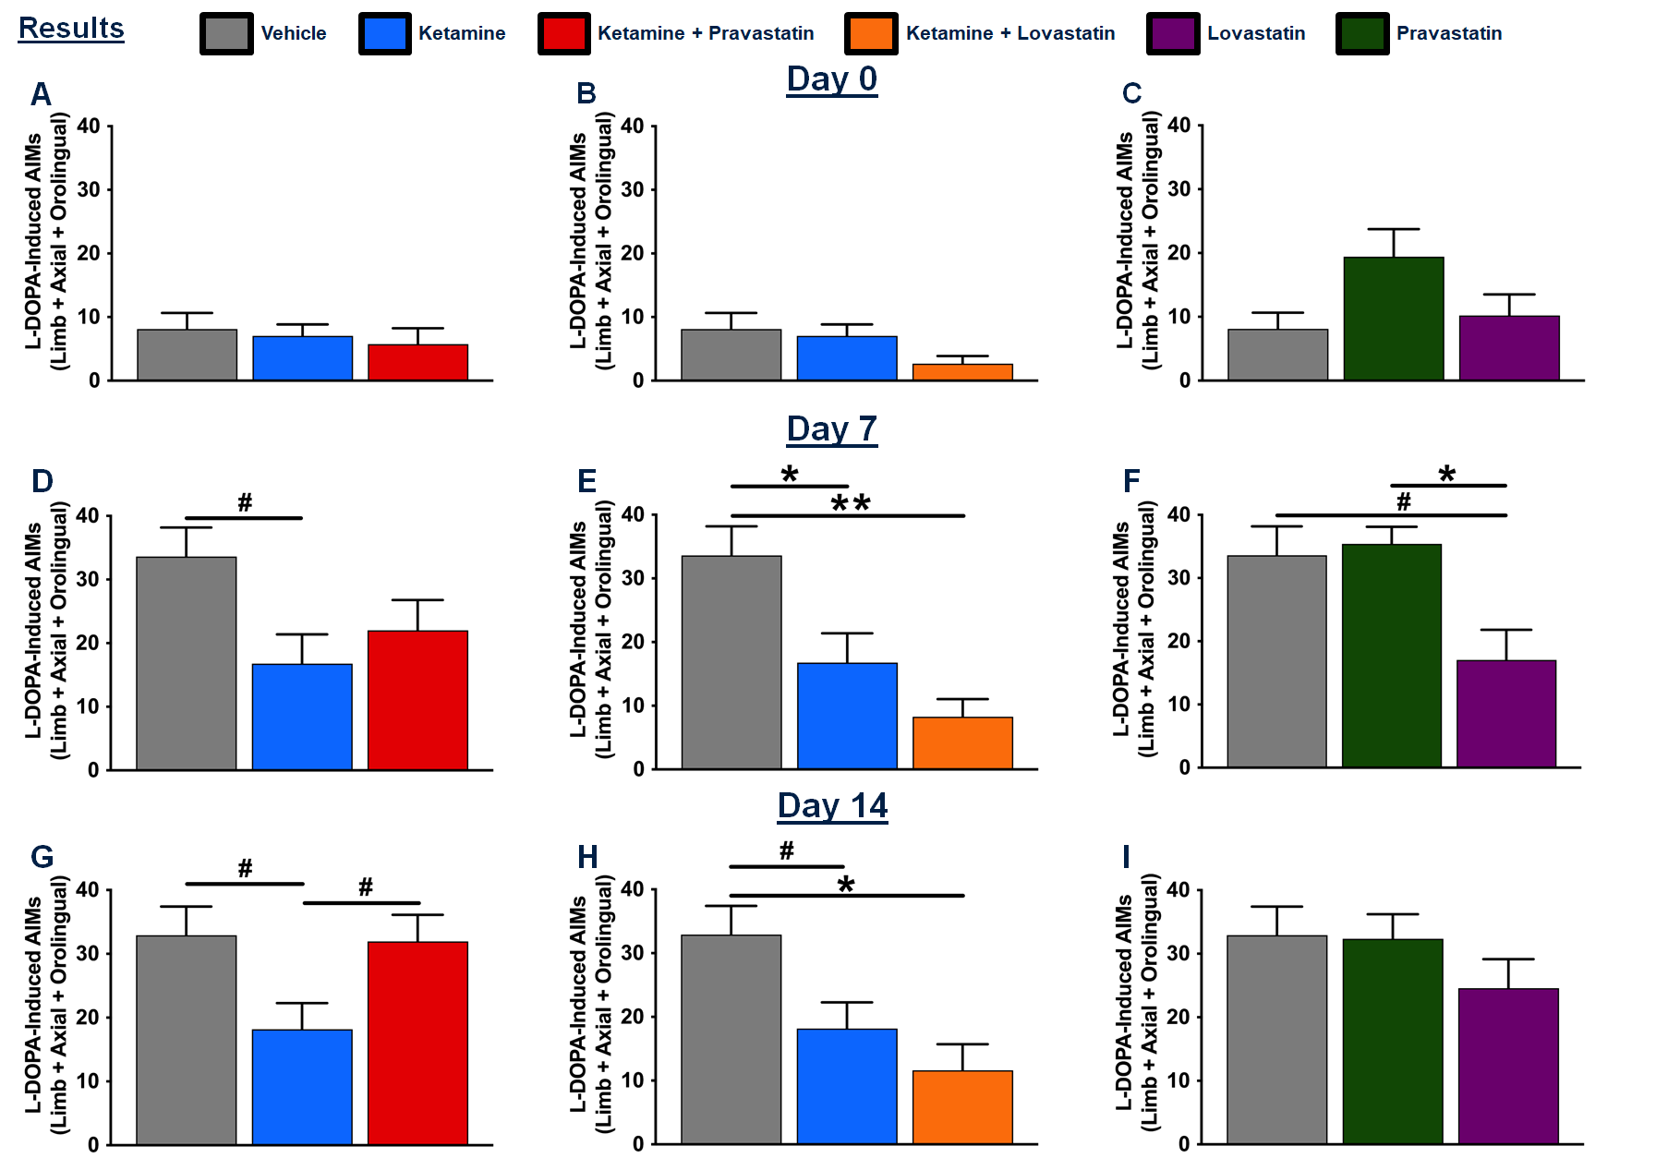
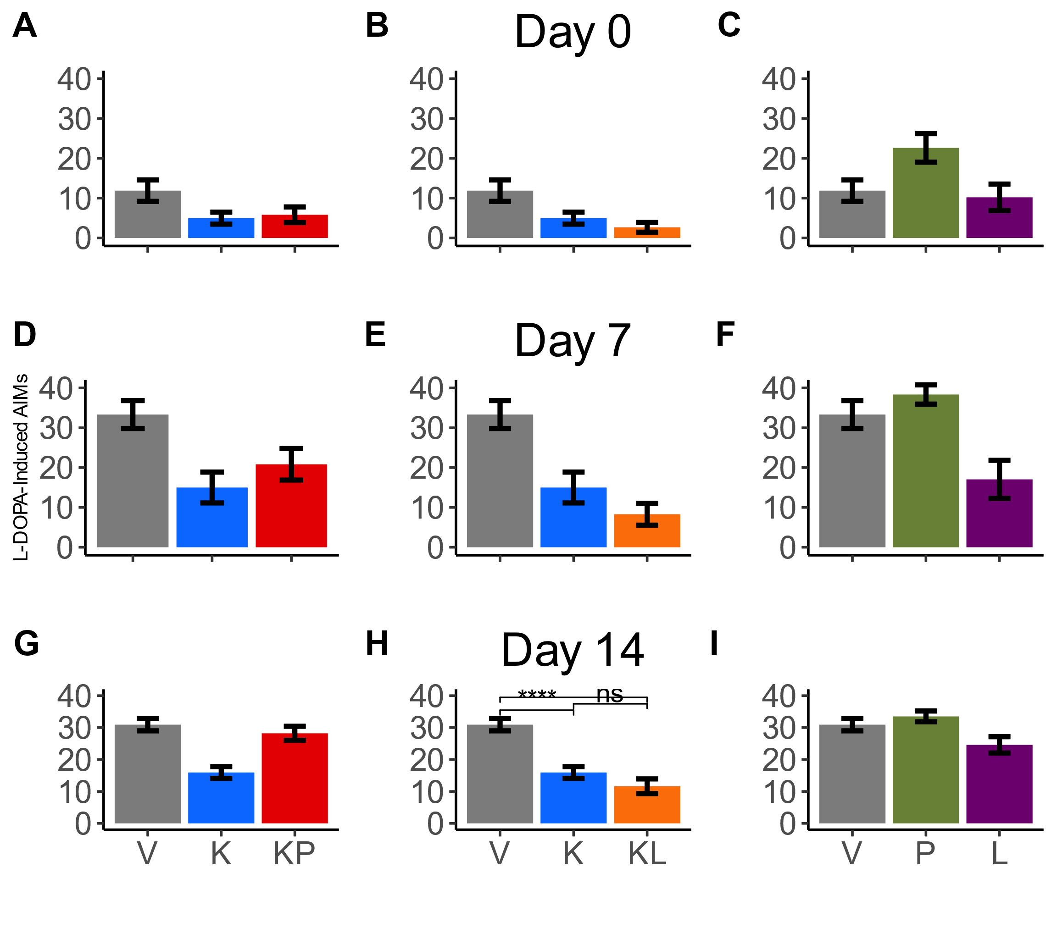

Slide 5
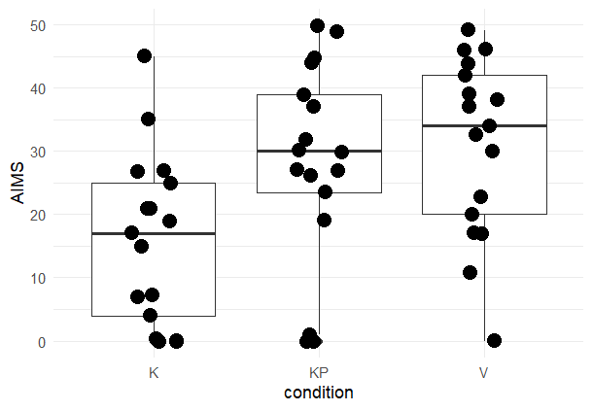
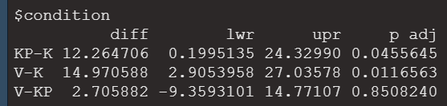

Effects from posthoc: KP-K differ, V-K differ.

Slide 6
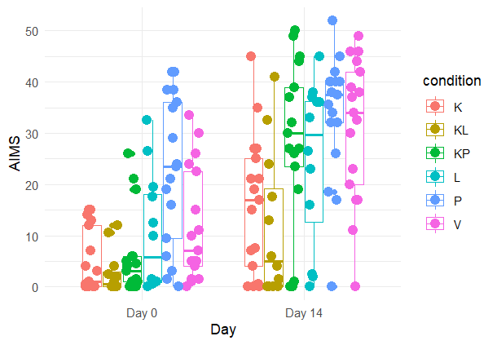
Overview of all data but we discussed a while back that Day 14 was the most important to analyze.

Slide 7
Extra

Slide 8
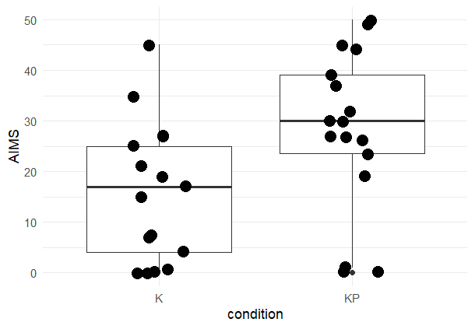
p-value = 0.0216, t-test
Left – pulled out Day 14 K and KP. That was a key comparson
Next slide: Instead, we can keep the K, KP, and V groups

