Slide 1
Insights from DEMO1
Just a demo file for a lab notebook. If you already have your own system for analysis note taking – use it. This is just how I collect figures and notes as I analyze data.
Cowen 7/2/2023
DEMO1_does_MFB_stim_affect_ensemble_act

Slide 2
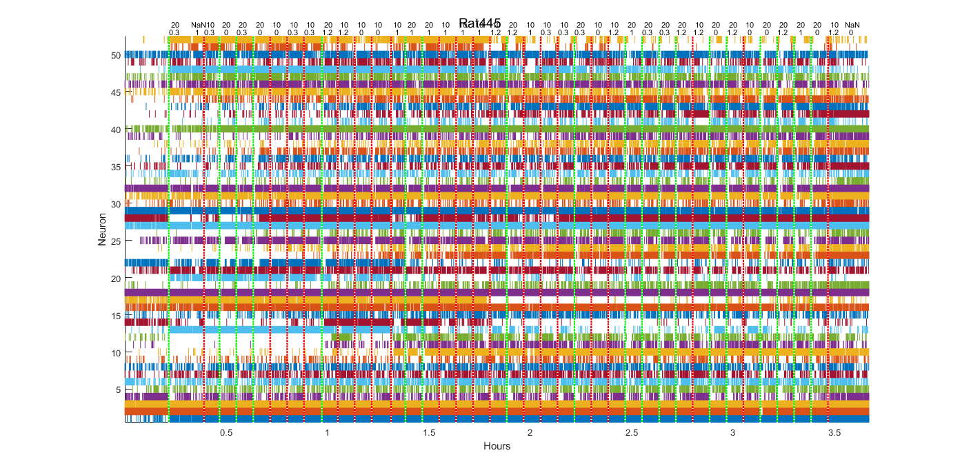
Ensemble recording with the top text indicating MFB stim frequency. The bottom row indicating local variance. For a 3.5hr recording.
Perhaps some drift in firing rate
DEMO1_does_MFB_stim_affect_ensemble_act

Slide 3
Looks like log normalization brings out more of the texture of the ensemble response.

Slide 4
Patterns of pair-wise correlations between cells. Definitely some patterns in there. Not sure what they mean though.

Slide 5
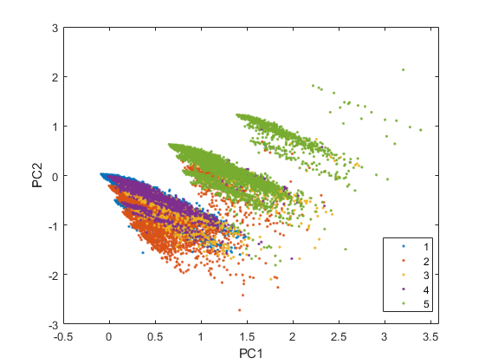

Whoa! Clusters! What do they mean??!!

