Slide 1




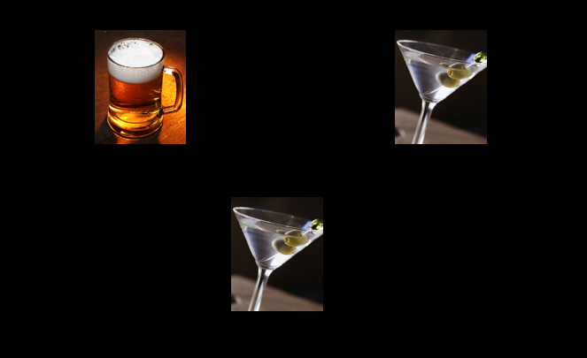
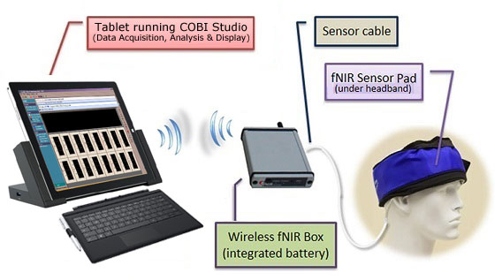
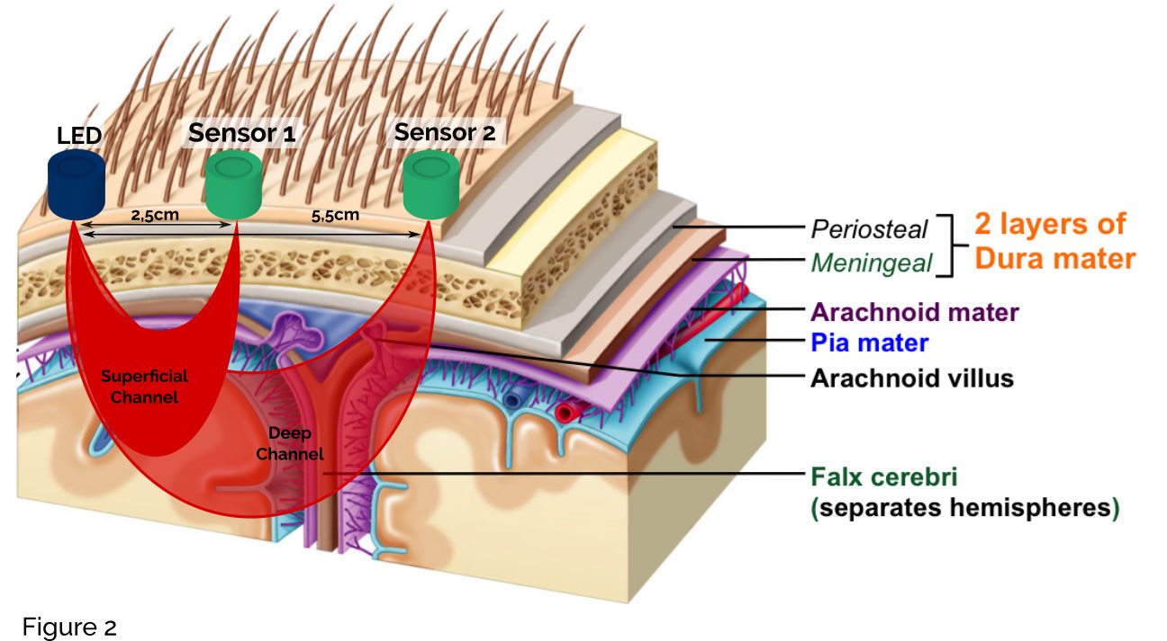
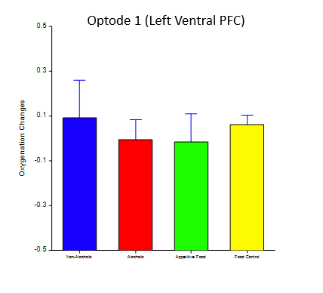
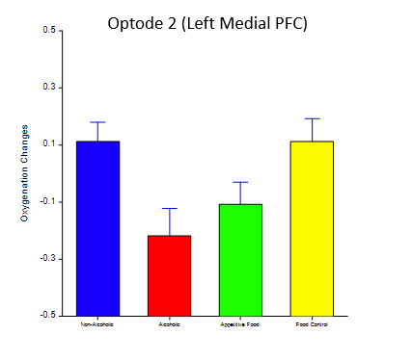
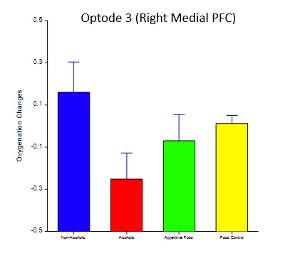
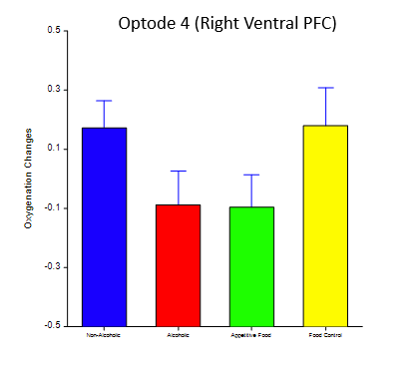
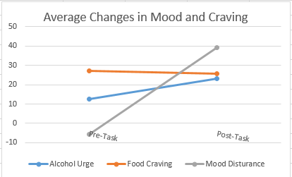
Using Functional Near-Infrared Spectroscopy (fNIRS) to Assess Alcohol Cue Reactivity in the Bar Lab
Cowie K¹, Momenan R², Leggio L¹, Lee MR¹
Section on Clinical Psychoneuroendocrinology and Neuropsychopharmacology (CPN)¹
Clinical Neuroimaging Research Core (CNIRC) ²
National Institute on Alcohol Abuse and Alcoholism (NIAAA) and National Institute on Drug Abuse (NIDA)
National Institutes of Health (NIH), Bethesda, MD
BACKGROUND
Functional Near-Infrared Spectroscopy (fNIRS) is a neuroimaging method that measures the hemodynamic response via the concentration of oxygenated (HbO₂) and deoxygenated (dHb) hemoglobin in the prefrontal cortex.
Light in the range of 700-900 nm pass several centimeters unimpeded through the skin and bone of the scalp into underlying cortex. Absorption spectra of HbO₂ and dHb are maximally separated between 730 and 850 nm (Izzetoglu, 2005).
The relative ratio of HbO₂ and dHb can be used to calculate oxygenation via the Modified Beer Lambert Law.
fNIRS can be used as an indirect measure of neural activity in the dorsolateral PFC, a region whose activation changes in response to alcohol cues or alcohol abstinence (Dempsey, 2015).
Few studies have used fNIRS to examine response to alcohol cues and the portability of the fNIRS apparatus allows measurement in ecologically relevant settings. Therefore, we used fNIRS to measure alcohol cue reactivity in bar lab.
CONCLUSION
The use of fNIRS offers the potential to measure brain function changes and their relationship to subjective reporting of mood and craving while in an ecologically relevant setting.
This same task will be performed during an fMRI session in the same subjects in order to compare BOLD signal with changes in cortical HB oxygenation measured with fNIRS.
The use of fNIRS could provide a biomarker of craving that can be used to assess the efficacy of pharmacotherapies used to treat AUD patients.
The effect of context could be investigated further by comparing task outcomes with fNIRS in the bar lab to those in a neutral setting (i.e. devoid of alcohol cues).
Given the neurocircuitry of the olfactory system (one synapse between olfactory receptors and the PFC), fNIRS can be used to detect cortical activity in response to alcohol olfactory cues.
Future research will compare subjects with AUD to healthy controls to determine whether there are group differences in cortical activity with alcohol cue exposure using fNIRS.
Alcohol
X 8 blocks
Control
X 8 blocks
Food
X 8 blocks
Control
X 8 blocks
Figure 1. In each block 4 trials were shown, and every cue type had eight blocks total. Pictures within each block were randomized.
Figure 2: Subjects were asked to match images. This presentation of cues was modeled of Hariri et al (2002).
Figure 3: fNIRS device and head placement are shown above.
Figure 4. Photodetectors on the skin sense the scattering photons, measuring the ratio of dHb and Hb0_{2.}
METHODS
We designed a task to assess response to alcohol and food cues that would be suitable for use with fNIRS and fMRI so we could correlate the outcome measures for both imaging methods.
To determine the number of trials, we piloted the device by measuring response to visual and olfactory drink cues.
The task was a block design (Figure 1) with 4 cue types: alcoholic beverages, non-alcoholic beverages, appetitive food, and neutral food*. Each block consisted of 4 trials, in which subjects were asked to match images (Figure 2).
8 blocks of each of the 4 cue types were presented. Order of the alcohol and food blocks was counterbalanced across subjects
Subjects were 3 males with alcohol use disorder (AUD).
The study was conducted using the fNIRS 1100W with COBI Studios as the acquisition software (Figure 3,4).
A 10 second baseline (hemodynamic response) was measured while in the bar lab and normalized to 0.
The task duration was approximately 15 minutes.
Subjective ratings of craving and mood were assessed before and after the trial using Profile of Mood Scores (POMS), General Food Questionnaire-State (GFQ-S), and Alcohol Urge Questionnaire (AUQ).
*Appetitive and neutral food cues were determined based on subjective input.
RESULTS
AC
A
F
FC
AC
FC
AC
FC
A
F
A
F
REFERENCES
Dempsey, J. P., Harris, K. S., Shumway, S. T., Kimball, T. G., Herrera, J. C., Dsauza, C. M., & Bradshaw, S. D. (2015). Functional near infrared spectroscopy as a potential biological assessment of addiction recovery: preliminary findings. The American Journal of Drug and Alcohol Abuse, 41(2), 119–126. https://doi.org/10.3109/00952990.2014.983273
Hariri, A. R., Mattay, V. S., Tessitore, A., Kolachana, B., Fera, F., Goldman, D., Weinberger, D. R. (2002). Serotonin transporter genetic variation and the response of the human amygdala. Science, 297(5580), 400-403.
M. Izzetoglu et al., "Functional near-infrared neuroimaging," in IEEE Transactions on Neural Systems and Rehabilitation Engineering, vol. 13, no. 2, pp. 153-159, June 2005.
Kirilina E, Jelzow A, Heine A, Niessing M, Wabnitz H, Bruhl R, Ittermann B, Jacobs AM, Tachtsidis I (2012) The physiological origin of task‐evoked systemic artefacts in functional near infrared spectroscopy. Neuroimage 61:70–81.
Soudry, Y. (2011). Olfactory system and emotion: Common substrates - ScienceDirect. Retrieved June 19, 2018, from https://www.sciencedirect.com/science/article/pii/S1879729610001237#bib0055
Figure 5. Left ventral PFC.
Figure 6. Left medial PFC
Figure 7. Right medial PFC
A
Figure 9. Average ratings of food (GFQ-S) and alcohol (AUQ)craving, and negative mood (POMS) before and after the task.
AC
A
F
FC
Figure 8. Right ventral PFC
Positive oxygenation changes indicate greater HbO₂ concentration in response to the stimulus indicated on the X axis compared to baseline.
The alcohol condition was associated with reduced HbO₂ compared to non-alcoholic beverages in all regions. In the right ventral PFC, there is the best separation in oxygenation changes between each food and alcohol compared to their respective control conditions.
Conflict of Interest: None
Acknowledgments/Funding: This work was supported by NIH intramural funding ZIA-AA000218 (CPN), jointly supported by the NIAAA Division of Intramural Clinical and Biological Research and the NIDA Intramural Research Program
Contact: katecowie14@gmail.com; 301-272-0957
Notes:
The left and right medial PFC showed similar trends with low activity from alcohol cues
The left ventral PFC is the only region in which activity increases in response to alcohol cues.
The left PFC processes appetitive stimuli, while the right processes negative stimuli (Soudry, 2011).
Hariri, A. R., Mattay, V. S., Tessitore, A., Kolachana, B., Fera, F., Goldman, D., Weinberger, D. R. (2002). Serotonin transporter genetic variation and the response of the human amygdala. Science, 297(5580), 400-403.
In the left ventral PFC appetitive cues caused the highest response.
On other optodes, alcohol and appetitive food cues resulted in decreased oxygenation from baseline. This may reflect a decrease in executive functioning when exposed to cues.
“Decrease in deoxygenated HHb concentration is part of a normal hemodynamic response (resulting from an increased oxygen supply to activated brain areas) and therefore reflects activation. Notably, the time effect differs between groups: smokers show a decrease in HHb concentration earlier (‘vision’ task) than controls (‘roll’ task). There was no significant effect of time or group in the other ROI.”

