Slide 1







JQM SPA – active li (HW7)
(DEV209HW7JQMactLi-design.pptx)
This a single page application (SPA) using the jQuery Mobile application development environment. This SPA ....
C:\Users\burns\MyProjects\BC-DEV209\DEV209HW7JQMactLi-work-area\
DEV209HW7JQMactLi-design.pptx

Slide 2
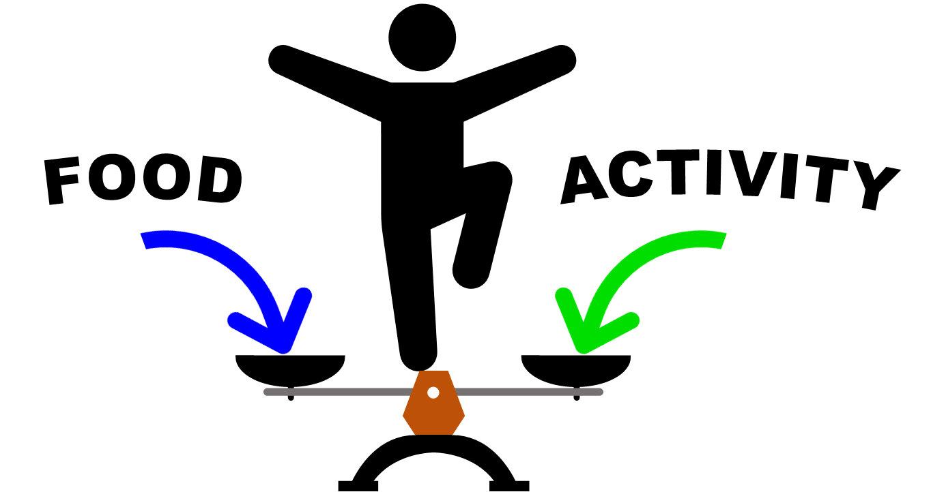
page template
My Energy Balance
Home Page
Display Log
app icon
app name
Window
<page title goes here>
header
New Log Entry
Copyright 2024 by Bill Burns
navbar
footer
C:\Users\burns\MyProjects\BC-DEV209\DEV209HW7JQMactLi-work-area\
DEV209HW7JQMactLi-design.pptx

Slide 3

home page
Home Page
Display Log
Window
My Energy Balance
Add Log Entry
Copyright 2024 by Bill Burns
My Energy Balance is your personal daily energy balance tracker.
Basal Metabolic Rate (BMR)
Amount of energy body uses for daily essential functions while at rest.
Physical Activity Level (PAL)
A way to quantify daily physical activity. Is used to estimate total daily energy expenditure (TDEE).
Total daily energy expenditure (TDEE)
Estimates the number calories the body burns daily. A method of estimating TDEE is ...
TDEE = BMR x PAL
Total Daily Caloric Intake (TDCI)
Daily Energy Balance Delta (DEBD)
DEBD = TDCI – TDEE
C:\Users\burns\MyProjects\BC-DEV209\DEV209HW7JQMactLi-work-area\
DEV209HW7JQMactLi-design.pptx

Slide 4
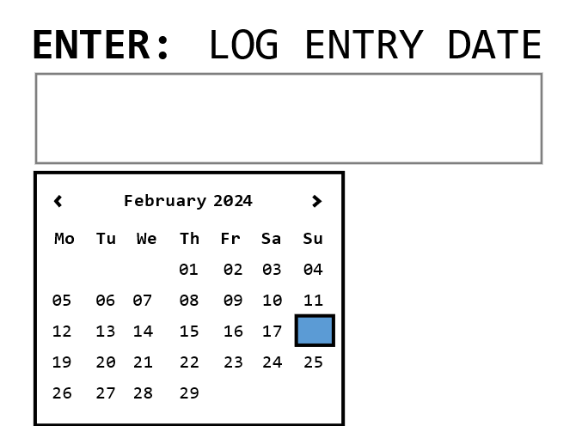
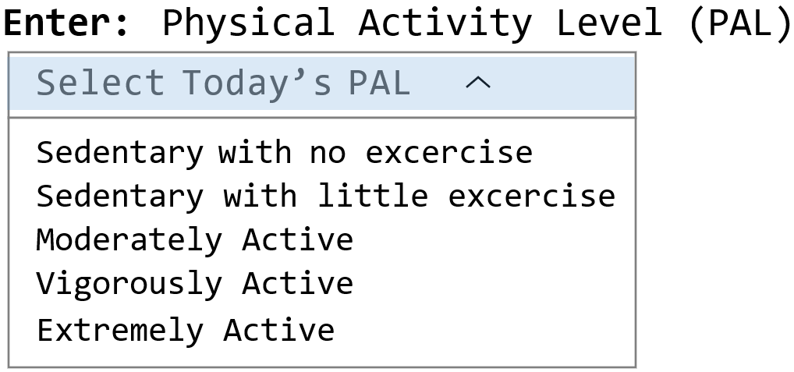
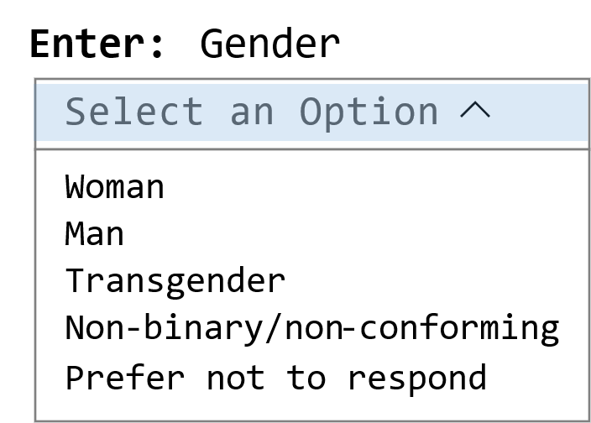
data entry page
Home Page
NEEDS TO BE
UPDATED
Display Log
Window
Log Entry
Add Log Entry
COLUMN 1
COLUMN 2
COLUMN 3
VALUES
initial: none
min: n/a
max: n/a
VALUES
initial: ”Select Today’s PAL”
min: n/a
max: n/a
Add New Log Entry
VALUES
initial: none
min: n/a
max: n/a
ROW 1
Copyright 2024 by Bill Burns
ROW 1
id = “selected-date”
id = “selected-pal”
id = “entry-add”
class="ui-block-a"
class="ui-block-b"
class="ui-block-c"
Enter: Calories from Protein
Enter: Calories from Carbohydrates
Enter: Calories from Fat
+
VALUES
initial: 780
min: 360
max: 1200
VALUES
initial: 1040
min: 480
max: 1600
780
-
+
1040
-
+
VALUES
initial: 780
min: 360
max: 1200
780
ROW 2
-
ROW 2
id = “protein-calories”
id = “carbo-calories”
id = “fat-calories”
class="ui-block-a"
class="ui-block-b"
class="ui-block-c"
VALUES
initial: ”Select an Option”
min: n/a
max: n/a
grid cell
col 2 | row 3
Currently Not Used
VALUES
initial: n/a
min: n/a
max: n/a
grid cell
col 3 | row 3
Currently Not Used
VALUES
initial: n/a
min: n/a
max: n/a
ROW 3
ROW 3
id = “selected-gender”
id = “”
id = “”
class="ui-block-a"
class="ui-block-b"
class="ui-block-c"
Enter: Age (yrs)
initial: 50
min: 1
max: 200
Enter: Height (in)
Enter: Weight (lbs)
+
initial: 65
min: 58
max: 84
initial: 150
min: 90
max: 300
50
-
+
150
+
-
65
ROW 4
-
ROW 4
class="ui-block-a"
class="ui-block-b"
class="ui-block-c"
COLUMN 1
COLUMN 2
COLUMN 3
C:\Users\burns\MyProjects\BC-DEV209\DEV209HW7JQMactLi-work-area\
DEV209HW7JQMactLi-design.pptx

Slide 5
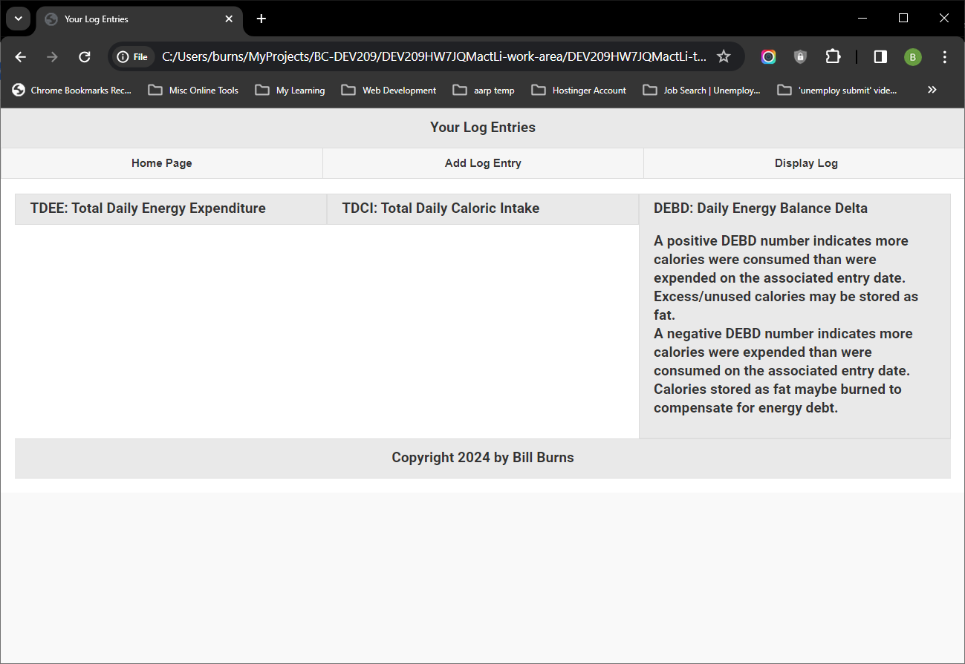
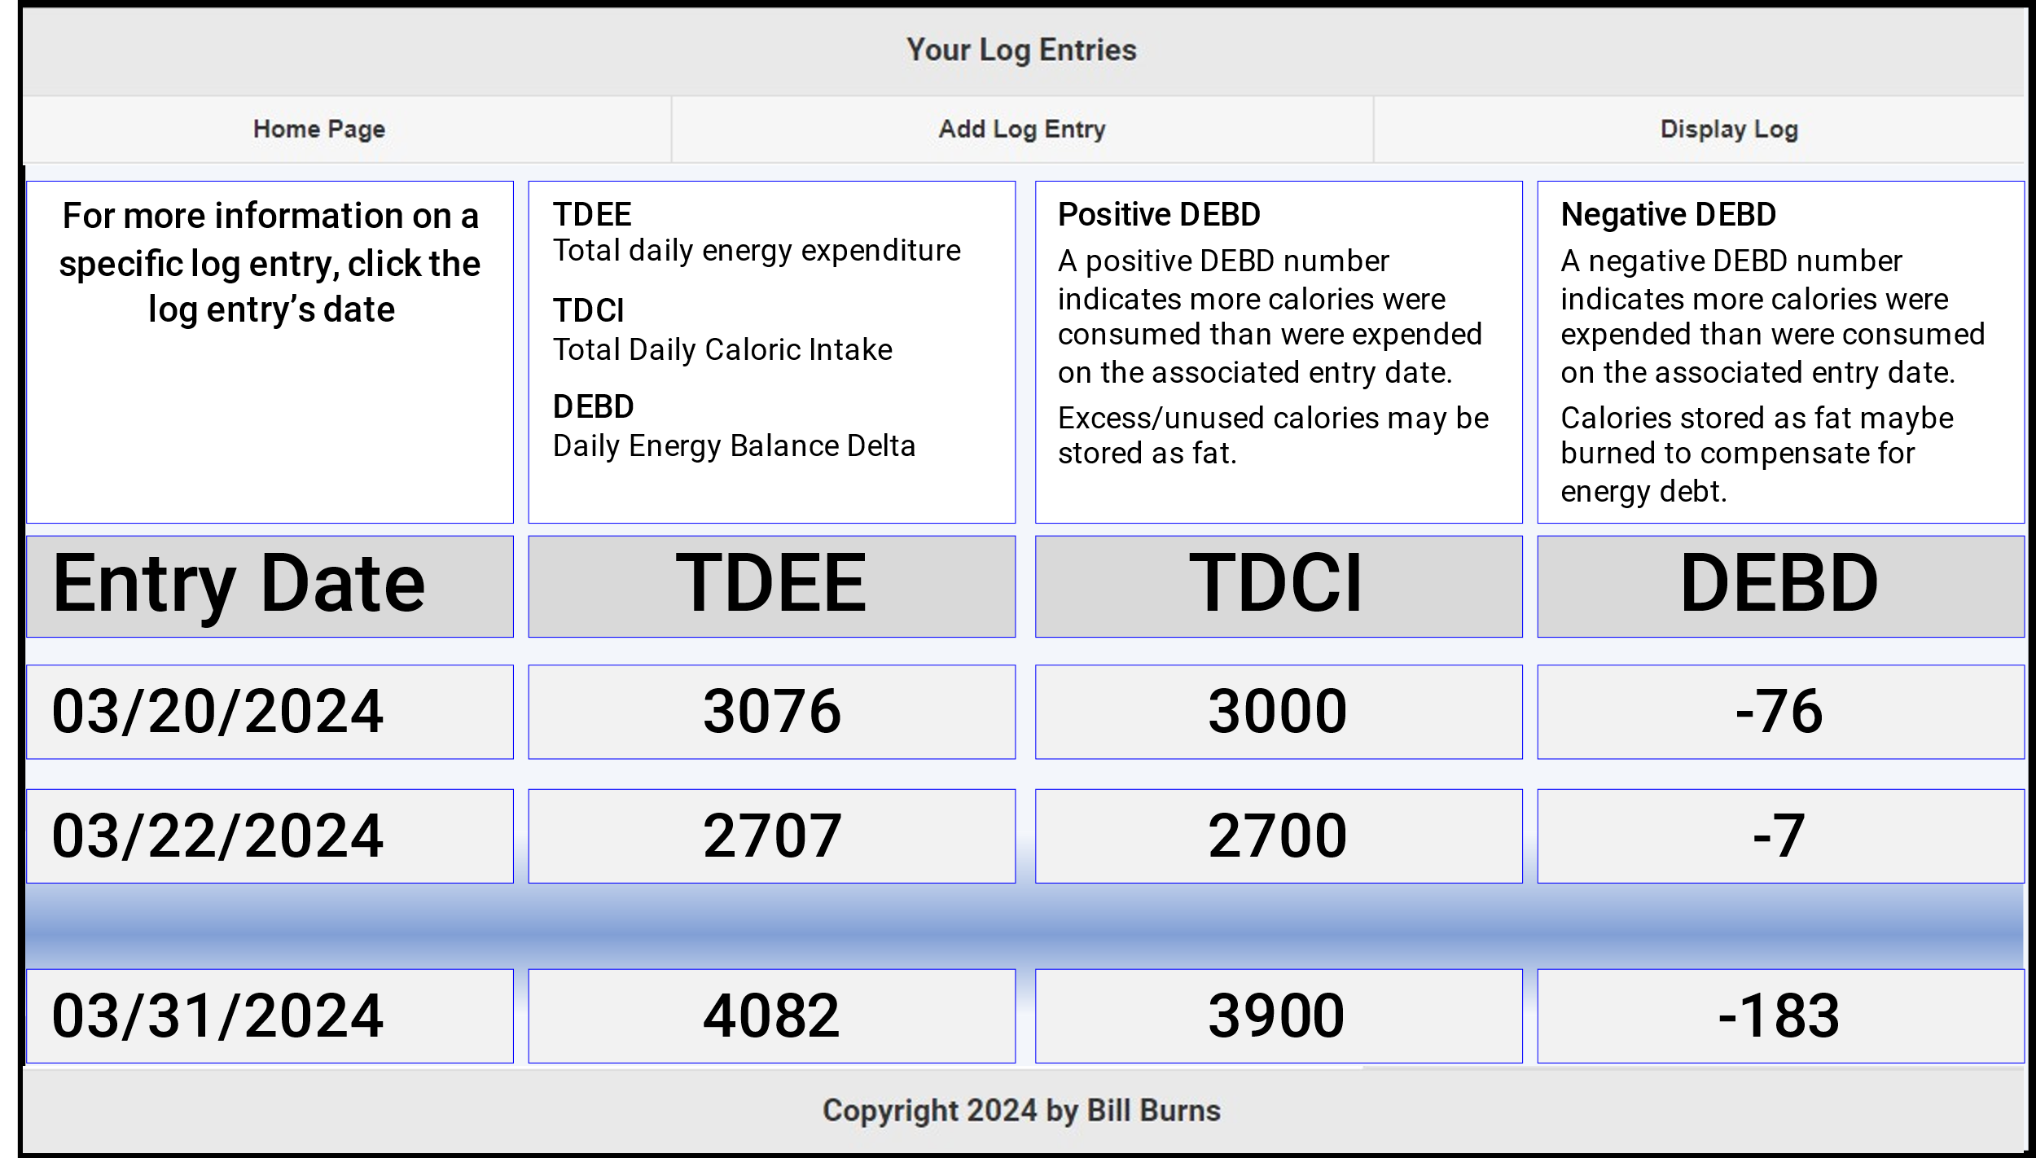
“list of log entries” page
Window
COLUMN 1
COLUMN 2
COLUMN 3
COLUMN 4
For more information on a specific log entry, click the log entry’s date
TDEE
Total daily energy expenditure
TDCI
Total Daily Caloric Intake
DEBD
Daily Energy Balance Delta
Positive DEBD
A positive DEBD number indicates more calories were consumed than were expended on the associated entry date.
Excess/unused calories may be stored as fat.
Negative DEBD
A negative DEBD number indicates more calories were expended than were consumed on the associated entry date.
Calories stored as fat maybe burned to compensate for energy debt.
c1 | r1
c2 | r1
c3 | r1
c4 | r1
ROW 1
ROW 1
Entry Date
TDEE
TDCI
DEBD
c1 | r2
class="ui-block-a"
c2 | r2
class="ui-block-b"
c3 | r2
class="ui-block-c"
c4 | r2
class="ui-block-d"
ROW 2
ROW 2
03/20/2024
3076
3000
-76
c1 | r3
class="ui-block-a"
c2 | r3
class="ui-block-b"
c3 | r3
class="ui-block-c"
c4 | r3
class="ui-block-d"
ROW 3
ROW 3
03/22/2024
2707
2700
-7
c1 | r4
class="ui-block-a"
c2 | r4
class="ui-block-b"
c3 | r4
class="ui-block-c"
c4 | r4
class="ui-block-d"
ROW 4
ROW 4
03/31/2024
4082
3900
-183
class="ui-block-a"
class="ui-block-b"
class="ui-block-c"
class="ui-block-d"
c1 | rn
c2 | rn
c3 | rn
c4 | rn
ROW n
ROW n
class="ui-block-a"
class="ui-block-b"
class="ui-block-c"
class="ui-block-d"
COLUMN 1
COLUMN 2
COLUMN 3
COLUMN 4
C:\Users\burns\MyProjects\BC-DEV209\DEV209HW7JQMactLi-work-area\
DEV209HW7JQMactLi-design.pptx

Slide 6
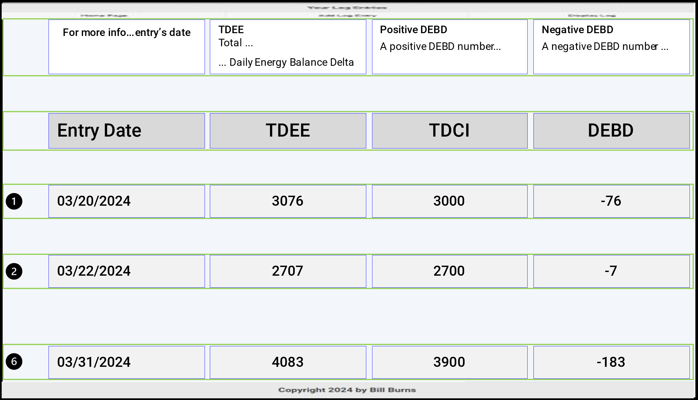



scratch page: “list of log entries” page
energyBalanceArray.length = L
energyBalanceArray[0]
energyBalanceArray[1]
...
energyBalanceArray[nthObject]
where nthObject = L - 1
Window
COLUMN 1
COLUMN 2
COLUMN 3
COLUMN 4
For more info...entry’s date
TDEE
Total ...
... Daily Energy Balance Delta
Positive DEBD
A positive DEBD number...
Negative DEBD
A negative DEBD number ...
ROW 1
ROW 1
c1 | r1
class="ui-block-a"
c2 | r1
class="ui-block-b"
c3 | r1
class="ui-block-c"
c4 | r1
class="ui-block-d"
Entry Date
TDEE
TDCI
DEBD
ROW 2
ROW 2
c1 | r2
class="ui-block-a"
c2 | r2
class="ui-block-b"
c3 | r2
class="ui-block-c"
c4 | r2
class="ui-block-d"
03/20/2024
3076
3000
-76
energyBalanceArray[0].entryDate
energyBalanceArray[0].tdee
energyBalanceArray[0].tdci
energyBalanceArray[0].debd
ROW 3
ROW 3
c1 | r3
class="ui-block-a"
c2 | r3
class="ui-block-b"
c3 | r3
class="ui-block-c"
c4 | r3
class="ui-block-d"
03/22/2024
2707
2700
-7
energyBalanceArray[1].entryDate
energyBalanceArray[1].tdee
energyBalanceArray[1].tdci
energyBalanceArray[1].debd
ROW 4
ROW 4
c1 | r4
class="ui-block-a"
c2 | r4
class="ui-block-b"
c3 | r4
class="ui-block-c"
c4 | r4
class="ui-block-d"
03/31/2024
4083
3900
-183
energyBalanceArray[x].entryDate
energyBalanceArray[x].tdee
energyBalanceArray[x].tdci
energyBalanceArray[x].debd
ROW n
ROW n
c1 | rn
class="ui-block-a"
c2 | rn
class="ui-block-b"
c3 | rn
class="ui-block-c"
c4 | rn
class="ui-block-d"
COLUMN 1
COLUMN 2
COLUMN 3
COLUMN 4
C:\Users\burns\MyProjects\BC-DEV209\DEV209HW7JQMactLi-work-area\
DEV209HW7JQMactLi-design.pptx

Slide 7
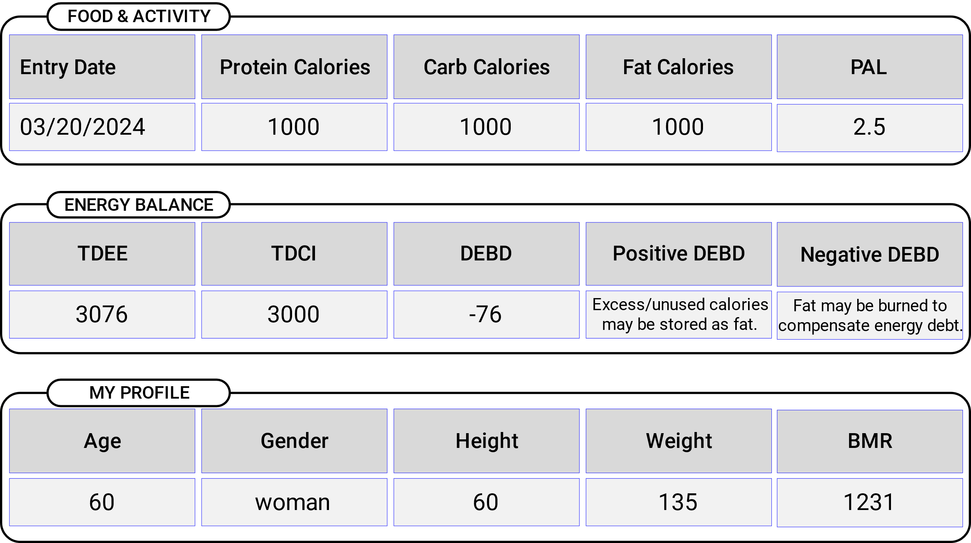
“log details” page
Window
COLUMN 1
COLUMN 2
COLUMN 3
COLUMN 4
COLUMN 5
Log Entry Details
FOOD & ACTIVITY
Entry Date
Protein Calories
Carb Calories
Fat Calories
PAL
c1 | r1
c2 | r1
c3 | r1
c4 | r1
c5 | r1
03/20/2024
1000
1000
1000
2.5
ROW 1
ROW 1
c1 | r2
class="ui-block-a"
c2 | r2
class="ui-block-b"
c3 | r2
class="ui-block-c"
c4 | r2
class="ui-block-d"
c5 | r2
class="ui-block-e"
ROW 2
ROW 2
ENERGY BALANCE
class="ui-block-a"
class="ui-block-b"
class="ui-block-c"
class="ui-block-d"
class="ui-block-e"
TDEE
TDCI
DEBD
Positive DEBD
Negative DEBD
ROW 1
c1 | r1
c2 | r1
c3 | r1
c4 | r1
c5 | r1
ROW 1
3076
3000
-76
Excess/unused calories may be stored as fat.
Fat may be burned to compensate energy debt.
c1 | r2
class="ui-block-a"
c2 | r2
class="ui-block-b"
c3 | r2
class="ui-block-c"
c4 | r2
class="ui-block-d"
c5 | r2
class="ui-block-e"
ROW 2
ROW 2
class="ui-block-a"
class="ui-block-b"
class="ui-block-c"
class="ui-block-d"
class="ui-block-e"
MY PROFILE
Age
Gender
Height
Weight
BMR
ROW 1
c1 | r1
c2 | r1
c3 | r1
c4 | r1
c5 | r1
ROW 1
c1 | r2
class="ui-block-a"
c2 | r2
class="ui-block-b"
c3 | r2
class="ui-block-c"
c4 | r2
class="ui-block-d"
c5 | r2
class="ui-block-e"
60
woman
60
135
1231
ROW 2
ROW 2
class="ui-block-a"
class="ui-block-b"
class="ui-block-c"
class="ui-block-d"
class="ui-block-e"
COLUMN 1
COLUMN 2
COLUMN 3
COLUMN 4
COLUMN 5
C:\Users\burns\MyProjects\BC-DEV209\DEV209HW7JQMactLi-work-area\
DEV209HW7JQMactLi-design.pptx

