Slide 1
OOTY
Professional Presentation • July 2025

Slide 2

Overview of the Picturesque Town of Ooty
• Ooty, also known as Udhagamandalam, is a popular hill station located in the Nilgiri Hills of Tamil Nadu, India.
• Renowned for its pleasant climate, lush green landscapes, and colonial-era architecture, Ooty is a prime tourist destination.
• The town's elevation of over 2,200 meters above sea level provides a refreshing escape from the heat of the plains.
1

Slide 3
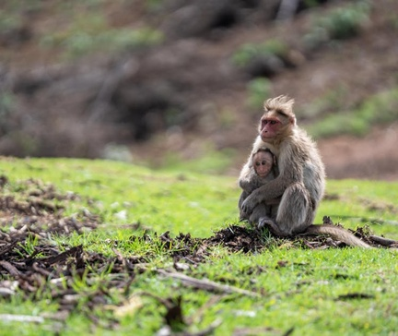
Ooty's Natural Wonders and Botanical Delights
• The Ooty Botanical Garden, spanning over 22 hectares, showcases a diverse collection of rare and exotic plant species.
• The picturesque Ooty Lake, surrounded by rolling hills, offers boating and other recreational activities for visitors.
• The Doddabetta Peak, the highest point in the Nilgiri Hills, provides panoramic views of the surrounding landscape.
2

Slide 4

Exploring Ooty's Rich Cultural Heritage
• The St. Stephen's Church, built in the 19th century, is a stunning example of Gothic architecture in Ooty.
• The Ooty Museum showcases the region's history, ethnography, and natural history, providing insights into the local culture.
• The Toda tribal community, indigenous to the Nilgiri Hills, is known for their unique pastoral lifestyle and traditional handicrafts.
3

Slide 5
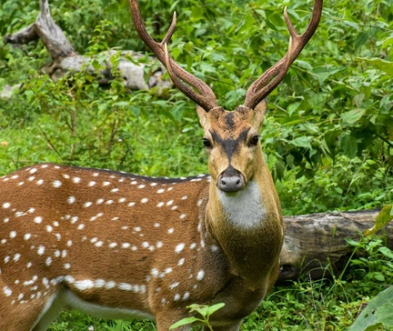
Outdoor Adventures and Leisure Activities in Ooty
• Trekking and hiking through the Nilgiri Hills offer breathtaking views and opportunities to explore the region's diverse flora and fauna.
• The Ooty Toy Train, a UNESCO World Heritage Site, provides a scenic and nostalgic railway journey through the picturesque landscape.
• Visitors can indulge in various leisure activities, such as horse riding, golf, and tea plantation tours, to fully experience the charm of Ooty.
4

Slide 6
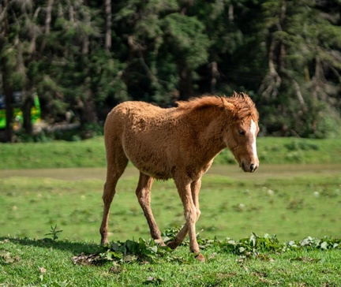
Ooty: A Year-Round Destination for All Seasons
• Ooty's temperate climate makes it a popular destination for travelers throughout the year, with each season offering unique experiences.
• The town's proximity to other tourist attractions in the Nilgiri Hills, such as Coonoor and Kotagiri, allows for a comprehensive exploration of the region.
• Ooty's well-developed infrastructure, including hotels, resorts, and transportation, caters to the needs of a diverse range of visitors.
5

Slide 7
THANK YOU
Questions & Discussion
Presentation on: ooty

