Slide 1
PHOTOSYNTHESIS
Professional Presentation • July 2025

Slide 2
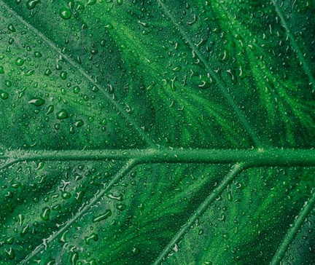
What is Photosynthesis?
• Photosynthesis is the process by which plants convert light energy from the sun into chemical energy in the form of glucose
• This chemical energy is used by the plant to fuel its growth and development
• Photosynthesis occurs in the chloroplasts of plant cells, which contain the green pigment chlorophyll
• Chlorophyll absorbs sunlight and uses it to convert carbon dioxide and water into glucose and oxygen
1

Slide 3
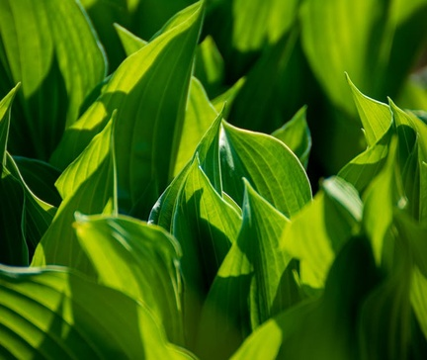
The Light-Dependent Reactions of Photosynthesis
• The light-dependent reactions occur in the thylakoid membranes of the chloroplasts and use sunlight to produce ATP and NADPH
• Photosystem II splits water molecules, releasing electrons, protons, and oxygen as a byproduct
• The electrons are then passed through an electron transport chain, generating a proton gradient that drives the production of ATP
• NADPH is also produced, which is used in the light-independent reactions to convert carbon dioxide into glucose
2

Slide 4
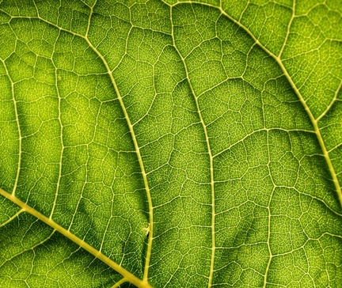
The Light-Independent Reactions of Photosynthesis
• The light-independent reactions, also known as the Calvin cycle, use the ATP and NADPH produced in the light-dependent reactions to convert carbon dioxide into glucose
• Carbon dioxide is fixed, or incorporated, into organic molecules through a series of enzymatic reactions
• The Calvin cycle produces 3-carbon molecules called glyceraldehyde 3-phosphate (G3P), which can be used to synthesize glucose and other organic compounds
• The light-independent reactions occur in the stroma of the chloroplasts and do not require direct sunlight
3

Slide 5
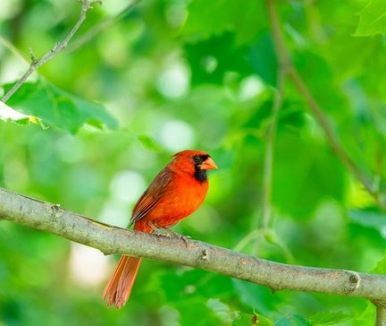
Factors Affecting Photosynthesis
• The rate of photosynthesis can be influenced by various environmental factors, including light intensity, carbon dioxide concentration, temperature, and water availability
• Increased light intensity generally leads to a higher rate of photosynthesis, up to a certain point where the plant becomes light-saturated
• Higher carbon dioxide concentrations can also increase the rate of photosynthesis, as carbon dioxide is a necessary substrate for the light-independent reactions
• Temperature affects the activity of the enzymes involved in photosynthesis, with an optimal temperature range for most plants
4

Slide 6
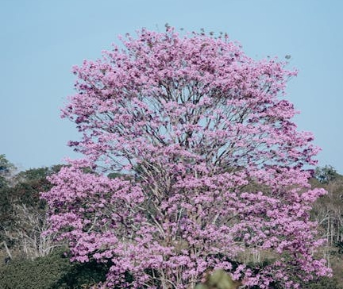
Importance of Photosynthesis in Ecosystems
• Photosynthesis is the foundation of most food chains and food webs, as it produces the glucose that serves as the primary energy source for heterotrophic organisms
• The oxygen produced as a byproduct of photosynthesis is essential for the respiration of aerobic organisms, including animals and many microbes
• Photosynthesis also plays a crucial role in the global carbon cycle, as it removes carbon dioxide from the atmosphere and stores it in the form of organic compounds
• Understanding the process of photosynthesis is essential for developing sustainable agricultural practices and addressing global environmental challenges, such as climate change
5

Slide 7
THANK YOU
Questions & Discussion
Presentation on: photosynthesis

