Slide 1
PHOTOSYNTHESIS
Professional Presentation • July 2025

Slide 2
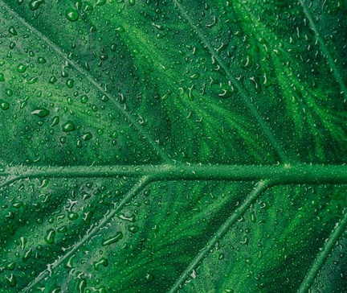
What is Photosynthesis?
• Photosynthesis is the process by which plants convert light energy from the sun into chemical energy in the form of glucose.
• This process occurs in the chloroplasts of plant cells, which contain the green pigment chlorophyll.
• Photosynthesis involves the use of carbon dioxide, water, and sunlight to produce glucose and oxygen.
• The glucose produced is used by the plant for energy, while the oxygen is released into the atmosphere.
1

Slide 3
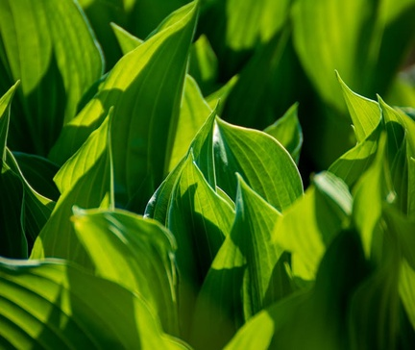
The Stages of Photosynthesis
• The first stage, called the light-dependent reactions, uses light energy to produce ATP and NADPH.
• The second stage, called the light-independent reactions (or Calvin cycle), uses the ATP and NADPH to convert carbon dioxide into glucose.
• The light-dependent reactions occur in the thylakoid membranes of the chloroplasts, while the light-independent reactions occur in the stroma of the chloroplasts.
• The two stages work together to convert light energy into chemical energy in the form of glucose.
2

Slide 4
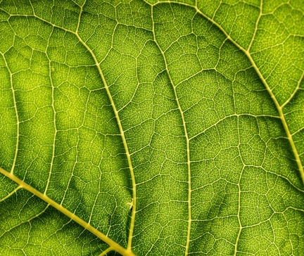
Factors Affecting Photosynthesis
• The rate of photosynthesis is affected by various environmental factors, including light intensity, carbon dioxide concentration, temperature, and water availability.
• Increased light intensity generally leads to a higher rate of photosynthesis, up to a certain point where the plant becomes light-saturated.
• Higher carbon dioxide concentrations can also increase the rate of photosynthesis, as carbon dioxide is a necessary reactant.
• Temperature also plays a role, with an optimal range for most plants, and extremes leading to decreased photosynthesis.
3

Slide 5
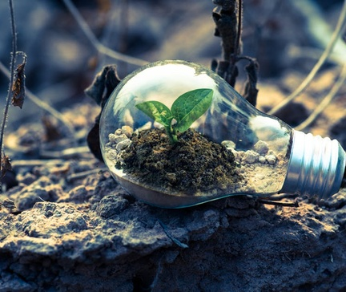
Importance of Photosynthesis
• Photosynthesis is the foundation of most food chains and food webs, as it produces the glucose that is the primary energy source for most organisms.
• The oxygen produced as a byproduct of photosynthesis is essential for the respiration of most aerobic organisms, including humans.
• Photosynthesis also helps to regulate the Earth's atmospheric composition, as it removes carbon dioxide and produces oxygen.
• Understanding the process of photosynthesis is crucial for developing sustainable agricultural practices and improving crop yields.
4

Slide 6
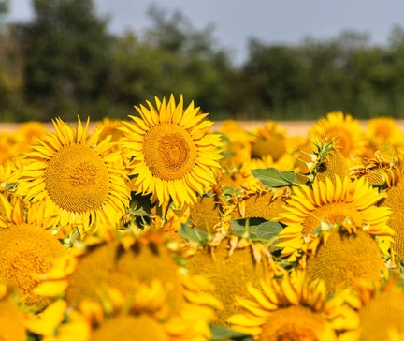
Adaptations for Photosynthesis
• Plants have evolved various adaptations to optimize the process of photosynthesis, such as the development of large, flat leaves to maximize light absorption.
• Some plants, like cacti, have adapted to conserve water by having a modified photosynthetic process called CAM (Crassulacean Acid Metabolism).
• Aquatic plants have adaptations like thin, submerged leaves and the ability to absorb carbon dioxide directly from the water.
• Certain plants, like the Venus flytrap, have evolved specialized structures to trap and digest insects, which can provide additional nutrients for photosynthesis.
5

Slide 7
THANK YOU
Questions & Discussion
Presentation on: photosynthesis

