Slide 1
PHOTOSYNTHESIS
Professional Presentation • July 2025

Slide 2

What is Photosynthesis?
• Photosynthesis is the process by which plants convert light energy from the sun into chemical energy in the form of glucose.
• It occurs in the chloroplasts of plant cells, where chlorophyll absorbs sunlight and uses carbon dioxide and water to produce glucose.
• Photosynthesis is the foundation of the food chain, providing energy for most living organisms on Earth.
1

Slide 3
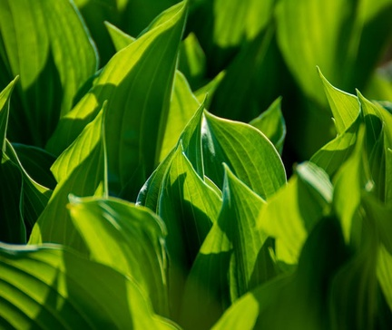
The Light-Dependent Reactions of Photosynthesis
• The light-dependent reactions occur in the thylakoid membranes of the chloroplast, where chlorophyll is located.
• Light energy is absorbed by chlorophyll, which excites electrons and creates an electron transport chain that generates ATP and NADPH.
• The light-dependent reactions produce the energy carriers needed for the light-independent (Calvin) cycle to convert carbon dioxide into glucose.
2

Slide 4
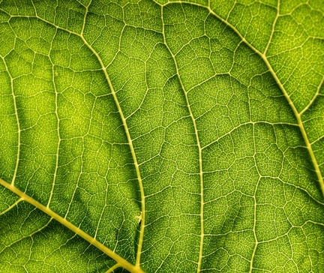
The Light-Independent (Calvin) Cycle
• The light-independent (Calvin) cycle, also known as the dark reactions, occurs in the stroma of the chloroplast.
• It uses the ATP and NADPH produced in the light-dependent reactions to convert carbon dioxide into organic compounds, primarily glucose.
• The Calvin cycle involves a series of enzymatic reactions that reduce carbon dioxide to form 3-carbon sugar molecules, which are then used to produce glucose.
3

Slide 5
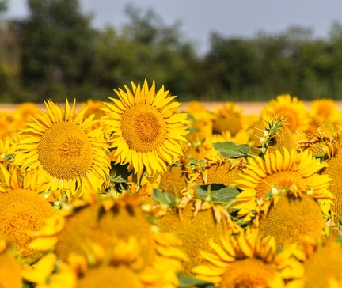
Factors Affecting Photosynthesis
• The rate of photosynthesis is influenced by various environmental factors, including light intensity, carbon dioxide concentration, temperature, and water availability.
• Increasing light intensity, carbon dioxide levels, and optimal temperature can enhance the rate of photosynthesis up to a certain point.
• Insufficient water can limit the plant's ability to transport nutrients and maintain the necessary turgor pressure for photosynthesis to occur effectively.
4

Slide 6

Importance of Photosynthesis
• Photosynthesis is the primary process that sustains life on Earth by producing the oxygen we breathe and the food we eat.
• It is the foundation of the food chain, as plants use photosynthesis to convert light energy into chemical energy in the form of glucose.
• Understanding the mechanisms and factors affecting photosynthesis is crucial for improving agricultural practices and developing sustainable energy solutions.
5

Slide 7
THANK YOU
Questions & Discussion
Presentation on: photosynthesis

