Slide 1
PHOTOSYNTHESIS
Professional Presentation • July 2025

Slide 2
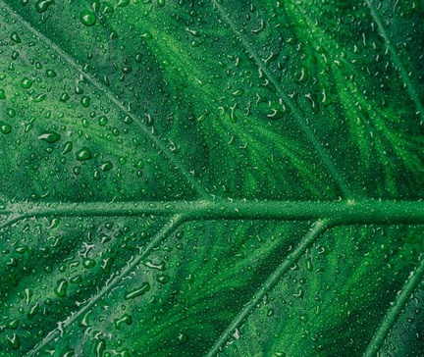
What is Photosynthesis?
• Photosynthesis is the process by which plants convert light energy from the sun into chemical energy in the form of glucose
• This chemical energy is used by the plant to fuel its growth and development
• Photosynthesis occurs in the chloroplasts of plant cells, which contain the green pigment chlorophyll
• Chlorophyll absorbs sunlight and uses it to convert carbon dioxide and water into glucose and oxygen
1

Slide 3
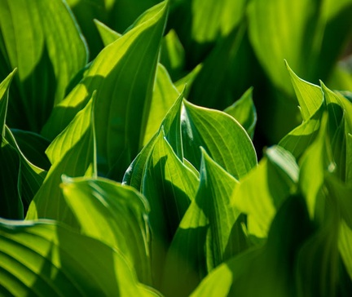
The Stages of Photosynthesis
• The first stage, called the light-dependent reactions, uses sunlight to produce ATP and NADPH
• The second stage, called the light-independent reactions (or Calvin cycle), uses the ATP and NADPH to convert carbon dioxide into glucose
• The light-independent reactions take place in the stroma of the chloroplast, while the light-dependent reactions take place in the thylakoid membrane
• The overall chemical equation for photosynthesis is 6CO2 + 6H2O → C6H12O6 + 6O2
2

Slide 4
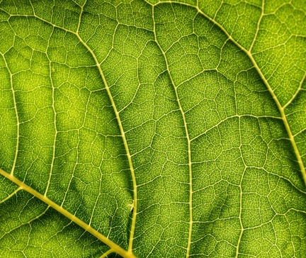
Factors Affecting Photosynthesis
• The rate of photosynthesis is affected by various environmental factors, including light intensity, carbon dioxide concentration, temperature, and water availability
• Increasing light intensity up to a certain point will increase the rate of photosynthesis, but too much light can damage the plant
• Increasing carbon dioxide concentration will also increase the rate of photosynthesis, up to a point
• Temperature affects the rate of chemical reactions in the plant, with an optimal temperature range for photosynthesis
3

Slide 5
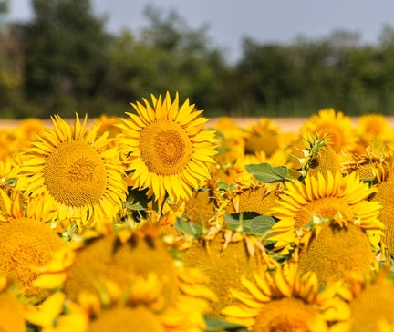
Importance of Photosynthesis
• Photosynthesis is the foundation of most food chains and food webs, as it produces the glucose that is the primary energy source for most organisms
• The oxygen produced as a byproduct of photosynthesis is essential for the respiration of most aerobic organisms, including humans
• Photosynthesis also helps to regulate the Earth's atmospheric composition, as it removes carbon dioxide and produces oxygen
• Understanding the process of photosynthesis is crucial for developing sustainable agricultural practices and improving crop yields
4

Slide 6
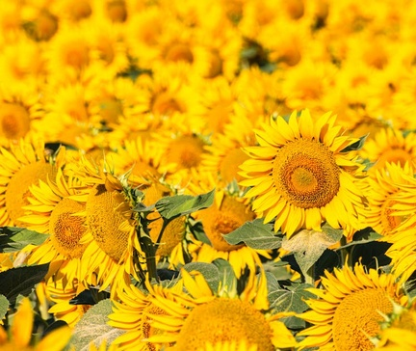
Adaptations for Photosynthesis
• Plants have evolved various adaptations to optimize their photosynthetic efficiency, such as the arrangement of chloroplasts in the leaves
• Some plants, like cacti, have adapted to conserve water by having specialized leaf structures or by performing photosynthesis at night
• Aquatic plants have adaptations like thin, flat leaves to maximize surface area for light absorption
• Certain plants, like the Venus flytrap, have evolved specialized structures to trap and digest insects, which provide additional nutrients for photosynthesis
5

Slide 7
THANK YOU
Questions & Discussion
Presentation on: photosynthesis

