Slide 1
PHOTOSYNTHESIS
Professional Presentation • July 2025

Slide 2
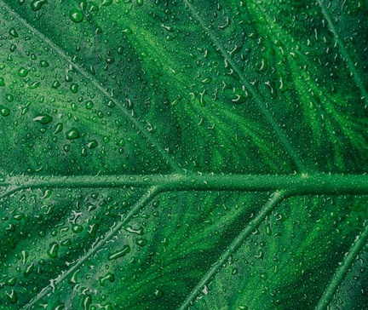
What is Photosynthesis?
• Photosynthesis is the process by which plants convert light energy from the sun into chemical energy in the form of glucose.
• It occurs in the chloroplasts of plant cells, where chlorophyll absorbs sunlight and uses carbon dioxide and water to produce glucose.
• Photosynthesis is essential for the survival of most life on Earth, as it provides the primary source of energy and oxygen.
1

Slide 3
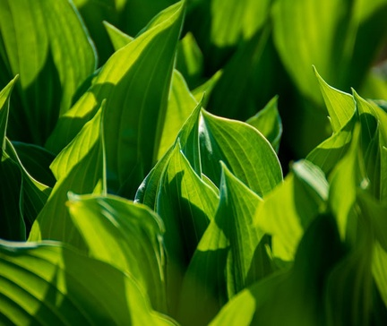
The Light-Dependent Reactions of Photosynthesis
• The light-dependent reactions occur in the thylakoid membranes of the chloroplasts, where chlorophyll is located.
• Light energy is absorbed by chlorophyll, which excites electrons and initiates a series of electron transport reactions.
• These reactions produce ATP and NADPH, which are used in the light-independent reactions to convert carbon dioxide into glucose.
• The light-dependent reactions also release oxygen as a byproduct.
2

Slide 4
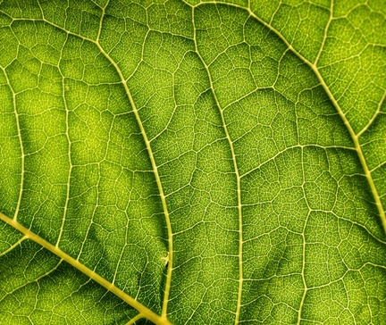
The Light-Independent Reactions of Photosynthesis
• The light-independent reactions, also known as the Calvin cycle, occur in the stroma of the chloroplasts.
• Using the ATP and NADPH produced in the light-dependent reactions, the Calvin cycle converts carbon dioxide into organic compounds, primarily glucose.
• This process involves a series of enzymatic reactions that reduce carbon dioxide and use the energy and reducing power from the light-dependent reactions.
• The Calvin cycle is a cyclic process that continues as long as there is a supply of ATP and NADPH from the light-dependent reactions.
3

Slide 5
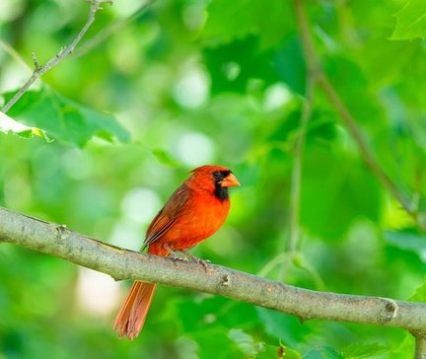
Factors Affecting Photosynthesis
• The rate of photosynthesis is influenced by various environmental factors, including light intensity, carbon dioxide concentration, temperature, and water availability.
• Increasing light intensity, carbon dioxide concentration, and temperature (within an optimal range) can generally increase the rate of photosynthesis.
• Water availability is also crucial, as it is required for the light-dependent reactions and the transport of nutrients and other essential molecules.
• Understanding these factors is important for optimizing plant growth and productivity in agricultural and horticultural settings.
4

Slide 6
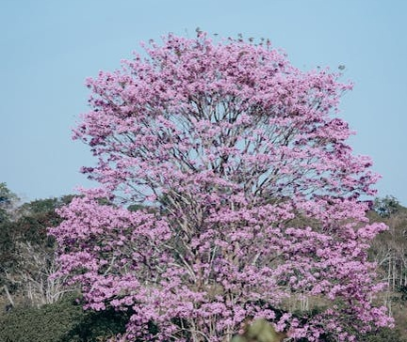
Importance of Photosynthesis in Ecosystems
• Photosynthesis is the foundation of most food chains and food webs in terrestrial and aquatic ecosystems.
• It provides the primary source of energy and organic compounds for heterotrophic organisms, such as animals and many microorganisms.
• Photosynthesis also produces oxygen as a byproduct, which is essential for the respiration of aerobic organisms.
• The balance between photosynthesis and respiration is crucial for maintaining the Earth's atmospheric composition and supporting life on our planet.
5

Slide 7
THANK YOU
Questions & Discussion
Presentation on: photosynthesis

