Slide 1
PYTHON
Professional Presentation • July 2025

Slide 2
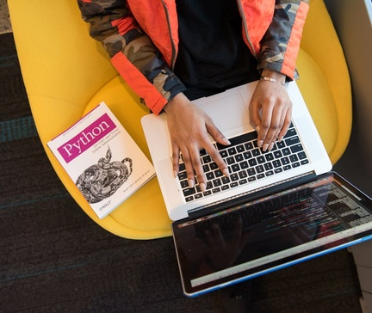
Overview of the Python Programming Language
• Python is a high-level, interpreted, and general-purpose programming language
• Known for its simplicity, readability, and versatility in various domains
• Widely used in web development, data analysis, machine learning, and automation
1

Slide 3
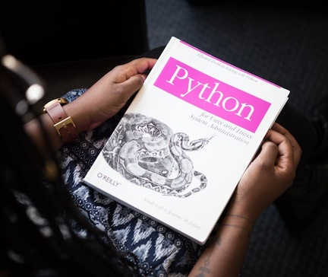
Key Features and Syntax of Python
• Dynamic typing and automatic memory management for efficient development
• Extensive standard library and vast ecosystem of third-party packages
• Clean and expressive syntax with emphasis on code readability
• Support for multiple programming paradigms, including object-oriented and functional
2

Slide 4

Python's Applications and Use Cases
• Powerful data analysis and visualization capabilities with libraries like NumPy, Pandas, and Matplotlib
• Widely used in machine learning and artificial intelligence with frameworks like TensorFlow and PyTorch
• Efficient for web development with frameworks like Django and Flask
• Versatile for scripting, automation, and system administration tasks
3

Slide 5
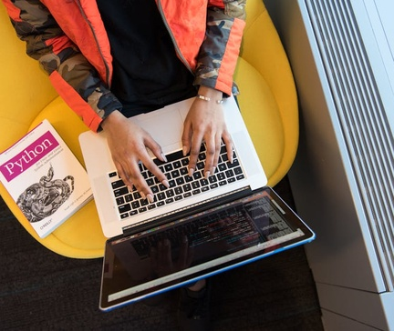
Python's Ecosystem and Community
• Large and active open-source community contributing to the language's growth and development
• Extensive documentation, tutorials, and online resources available for learning and problem-solving
• Supported by major tech companies and organizations, ensuring long-term sustainability
4

Slide 6
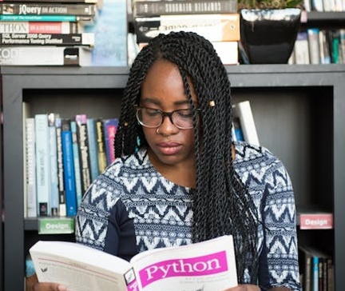
Getting Started with Python
• Multiple ways to install Python, including official downloads and package managers
• Integrated development environments (IDEs) like PyCharm, Visual Studio Code, and Jupyter Notebook
• Basic syntax and structure, including variables, data types, control structures, and functions
• Importance of writing clean, maintainable, and well-documented code
5

Slide 7
THANK YOU
Questions & Discussion
Presentation on: python

