Slide 1
PYTHON
Professional Presentation • July 2025

Slide 2
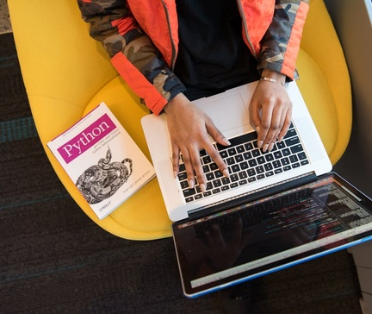
Overview of the Python Programming Language
• Python is a high-level, interpreted, and general-purpose programming language
• Known for its simplicity, readability, and versatility in various applications
• Widely used in fields like web development, data analysis, machine learning, and automation
1

Slide 3
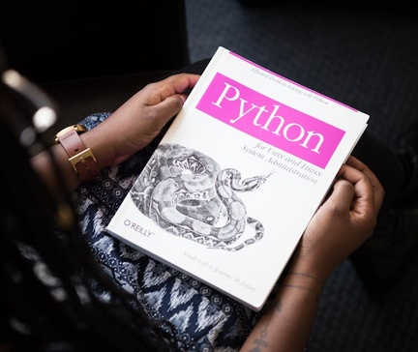
Key Features and Syntax of Python
• Python has a clean and elegant syntax, emphasizing readability and ease of use
• Supports multiple programming paradigms, including procedural, object-oriented, and functional programming
• Provides a vast standard library with modules for a wide range of tasks
• Dynamically typed language, allowing for flexible and rapid development
2

Slide 4
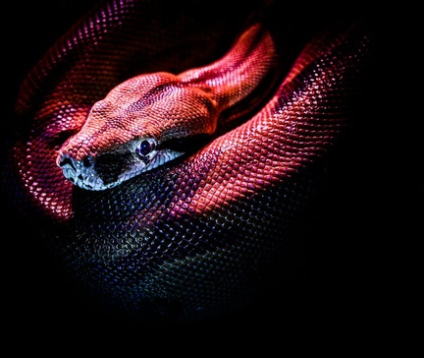
Python's Extensive Ecosystem and Libraries
• Python has a thriving and active community, contributing to its rich ecosystem of libraries and frameworks
• Popular libraries include NumPy for scientific computing, Pandas for data manipulation, and TensorFlow for machine learning
• Extensive support for web development with frameworks like Django and Flask
• Powerful data visualization tools like Matplotlib and Seaborn
3

Slide 5

Applications and Use Cases of Python
• Python is widely used in web development, creating dynamic and scalable web applications
• Prominent in the field of data science, enabling efficient data analysis, visualization, and machine learning
• Utilized in automation and scripting tasks, automating repetitive workflows and system administration
• Increasingly popular in the field of artificial intelligence and deep learning
4

Slide 6
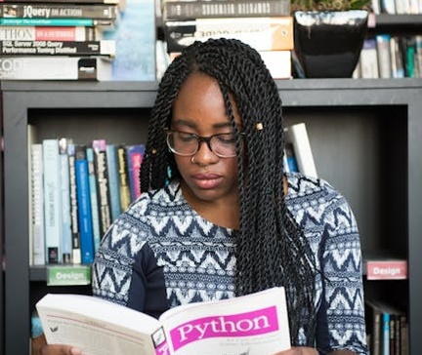
Getting Started with Python
• Python is easy to learn and has a gentle learning curve, making it accessible for beginners
• Multiple resources available for learning Python, including online tutorials, books, and interactive coding platforms
• Python can be installed on various operating systems, including Windows, macOS, and Linux
• Integrated development environments (IDEs) like PyCharm and Visual Studio Code provide a powerful coding environment
5

Slide 7
THANK YOU
Questions & Discussion
Presentation on: python

