Slide 1
PYTHON
Professional Presentation • July 2025

Slide 2

Overview of the Python Programming Language
• Python is a high-level, interpreted, and general-purpose programming language
• Known for its simplicity, readability, and versatility in various domains
• Supports multiple programming paradigms, including object-oriented, functional, and procedural
• Widely used in web development, data analysis, machine learning, and automation
1

Slide 3
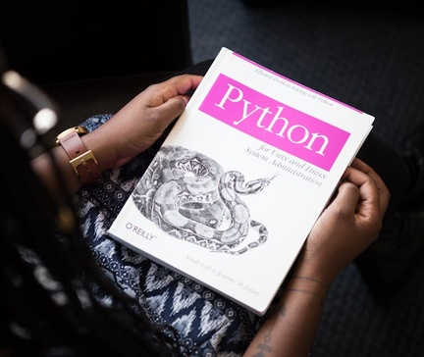
Key Features and Advantages of Python
• Easy-to-learn syntax with emphasis on code readability and maintainability
• Extensive standard library and vast ecosystem of third-party packages
• Cross-platform compatibility, allowing code to run on multiple operating systems
• Dynamic typing and automatic memory management, reducing development time
2

Slide 4

Python's Applications and Use Cases
• Web development with frameworks like Django, Flask, and Pyramid
• Data analysis and visualization using libraries like NumPy, Pandas, and Matplotlib
• Machine learning and artificial intelligence with tools like TensorFlow and scikit-learn
• Scripting and automation for system administration and task automation
3

Slide 5

Python's Ecosystem and Community
• Large and active open-source community contributing to the language's growth
• Availability of extensive documentation, tutorials, and online resources
• Robust package management system (pip) for easy installation and distribution of libraries
• Regular language updates and improvements through the Python Enhancement Proposal (PEP) process
4

Slide 6

Getting Started with Python
• Installing Python on various operating systems (Windows, macOS, Linux)
• Exploring Python's interactive shell (REPL) and writing simple programs
• Learning basic syntax, data types, and control structures
• Utilizing Python's built-in functions and modules for common tasks
5

Slide 7
THANK YOU
Questions & Discussion
Presentation on: python

