Slide 1
PYTHON
Professional Presentation • July 2025

Slide 2

What is Python? A Versatile Programming Language
• Python is a high-level, interpreted, and general-purpose programming language
• Known for its simplicity, readability, and ease of use
• Widely used in various domains, including web development, data analysis, and automation
1

Slide 3
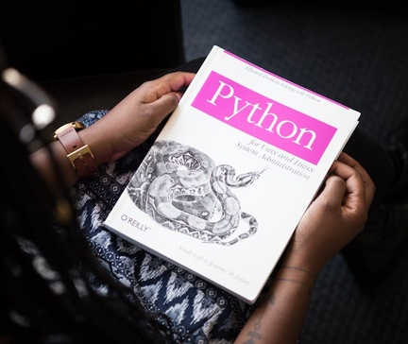
Key Features of Python: Simplicity and Flexibility
• Dynamic typing and automatic memory management for efficient development
• Extensive standard library and vast ecosystem of third-party packages
• Cross-platform compatibility, allowing code to run on multiple operating systems
• Supports multiple programming paradigms, including object-oriented, functional, and procedural
2

Slide 4

Python's Applications: From Data Science to Web Development
• Data analysis and scientific computing with libraries like NumPy, Pandas, and SciPy
• Machine learning and artificial intelligence with frameworks like TensorFlow and PyTorch
• Web development with frameworks like Django, Flask, and FastAPI
• Automation and scripting for system administration and task automation
3

Slide 5

Python's Ecosystem: Vibrant Community and Abundant Resources
• Large and active community of developers contributing to open-source projects
• Extensive documentation, tutorials, and online resources for learning and problem-solving
• Regular updates and improvements to the language and its ecosystem
• Versatile IDEs and code editors, such as PyCharm, Visual Studio Code, and Jupyter Notebook
4

Slide 6

Getting Started with Python: A Beginner's Guide
• Installing Python on your operating system (Windows, macOS, or Linux)
• Understanding basic syntax and language constructs, like variables, data types, and control structures
• Exploring Python's built-in functions and modules for common tasks
• Practicing with simple programs and projects to build proficiency
5

Slide 7
THANK YOU
Questions & Discussion
Presentation on: python

