Slide 1
PYTHON
Professional Presentation • July 2025

Slide 2
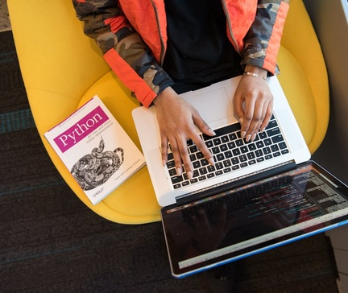
Overview of the Python Programming Language
• Python is a high-level, interpreted, and general-purpose programming language
• Known for its simplicity, readability, and versatility in various domains
• Widely used in web development, data analysis, machine learning, and automation
1

Slide 3
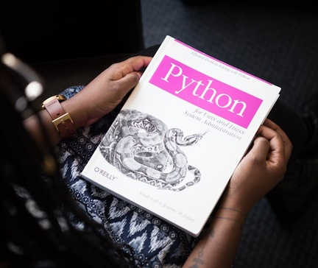
Key Features and Capabilities of Python
• Dynamic typing, allowing for flexible and rapid development
• Extensive standard library with modules for a wide range of tasks
• Large and active community providing a wealth of third-party packages
• Cross-platform compatibility, running on Windows, macOS, and Linux
2

Slide 4

Python's Syntax and Programming Constructs
• Simple and intuitive syntax, emphasizing readability and ease of use
• Support for object-oriented, functional, and procedural programming paradigms
• Powerful control structures like if-else statements, loops, and conditional expressions
• Extensive use of indentation to define code blocks, rather than curly braces
3

Slide 5

Applications and Use Cases of Python
• Web development with frameworks like Django, Flask, and Pyramid
• Data analysis and visualization using libraries like NumPy, Pandas, and Matplotlib
• Machine learning and artificial intelligence with tools like TensorFlow and scikit-learn
• Scripting and automation tasks, including system administration and file management
4

Slide 6
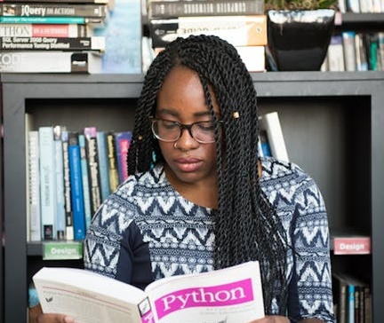
Getting Started with Python
• Installing Python on your operating system (Windows, macOS, or Linux)
• Exploring Python's interactive shell and writing simple programs
• Learning basic syntax, data types, and control structures
• Utilizing Python's extensive standard library and third-party packages
5

Slide 7
THANK YOU
Questions & Discussion
Presentation on: python

