Slide 1
PYTHON
Professional Presentation • July 2025

Slide 2

What is Python? A Powerful Programming Language
• Python is a high-level, interpreted, and general-purpose programming language
• It is known for its simplicity, readability, and ease of use
• Python is widely used in various domains, including web development, data analysis, and artificial intelligence
1

Slide 3
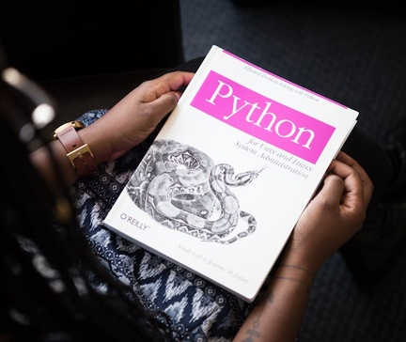
Key Features of Python: Versatility and Efficiency
• Python supports multiple programming paradigms, including object-oriented, functional, and procedural programming
• It has a vast standard library that provides a wide range of functionalities, reducing development time
• Python's dynamic typing and automatic memory management make it a productive and efficient language
2

Slide 4

Python's Ecosystem: Thriving Community and Extensive Libraries
• Python has a large and active community that contributes to its growth and development
• There are numerous open-source libraries and frameworks available, such as NumPy, Pandas, and TensorFlow
• The Python Package Index (PyPI) provides access to thousands of third-party packages, expanding Python's capabilities
3

Slide 5

Applications of Python: From Web Development to Data Science
• Python is widely used in web development, with frameworks like Django and Flask
• It is a popular language for data analysis and machine learning, with libraries like Pandas and Scikit-learn
• Python is also used in fields like scientific computing, automation, and game development
4

Slide 6

Learning and Mastering Python: Resources and Best Practices
• Python has a gentle learning curve, making it accessible for beginners
• There are numerous online resources, tutorials, and courses available to learn Python
• Developing good coding habits, such as writing clean and modular code, is essential for mastering Python
• Continuous learning and staying up-to-date with the latest Python developments are key to becoming a proficient Python programmer
5

Slide 7
THANK YOU
Questions & Discussion
Presentation on: python

