Slide 1
PYTHON
Professional Presentation • July 2025

Slide 2

Overview of the Python Programming Language
• Python is a high-level, interpreted, and general-purpose programming language
• Known for its simplicity, readability, and versatility in various domains
• Supports multiple programming paradigms, including object-oriented, functional, and procedural
• Widely used in web development, data analysis, machine learning, and automation
1

Slide 3
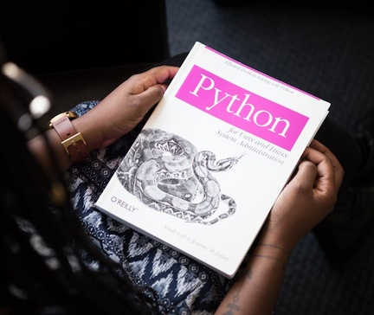
Key Features and Advantages of Python
• Easy-to-learn syntax with emphasis on code readability and productivity
• Extensive standard library and vast ecosystem of third-party packages
• Cross-platform compatibility and support for multiple operating systems
• Dynamic typing and automatic memory management for efficient development
2

Slide 4

Python's Applications and Use Cases
• Web development with frameworks like Django, Flask, and Pyramid
• Data analysis and visualization using libraries like NumPy, Pandas, and Matplotlib
• Machine learning and artificial intelligence with tools like TensorFlow and scikit-learn
• Scripting and automation tasks with its powerful scripting capabilities
3

Slide 5

Python's Ecosystem and Community
• Large and active open-source community contributing to its growth
• Extensive documentation, tutorials, and online resources for learning
• Regular updates and improvements to the language and its ecosystem
• Widespread adoption in academia, research, and industry
4

Slide 6
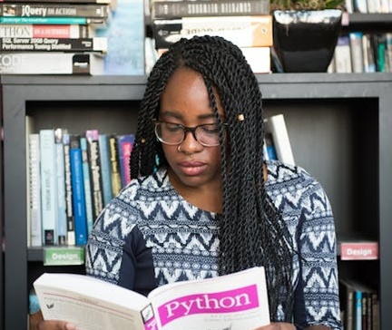
Getting Started with Python
• Installing Python on different operating systems (Windows, macOS, Linux)
• Exploring Python's interactive shell and writing simple programs
• Using integrated development environments (IDEs) like PyCharm and Visual Studio Code
• Accessing and utilizing Python's standard library and third-party packages
5

Slide 7
THANK YOU
Questions & Discussion
Presentation on: python

