Slide 1
t-SNE: parameter tuning
Daniel Centurion Barrionuevo

Slide 2
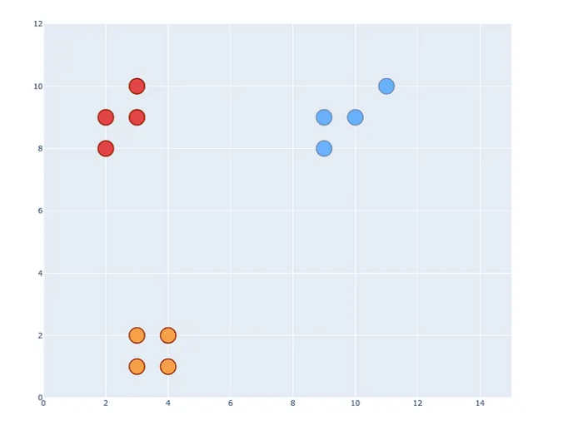
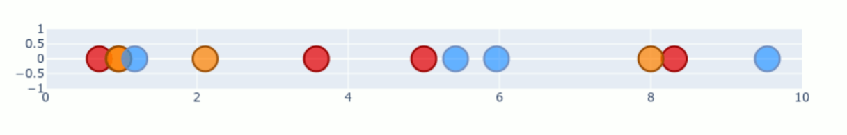
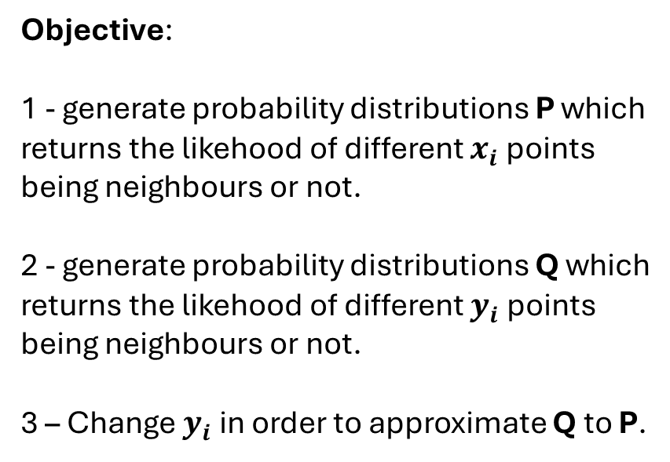
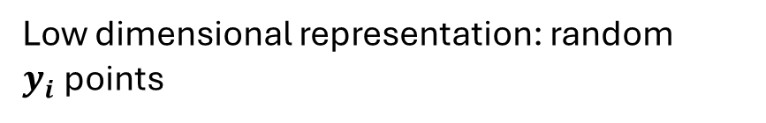

t-SNE: how it works
High dimensional data: true $x_{i}$ points
Low dimensional representation: random $y_{i}$points
Objective:
1 - generate probability distributions P which returns the likehood of different $x_{i}$ points being neighbours or not.
2 - generate probability distributions Q which returns the likehood of different $y_{i}$ points being neighbours or not.
3 – Change $y_{i}$ in order to approximate Q to P.
Figures source: https://medium.com/data-science/t-sne-clearly-explained-d84c537f53a

Slide 3
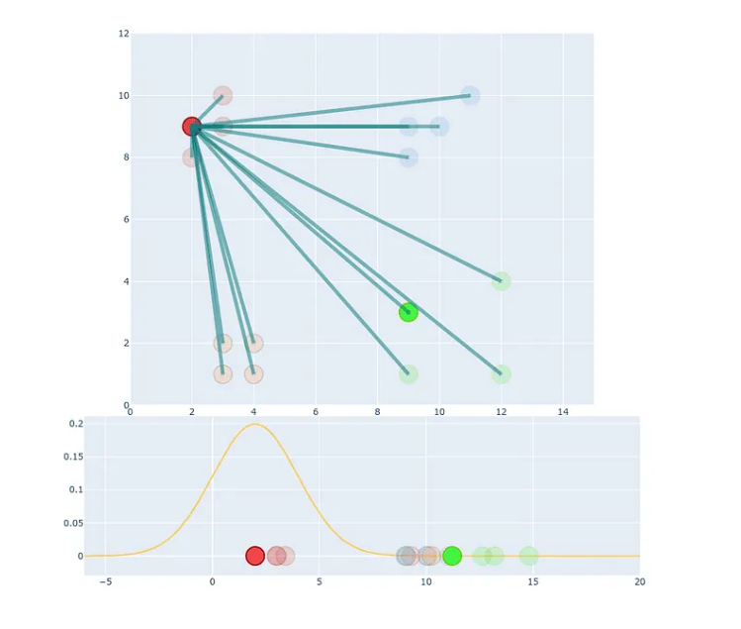
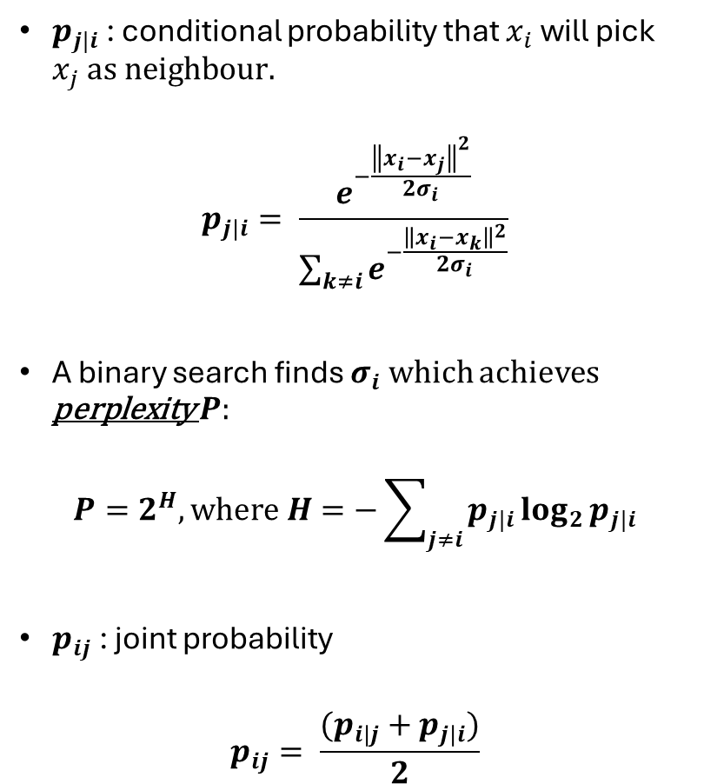
High Dimensional Similarity
$p_{j|i}$ : conditional probability that $x_{i}$ will pick $x_{j} as neighbour.$
$$p_{j|i}= \frac{e^{−\frac{{\left\|x_{i}−x_{j}\right\|}^{2}}{2σ_{i}}}}{\sum_{k≠i}{e^{−\frac{{\left\|x_{i}−x_{k}\right\|}^{2}}{2σ_{i}}}}}$$
A binary search finds $σ_{i}$ which achieves perplexity $P:$
$$P=2^{Η}, where Η=−\sum_{j≠i}{p_{j|i}}\log_{2}{p_{j|i}}$$
$p_{ij}$ : joint probability
$$p_{ij}= \frac{({p_{i|j}+p}_{j|i})}{2}$$
Figures source: https://medium.com/data-science/t-sne-clearly-explained-d84c537f53a

Slide 4
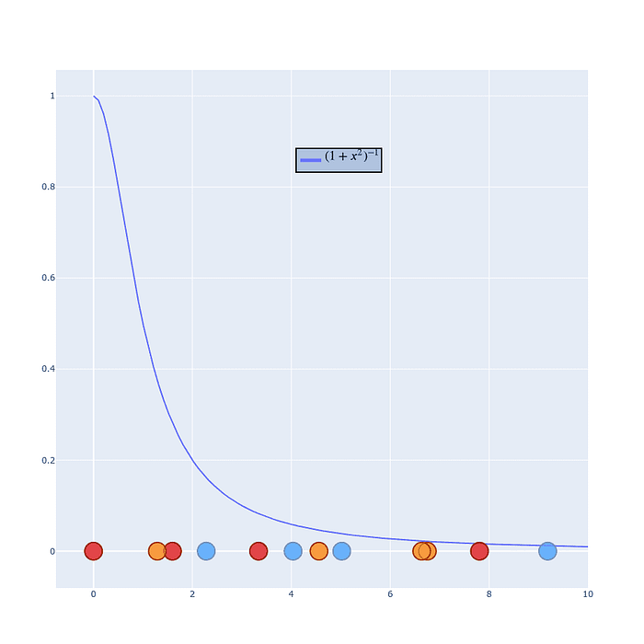

Low Dimensional Similarity
$q_{ij}$ : joint probability that $y_{i}$ will pick $y_{j} as neighbour.$
$$q_{ij}= \frac{{(1+{\left\|x_{i}−x_{j}\right\|}^{2})}^{−1}}{\sum_{k≠l}{{(1+{\left\|x_{l}−x_{k}\right\|}^{2})}^{−1}}}$$
Figures source: https://medium.com/data-science/t-sne-clearly-explained-d84c537f53a

Slide 5
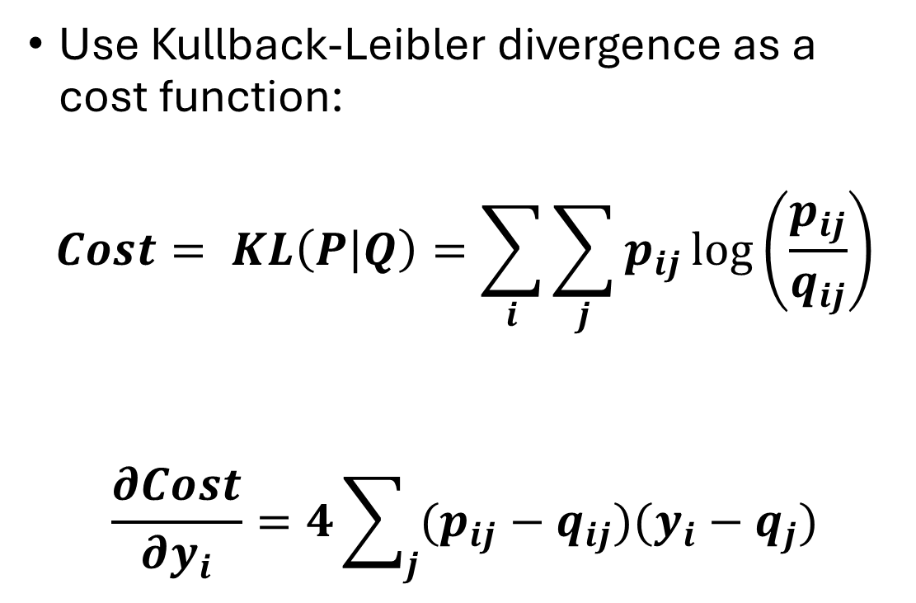
How to approximate Q to P?
Use Kullback-Leibler divergence as a cost function:
$$Cost= KL\left(P | Q\right)=\sum_{i}{\sum_{j}{p_{ij}\log\left(\frac{p_{ij}}{q_{ij}}\right)}}$$
$$\frac{∂Cost}{∂y_{i}}=4\sum_{j}{(p_{ij}−q_{ij})(y_{i}−q_{j})}$$

Slide 6
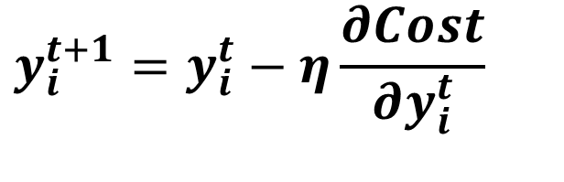
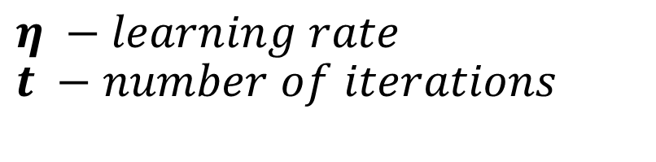
Iteratively update yi
$$y_{i}^{t+1}=y_{i}^{t}−η\frac{∂Cost}{∂y_{i}^{t}}$$
$$η −learning rate$$
$$t −number of iterations$$
Figures source: https://medium.com/data-science/t-sne-clearly-explained-d84c537f53a

Slide 7
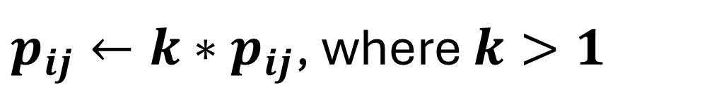
Early Exaggeration
Exaggerate the values of all high dimensional probabilities P during the initial stage (first 250 iterations in scikit-learn):
$p_{ij}←k∗p_{ij}$, where $k>1$
Higher values of Q will be achieved, leading to tighly packed clusters.

Slide 8
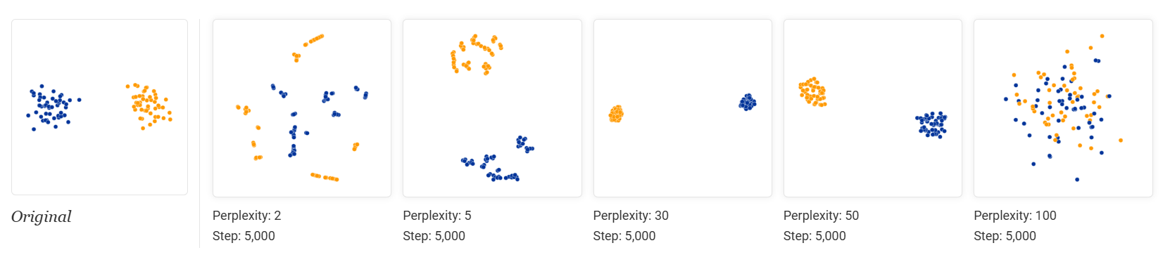
Perplexity tuning
Suggested Values: 5 to 50
Low Perplexity: local structure is preserved
High Perplexity: global structure is preserved
https://distill.pub/2016/misread-tsne/

Slide 9
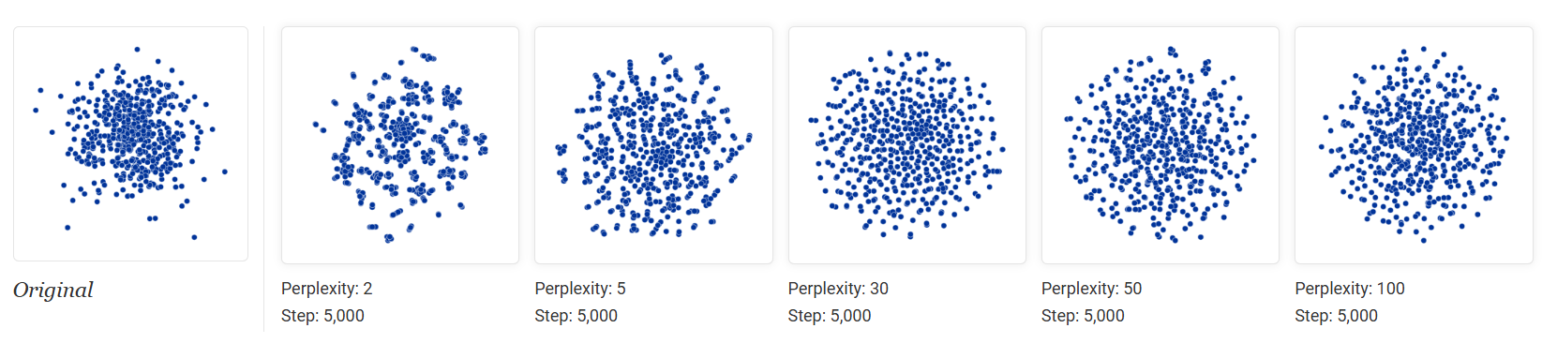
Beware of Random Noise
Low perplexity values may lead to false relations when there is only noise!
https://distill.pub/2016/misread-tsne/

Slide 10
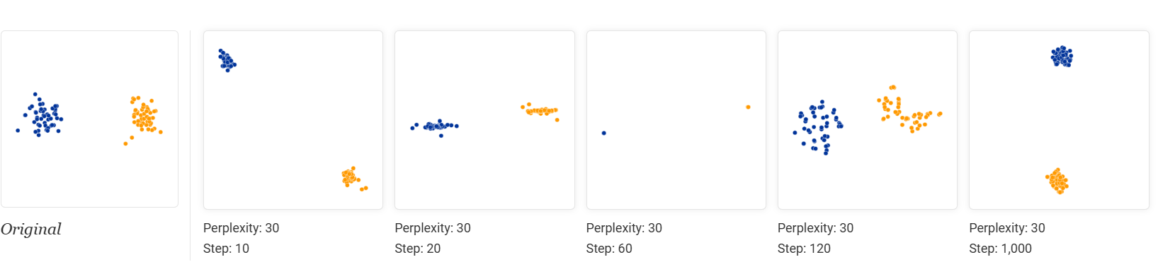
Number of iterations
Iterate until reaching a stable configuration.
Scikit-learn default: 1000
https://distill.pub/2016/misread-tsne/

Slide 11
Learning Rate
Too low: the map changes slowly and could get stuck in a poor local minimum (e.g. everything clumped together).
Too high: points move too aggressively and the structure “explodes” (points scatter randomly).
Scikit-learn default: max(N /early_exaggeration / 4, 50) where N is the sample size,

Slide 12
Early Exaggeration
Start with 12.0 (the default).
Increase it if:
Clusters are too close or overlapping.
You have many samples (>10k).
Decrease it if:
The embedding “explodes” or spreads too far apart.
You have small datasets (<1k).
Rule of thumb: For N data points, a slightly larger early exaggeration (≈ 12–32) helps stabilize large-scale structure before fine-grained adjustment.

