Slide 1
SWE599 – Project LittleRedButton
An Android Based Mobile Emergency Declaration Application
Developed by
Mustafa Göksu GÜRKAŞ (2011719225)
Project Advisor
Prof.Dr. Fatih ALAGÖZ

Slide 2
Outline
Introduction
Functionalities of LittleRedButton
Technologies Involved in Development
Development Lifecycle of LittleRedButton
Conclusion & Future Work

Slide 3
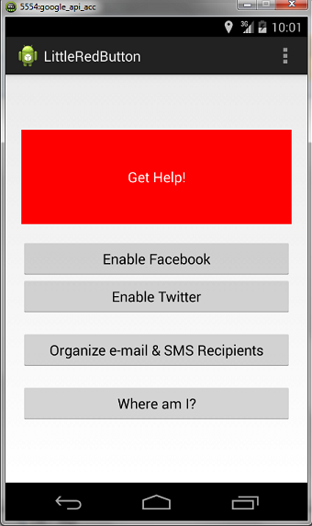
Introduction
The LittleRedButton project is a mobile application design and development project for users who need urgent help in some cases.
The main goal is to notify the user’s selected associates via selected notification channels on his/her current situation & place.
Project’s target users are the ones who have a mobile device powered with Android OS.

Slide 4
Functionalities of LittleRedButton
By using LittleRedButton, one shall be able to:
Send emergency notifications via selected channels on an urgent situation with a single button hit,
Locate himself/herself by using his/her smart phone’s GPS/Network location services on Google Maps,
Find out which help points (police stations & health institutions) are the nearest ones to his/her current location,

Slide 5
Functionalities of LittleRedButton
Determine his/her friends to be notified with LittleRedButton e-mail & SMS messages,
Use his/her Facebook or Twitter account (or both) to notify his current situation and place to his/her followers,
Make LittleRedButton track himself/herself by sending notifications with updated location coordinates to those previously selected channels every 60 seconds.

Slide 6
Technologies Involved in Development
JAVA & Android SDK: are used to proivde the API libraries and developer tools necessary to build, test and debug Android application.
ADT (Android Developer Tools): is a plugin that provides a suite of tools that are integrated with the Eclipse IDE.
Facebook SDK: is a JAVA programming language wrapper to the Facebook APIs.
Twitter4j: is a core JAVA library which makes use of the Twitter API.

Slide 7
Technologies Involved in Development (cont’d)
OAuth (Open Authorization): allows the users to share their private resources (e.g. Photos, videos, contact lists) without having to hand out their credentials. Used in Facebook and Twitter authorization processes.
SQLite: a light weighted SQL engine which is actually a relational database management system.
Google Maps Android API v2: a Google API which automatically handles access to Google Maps servers in order to let the developer add maps based on Google Maps data into his application.

Slide 8
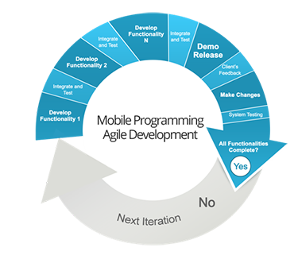
Development Lifecycle of LittleRedButton
Agile Software Development methodolgy has been used to develop LittleRedButton project.
The project has been broken into 5 main functionalities which include:
Database operations,
Facebook operations,
Twitter operations,
E-mail & SMS operations,
Google Maps operations.

Slide 9
Conclusion & Future Work
As a conclusion;
LittleRedButton now satisfies the initial requirements that are set to be implemented,
It has been a great experience to work with a different platform, various frameworks, libraries and mobile application APIs in the same project with a knowledge from scratch.
For enhancement purposes, LittleRedButton may have features such as;
Recording for a defined length of audio/video data and send them in attachment as well,
Calling the emergency services such as 112, 155 etc. by a text message or by voice.
Displaying the shortest route to the selected nearest place on Google Maps .

Slide 10
Thanks
Any Questions?

