Slide 1
Team 24 - Ground Penetrating Radar
Members: Tyler Castro, Coy Coburn, Daniel Miller, and Michael Turner
Design and simulate subsystems | Buy necessary hardware | Incorporate transmitter circuit and antenna | Incorporate receiver circuit and antenna | Integrate subsystems and testing with network analyzer
Control Unit
Transmitter Circuit
Direct Signal
Receiver Circuit
Transmitter Antenna
Receiver Antenna
Transmitted Pulse
Reflected Pulse
Buried Object

Slide 2
Signal Generation Daniel Miller
Accomplishments since the last presentation ~35 hrs | Ongoing progress/problems and plans until the next presentation
Finished PCB Needs decoupling Tested Function Generated 5 MHz Bandwidth (80 mVpp) Voltage divider Start of ISM band (2V) Op-Amp | Solder PCB Prepare for Demo Problem: Excess Noise
VCO frequency equation:
frequency = 68.065 (Voltage) + 2268.8
Notes:
‹#›

Slide 3
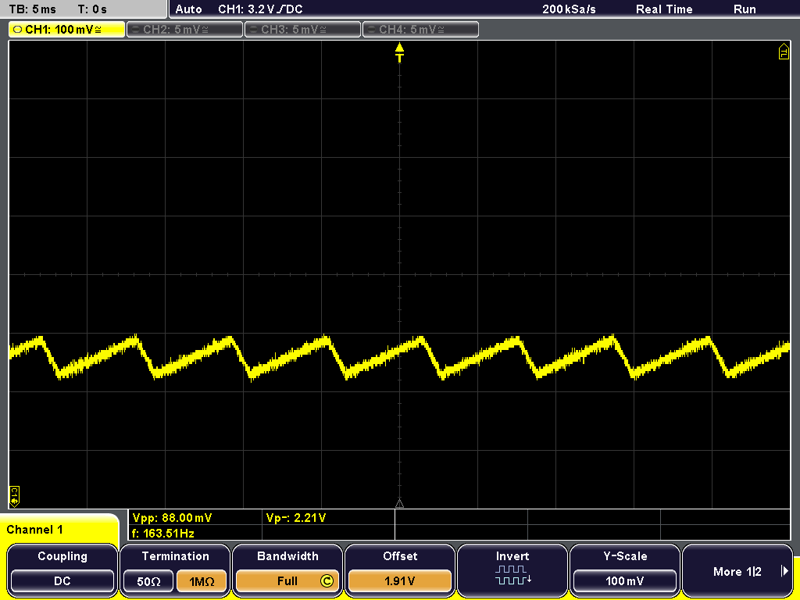
Output from Op-Amp
Vpp = 88mV
Vp = 2.21 V

Slide 4
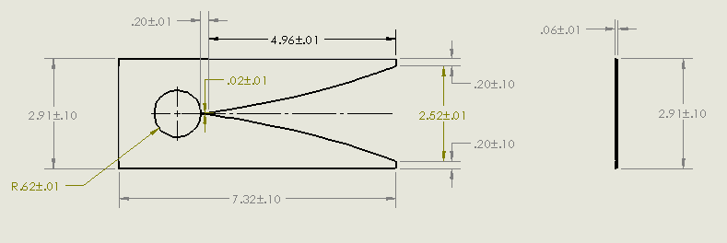
Antennas Tyler Castro
Accomplishments since the last presentation 30 hrs | Ongoing progress/problems and plans until the next presentation
Tested antenna created by hand Used Solidworks to create files for having the antennas made with the mill Currently working to ensure antennas get cut Ordered parts for demo | Ensure antennas are created in order to begin immediate testing Prepare for demo
Notes:
‹#›

Slide 5
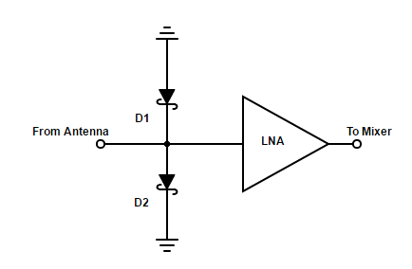
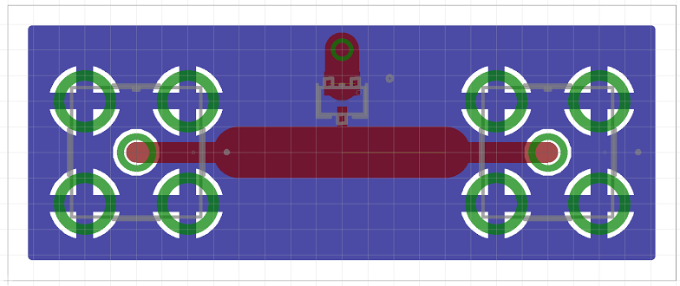
Receiver Circuit Michael Turner
Accomplishments since the last presentation 20 hrs | Ongoing progress/problems and plans until the next presentation
Finished ordering parts and SMA cables Designed and received PCB Assisted Coy with redesign of receiver conversion and PCB design | Solder PCB Test Schottky diodes and LNA Work with Coy with integrating the receiver together
Notes:
‹#›

Slide 6
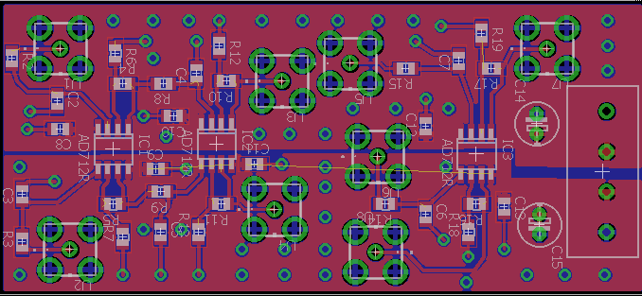
Receiver Conversion Coy Coburn
Accomplishments since the last presentation 32 hrs | Ongoing progress/problems and plans until the next presentation
Redesigned and simulating receiver schematic Recalculated sampling rate data based on new bandwidth of 5MHz Bought chips,eval boards, and other hardware Designed and received PCB Found and bought power divider | Check necessary gain and corner freuencies for each LPF/AAF stage Locate ADC eval board and test digitization with Analog Visual Test ADC driver output Integrate circuit with Michael’s LNA/Schottky circuit
Notes:
‹#›

Slide 7
Block Diagram and Parts Table
SHIELD
IMAGE
REJECT
FILTER (LPF)
Schottky
LNA
Rx MIXER
IF Amp
LPF
ADC Driver
AAF/LPF
ADC
Gain Block
Block | Part number
Rx Mixer | ADL5363
Gain block | ADL5611
Low pass filter (LPF) op amps | LT1813
ADC Driver | AD8138
ADC | AD9280
Power Splitter | BP2U+
Gain Block
Power Splitter
SHIELD
SHIELD

Slide 8
Any Questions?
Thanks and Gig em’

