Slide 1
Team:24 Ground Penetrating Radar
Design and simulate subsystems | Buy necessary hardware | Install transmitter and phased array antenna | Install receiver and phased array antenna | Integrate subsystems and testing with network analyzer | Design image processing system (if time)
Control Unit
Transmitter Circuit
Receiver Circuit
Transmitter Antenna
Direct Signal
Receiver Antenna
Transmitted Pulse
Reflected Pulse
Buried Object

Slide 2
Power/Signal Generation Daniel Miller
Accomplishments since the last presentation ~20 hrs | Ongoing progress/problems and plans until the next presentation
Redefined requirements Power loss through media (not good estimate) Researched other ways to achieve bandwidth (DDS/NCO) | Meet with Professor Nevels Obtain antenna info (sensitivity/gain) Calculate power needed at output Power needed through system (PA)
Transmitter Circuit
Receiver Circuit
Transmitter Antenna
Direct Signal
Receiver Antenna
Transmitted Pulse
Reflected Pulse
Buried Object
Notes:
‹#›

Slide 3
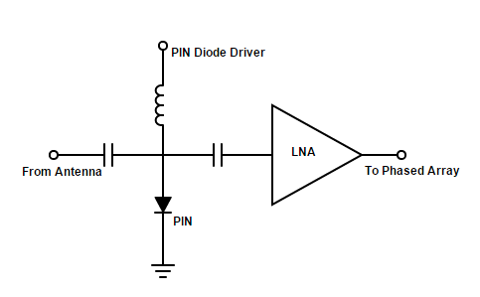
Receiver Circuit Michael Turner
Accomplishments since the last presentation 20 hrs | Ongoing progress/problems and plans until the next presentation
Redesigned Receiver circuit Bought LNAs Found possible PIN Diodes Research PIN Diode driver | Design PIN Diode Driver Decide on PIN Diode and order all parts
Notes:
‹#›

Slide 4
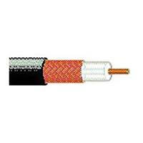
Receiver Antenna Coy Coburn
Accomplishments since the last presentation 15 hrs | Ongoing progress/problems and plans until the next presentation
Calculated/bought necessary coax cable to create phase shifters Designing/simulating summing amp Researching mixers and IQ demodulation | Finalize receiver schematic Choose and order IQ demodulator and mixers (if needed)
Belden 9258 specs:
Impedance: 50 Ω
Propagation Velocity: %82
Nominal Attenuation: 10.7 dB/100 ft @ 900 MHz
Price: $0.82 per ft
Length of coax: d = (Vf*c/ƒ)*(Θ/360)
30° | 45° | 60° | 90°
2.24 cm | 3.36 cm | 5.04 cm | 6.72 cm
180°
13.44 cm
Phase shift:
Length:
Notes:
‹#›

Slide 5
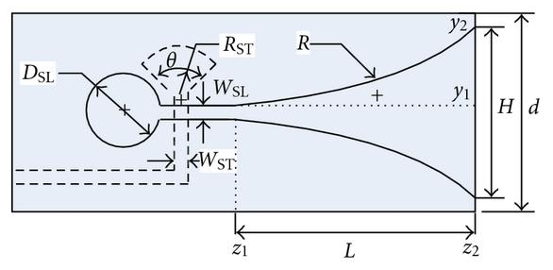
Transmitting Antenna Tyler Castro
Accomplishments since the last presentation 15 hrs | Ongoing progress/problems and plans until the next presentation
Decided on specific amplifiers for gain stages Using Vivaldi antennas for directivity, simplicity and cost of construction Calculated design parameters for Vivaldi antennas | Order components to begin construction Design balun to prevent current from travelling along outside of coaxial cable at antenna connection
Vivaldi Antenna, facing right
For 700 MHz:
H = 8.44 inches
L = 16.87 inches
Dsl = 2.48 inches
Notes:
‹#›

