Slide 1
Team:24 Ground Penetrating Radar
Design and simulate subsystems | Buy necessary hardware | Install transmitter and phased array antenna | Install receiver and phased array antenna | Integrate subsystems and testing with network analyzer | Design image processing system (if time)
Control Unit
Transmitter Circuit
Direct Signal
Receiver Circuit
Transmitter Antenna
Receiver Antenna
Transmitted Pulse
Reflected Pulse
Buried Object

Slide 2
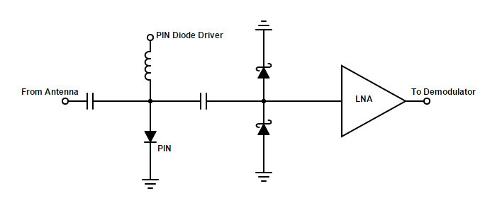
Receiver Circuit Michael Turner
Accomplishments since the last presentation 20 hrs | Ongoing progress/problems and plans until the next presentation
Added schottky diodes to protect LNA Ordered schottky diodes Work on simulation for PIN Diode driver | Finish PIN diode driver simulation Design PCB board Work with Coy to combine LNA and diode circuit with demodulator
Notes:
‹#›

Slide 3
Receiver Antenna Coy Coburn
Accomplishments since the last presentation 17 hrs | Ongoing progress/problems and plans until the next presentation
Redefined goals for GPR system Helped set excel doc to calculate needed variables Researching mixers and IQ demodulation | Finalize receiver schematic Choose and order IQ demodulator and ADC Work with Michael to combine LNA and diode circuit with demodulator
Sample rate(Fs): 2 * BW = 150 MHz = 150 Msamples/sec
Slope (freq/time): BW / 4 * TOF = 1.9 E 15 Hz/s
Freq resolution(Δf): (2*spatial resolution/ Vs)* Slope = 2.4MHz
Δf = 1/T T = #samples / Fs
#samples = 62.5 => 63 samples
Notes:
‹#›

Slide 4
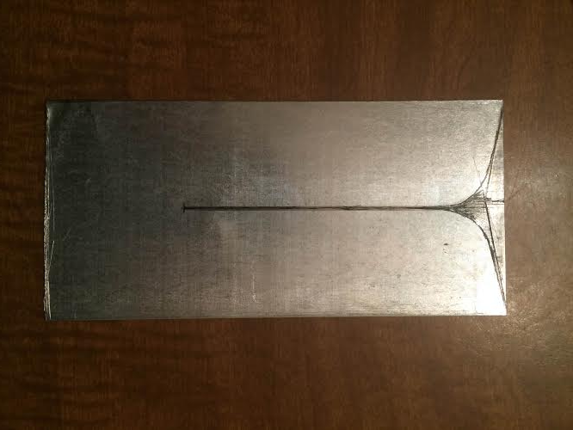
Transmitting Antenna Tyler Castro
Accomplishments since the last presentation 15 hrs | Ongoing progress/problems and plans until the next presentation
Purchased metal sheets and tools, began construction of prototype antenna Ordered balun parts | Finish construction, solder balun and begin running tests using network analyzer Use data to improve design
Notes:
‹#›

Slide 5
Power/Signal Generation Daniel Miller
Accomplishments since the last presentation ~15 hrs | Ongoing progress/problems and plans until the next presentation
Ordered function generator up to 1 MHz meets pulse duration requirement (duty cycle) Ordered VCO ISM band 2-2.5V Minimum of 50 mW output for antennas | Test outputs from VCO Select/Order PA Think about portable power supply
Notes:
‹#›

Slide 6
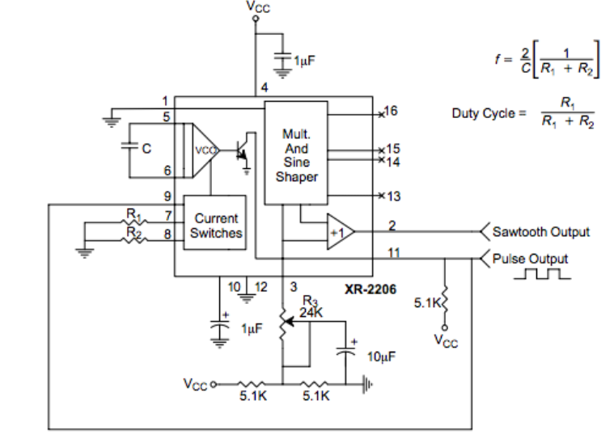
Function Generator circuit
Jameco XR-2206 Data sheet

