Slide 1
Team 24 - Ground Penetrating Radar
Design and simulate subsystems | Buy necessary hardware | Incorporate transmitter circuit and antenna | Incorporate receiver circuit and antenna | Integrate subsystems and testing with network analyzer | Design image processing system (if time)
Control Unit
Transmitter Circuit
Direct Signal
Receiver Circuit
Transmitter Antenna
Receiver Antenna
Transmitted Pulse
Reflected Pulse
Buried Object

Slide 2
Power/Signal Generation Daniel Miller
Accomplishments since the last presentation ~18 hrs | Ongoing progress/problems and plans until the next presentation
Ordered PAs (Approx 1 W) 24 dB gain Output +26dBm Tested VCO (broken) Soldered wires to inputs Stripped coaxial to wire for testing Talked with manufacturer to ship new part Started PCB design | Test VCO .5-5V Vtune Finish designing PCB Test Function generator Think about portable power supply
Notes:
‹#›

Slide 3
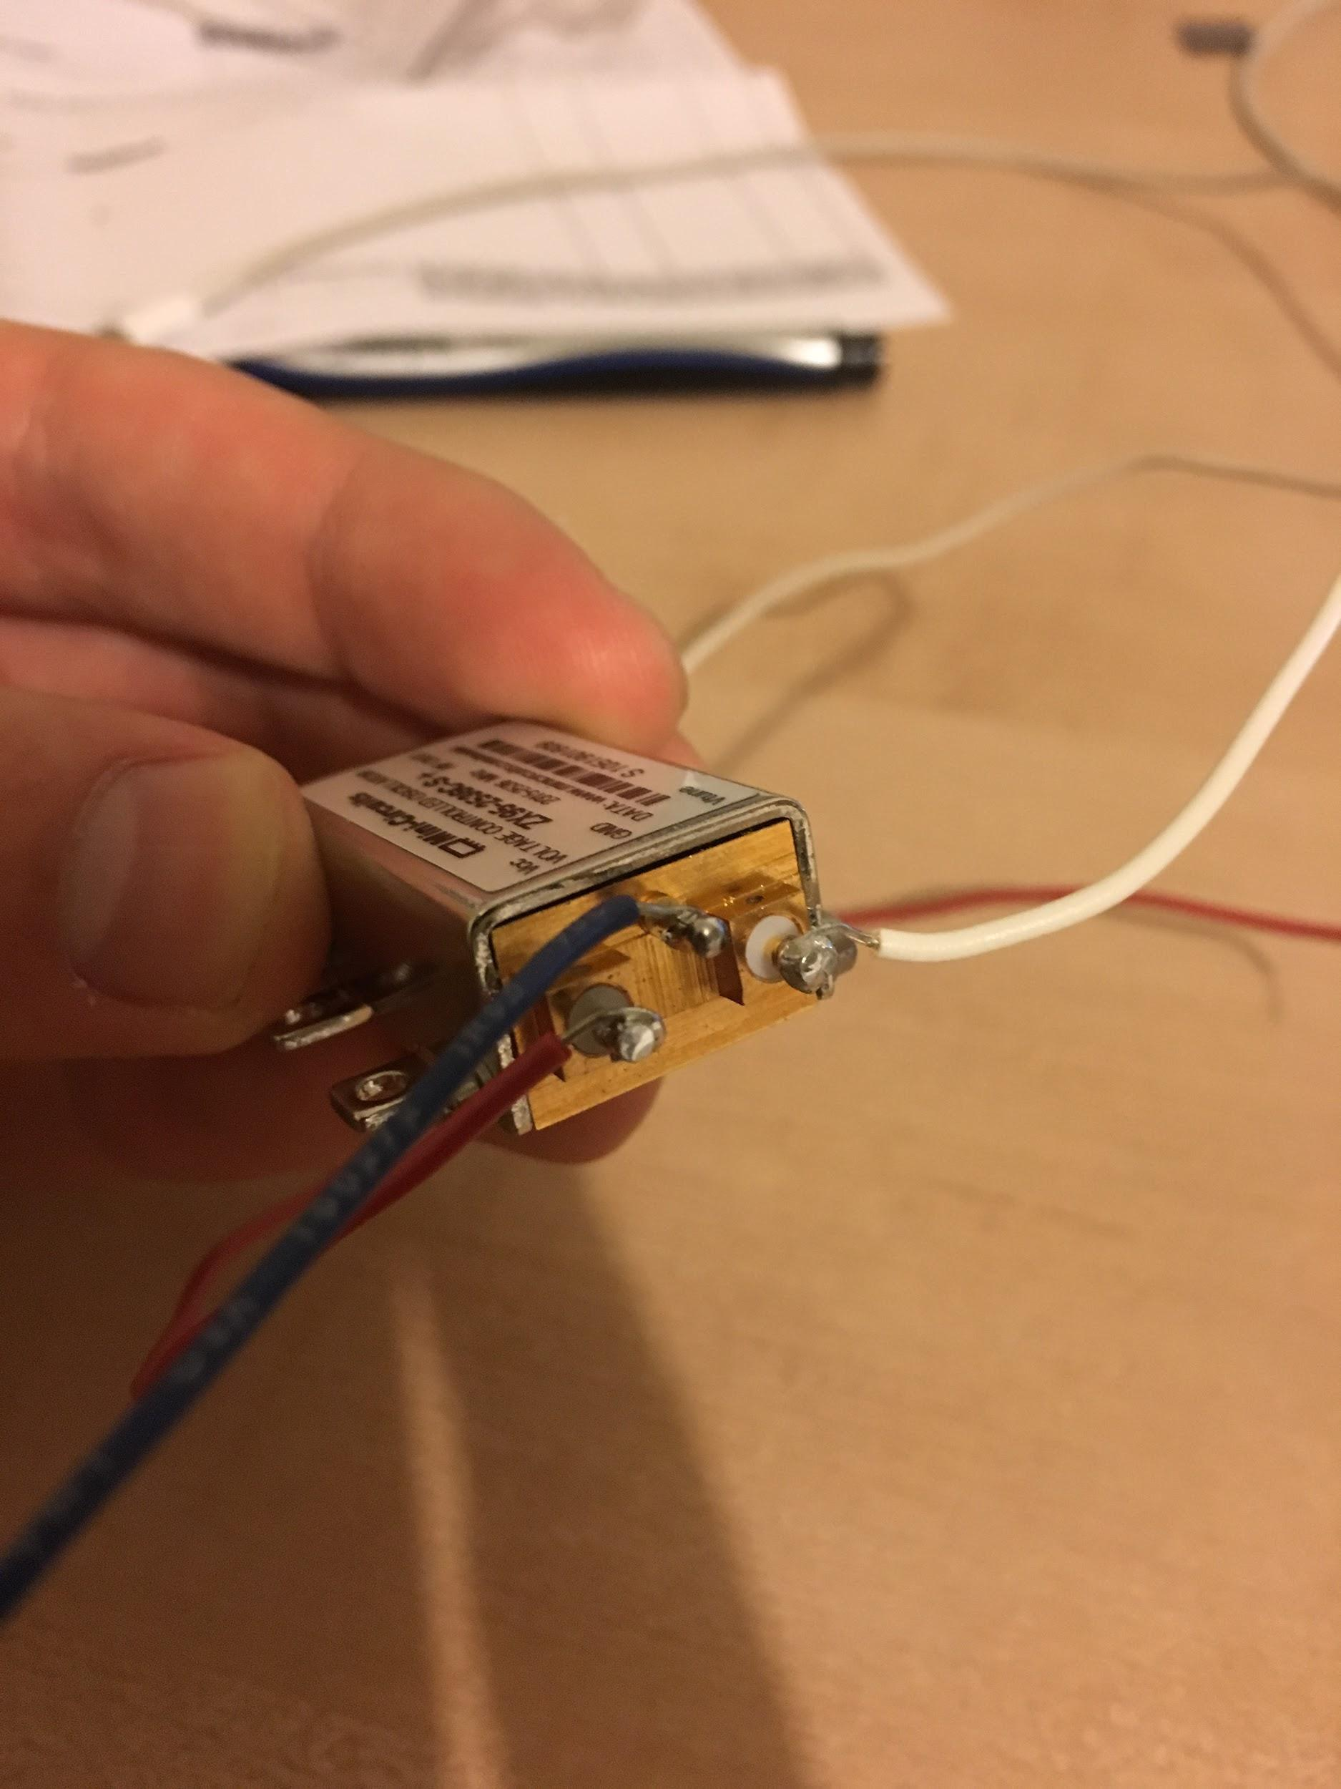
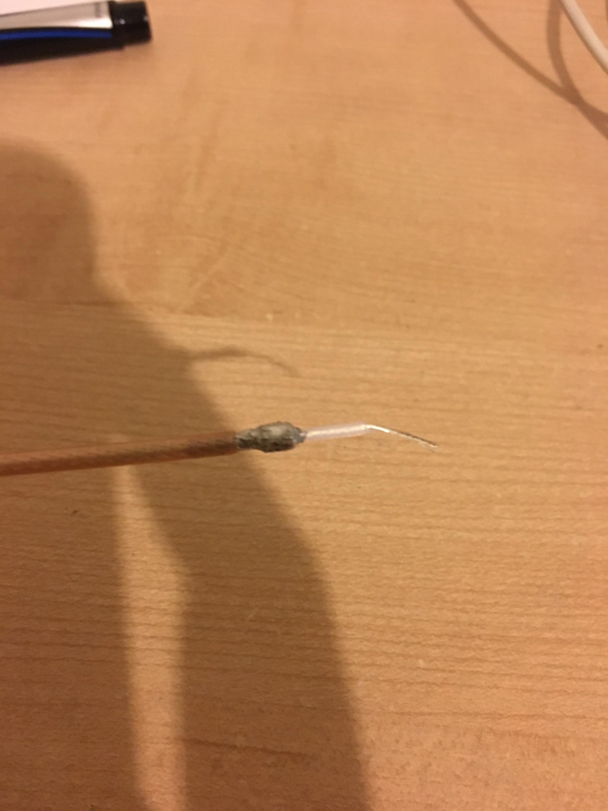
Vtune
SMA to wire termination
GND
Vcc

Slide 4
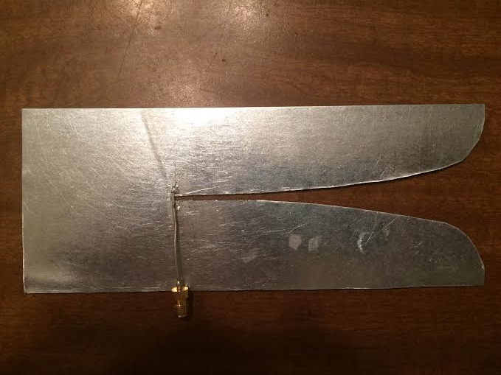
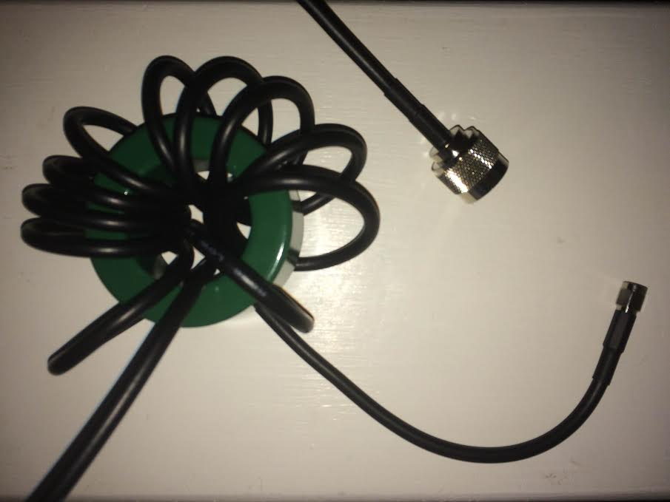
Antennas Tyler Castro
Accomplishments since the last presentation 20 hrs | Ongoing progress/problems and plans until the next presentation
Vivaldi antenna cut to proper curve shape Obtained SMA Female Cable, N-type/SMA Male Cable, Ferrite Toroidal Core SMA Cable soldered to gap of antenna and balun assembledy, ready for testing | Begin testing using network analyzer Depending on the results of testing, either Alter current design to increase effectiveness Move toward developing a more compact balun
Left: Vivaldi antenna with SMA-cable soldered Right: N type-SMA cable wrapped around ferrite core
Notes:
‹#›

Slide 5
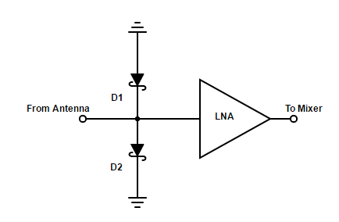
Receiver Circuit Michael Turner
Accomplishments since the last presentation 20 hrs | Ongoing progress/problems and plans until the next presentation
Removed PIN diode from receiver circuit Ordered and received new LNA Helped Coy with redesign of receiver conversion Started PCB design | Finish PCB design Test Schottky diodes and LNA Work with Coy with integrating the receiver together
Notes:
‹#›

Slide 6
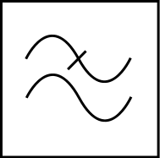
Receiver Conversion Coy Coburn
Accomplishments since the last presentation 18 hrs | Ongoing progress/problems and plans until the next presentation
Redesign schematic for subsystem Calculating max bandwidth frequency and mixing spurs Chosen frequency mixer, calculating specs needed for LPF and ADC | Finalize receiver schematic Choose and order LPF and ADC Design buffer to handle ADC driving impedance Integrate circuit with Michael’s LNA/Schottky circuit
LO
Mixer
Low pass filter
Buffer
ADC
RF
IF
Notes:
‹#›

