Slide 1
THE GERBIES
FLIGHT
CONTEXT
A USER-FOCUSED TRAVEL APP
G345
GATE
F8
SEAT
29E
AUTHORS: BRADY LI, BOBBY PALAZZI, GAVIN SANDERS, SEAMUS COYNE

Slide 2
TABLE OF CONTENTS
01
PURPOSE
02
DATA
03
ML MODELING
04
STREAMLIT DEMO
You can describe the topic of the section here
You can describe the topic of the section here
You can describe the topic of the section here
You can describe the topic of the section here

Slide 3
OUR PERSONAS
1st
2nd
3rd
KLEMENT GORRING
THOUGHTSTORMS
BELL STONER
A new retiree considering moving abroad
A moving company focused on US to EU transitions
A Portuguese admin official known for giving tips

Slide 4
THE GERBIES
FLIGHT
OUR DATASETS
G345
GATE
F8
SEAT
29E
!
BUZZWORD: BIG DATA

Slide 5
EUROSTAT DATASETS
LEISURE……………………. score of activities per nation
HAPPINESS……………….. average happiness per person
PUBLIC EDUCATION…….. spending on public education
CRIME………………………. crime rates by nation over time
TRANSIT…………………… train coverage by nation (km)
POPULATION……………… population of each nation

Slide 6

DATA CLEANING
REMOVING NON-EU NATIONS
DROPPING OR REPLACING NaN VALUES
REMOVING UNWANTED COLUMNS
ENSURING CONSISTENT FORMATTING AND CONSISTENCY AMONG DATA

Slide 7
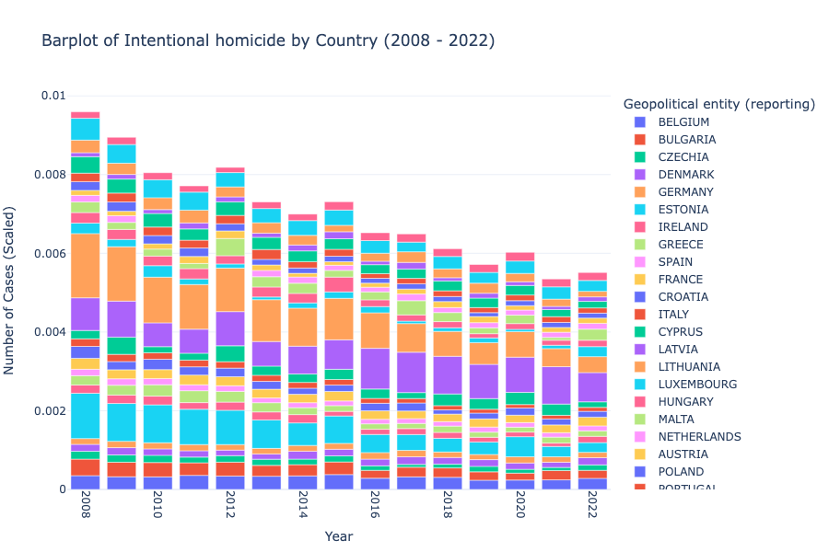

Slide 8
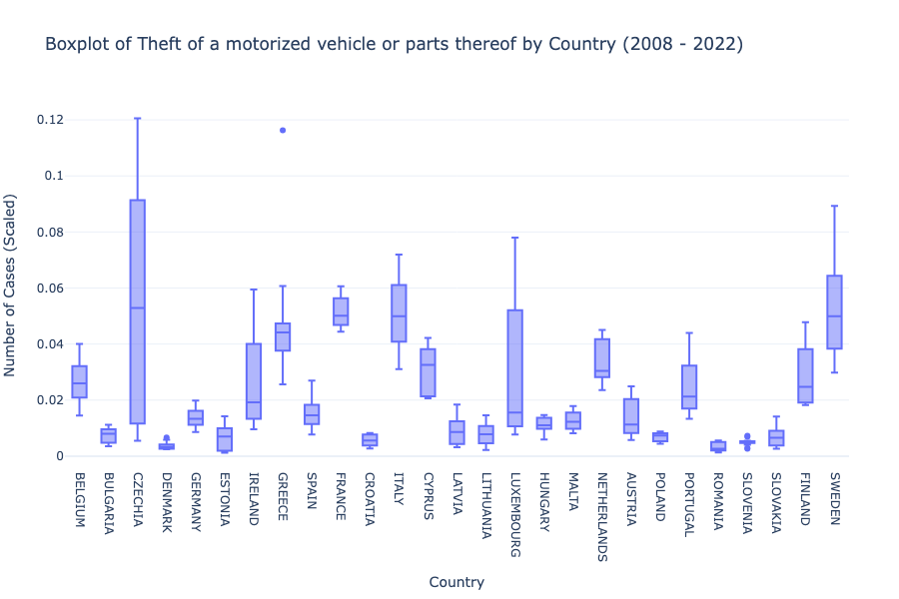

Slide 9
THE GERBIES
FLIGHT
ML MODELS
G345
GATE
F8
SEAT
29E
!
BUZZWORD: AI

Slide 10
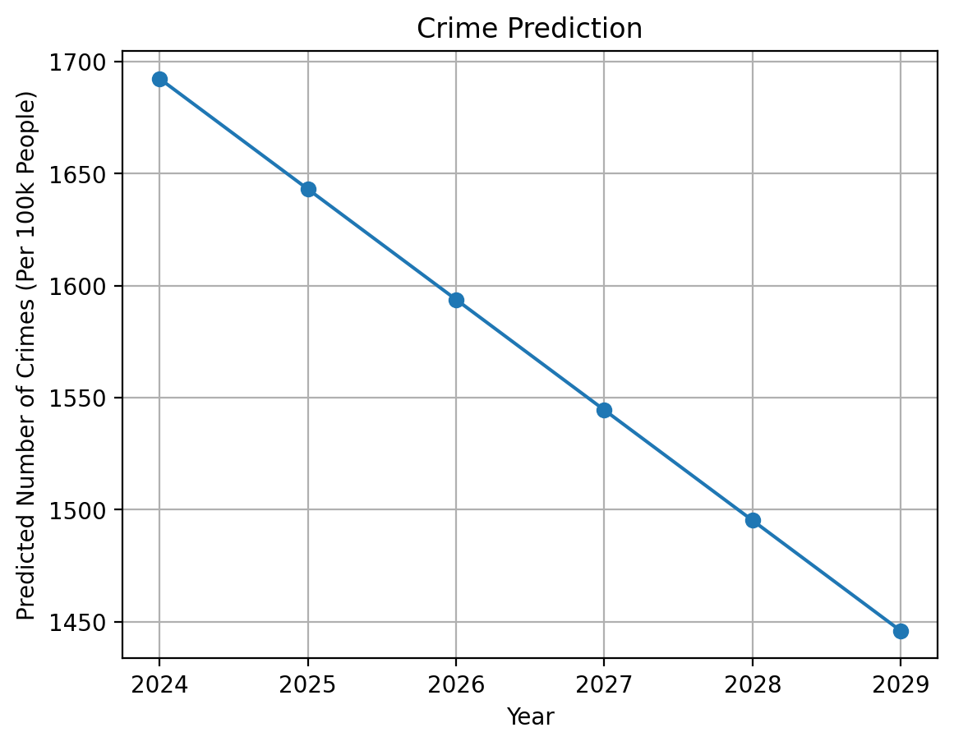
LINEAR REGRESSION
Manually programmed linear regression predicted net crime over time by nation.

Slide 11
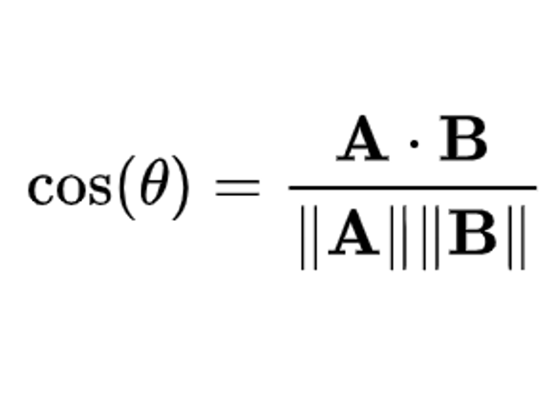

COSINE SIMILARITY
Calculates cosine similarity between nations and user-input fields to provide ranking

Slide 12
THE GERBIES
FLIGHT
THE INTERFACE
G345
GATE
F8
SEAT
29E
!
BUZZWORD: SERVERLESS ARCHITECTURE

Slide 13
