Slide 1
Omophagic Content Reader
Corey Ford

Slide 2
omophagic?
omophagy (also omophagia)
noun the eating of raw food, esp. raw meat.
– New Oxford American Dictionary

Slide 3
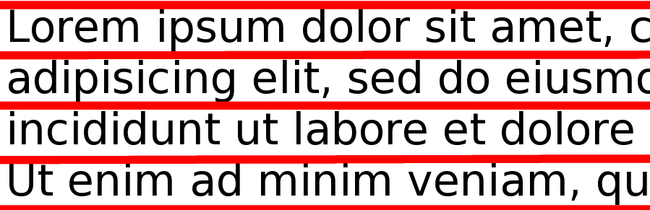
Separating lines
Divide page into lines by blank rows

Slide 4

Separating characters
_x0013_Separate lines into symbols by blank columns
  Causes issues with many fonts that overlap horizontally…

Slide 5

Identifying a symbol using characteristics
Number of “holes” (using BFS)
Proportion (height/width)
Density (foreground pixels/total)
  Overall
  Each quadrant
  Midpoint lines
  Border
Notes:
Several simple characteristics are computed for a symbol. A breadth first search flood fill algorithm is involved
in counting the number of holes in the symbol.

Slide 6
Matching an unknown character
Test against each known character
Weighted differences between values of characteristics produce a “score”
Known character with the lowest “score” is chosen

Slide 7
Learning a font
Provide samples of alphabet in the font
Multiple samples are averaged
Characteristics are computed and stored in a file
m 0 0.703738 0.420753 0.547762 0.459129 0.525189 0.36202 0.365671 0.908443 0.352532
Notes:
A companion program can “learn” fonts. If you give it sample images of a predefined alphabet,
it will compute those characteristics for the symbols and store the values in a file.
So, for instance, the entry for that “m” we saw might look like this, with the values for the number of holes,
proportion, overall density, border density, the four quadrants and the two midlines

